Slide 1
Process Dynamics & Control

Slide 2
Biochemical Reactor
Substrate
F, x_{2f}
Cells /
Biomass
F, x₁, x₂
x₁ is mass of cells per unit volume in the reactor
x₂ is mass of substrate per unit volume in the reactor
x_{2f} is mass of substrate per unit volume in the feed stream
Assumption:
Exit Condition = Reactor Condition
Isothermal Reaction
Constant volume, i.e, F_{in} = F_{out}=F
No cell/biomass is present in the feed stream.

Slide 3
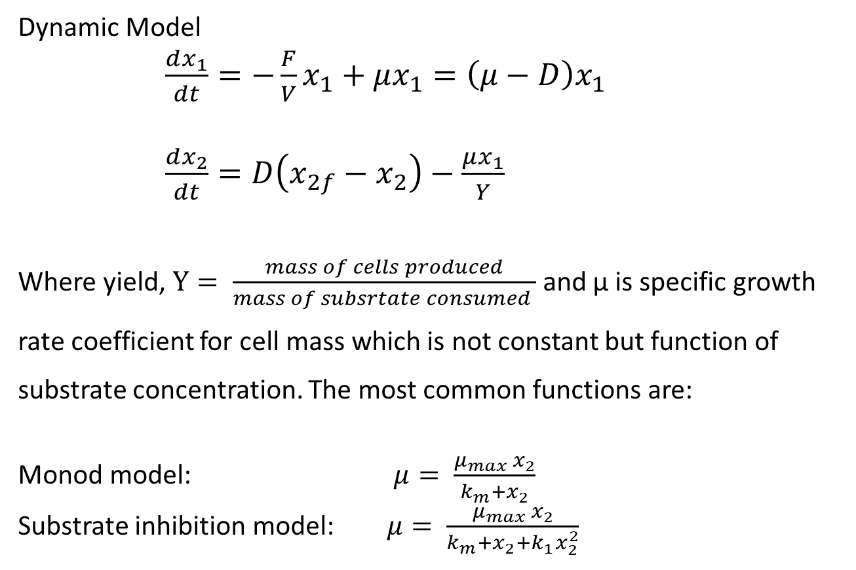
Biochemical Reactor (Dynamic Model)
Dynamic Model
$\frac{dx_{1}}{dt}=−\frac{F}{V}x_{1}+μx_{1}=\left(μ−D\right)x_{1}$
$\frac{dx_{2}}{dt}=D\left(x_{2f}−x_{2}\right)−\frac{μx_{1}}{Y}$
Where yield, $Y= \frac{mass of cells produced}{mass of subsrtate consumed }$ and μ is specific growth rate coefficient for cell mass which is not constant but function of substrate concentration. The most common functions are:
Monod model: $μ= \frac{μ_{max} x_{2}}{k_{m}+x_{2}}$
Substrate inhibition model: $μ= \frac{μ_{max} x_{2}}{k_{m}+x_{2}+k_{1}x_{2}^{2}}$

Slide 4
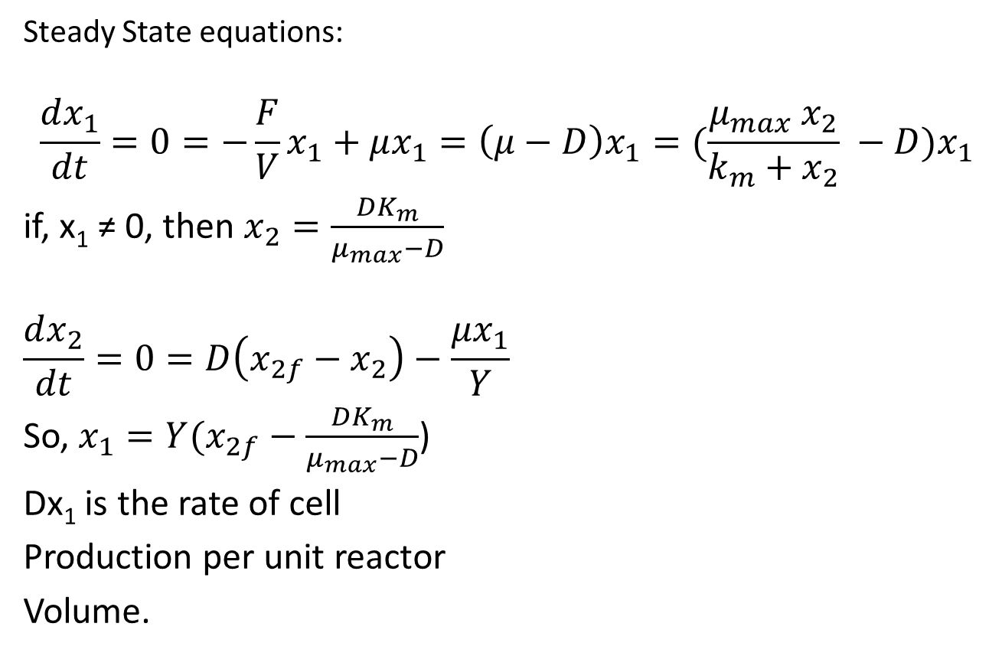
Biochemical Reactor
Steady State equations:
$$\frac{dx_{1}}{dt}=0=−\frac{F}{V}x_{1}+μx_{1}=\left(μ−D\right)x_{1}=(\frac{μ_{max} x_{2}}{k_{m}+x_{2}} −D)x_{1}$$
if, x₁ ≠ 0, then $x_{2}=\frac{DK_{m}}{μ_{max}−D}$
$$\frac{dx_{2}}{dt}=0=D\left(x_{2f}−x_{2}\right)−\frac{μx_{1}}{Y}$$
So, $x_{1}=Y(x_{2f}−\frac{DK_{m}}{μ_{max}−D}$)
Dx₁ is the rate of cell
Production per unit reactor
Volume.
x₁
Dx₁
x₂

Slide 5
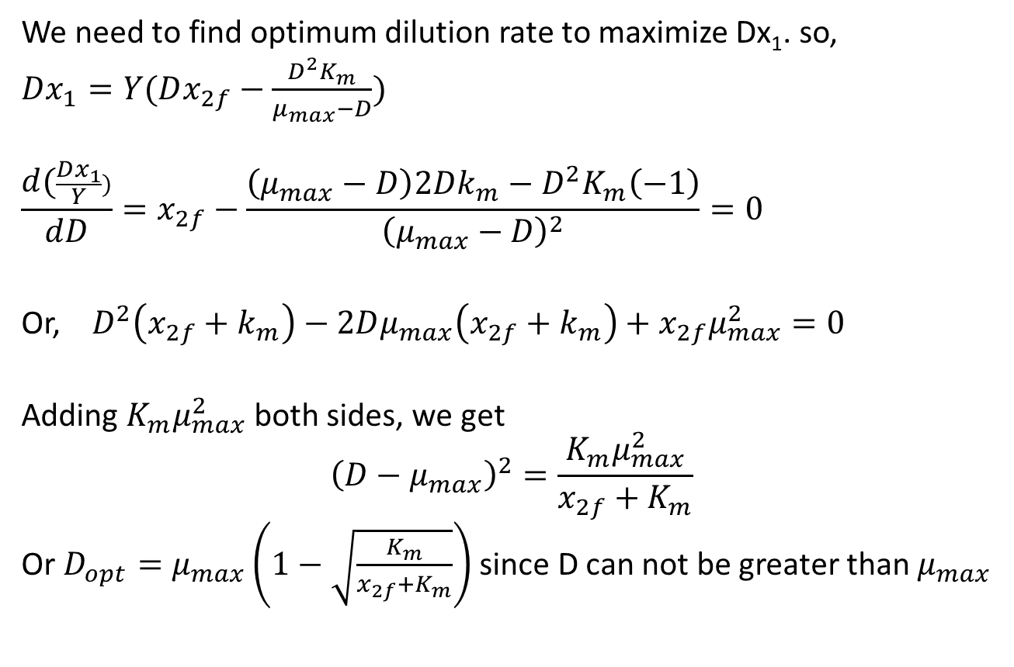
Biochemical Reactor
We need to find optimum dilution rate to maximize Dx₁. so,
$Dx_{1}=Y(Dx_{2f}−\frac{D^{2}K_{m}}{μ_{max}−D})$
$$\frac{d(\frac{Dx_{1}}{Y})}{dD}=x_{2f}−\frac{\left(μ_{max}−D\right)2Dk_{m}−D^{2}K_{m}\left(−1\right)}{{\left(μ_{max}−D\right)}^{2}}=0$$
Or, $D^{2}\left(x_{2f}+k_{m}\right)−2Dμ_{max}\left(x_{2f}+k_{m}\right)+x_{2f}μ_{max}^{2}=0$
Adding $K_{m}μ_{max}^{2}$ both sides, we get
$${\left(D−μ_{max}\right)}^{2}=\frac{K_{m}μ_{max}^{2}}{x_{2f}+K_{m}}$$
Or $D_{opt}=μ_{max}\left(1−\sqrt{\frac{K_{m}}{x_{2f}+K_{m}}}\right)$ since D can not be greater than $μ_{max}$

Slide 6
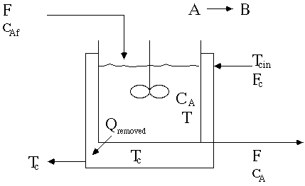
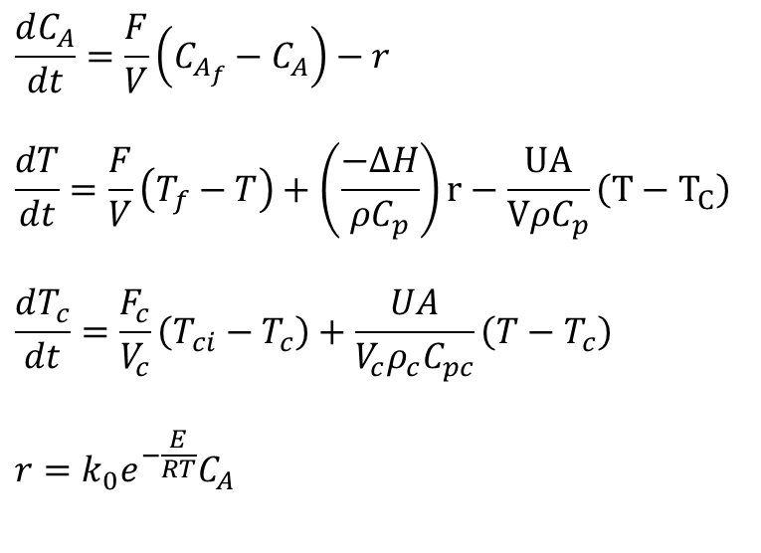
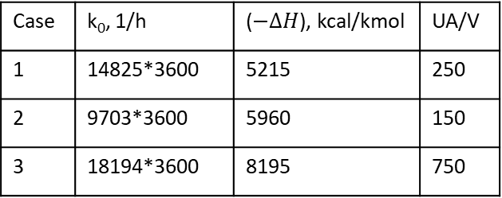
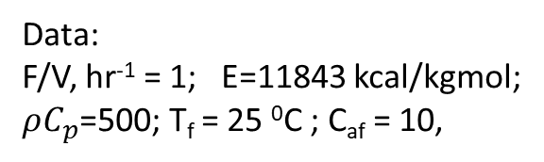
Non-Isothermal Jacketed CSTR
$$\frac{dC_{A}}{dt}=\frac{F}{V}\left(C_{A_{f}}−C_{A}\right)−r$$
$$\frac{dT}{dt}=\frac{F}{V}\left(T_{f}−T\right)+\left(\frac{−∆H}{ρC_{p}}\right)r−\frac{UA}{VρC_{p}}\left(T−T_{C}\right)$$
$$\frac{dT_{c}}{dt}=\frac{F_{c}}{V_{c}}\left(T_{ci}−T_{c}\right)+\frac{UA}{V_{c}ρ_{c}C_{pc}}\left(T−T_{c}\right)$$
$$r=k_{0}e^{−\frac{E}{RT}}C_{A}$$
Data:
F/V, hr⁻¹ = 1; E=11843 kcal/kgmol; $ρC_{p}$=500; T_{f} = 25 ⁰C ; C_{af} = 10,
Case | k₀, 1/h | ($−∆H$), kcal/kmol | UA/V
1 | 14825*3600 | 5215 | 250
2 | 9703*3600 | 5960 | 150
3 | 18194*3600 | 8195 | 750

Slide 7
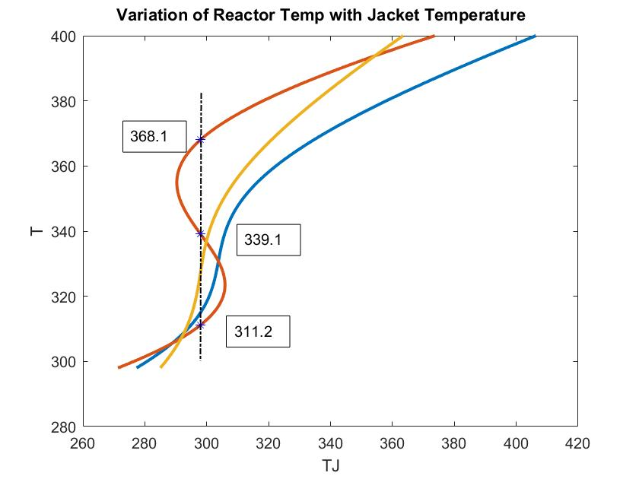
Case 2
Case 1
Steady State for case 2
C_{A} T
1 8.564 311.2
2 5.518 339.1
3 2.359 368.1

Slide 8
Steady State Heat Power vs Reactor Temperature
2
3
1

Slide 10
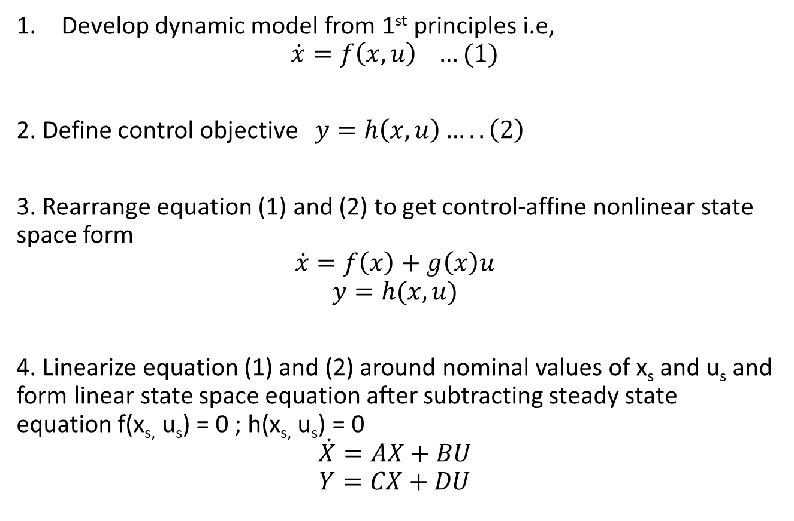
Developing Control Relevant Models
Develop dynamic model from 1st principles i.e,
$$\dot{x}=f\left(x,u\right) …(1)$$
2. Define control objective $y=h\left(x,u\right)…..\left(2\right)$
3. Rearrange equation (1) and (2) to get control-affine nonlinear state space form
$$\dot{x}=f\left(x\right)+g\left(x\right)u$$
$$y=h(x,u)$$
4. Linearize equation (1) and (2) around nominal values of x_{s} and u_{s} and form linear state space equation after subtracting steady state equation f(x_{s,} u_{s}) = 0 ; h(x_{s,} u_{s}) = 0
$$\dot{X}=AX+BU$$
$$Y=CX+DU$$

Slide 11
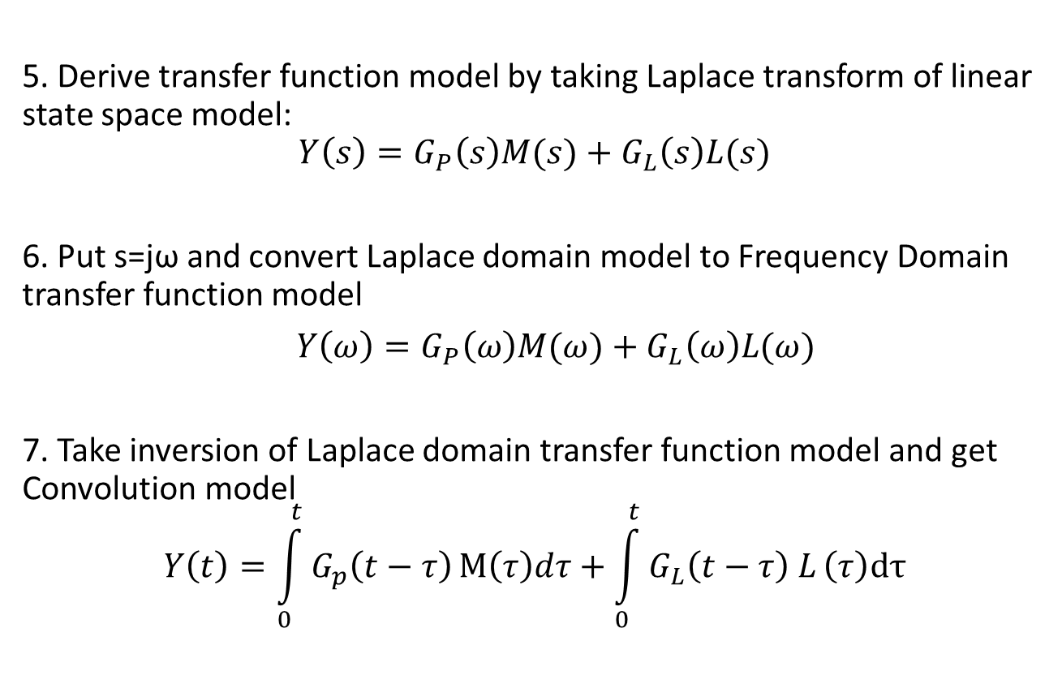
Developing Control Relevant Models
5. Derive transfer function model by taking Laplace transform of linear state space model:
$$Y\left(s\right)=G_{P}\left(s\right)M(s)+G_{L}\left(s\right)L(s)$$
6. Put s=jω and convert Laplace domain model to Frequency Domain transfer function model
$Y\left(ω\right)=G_{P}\left(ω\right)M(ω)+G_{L}\left(ω\right)L(ω)$
7. Take inversion of Laplace domain transfer function model and get Convolution model
$$Y\left(t\right)=\int_{0}^{t}{G_{p}\left(t−τ\right)}M\left(τ\right)dτ+\int_{0}^{t}{G_{L}\left(t−τ\right) L}\left(τ\right)dτ$$

Slide 12
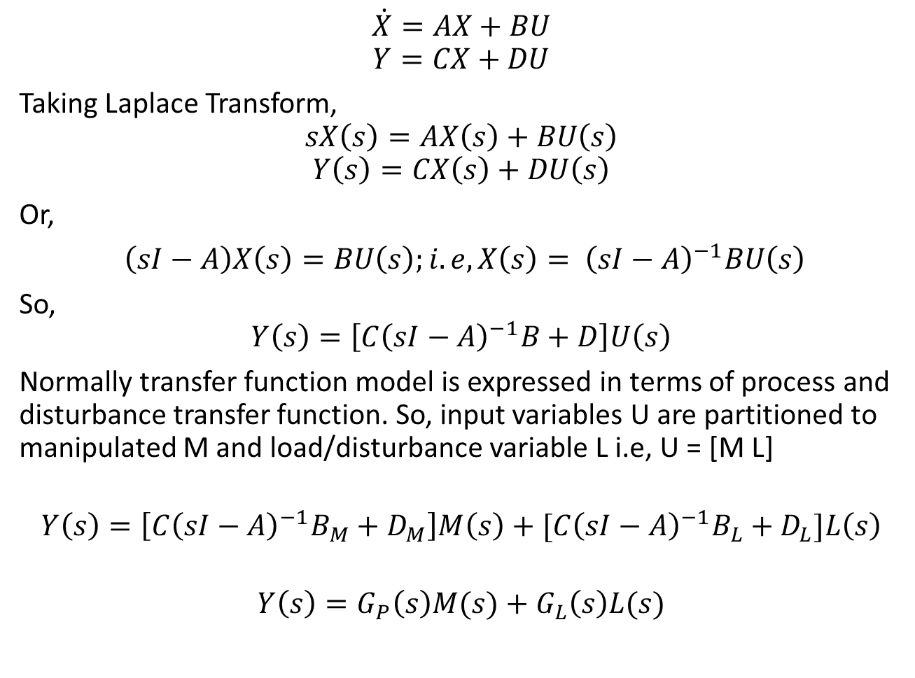
$$\dot{X}=AX+BU$$
$$Y=CX+DU$$
Taking Laplace Transform,
$$sX\left(s\right)=AX\left(s\right)+BU\left(s\right)$$
$$Y\left(s\right)=CX\left(s\right)+DU\left(s\right)$$
Or,
$\left(sI−A\right)X\left(s\right)=BU\left(s\right);i.e, X\left(s\right)= {\left(sI−A\right)}^{−1}BU\left(s\right)$
So,
$$Y\left(s\right)=\left[C{\left(sI−A\right)}^{−1}B+D\right]U\left(s\right)$$
Normally transfer function model is expressed in terms of process and disturbance transfer function. So, input variables U are partitioned to manipulated M and load/disturbance variable L i.e, U = [M L]
$$Y\left(s\right)=\left[{C\left(sI−A\right)}^{−1}B_{M}+D_{M}\right]M\left(s\right)+{[C\left(sI−A\right)}^{−1}B_{L}+D_{L}]L\left(s\right)$$
$$Y\left(s\right)=G_{P}\left(s\right)M(s)+G_{L}\left(s\right)L(s)$$

Slide 13
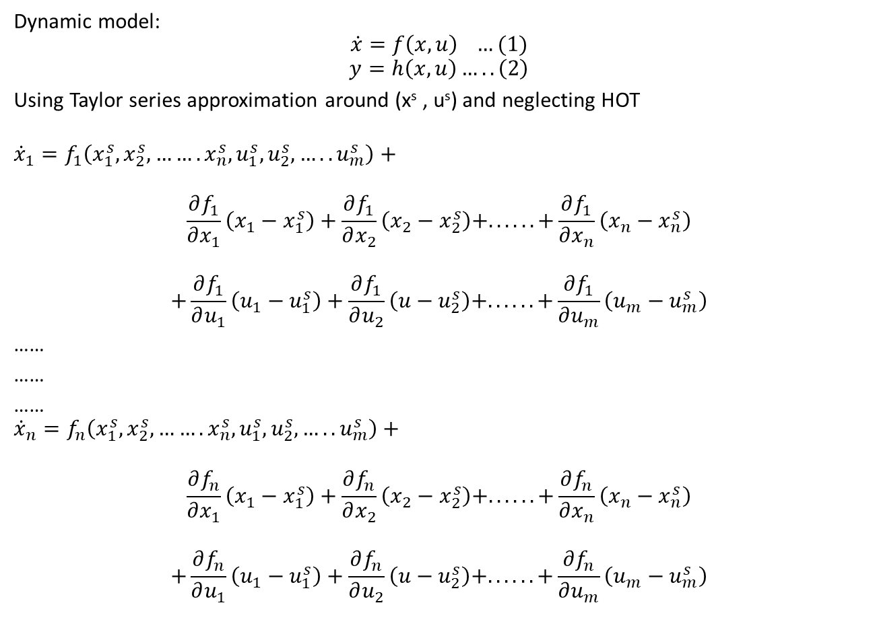
Dynamic model:
$$\dot{x}=f\left(x,u\right) …(1)$$
$$y=h\left(x,u\right)…..\left(2\right)$$
Using Taylor series approximation around (x^{s} , u^{s}) and neglecting HOT
$${\dot{x}}_{1}=f_{1}\left(x_{1}^{s},x_{2}^{s},…….x_{n}^{s},u_{1}^{s},u_{2}^{s},…..u_{m}^{s}\right)+$$
$$\frac{∂f_{1}}{∂x_{1}}\left(x_{1}−x_{1}^{s}\right)+\frac{∂f_{1}}{∂x_{2}}\left(x_{2}−x_{2}^{s}\right)+. . . . . .+\frac{∂f_{1}}{∂x_{n}}\left(x_{n}−x_{n}^{s}\right)$$
$$+\frac{∂f_{1}}{∂u_{1}}\left(u_{1}−u_{1}^{s}\right)+\frac{∂f_{1}}{∂u_{2}}\left(u−u_{2}^{s}\right)+. . . . . .+\frac{∂f_{1}}{∂u_{m}}\left(u_{m}−u_{m}^{s}\right)$$
……
……
……
$${\dot{x}}_{n}=f_{n}\left(x_{1}^{s},x_{2}^{s},…….x_{n}^{s},u_{1}^{s},u_{2}^{s},…..u_{m}^{s}\right)+$$
$$\frac{∂f_{n}}{∂x_{1}}\left(x_{1}−x_{1}^{s}\right)+\frac{∂f_{n}}{∂x_{2}}\left(x_{2}−x_{2}^{s}\right)+. . . . . .+\frac{∂f_{n}}{∂x_{n}}\left(x_{n}−x_{n}^{s}\right)$$
$$+\frac{∂f_{n}}{∂u_{1}}\left(u_{1}−u_{1}^{s}\right)+\frac{∂f_{n}}{∂u_{2}}\left(u−u_{2}^{s}\right)+. . . . . .+\frac{∂f_{n}}{∂u_{m}}\left(u_{m}−u_{m}^{s}\right)$$

Slide 14
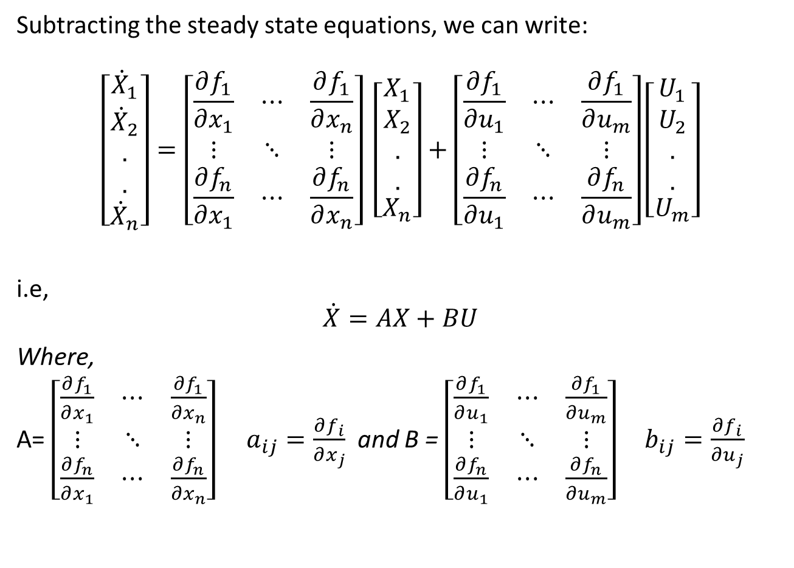
Subtracting the steady state equations, we can write:
$$\left[\begin{matrix}{\dot{X}}_{1} \\ \begin{aligned}{\dot{X}}_{2} \\ . \\ .\end{aligned} \\ {\dot{X}}_{n}\end{matrix}\right]=\left[\begin{matrix}\frac{∂f_{1}}{∂x_{1}} & ⋯ & \frac{∂f_{1}}{∂x_{n}} \\ ⋮ & ⋱ & ⋮ \\ \frac{∂f_{n}}{∂x_{1}} & ⋯ & \frac{∂f_{n}}{∂x_{n}}\end{matrix}\right] \left[\begin{matrix}X_{1} \\ \begin{aligned}X_{2} \\ . \\ .\end{aligned} \\ X_{n}\end{matrix}\right]+\left[\begin{matrix}\frac{∂f_{1}}{∂u_{1}} & ⋯ & \frac{∂f_{1}}{∂u_{m}} \\ ⋮ & ⋱ & ⋮ \\ \frac{∂f_{n}}{∂u_{1}} & ⋯ & \frac{∂f_{n}}{∂u_{m}}\end{matrix}\right]\left[\begin{matrix}U_{1} \\ \begin{aligned}U_{2} \\ . \\ .\end{aligned} \\ U_{m}\end{matrix}\right]$$
i.e,
$$\dot{X}=AX+BU$$
Where,
A= $\left[\begin{matrix}\frac{∂f_{1}}{∂x_{1}} & ⋯ & \frac{∂f_{1}}{∂x_{n}} \\ ⋮ & ⋱ & ⋮ \\ \frac{∂f_{n}}{∂x_{1}} & ⋯ & \frac{∂f_{n}}{∂x_{n}}\end{matrix}\right]$ $a_{ij}=\frac{∂f_{i}}{∂x_{j}}$ and B = $\left[\begin{matrix}\frac{∂f_{1}}{∂u_{1}} & ⋯ & \frac{∂f_{1}}{∂u_{m}} \\ ⋮ & ⋱ & ⋮ \\ \frac{∂f_{n}}{∂u_{1}} & ⋯ & \frac{∂f_{n}}{∂u_{m}}\end{matrix}\right] b_{ij}=\frac{∂f_{i}}{∂u_{j}}$

Slide 15
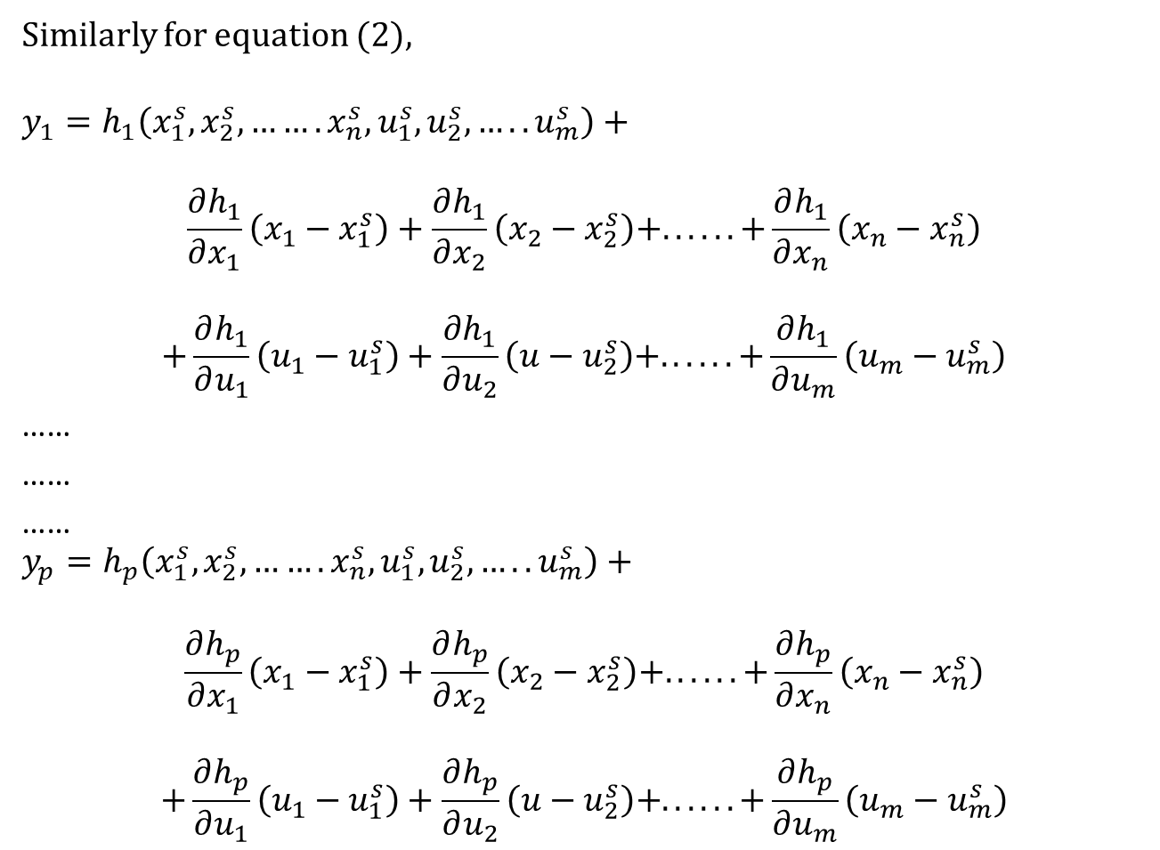
Similarly for equation (2),
$$y_{1}=h_{1}\left(x_{1}^{s},x_{2}^{s},…….x_{n}^{s},u_{1}^{s},u_{2}^{s},…..u_{m}^{s}\right)+$$
$$\frac{∂h_{1}}{∂x_{1}}\left(x_{1}−x_{1}^{s}\right)+\frac{∂h_{1}}{∂x_{2}}\left(x_{2}−x_{2}^{s}\right)+. . . . . .+\frac{∂h_{1}}{∂x_{n}}\left(x_{n}−x_{n}^{s}\right)$$
$$+\frac{∂h_{1}}{∂u_{1}}\left(u_{1}−u_{1}^{s}\right)+\frac{∂h_{1}}{∂u_{2}}\left(u−u_{2}^{s}\right)+. . . . . .+\frac{∂h_{1}}{∂u_{m}}\left(u_{m}−u_{m}^{s}\right)$$
……
……
……
$$y_{p}=h_{p}\left(x_{1}^{s},x_{2}^{s},…….x_{n}^{s},u_{1}^{s},u_{2}^{s},…..u_{m}^{s}\right)+$$
$$\frac{∂h_{p}}{∂x_{1}}\left(x_{1}−x_{1}^{s}\right)+\frac{∂h_{p}}{∂x_{2}}\left(x_{2}−x_{2}^{s}\right)+. . . . . .+\frac{∂h_{p}}{∂x_{n}}\left(x_{n}−x_{n}^{s}\right)$$
$$+\frac{∂h_{p}}{∂u_{1}}\left(u_{1}−u_{1}^{s}\right)+\frac{∂h_{p}}{∂u_{2}}\left(u−u_{2}^{s}\right)+. . . . . .+\frac{∂h_{p}}{∂u_{m}}\left(u_{m}−u_{m}^{s}\right)$$

Slide 16
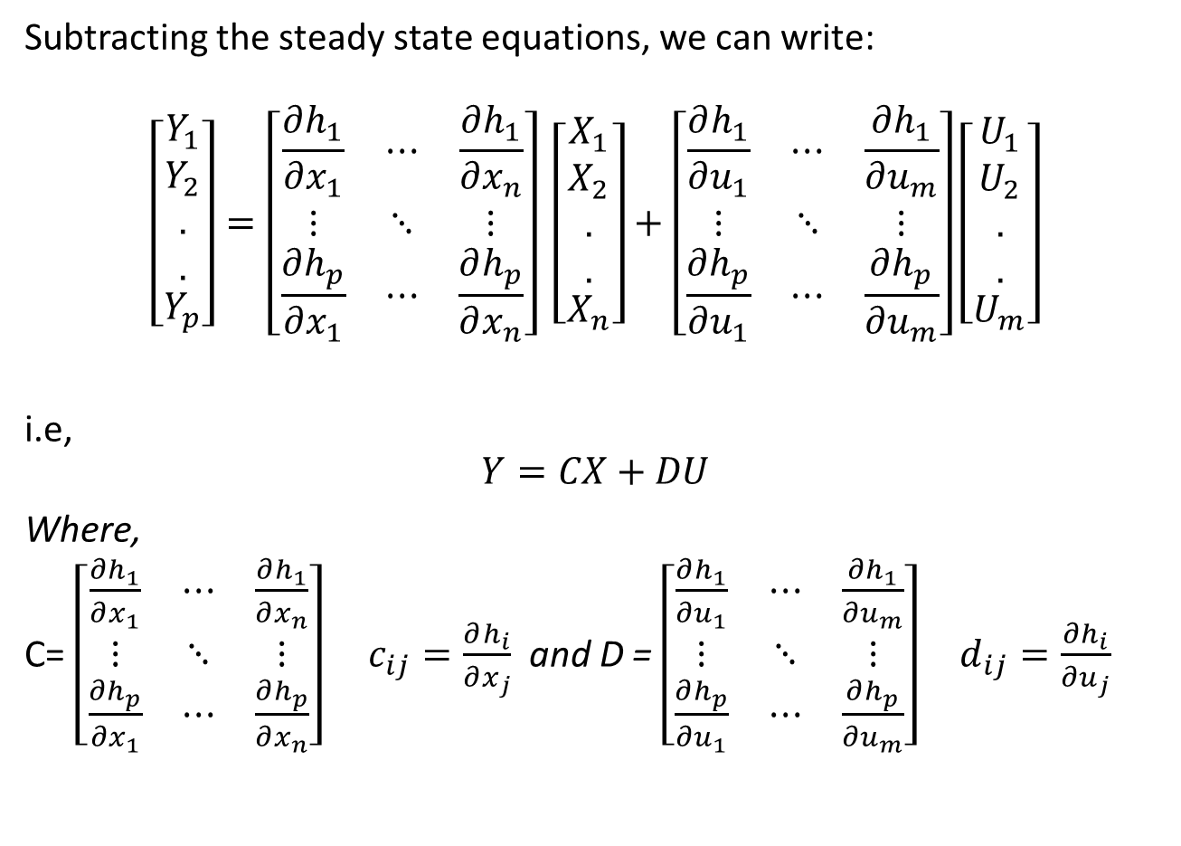
Subtracting the steady state equations, we can write:
$$\left[\begin{matrix}Y_{1} \\ \begin{aligned}Y_{2} \\ . \\ .\end{aligned} \\ Y_{p}\end{matrix}\right]=\left[\begin{matrix}\frac{∂h_{1}}{∂x_{1}} & ⋯ & \frac{∂h_{1}}{∂x_{n}} \\ ⋮ & ⋱ & ⋮ \\ \frac{∂h_{p}}{∂x_{1}} & ⋯ & \frac{∂h_{p}}{∂x_{n}}\end{matrix}\right] \left[\begin{matrix}X_{1} \\ \begin{aligned}X_{2} \\ . \\ .\end{aligned} \\ X_{n}\end{matrix}\right]+\left[\begin{matrix}\frac{∂h_{1}}{∂u_{1}} & ⋯ & \frac{∂h_{1}}{∂u_{m}} \\ ⋮ & ⋱ & ⋮ \\ \frac{∂h_{p}}{∂u_{1}} & ⋯ & \frac{∂h_{p}}{∂u_{m}}\end{matrix}\right]\left[\begin{matrix}U_{1} \\ \begin{aligned}U_{2} \\ . \\ .\end{aligned} \\ U_{m}\end{matrix}\right]$$
i.e,
$$Y=CX+DU$$
Where,
C= $\left[\begin{matrix}\frac{∂h_{1}}{∂x_{1}} & ⋯ & \frac{∂h_{1}}{∂x_{n}} \\ ⋮ & ⋱ & ⋮ \\ \frac{∂h_{p}}{∂x_{1}} & ⋯ & \frac{∂h_{p}}{∂x_{n}}\end{matrix}\right]$ $c_{ij}=\frac{∂h_{i}}{∂x_{j}}$ and D = $\left[\begin{matrix}\frac{∂h_{1}}{∂u_{1}} & ⋯ & \frac{∂h_{1}}{∂u_{m}} \\ ⋮ & ⋱ & ⋮ \\ \frac{∂h_{p}}{∂u_{1}} & ⋯ & \frac{∂h_{p}}{∂u_{m}}\end{matrix}\right] d_{ij}=\frac{∂h_{i}}{∂u_{j}}$

Slide 17
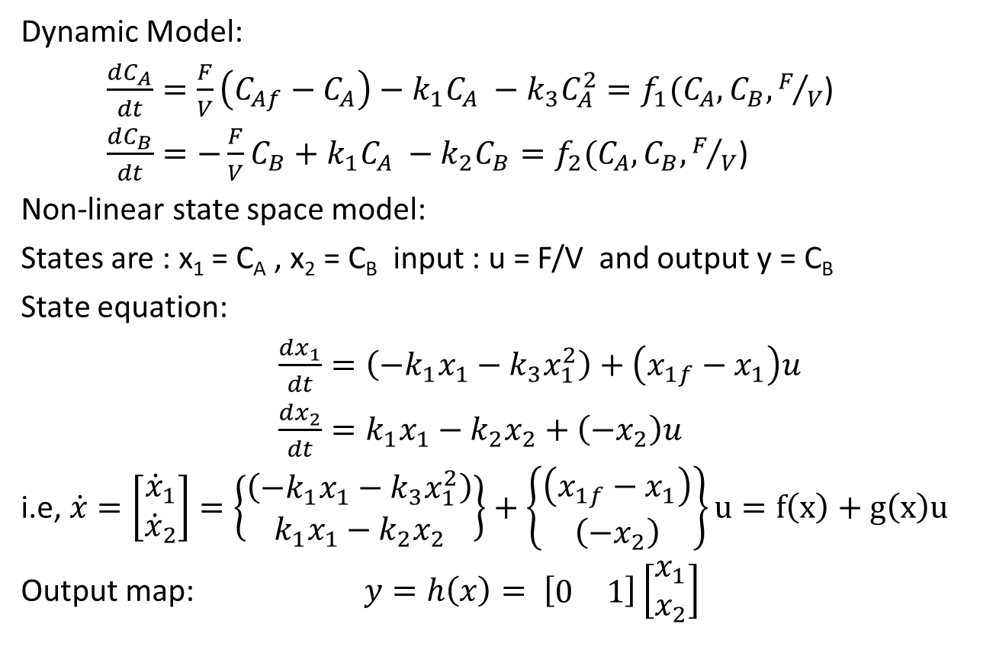
Example: Van De Vusse Reactor
Dynamic Model:
$\frac{dC_{A}}{dt}=\frac{F}{V}\left(C_{Af}−C_{A}\right)−k_{1}C_{A} −k_{3}C_{A}^{2}=f_{1}(C_{A},C_{B},F/V$)
$\frac{dC_{B}}{dt}=−\frac{F}{V}C_{B}+k_{1}C_{A} −k_{2}C_{B}=f_{2}(C_{A},C_{B},F/V$)
Non-linear state space model:
States are : x₁ = C_{A} , x₂ = C_{B} input : u = F/V and output y = C_{B}
State equation:
$\frac{dx_{1}}{dt}=\left(−k_{1}x_{1}−k_{3}x_{1}^{2}\right)+\left(x_{1f}−x_{1}\right)u$
$\frac{dx_{2}}{dt}=k_{1}x_{1}−k_{2}x_{2}+\left(−x_{2}\right)u$
i.e, $\dot{x}=\left[\begin{matrix}{\dot{x}}_{1} \\ {\dot{x}}_{2}\end{matrix}\right]=\left\{\begin{matrix}\left(−k_{1}x_{1}−k_{3}x_{1}^{2}\right) \\ k_{1}x_{1}−k_{2}x_{2}\end{matrix}\right\}+\left\{\begin{matrix}\left(x_{1f}−x_{1}\right) \\ \left(−x_{2}\right)\end{matrix}\right\}u=f\left(x\right)+g\left(x\right)u$
Output map: $y=h\left(x\right)= \left[\begin{matrix}0 & 1\end{matrix}\right]\left[\begin{matrix}x_{1} \\ x_{2}\end{matrix}\right]$

Slide 18
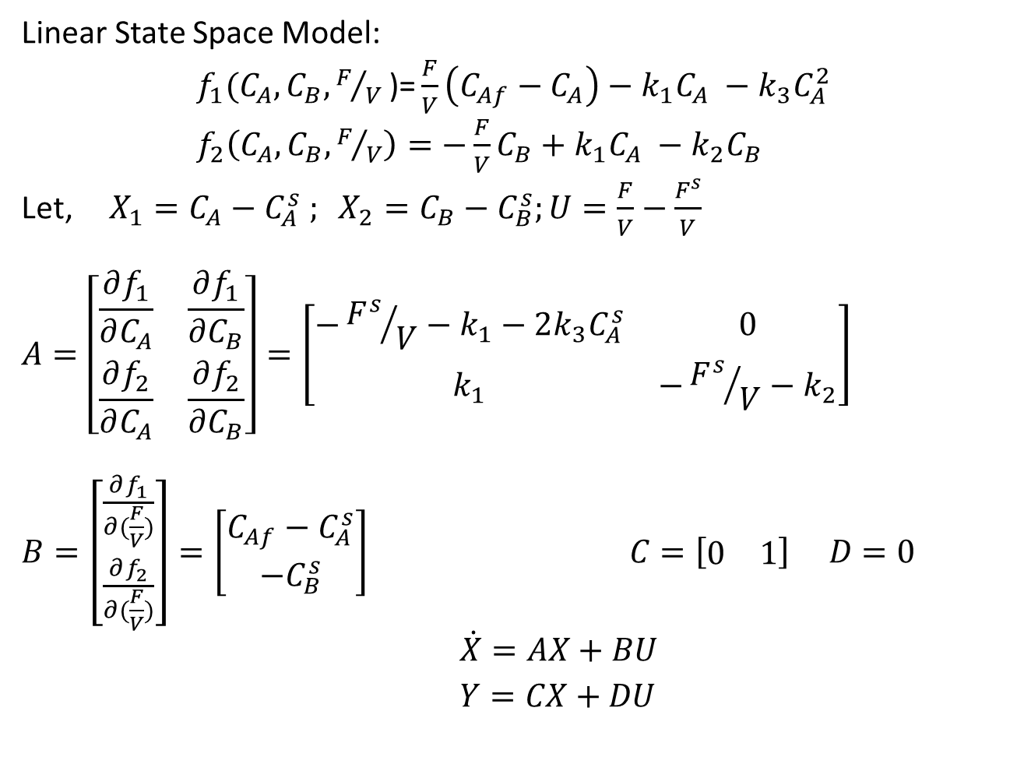
Example: Van De Vusse Reactor
Linear State Space Model:
$f_{1}(C_{A},C_{B},F/V\text{)}\text{=}\frac{F}{V}\left(C_{Af}−C_{A}\right)−k_{1}C_{A} −k_{3}C_{A}^{2}$
$f_{2}\left(C_{A},C_{B},F/V\right)=−\frac{F}{V}C_{B}+k_{1}C_{A} −k_{2}C_{B}$
Let, $X_{1}=C_{A}−C_{A}^{s} ; X_{2}=C_{B}−C_{B}^{s};U=\frac{F}{V}−\frac{F^{s}}{V}$
$$A=\left[\begin{matrix}\frac{∂f_{1}}{∂C_{A}} & \frac{∂f_{1}}{∂C_{B}} \\ \frac{∂f_{2}}{∂C_{A}} & \frac{∂f_{2}}{∂C_{B}}\end{matrix}\right]=\left[\begin{matrix}−{F^{s}}/V−k_{1}−2k_{3}C_{A}^{s} & 0 \\ k_{1} & −{F^{s}}/V−k_{2}\end{matrix}\right]$$
$B=\left[\begin{matrix}\frac{∂f_{1}}{∂(\frac{F}{V})} \\ \frac{∂f_{2}}{∂(\frac{F}{V})}\end{matrix}\right]=\left[\begin{matrix}C_{Af}−C_{A}^{s} \\ −C_{B}^{s}\end{matrix}\right] C=\left[\begin{matrix}0 & 1\end{matrix}\right] D=0$
$\dot{X}=AX+BU$
$Y=CX+DU$

Slide 19
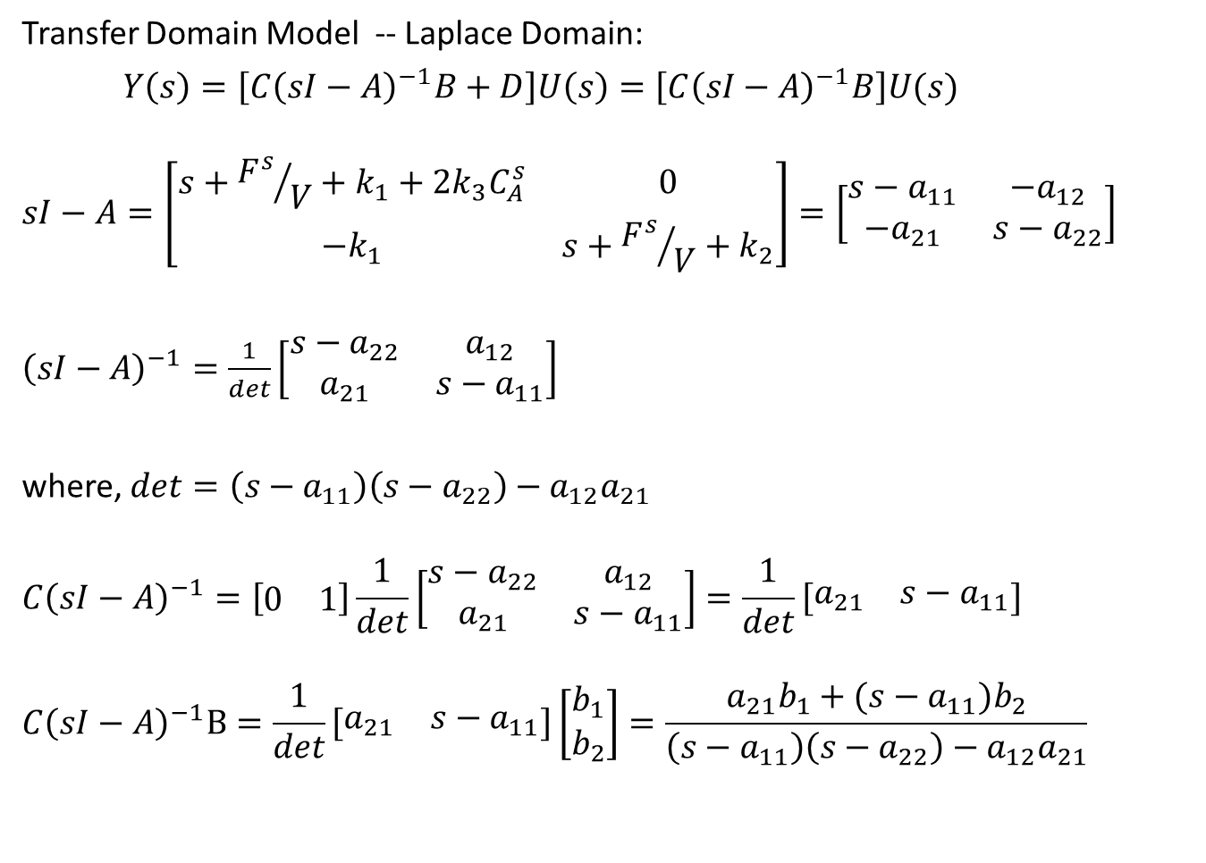
Example: Van De Vusse Reactor
Transfer Domain Model -- Laplace Domain:
$Y\left(s\right)=\left[C{\left(sI−A\right)}^{−1}B+D\right]U\left(s\right)=\left[C{\left(sI−A\right)}^{−1}B\right]U(s)$
$$sI−A=\left[\begin{matrix}s+{F^{s}}/V+k_{1}+2k_{3}C_{A}^{s} & 0 \\ −k_{1} & s+{F^{s}}/V+k_{2}\end{matrix}\right]=\left[\begin{matrix}s−a_{11} & −a_{12} \\ −a_{21} & s−a_{22}\end{matrix}\right]$$
${\left(sI−A\right)}^{−1}=\frac{1}{det}\left[\begin{matrix}s−a_{22} & a_{12} \\ a_{21} & s−a_{11}\end{matrix}\right]$
where, $det=\left(s−a_{11}\right)\left(s−a_{22}\right)−a_{12}a_{21}$
$$C{\left(sI−A\right)}^{−1}=\left[\begin{matrix}0 & 1\end{matrix}\right]\frac{1}{det}\left[\begin{matrix}s−a_{22} & a_{12} \\ a_{21} & s−a_{11}\end{matrix}\right]=\frac{1}{det}\left[\begin{matrix}a_{21} & s−a_{11}\end{matrix}\right]$$
$$C{\left(sI−A\right)}^{−1}B=\frac{1}{det}\left[\begin{matrix}a_{21} & s−a_{11}\end{matrix}\right]\left[\begin{matrix}b_{1} \\ b_{2}\end{matrix}\right]=\frac{a_{21}b_{1}+(s−a_{11})b_{2}}{\left(s−a_{11}\right)\left(s−a_{22}\right)−a_{12}a_{21}}$$

Slide 20
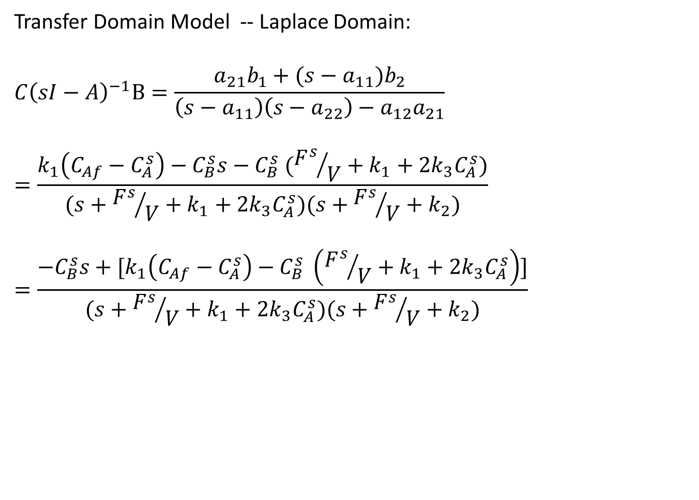
Example: Van De Vusse Reactor
Transfer Domain Model -- Laplace Domain:
$$C{\left(sI−A\right)}^{−1}B=\frac{a_{21}b_{1}+(s−a_{11})b_{2}}{\left(s−a_{11}\right)\left(s−a_{22}\right)−a_{12}a_{21}}$$
$$=\frac{k_{1}\left(C_{Af}−C_{A}^{s}\right)−C_{B}^{s}s−C_{B}^{s} ({F^{s}}/V+k_{1}+2k_{3}C_{A}^{s})}{(s+{F^{s}}/V+k_{1}+2k_{3}C_{A}^{s})(s+{F^{s}}/V+k_{2})}$$
$$=\frac{−C_{B}^{s}s+[k_{1}\left(C_{Af}−C_{A}^{s}\right)−C_{B}^{s} \left({F^{s}}/V+k_{1}+2k_{3}C_{A}^{s}\right)]}{(s+{F^{s}}/V+k_{1}+2k_{3}C_{A}^{s})(s+{F^{s}}/V+k_{2})}$$

