Slide 1
Process Dynamics & Control

Slide 2
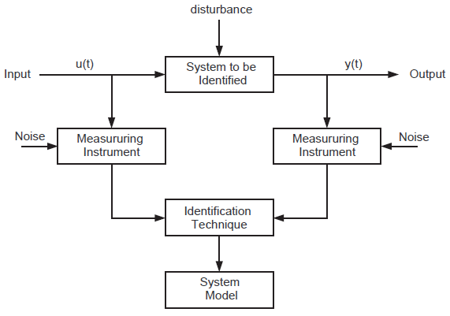
Process Identification
What is Identification?
Identification is the process of constructing a empirical model of a (dynamical) system from observations of its inputs and outputs. In a dynamical system, the output at any instant depends on its history not just present input, i.e. it has some form of memory (storage).

Slide 3
Classification of identification
Based on the degree of a priori knowledge of the system.
Black Box:
This means we know nothing about the basic characteristics of the system.
Extremely difficult to solve.
Usually some kind of assumptions have to be made before any meaningful solution can be attempted.
Grey Box:
In this case, some basic characteristics of the system are known (ie. linearity, bandwidth, structure).
However, order of the dynamic equation or values of the associated coefficients may be unknown.

Slide 4
Process Identification Procedure
The experiment design objective is to make choices such that the collected data is maximally informative, i.e.
types of signals,
amplitudes,
what to measure
input/outputs
In the model calculation block, decisions need to be made on:
what type of model,
model structure,
parameter estimation technique

Slide 5
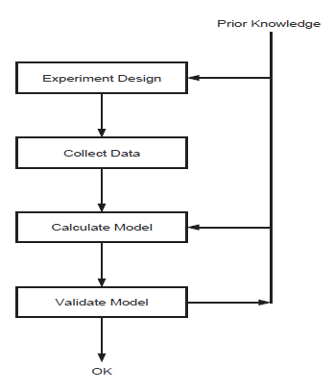
Process Identification Procedure
To validate the model, the following questions need to be asked:
How does the model output
relate to the data observed?
Is it good enough for specific
purpose?

Slide 6
Types of Test Signals
The input signal used in an identification experiment can have a significant influence on the resulting parameter estimates.
Typical types of input signal often used in practice include:
Impulse function (approximate)
Step function
Pseudo-random binary sequence
Sinusoids
The signal we consider in this course is step function.

Slide 7
Types of Test Signals
Step function
From the response of a process to a step input a number of practical parameters can be obtained, i.e. dead time, time constant, etc.
It is easy to apply.
It is very sensitive to noise. (Usually requires a rather large amplitude to obtain reasonable results)
Generally, it can only give a basic model.
Steady state gain is easily found, in the absence of drift, from the initial and final values of the step response.
User choices to be considered:
Amplitude
Duration

Slide 8
Design of Identification Experiments
There are a number of factors to consider before performing an identification experiment.
What form of test signal should be used, i.e. step, doublet, prbs?
This depends on the quality of the model you require. In most cases, for PID control, step tests are adequate.
What size should the amplitude be? There a quite a number of factors to consider here.
There may be constraints on how much variation can be tolerated in the input and/or output. (economic, safety, actuator limits, etc).
One reason for a large amplitude is that the effects of noise become less (signal to noise ratio is larger).
For systems with known nonlinearities it is best to keep the amplitude small as generally you are interested in a model around a particular operating point.

Slide 9
Design of Identification Experiments
What sampling frequency should be used?
Typically, the sampling frequency should be chosen as 10 - 20× that of the test signal frequency. (5× should be considered as the absolute minimum).
For a step test, you want to capture at least 5 samples per the time constant of the process.
What should the frequencies of multi-step test signal be?
The frequencies of these test signals should be in the frequency region of interest and should be chosen as a multiple of the sampling frequency and of each other. This will minimise errors.
When collecting data from a multi-step test one should wait until the transients have decayed significantly.

Slide 10
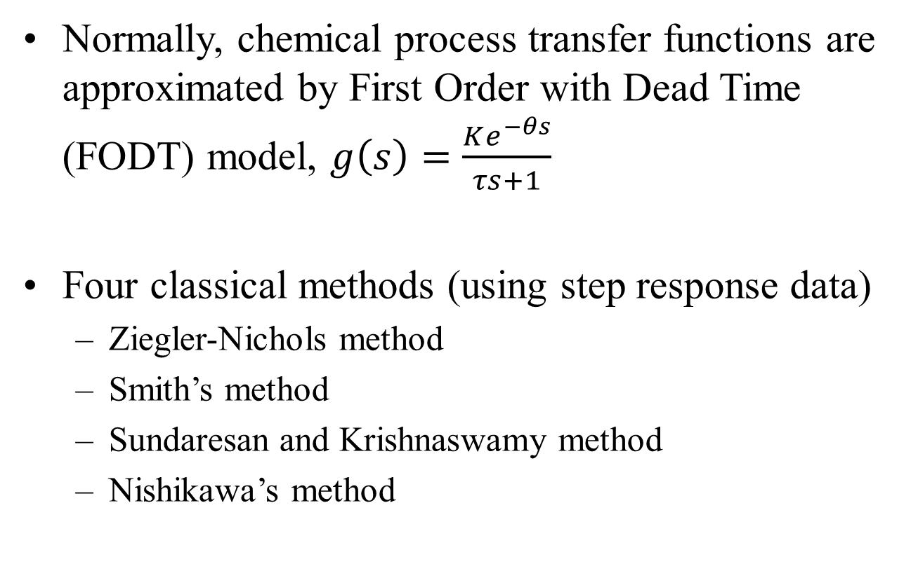
Transfer Function from Process Data
Normally, chemical process transfer functions are approximated by First Order with Dead Time (FODT) model, $g\left(s\right)=\frac{Ke^{−θs}}{τs+1}$
Four classical methods (using step response data)
Ziegler-Nichols method
Smith’s method
Sundaresan and Krishnaswamy method
Nishikawa’s method

Slide 11
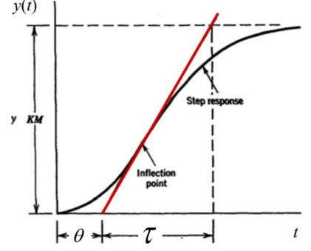
Transfer function from Process Data
Ziegler-Nichols method (1942) consists of applying a tangent line to the curve at an inflection point, to determine the system’s gain, time, and delay constants, as shown in Figure.
The inflection point is
defined where the curve
changes direction and the
derivative is equal to zero.
Drawback:
Difficult to find inflection
Point and to draw tangent.

Slide 12
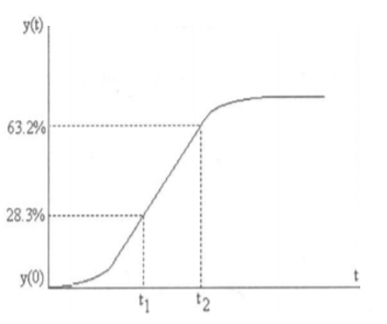
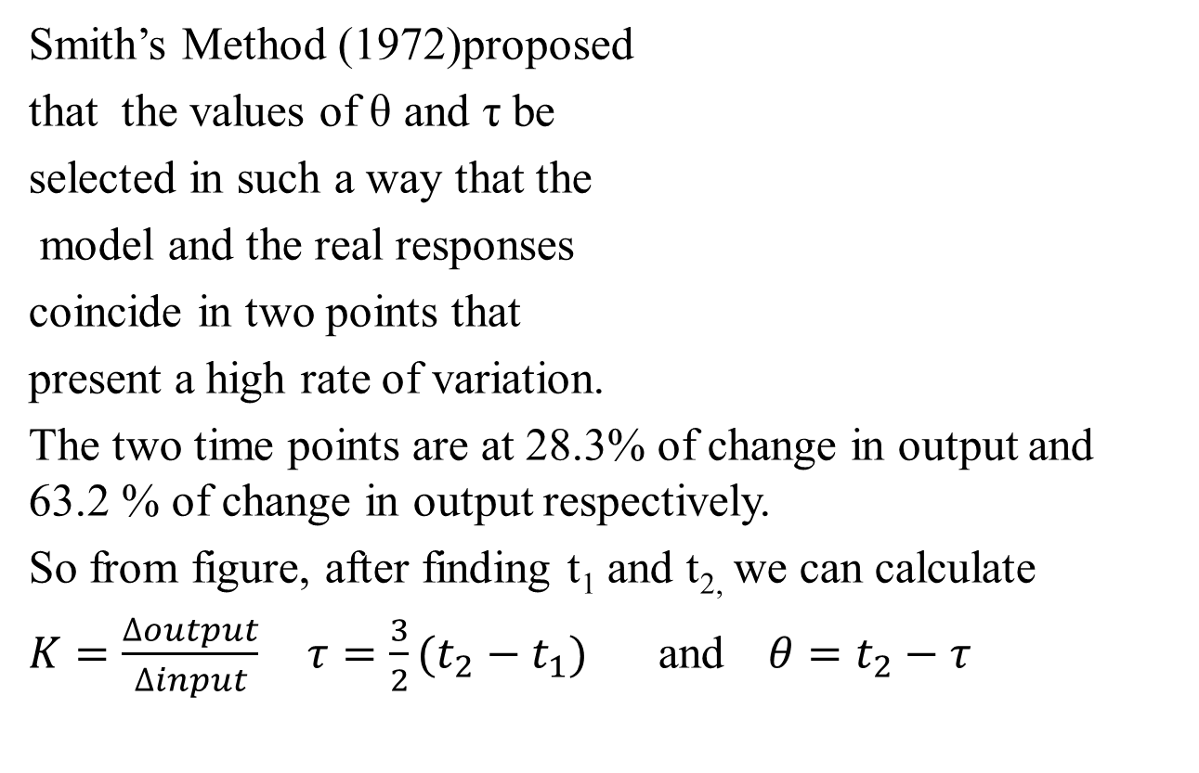
Transfer function from Process Data

Slide 13
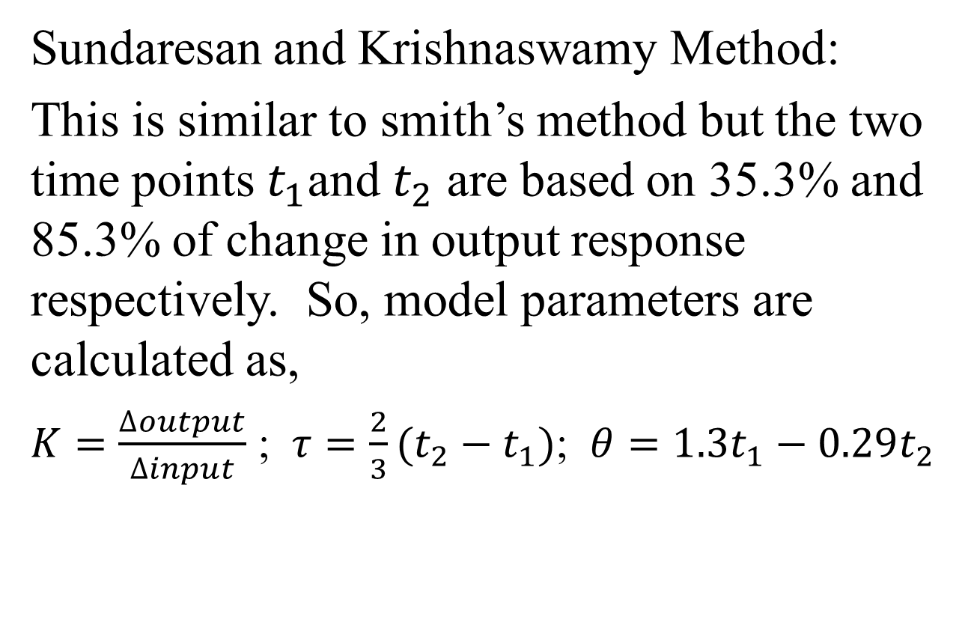
Transfer function from Process Data

Slide 14
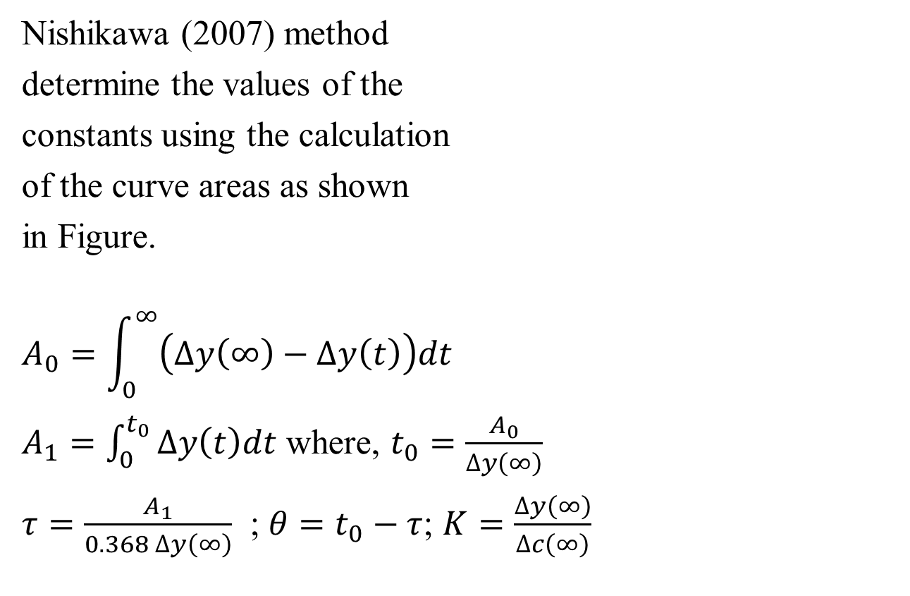
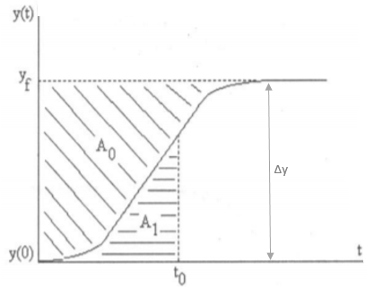
Transfer function from Process Data

Slide 15
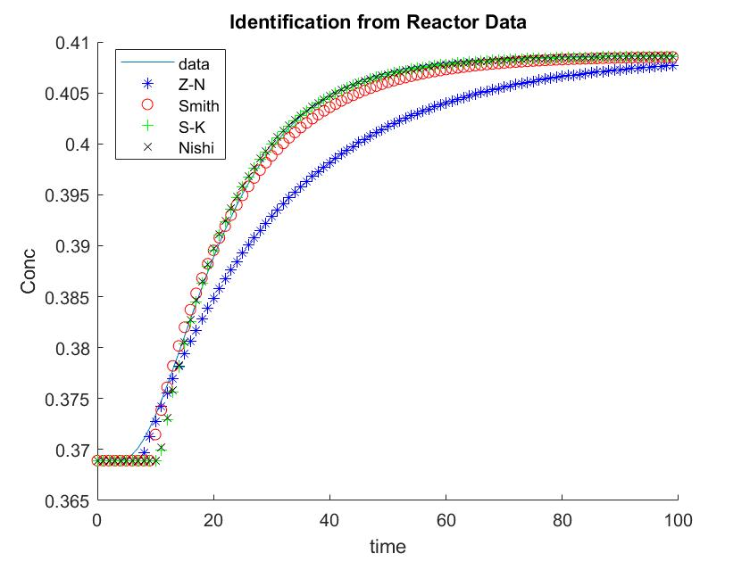
Method K Tau Theta Mape
Z-N 0.20 24.32 7.52 0.84
Smith 0.20 15.00 9.00 0.16
Sunder 0.20 12.73 10.65 0.11
Nishi 0.20 12.69 10.59 0.11

Slide 16
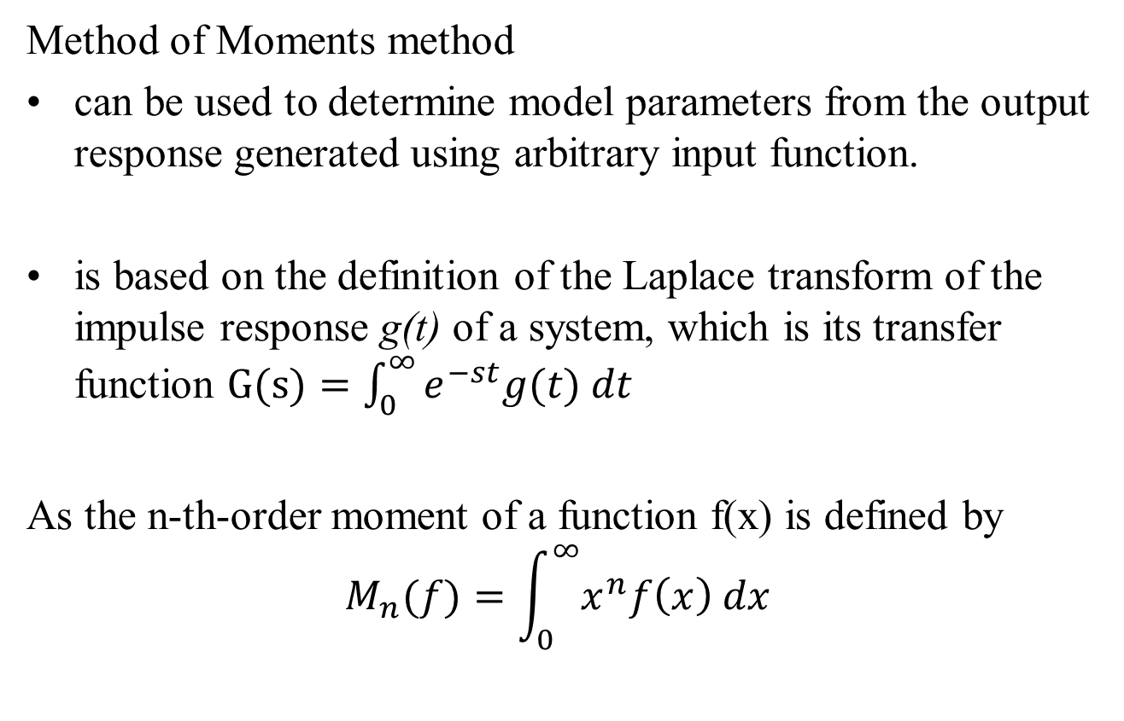
Transfer function from Process Data

Slide 17
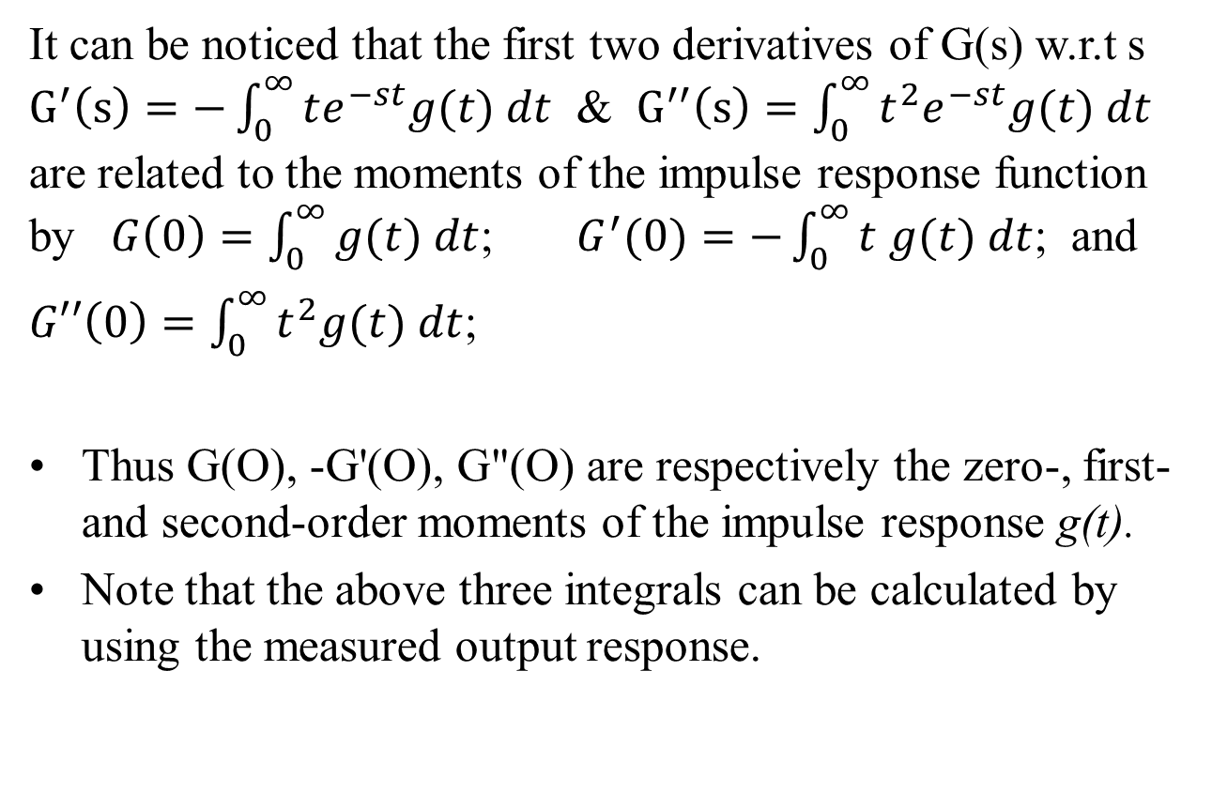
Transfer function from Process Data

Slide 18
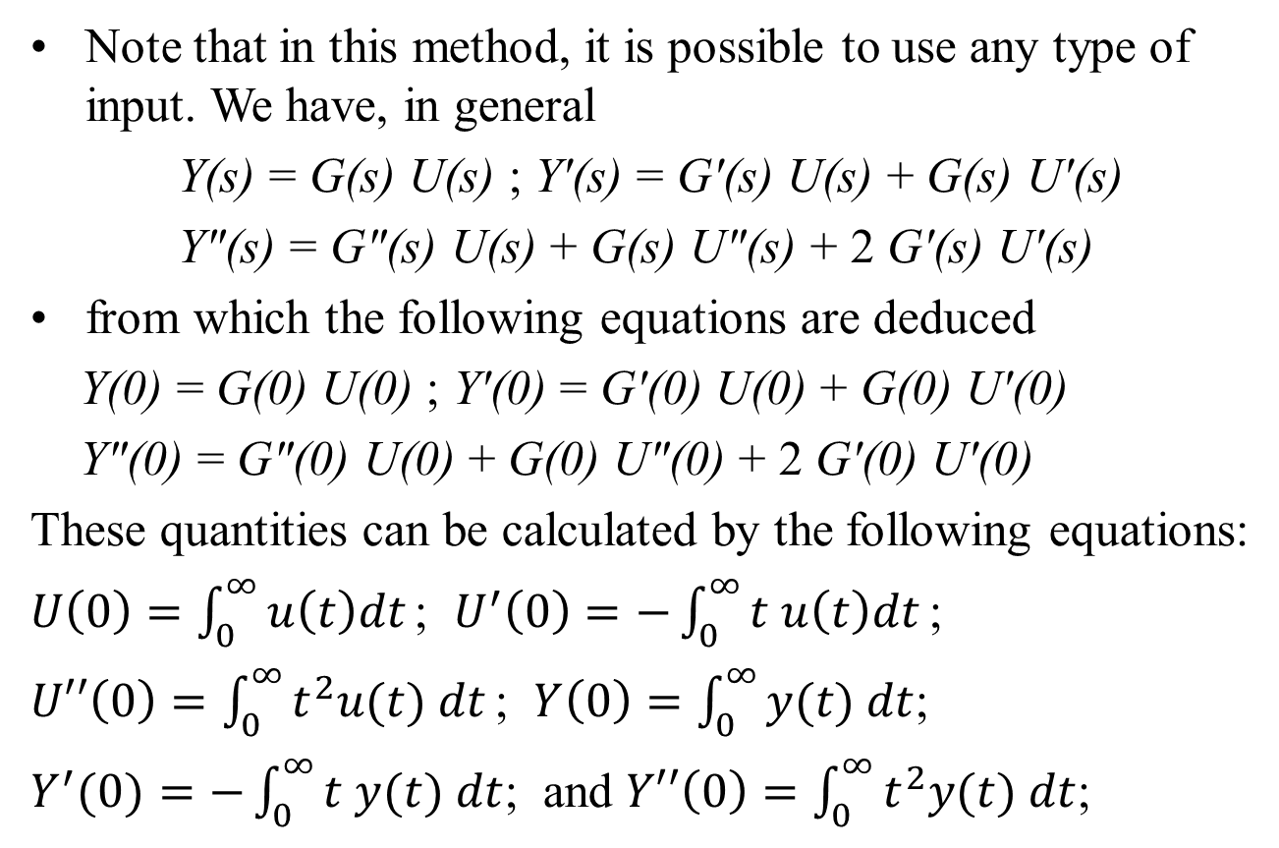
Transfer function from Process Data

Slide 19
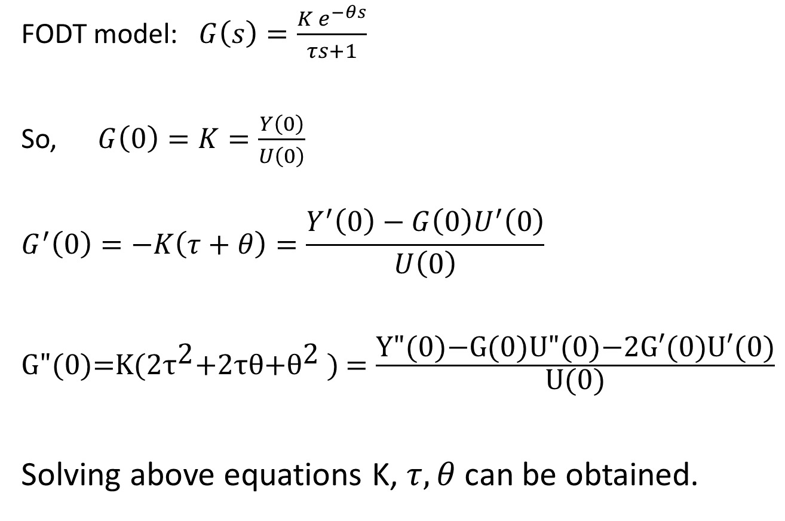
Transfer function from Process Data
FODT model: $G\left(s\right)=\frac{K e^{−θs}}{τs+1}$
So, $G\left(0\right)=K=\frac{Y\left(0\right)}{U\left(0\right)}$
$$G^{′}\left(0\right)=−K\left(τ+θ\right)=\frac{Y^{′}\left(0\right)−G\left(0\right)U^{′}\left(0\right)}{U\left(0\right)}$$
$\text{G}\text{"(0)=}\text{K}\text{(2}{\text{τ}}^{\text{2}}\text{+2}\text{τθ}\text{+}{\text{θ}}^{\text{2}}\text{ )}$ $=\frac{\text{Y}\text{"(0)−}\text{G}\text{(0)}\text{U}\text{"(0)−2}\text{G}\text{′(0)}\text{U}\text{′(0)}}{\text{U}\text{(0)}}$
Solving above equations K, $τ, θ$ can be obtained.

Slide 20
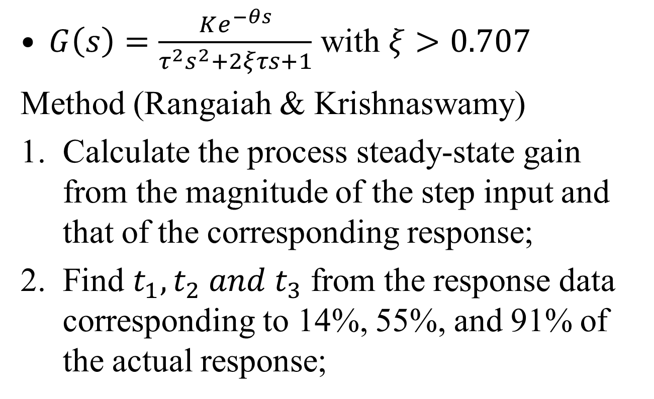
SODT model from step response
$G\left(s\right)=\frac{Ke^{−θs}}{τ^{2}s^{2}+2ξτs+1}$ with $ξ>0.707$
Method (Rangaiah & Krishnaswamy)
Calculate the process steady-state gain from the magnitude of the step input and that of the corresponding response;
Find $t_{1}, t_{2} and t_{3}$ from the response data corresponding to 14%, 55%, and 91% of the actual response;

Slide 21
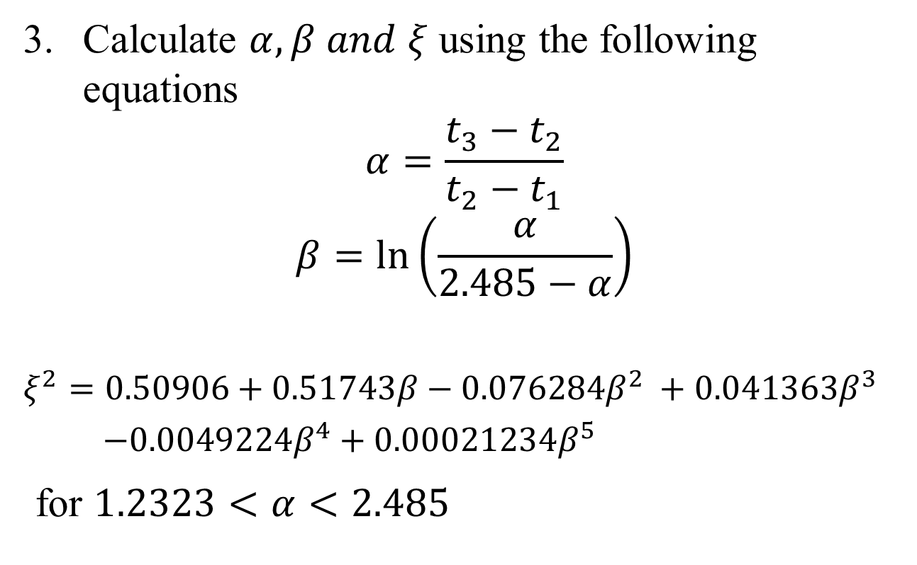
SODT model from step response
Calculate $α, β and ξ$ using the following equations
$$α=\frac{t_{3}−t_{2}}{t_{2}−t_{1}}$$
$$β=\ln\left(\frac{α}{2.485−α}\right)$$
$$ξ^{2}=0.50906+0.51743β−0.076284β^{2} +0.041363β^{3}$$
$−0.0049224β^{4}+0.00021234β^{5}$
for $1.2323<α<2.485$

Slide 22
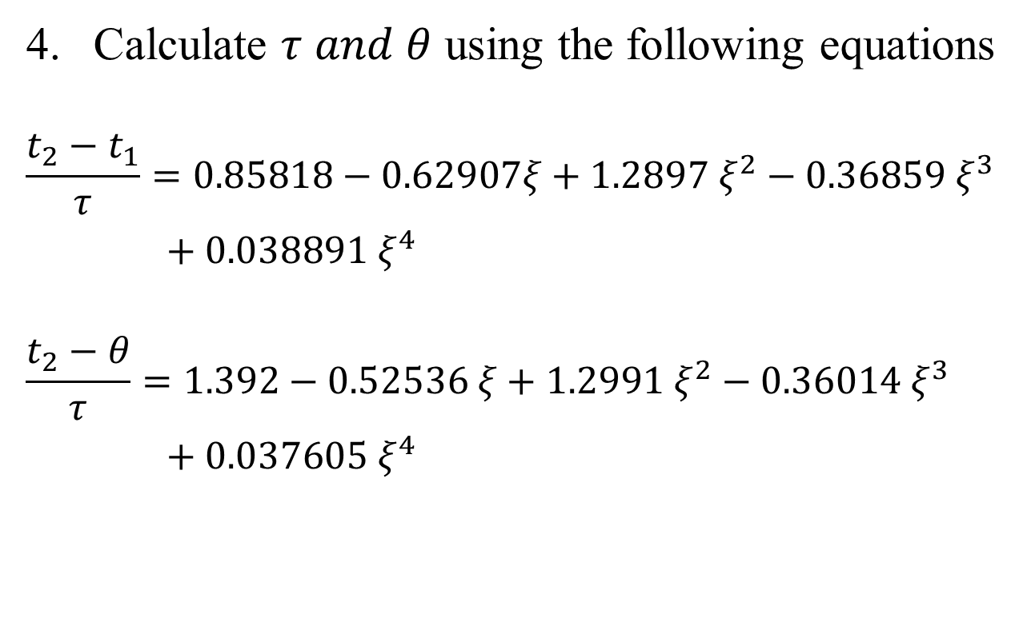
SODT model from step response
Calculate $τ and θ$ using the following equations
$$\frac{t_{2}−t_{1}}{τ}=0.85818−0.62907ξ+1.2897{ ξ}^{2}−0.36859{ ξ}^{3}$$
$+ 0.038891 ξ^{4}$
$$\frac{t_{2}−θ}{τ}=1.392−0.52536 ξ+1.2991 ξ^{2}−0.36014 ξ^{3}$$
$+ 0.037605 ξ^{4}$

Slide 23
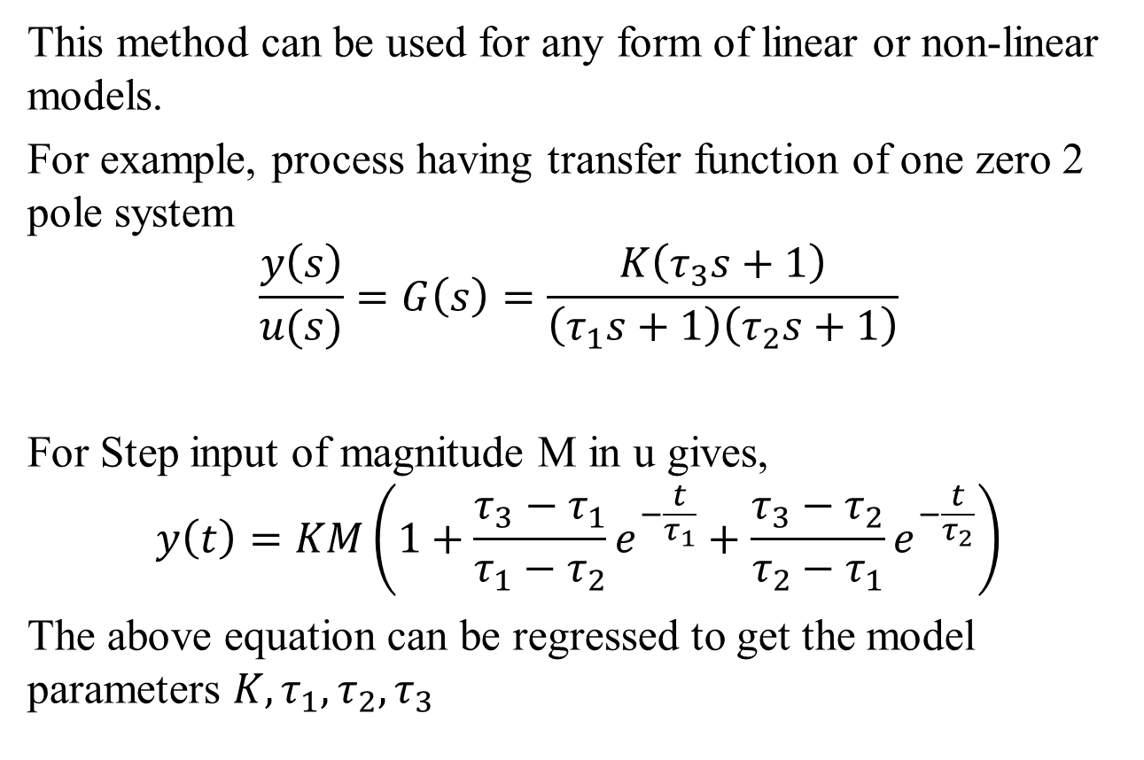
Non-linear Regression
This method can be used for any form of linear or non-linear models.
For example, process having transfer function of one zero 2 pole system
$$\frac{y\left(s\right)}{u(s)}=G\left(s\right)=\frac{K\left(τ_{3}s+1\right)}{\left(τ_{1}s+1\right)\left(τ_{2}s+1\right)}$$
For Step input of magnitude M in u gives,
$$y\left(t\right)=KM\left(1+\frac{τ_{3}−τ_{1}}{τ_{1}−τ_{2}}e^{−\frac{t}{τ_{1}}}+\frac{τ_{3}−τ_{2}}{τ_{2}−τ_{1}}e^{−\frac{t}{τ_{2}}}\right)$$
The above equation can be regressed to get the model parameters $K, τ_{1}, τ_{2}, τ_{3}$

Slide 24
Matlab Implementation
Step response data:
t | 0 | 1 | 2 | 3 | 4 | 5 | 6 | 7 | 8 | 9 | 10
u | 1 | 1 | 1 | 1 | 1 | 1 | 1 | 1 | 1 | 1 | 1
y | 0 | 0.058 | 0.217 | 0.36 | 0.488 | 0.6 | 0.692 | 0.772 | 0.833 | 0.888 | 0.925
Use command
mdl = procest(data, Type)
Where, data should stored in iddata format.
Type =‘P2DUZ’ [ 2 poles, delay, U underdamped, Z zero]
>> u=[0;0;0;u]; y=[0;0;0;y]; % for step changes
>> z = iddata(y, u, 1); % y and u should be column vectors
>> mdl= procest(z,’P2DUZ’);
‘procest’ can work for step as well as arbitrary input changes.

