Slide 1




PNEUMONIA DETECTION FROM CHEST X-RAY: A DEEP LEARNING APPROACH
Group No. :- 40
Project Mentor : Prof. Patrali Pradhan
HOD : Dr.(Prof.) Subhankar Joardar
Team Members:
Shubham Prakash (10300120158)
Ruhi Raj (10300120134)
Sayan Digar (10300120147)
Sankhajoti Saha (10300120142)

Slide 2

Purpose and Goals of Our project.
The primary objective of this project is to develop an advanced system for pneumonia detection in chest X-rays, leveraging the power of Convolutional Neural Networks (CNN), DenseNet, Inception Net, and VGG16 models.
The overarching goal is to enhance the accuracy and efficiency of pneumonia diagnosis, contributing to early detection and timely medical intervention.
Improve the accuracy of pneumonia diagnosis in chest X-rays.

Slide 3
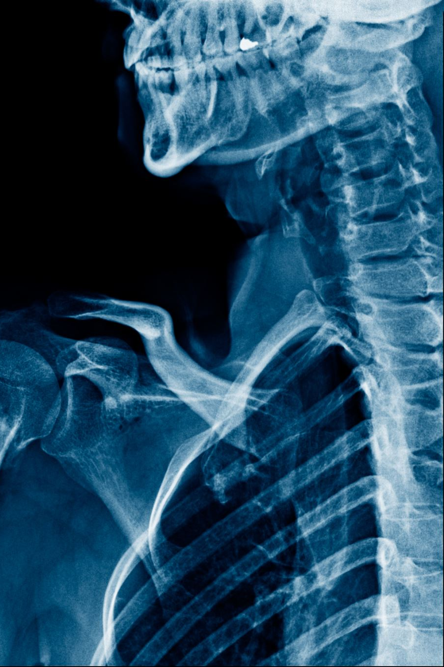
Introduction and Relevance
Introduction :
Chest X-ray pneumonia detection is a critical area in medical imaging, with the potential to significantly impact patient outcomes.
The project focuses on leveraging cutting-edge deep learning models—CNN, DenseNet, Inception Net, and VGG16—for accurate and efficient pneumonia detection.
Relevance :
Pneumonia remains a prevalent and life-threatening respiratory condition.
Timely detection is crucial for prompt medical intervention, yet current methods can be time-consuming and prone to errors.
Our project aims to address these challenges by introducing a robust and rapid diagnostic tool for pneumonia through advanced deep learning techniques.

Slide 4

Literature Review
1. Author : Johnson, A. et al, 2018
Methodologies Overview: Johnson et al. conducted an extensive survey to analyze the methodologies applied in chest X-ray pneumonia detection. Classical methods include image segmentation and feature extraction, while modern approaches involve the application of deep learning architectures like Convolutional Neural Networks (CNNs).
2. Author : Smith, J. et al., 2020
Methodologies Overview: Smith et al. conducted a comprehensive review of various methodologies employed in chest X-ray pneumonia detection. The study encompasses both traditional and deep learning-based approaches.

Slide 5
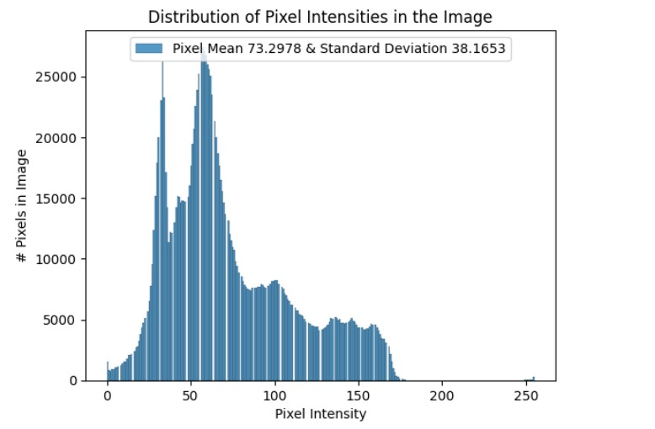

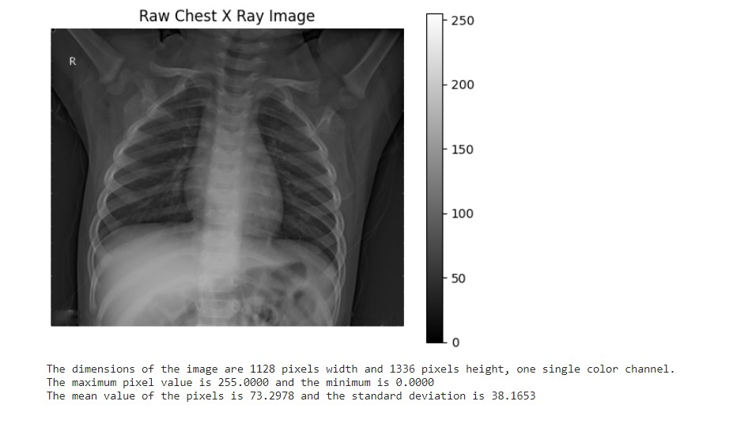
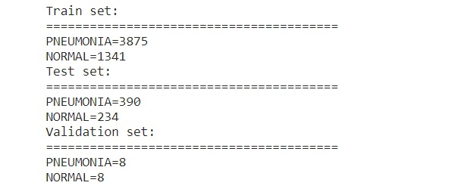
Distribution of Dataset

Slide 6
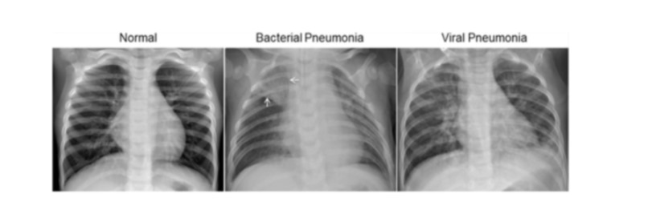
Radiographic Characteristics of Pneumonia
Normal chest X-ray: Clear lungs without any areas of abnormal opacification.
Bacterial pneumonia: Exhibits a focal lobar consolidation, typically in the right upper lobe.
Viral pneumonia: Manifests with a more diffuse interstitial pattern in both lungs.

Slide 7
Technologies and Methods
Deep Learning Models :
1. CNN (Convolutional Neural Network):
Convolutional Neural Networks (CNNs) have demonstrated remarkable success in medical image analysis, including chest X-ray pneumonia detection.
2. DenseNet, Inception Net, VGG16:
They are well-suited for pneumonia detection, particularly in scenarios with limited computational resources.

Slide 8
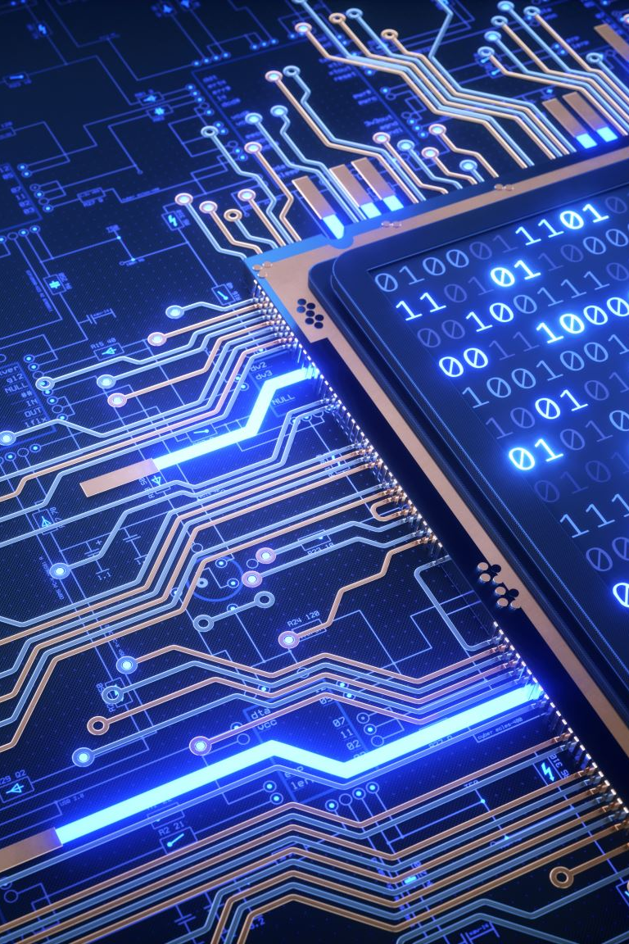
System Hardware/Software Requirements
Hardware:
GPU: NVIDIA GeForce RTX or equivalent
CPU: Intel Core i5 or higher
RAM: 8 GB or higher
Software:
OS: Windows 10 or higher
Python: Anaconda with Python 3.7+
Frameworks: TensorFlow
IDE: Kaggle, Google collab
Version Control: Git

Slide 9

Project Requirements:
1.Objective: Develop a robust pneumonia detection system using deep learning models.
2. Accuracy Target: Achieve a minimum accuracy of 85% in pneumonia detection.
3. Scalability: Design the system to handle a diverse range of chest X-ray images.
4. Real-time Processing : Explore the feasibility of real-time processing for immediate diagnostics.
System Requirements:
1. Platform: Cross-platform compatibility (Linux, Windows, macOS).
2. Scalability: Ability to scale with increased data and user load.
3. Response Time: Ensure low-latency response times for efficient diagnosis.

Slide 10

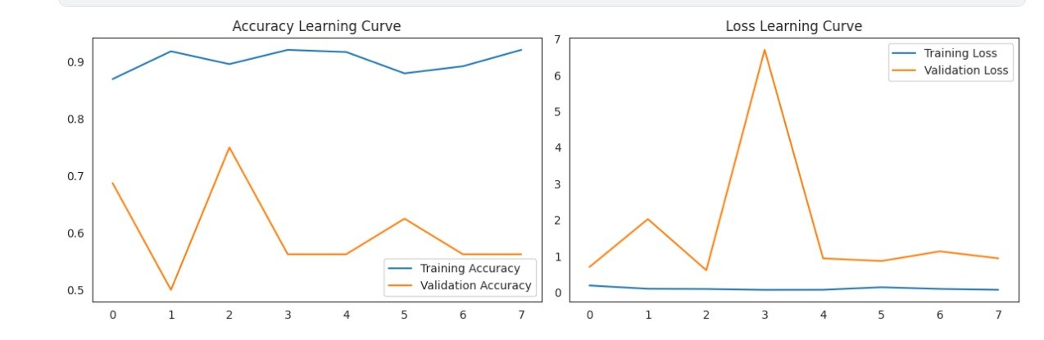
Algorithm used in Project
1.Convolutional Neural Network (CNN):
Specialized in image recognition and pattern detection.
A type of neural network designed for processing grid-like data,
such as images.
Convolutional Layers: Detect features like edges, textures.
Fully Connected Layers: Classify features for final output.

Slide 11
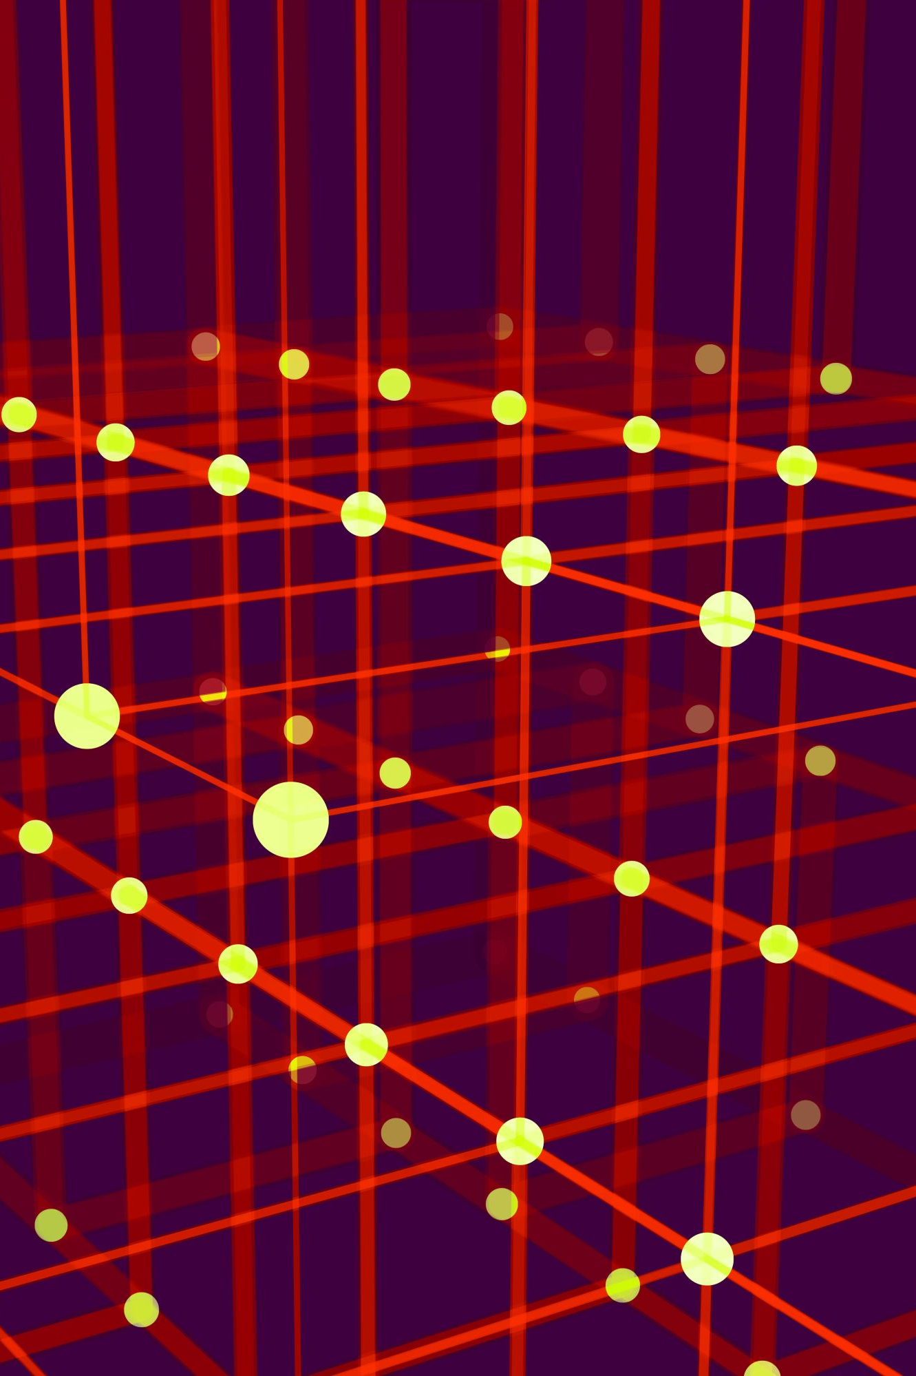
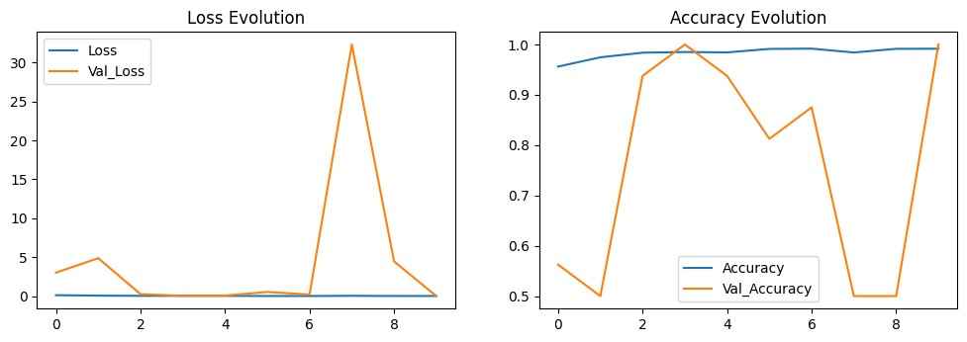
2. DenseNet
Dense connectivity improves feature propagation.
Addresses vanishing gradient problem.
Reduces parameters compared to traditional architectures.
Efficient use of parameters leads to better parameter utilization.
Advantages
Dense Connectivity: Direct connections between layers promote efficient feature reuse.
Reduced Redundancy: Dense connectivity reduces redundancy, optimizing parameter usage.
Disadvantages
Memory Consumption: Due to dense connections, DenseNet may require higher memory usage, limiting its applicability in memory-constrained environments.
Training Time: Training a DenseNet can take longer compared to shallower architectures, especially when working with large datasets.

Slide 12

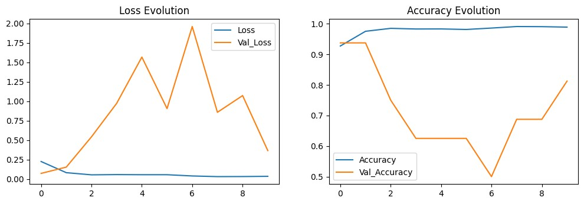
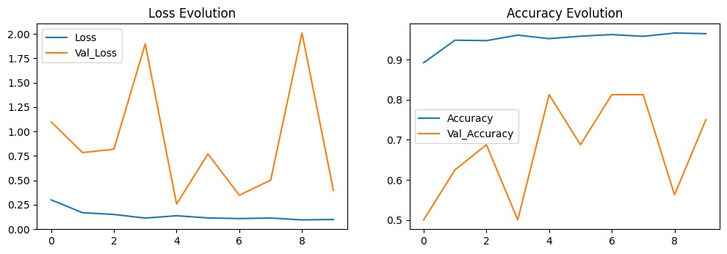
3. Inception Net
Utilizes inception modules for multi-scale feature extraction.
Balances computational efficiency and expressive power.
Suitable for pneumonia detection with its ability to capture diverse features.
Efficient in terms of computational resources.
Incorporates techniques like global average pooling to reduce overfitting.
Captures features at different scales simultaneously.
4. VGG16
Simplicity with uniform architecture.
Small convolutional filters for feature extraction.
Easy to understand and interpret.
Performance comparable to more complex models.
VGG16 achieved high accuracy and was among the top performers in the ImageNet Large Scale Visual Recognition Challenge

Slide 13
Pneumonia Detection System Architecture:
1. Input:
The system takes chest X-ray images as input.
2. Preprocessing:
Perform preprocessing on the input images, including resizing, normalization, and enhancement to prepare them for analysis.
3. Convolutional Neural Network (CNN) Models:
Utilize multiple CNN models such as CNN, DenseNet, Inception Net, and VGG16 for feature extraction and classification.
Each model is trained on a dataset, e.g., Kaggle X-ray dataset, to learn patterns indicative of pneumonia.
4. Thresholding and Decision Making:
Apply a thresholding mechanism to the model predictions to determine whether an input X-ray image is indicative of pneumonia.
Decision-making logic may involve considering the consensus of multiple models for more reliable results.
5. Output:
Provide a binary output indicating the presence or absence of pneumonia in the chest X-ray.

Slide 14
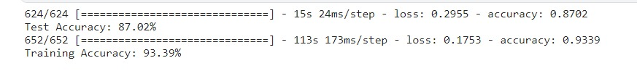
Performance of models
VGG16
INCEPTION MODEL
CNN
DenseNet

Slide 15
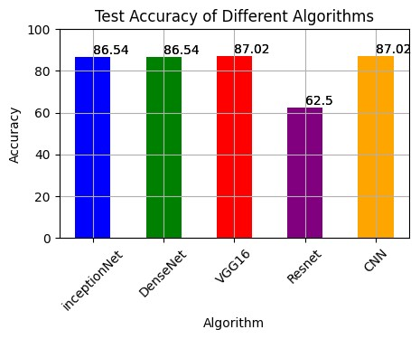
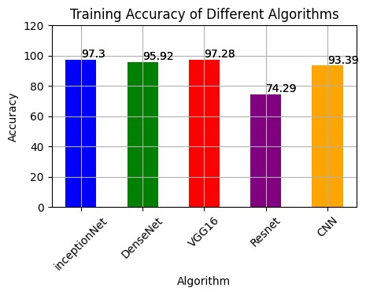
ACCURACY COMPARISON

Slide 16
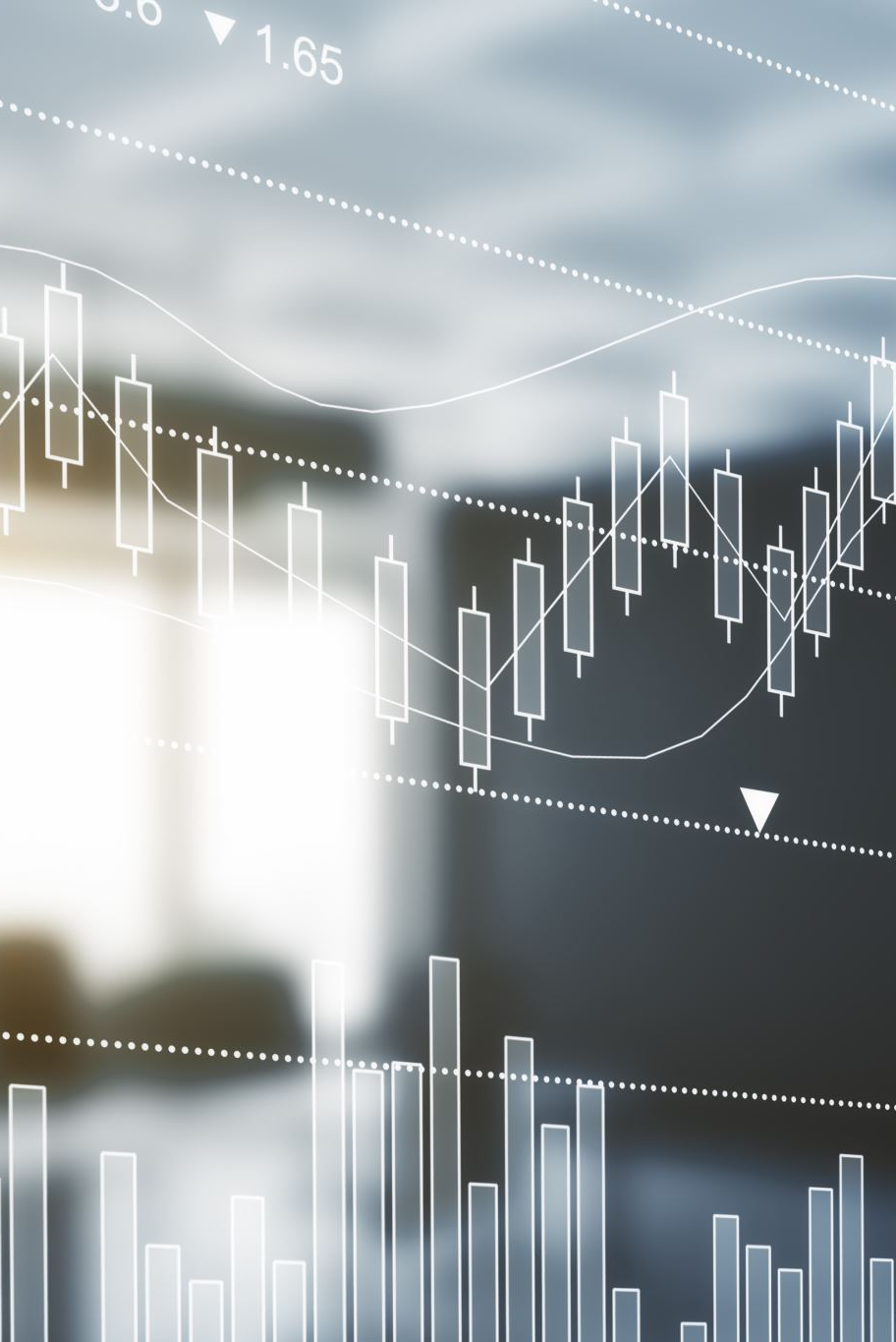
Future Scope
Enhancing the project to support real-time monitoring of patients
Exploration of ensemble methods combining multiple architectures.
Investigation of different preprocessing techniques and hyperparameter adjustments.
Integrating explainable AI features into the model can provide insights into the decision-making process.

Slide 17

Conclusion
This study provides a comprehensive assessment of deep learning algorithms—CNN, VGG16, DenseNet,ResNet and InceptionNet—in the context of pneumonia detection.
To overcome pneumonia, the infection must be detected in the early stages.
Detection is most easily accomplished with chest X-rays due to the cost effectiveness in comparison with other methods of diagnosis
We have critically reviewed relevant contributions of authors, who proposed to use neural networks to detect pneumonia and compared their results and methodology.

Slide 18
References
Mooney, P. (2017). Chest X-Ray Images (Pneumonia). Kaggle.
https://www.kaggle.com/datasets/paultimothymooney/chest-xray-pneumonia
IBM Cloud Education. (2020, July 15). Machine Learning.
https://www.ibm.com/cloud/learn/machine-learning
Oracle. (n.d.). What is deep learning?
https://www.oracle.com/artificial-intelligence/machine-learning/what-is-deep-learning/

