Slide 1
Mutual Fund Analytics Platform
Prepared by: Sayandip Sen
Email: sayandipsen03@gmail.com
Organization: Bluestock Fintech

Slide 2
Problem Statement & Objectives
Problem Statement
The mutual fund industry generates large volumes of financial and investor data. Extracting meaningful insights from this data requires a structured analytics platform capable of integrating data engineering, financial analysis, and business intelligence.
Project Objectives
Build a complete ETL pipeline
Analyze mutual fund performance
Evaluate investor behavior and SIP trends
Develop risk analytics models
Create interactive Power BI dashboards
Generate actionable investment insights

Slide 3
Data Sources
Dataset | Purpose
Fund Master | Scheme metadata
NAV History | Daily NAV analysis
Scheme Performance | Return and risk metrics
Investor Transactions | Investor behavior analysis
AUM by Fund House | Industry growth analysis
SIP Inflows | SIP trend analysis
Category Inflows | Fund category analysis
Portfolio Holdings | Sector allocation analysis
Benchmark Indices | Market comparison

Slide 4
System Architecture
Raw CSV Data
↓
Data Extraction
↓
Data Cleaning & Validation
↓
Feature Engineering
↓
SQLite Database
↓
Analytics Layer
↓
Power BI Dashboard
↓
Business Insights

Slide 5
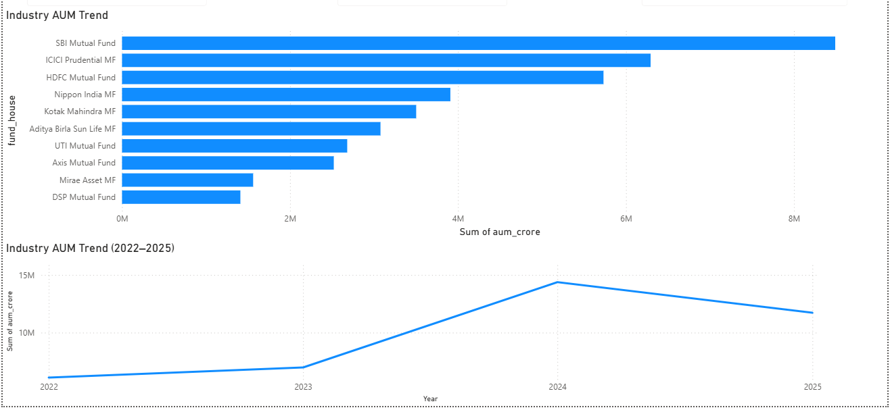
EDA Highlights – Industry Analysis
Industry Growth Trends
Industry AUM demonstrated consistent growth from 2022–2025.
SIP contributions reached approximately ₹31,000 Crore.
Folio count increased significantly during the analysis period.
Major AMCs continue to dominate market share.

Slide 6
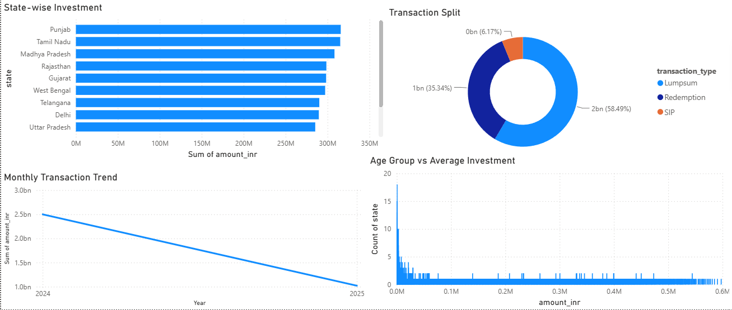
EDA Highlights – Investor Analysis
Investor Behavior Analysis
Significant participation from working-age investors.
SIP remains the dominant investment mode.
Tier-1 cities contribute a major share of investments.
Strong participation observed across multiple states.

Slide 7
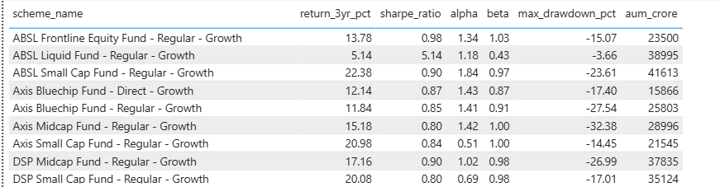
Performance Metrics – Return Analysis

Slide 8
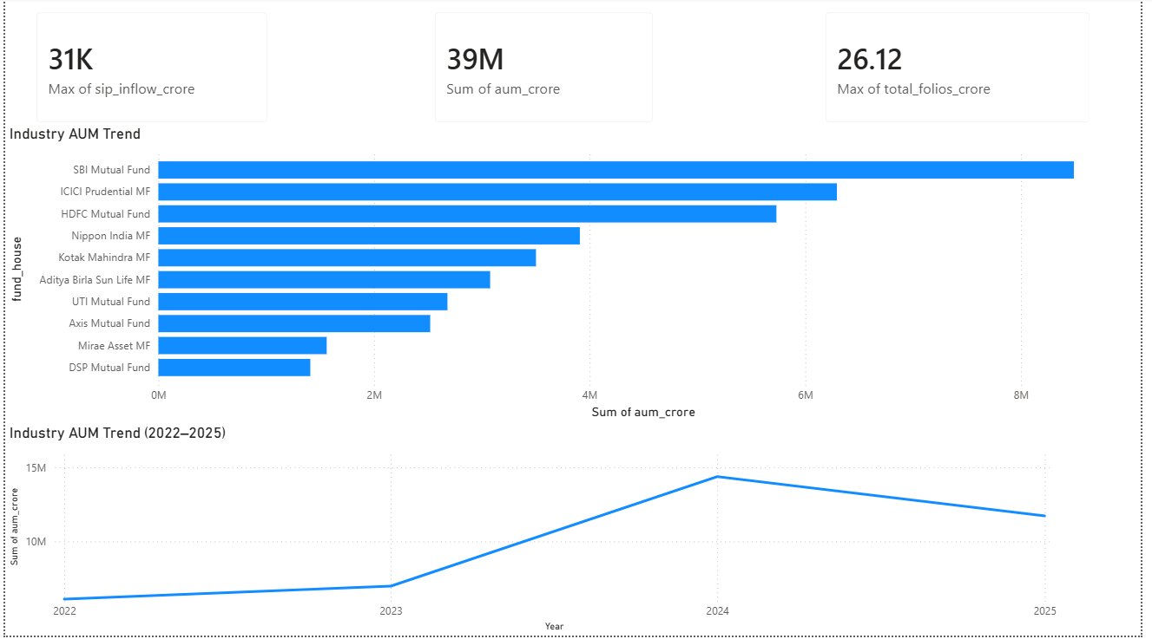
Dashboard – Industry Overview

Slide 9
Key Findings & Recommendations
Key Findings
Mutual fund industry exhibited strong growth between 2022 and 2025.
SIP inflows reached record levels.
Leading AMCs maintained dominant market positions.
Risk-adjusted metrics identified top-performing schemes.
Investor participation continued to expand across regions.

Slide 10
THANK YOU

