Slide 1
NAME: sayan ghosh
STREAM: BCA(2ND YEAR)
SECTION: gamma; Sem: 3rd
PAPER NAME: DATA STRUCTURE and algorithm
PAPER CODE: BCAC 303
UNIVERSITY ROLL NO: 15201222165
TOPIC: “LINKED LIST”

Slide 2
PRESENTATION ON
“LINKED LIST”
INTRODUCTION: Linked list is the most sought-after data structure when it comes to handling dynamic data elements. A linked list consists of a data element known as a node and each node consists of two fields
one field has data and in the second field ,the node ,the node has an address that keeps a reference to the next node.

Slide 3
what is a linked list?....
A linked list is a linear data structure that stores a collection of data elements dynamically.
Nodes represent those data elements, and links or pointers connect each node.
Each node consists of two fields, the information stored in a linked list and a pointer that stores the address of its next node.
The last node contains null in its second field because it will point to no node.
A linked list can grow and shrink its size, as per the requirement.
It does not waste memory space.

Slide 4
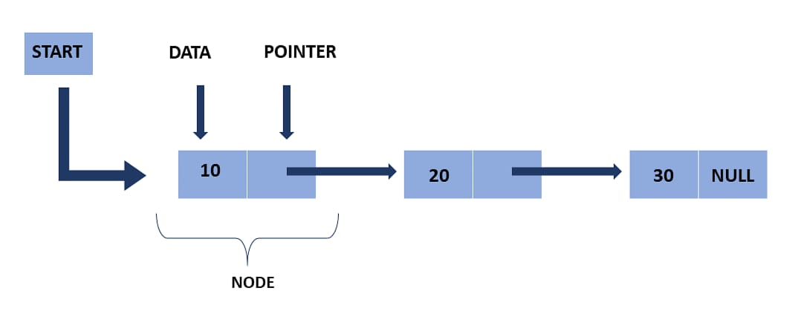
Representation of a linked list: This representation of a linked list depicts that each node consists of two fields . The first field consists of data and the second field consists of pointers that point to another node.

Slide 5
Types of linked list:
The linked list mainly has three types, they are:
1. singly linked list
2. doubly linked list
3. circular linked list

Slide 6
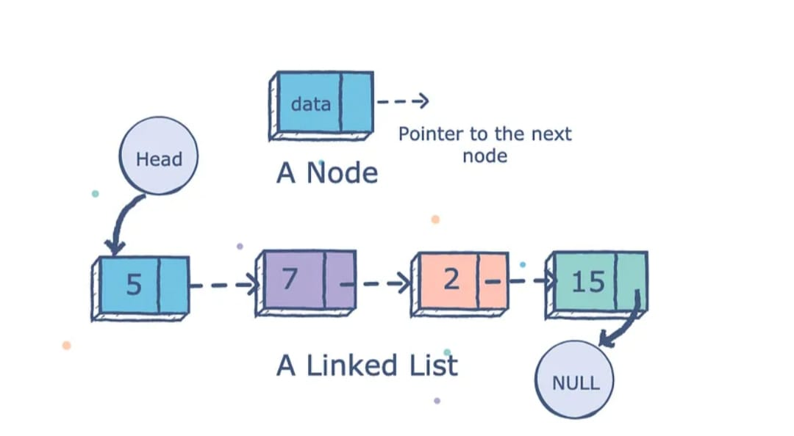
Structure of linked list:

Slide 7
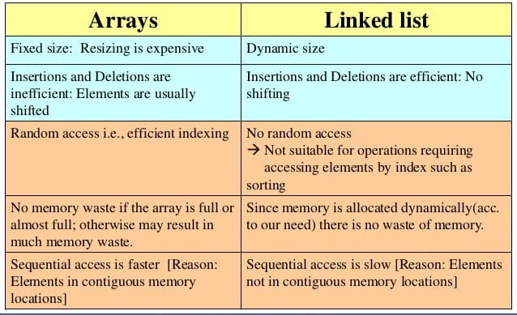
Array vs linked list:

Slide 8
Basic operation on linked list:
The basic operations in the linked lists are insertion, deletion, searching and display an element at a given key. These operations are performed on Singly Linked Lists as given below −
Insertion − Adds an element at the beginning of the list.
Deletion − Deletes an element at the beginning of the list.
Display − Displays the complete list.
Search − Searches an element using the given key

Slide 9
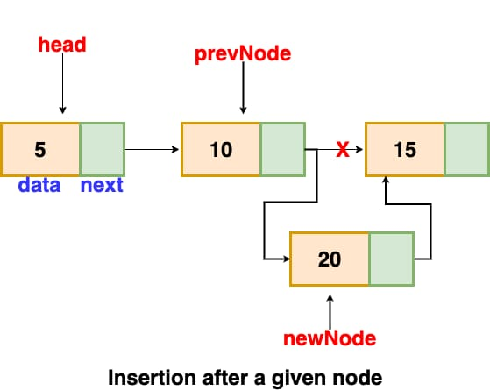
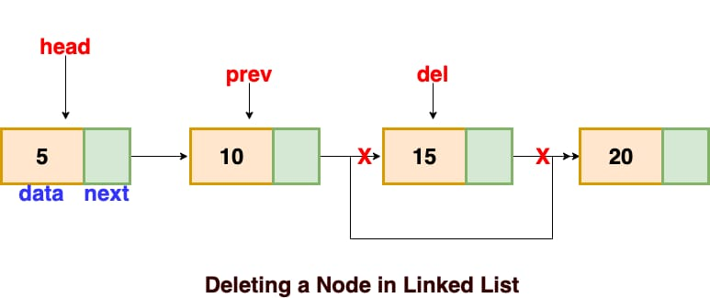
Insertion operation & deletion operation

Slide 10
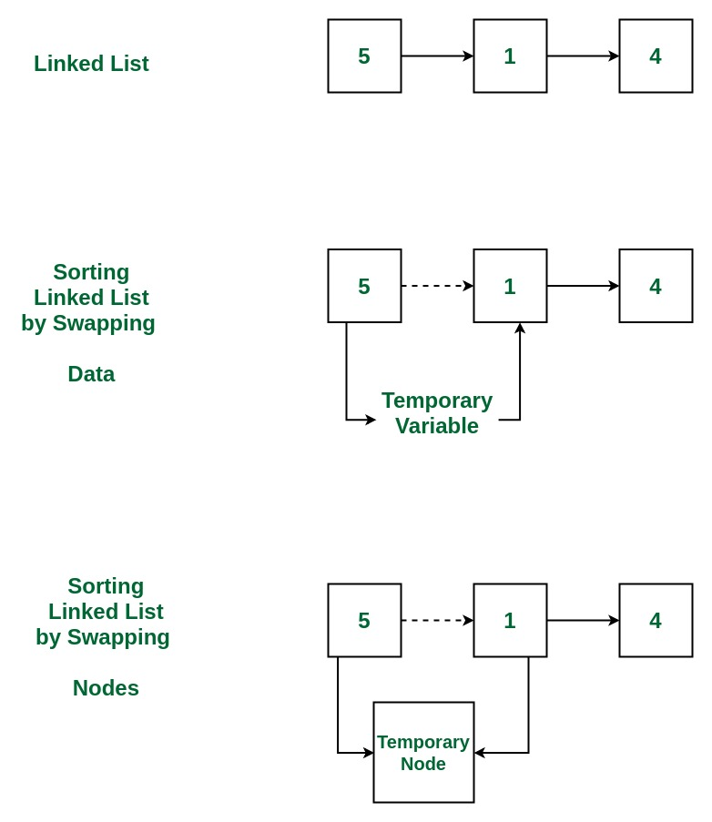
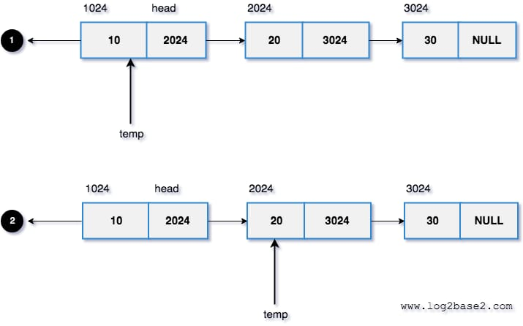
Search & sort operation in linked list

Slide 11
END

