Slide 1
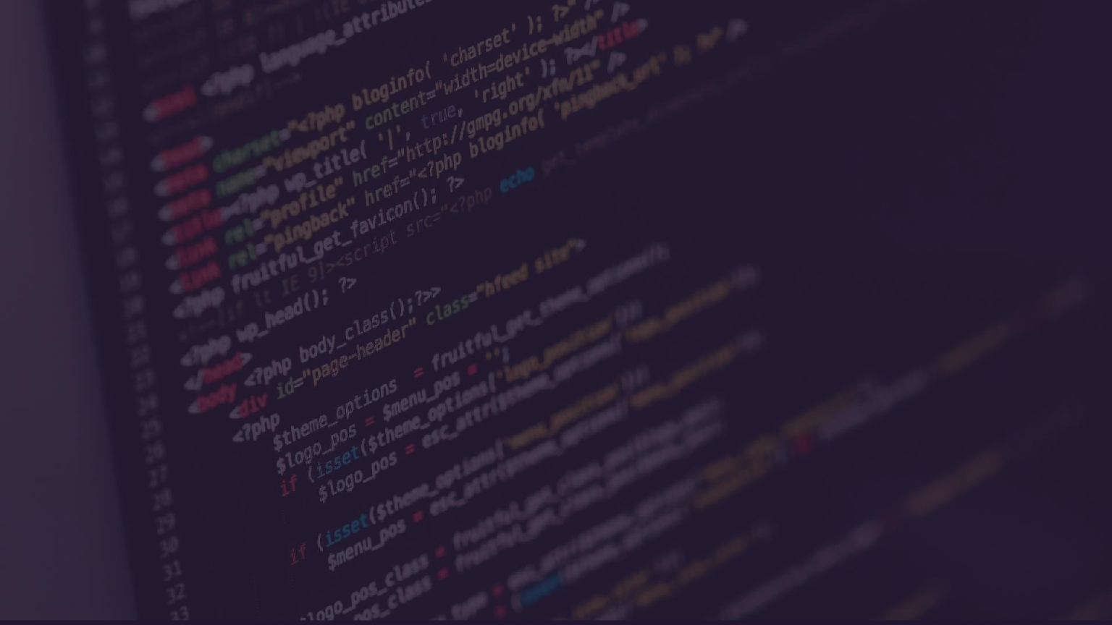
C vs Java:
Welcome to my comparison of C and Java - two popular programming languages utilized in creating software and applications. We'll break down the key differences and help you navigate the decision-making process.
BY SAYAN GHOSH
BCA 2ND YEAR (3rd SEMESTER)
ROLL NO. – 15201222165
PAPER CODE:- BCAC301
SEC: GAMMA
SUBJECT:-OBJECT ORIENTED PROGRAMMING (JAVA)

Slide 2
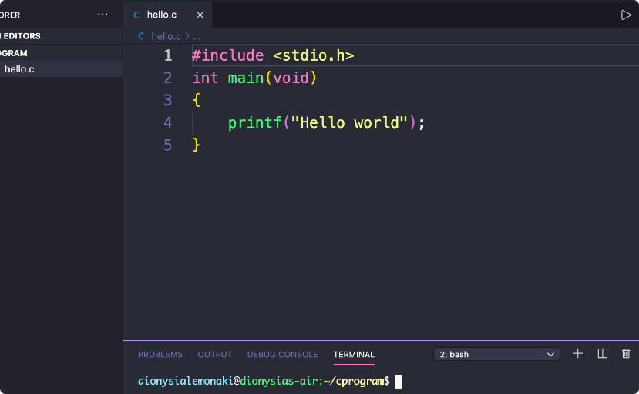
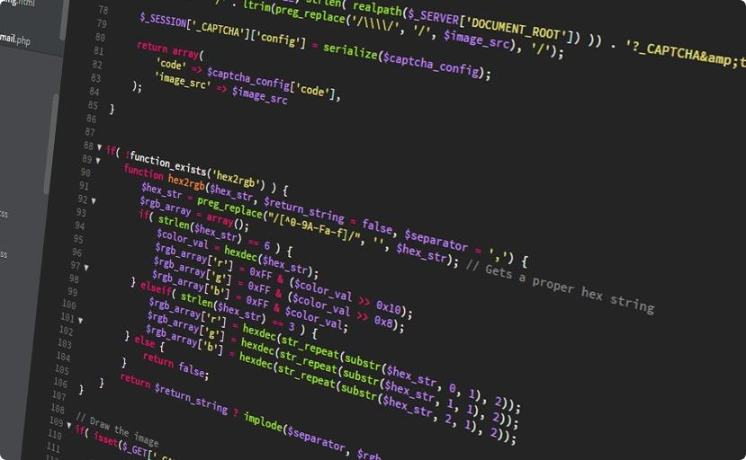
Overview of C and Java
C Programming Language
Java Programming Language
Created by Dennis Ritchie, C is a low-level programming language used for creating hardware, operating systems, and applications with specific memory requirements.
Developed by James Gosling, Java is an object-oriented language that uses a virtual machine to support cross- platform compatibility and simplify development.

Slide 3
Pros and Cons of C
Efficiency
Portability
Learning Curve
C runs very close to the machine level, and has minimal runtime. As a result, it is often used in applications where performance is critical.
C is easy to port to different architectures and operating systems, and can be used to develop software for platforms with limited resources.
C exposes the complexities of computer architecture and memory management, requiring a deep understanding of the language, making it less beginner- friendly.

Slide 4
Pros and Cons of Java
Garbage Collection
Java automatically manages memory allocation, freeing developers from manual memory management tasks. However, this feature can lead to slower execution and increased memory usage.
1
2
3
Platform Independence
Learning Curve
Java code can run on any platform with Java Virtual Machine support, eliminating the need to re-write applications for each individual platform.
Java was designed to be more beginner-friendly than C,
with a simple syntax that is easier to read and write.

Slide 5
Performance | Comparison
Factor | C | Java
Memory Management | Manual | Automatic
Execution Speed | Faster | Slower
Platform Independence | Difficult | Effortless

Slide 6
Conclusion
1
Choose C if:
You require a high-performance programming language that can interface efficiently with hardware and you have the expertise to implement low-level programming functions.
2
Choose Java if:
You want to build software that can be easily ported to multiple platforms, and you value the simplicity and ease of development.

Slide 7
Acknowledgement
I would like to express my special thanks of gratitude to my teacher for her able guidance and support in completing my presentation.
- THANK YOU…

