Slide 1

OPERATING SYSTEM
Topic :- operating system and their types
Name :- SAYAN GHOSH
Roll No. :- 15201222165
Stream :- BCA
Sem :- 3rd
Paper Code :- BCAC302
Paper Name :- Operating System

Slide 2
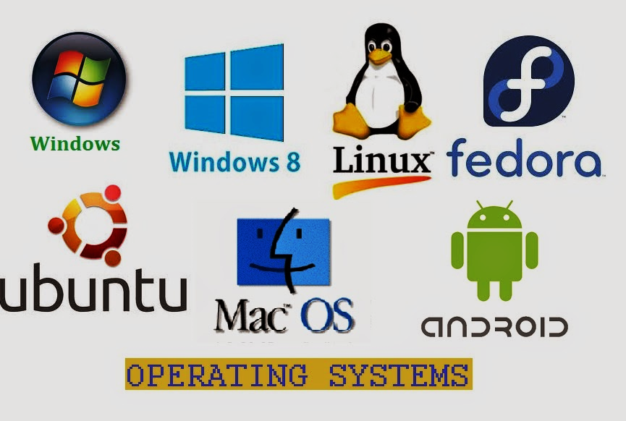
What is operating system ?
An operating system is a program that acts as an interface between the user and the computer hardware and it controls the execution of all kind of programs. It is also known as resource manager of the system.
Examples :- Microsoft Windows, Linux,
macOS etc.

Slide 3
Operating system as resource manager
Operating System is called recourse manager as it manages different resources like main memory, CPU, I/O devices so that each resource is used optimally and system performance doesn't deteriorate.

Slide 4
Types of operating system
There are FIVE Types of Operating System
Batch OS
Batch Operating System
Time Sharing Operating System
Network Operating System
Real Time Operating System
Distributed Operating System
Time Sharing OS
Distributed OS
Operating System
Network OS
Real Time OS

Slide 5
Batch Operating System
JOB 1
Operating System
Batch
CPU
JOB 1
Batch
JOB 1
Batch
An Operating System that allows multiple user to use it, without direct communication between them. It achieve this by keeping all users in separate ‘batches’ means they cannot interact with each other directly

Slide 6
Time sharing operating system
User 3
User 4
CPU
User 2
User 5
Active state
User 1
User 6
Ready state
It is a type of Operating system in which user can perform more than one task and each task gets the same amount of time to execute. It is also called a multitasking operating system

Slide 7

Network operating system
Client 2
Sends Request
Response from server
Client 1
Response from server
Client 3
HUB
Sends Request
Sends Request
Request
Server
Client 4
Client 5
Auxiliary storage
It is a specializes operating system for a network devices such as a router switch or firewall.

Slide 8
Real time operating system
User
Application program
RTOS
Hardware
A Realtime Operating System (RTOS) is a type of operating system. That acts as an interface between the system hardware and the user. It handle all the interactions between the software and the hardware. It is used in real time systems where the time constraints are fixed and followed strictly. This means the response time is very small. Moreover the system should perform the given task in a fixed time otherwise, it results in a system failure. Response time is the time within which the system takes the input, processes the data, and gives the results. Moreover they are used in systems like robots, missile launches, airplanes etc.

Slide 9
Distributed operating system
CPU
Memory
Disk
CPU
Memory
Operating system
CPU
Memory
Disk
CPU
Memory
Disk
A distributed operating system is an important type of operating system. A program that acts as an interface between the system hardware and the user. Moreover it handles all the interactions between the software and the hardware. A distributed operating system is the one in which several computer systems connected through a single communication channel. Moreover, these system have their individual processors and memory.

