Slide 1
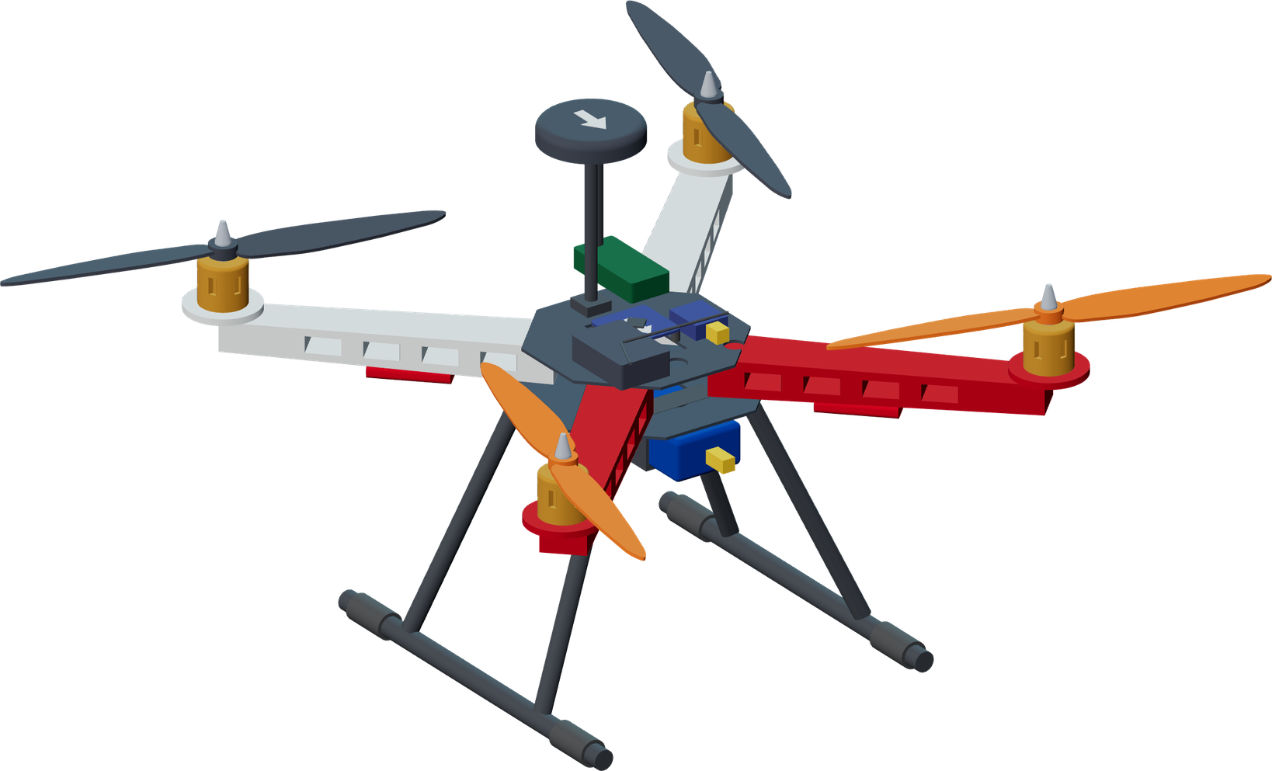
PROJECT NAVI // VIT CHENNAI [SCOPE • SENSE • SMEC] // 20% WORK COMPLETION REVIEW
20% REVIEW MILESTONE
NAVI
Navigation Assistant for Visitor Interaction
An Autonomous Micro Aerial Vehicle for Outdoor Campus Visitor Guidance
REVIEW 20% Work Completion Review
INSTITUTION Vellore Institute of Technology, Chennai
SCHOOLS SCOPE • SENSE • SMEC
COURSE [COURSE CODE] · DATE [REVIEW DATE]
GUIDE [FACULTY NAME / PROJECT GUIDE]
TEAM
REG. NO.
SCHOOL
DESIGN MODEL · NOMINAL F450 LAYOUT · NOT A PHOTOGRAPH
Carollo Aradhan V
26BMH1173
SMEC
Utkarsh Dilipkumar Ghorpade
26BEC1215
SENSE
N Arun
26BCE1550
SCOPE
Signed by faculty:
Muhammed Farhan
26BCE1551
SCOPE
Sayanjeet Das
26BCE5502
SCOPE
[ 01 / 18 ]
Notes:
[TIME 0:30 · SUGGESTED SPEAKER: Sayanjeet Das (suggestion, team to confirm)]
SAY: Good morning. We are presenting NAVI, the Navigation Assistant for Visitor Interaction: a proposed GPS quadcopter that leads a walking visitor along mapped, inspected outdoor campus routes. This is our 20% work-completion review: what is designed, computed and simulated so far, and what still needs physical validation.
INTRODUCE TEAM (names/registrations on slide). Proposed workstreams are in backup A09.
CLICKS: none. Title slide is static so the signing area always prints.
SIGNATURE: The box at bottom-right is deliberately blank for a real pen signature. No faculty signature has been supplied, so the signed-and-scanned Slide 1 remains pending. Do not trace or generate a signature. If a genuine signed scan is supplied, insert it as Slide 1 and keep this editable cover in backup.
PLACEHOLDERS: [COURSE CODE], [REVIEW DATE], [FACULTY NAME / PROJECT GUIDE] must be filled by the team.
SOURCES: Team names, registration numbers and schools are from NAVI_Project_Summary.pdf (status date 12 Oct 2026), p.1 and §2 (pp.3–4). The aircraft image is the supplied NAVI CAD design model (NAVI_CAD/models/navi_f450.glb, rendered for this deck). It is not a photograph of a built aircraft.
TERMINOLOGY: NAVI leads the visitor. Where older material says "follow-me", say "leads", because the aircraft flies ahead.

Slide 2
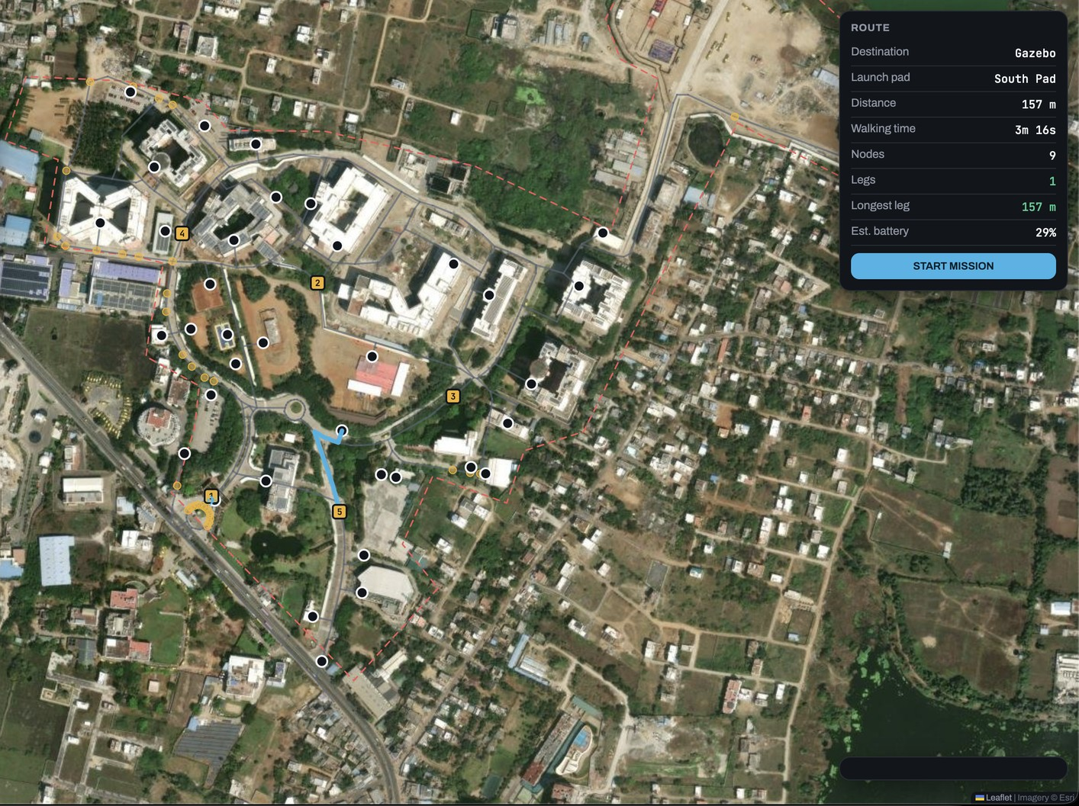
First-time visitors must translate maps into movement
PROJECT NAVI // VIT CHENNAI [SCOPE • SENSE • SMEC] // STAGE 01: PROBLEM
// PROBLEM IDENTIFICATION
01 ARRIVE AT GATE
02 READ SIGN / MAP
03 SELF-LOCALISE
04 MAP → TURNS
05 ARRIVE OR ASK
Visitor knows a destination name, not the campus.
Board or phone shows a map, not a route.
"Where am I on this map?" The friction step.
Relate map to paths, kerbs and buildings.
Success, or ask a busy person for help.
CONCEPTUAL JOURNEY · NOT OBSERVED DATA
WHO
WHY MAPS FALL SHORT
42.2 ha
CAMPUS AREA (OSM POLYGON)
453 m
MEDIAN GATE→DESTINATION (GRAPH)
First-time visitors: mostly visiting parents and guests. Demand peaks on event days, when staff are busiest.
Signage is passive, escorts do not scale, and phone maps carry little internal campus path detail.
COMPUTED / SOURCE-REPORTED
NAVI live map (simulation) · Imagery © Esri · Leaflet
STATUS // PROBLEM FRAMING · CONCEPTUAL JOURNEY
SRC: Summary §1 p3; §9 p8
[ 02 / 18 ]
Notes:
[TIME 0:45 · SUGGESTED SPEAKER: Sayanjeet Das (suggestion)]
SAY: The users are first-time visitors, mostly visiting parents and guests. Every wayfinding aid we have today, from signs to phone maps, asks the visitor to do one step first: find themselves on the map, then turn that into a sequence of turns. That self-localisation step is the friction NAVI targets.
CLICK 1: journey nodes 01→05 rise in sequence; step 03 (self-localise) is amber because it is the friction point.
CLICK 2: the three context cards and campus image appear.
CAVEAT: The journey is a conceptual illustration, not observed visitor data. We have not measured how often visitors get lost. The summary describes the problem qualitatively. A visitor study is part of validation.
NUMBERS (COMPUTED / SOURCE-REPORTED, Summary §9 p8): campus 42.2 ha; median graph distance from main gate 453 m, max 1,264 m (E Block Hostel); 36 mapped destinations. These are computed graph distances, not walked measurements.
IMAGE: NAVI software live-map screenshot (webpage1.png) on Esri World Imagery; it shows simulation state ("NO FIX · SIMULATION").
LIKELY QUESTION: "Is getting lost really a problem?" → We have not measured it. We will report it as a hypothesis and include a short visitor survey or observation in trials.

Slide 3
NAVI adds a physical guide to existing wayfinding
PROJECT NAVI // VIT CHENNAI [SCOPE • SENSE • SMEC] // STAGE 01: PROBLEM
// EXISTING APPROACHES
SIGNAGE
HUMAN ESCORTS
PHONE MAPS
VIT CHENNAI WAYFINDER
Passive
Does not scale
Stops at the gate
Still a map
Shows a map, not a route. The visitor must first find themselves on it.
Demand peaks on event days, exactly when staff and volunteers are busiest.
Consumer apps carry little internal campus path detail.
Excellent building data and 3D geometry, yet self-localisation remains.
NAVI · PROPOSED
SHARED ROUTE DATA
path.json · 278 waypoints · 36 entrances
A visible aerial guide that leads
The aircraft flies ahead along a computed, inspected route and waits when the visitor falls behind, so the visitor never has to self-localise. Effectiveness is untested until supervised trials.
COMPLEMENTARY BY DESIGN
The wayfinder remains the data source and the reference map. NAVI adds the physical guide.
STATUS // COMPARISON · NAVI COMPLEMENTS, DOES NOT REPLACE
SRC: Summary §1 p3; §9 p8
[ 03 / 18 ]
Notes:
[TIME 0:45 · SUGGESTED SPEAKER: Sayanjeet Das (suggestion)]
SAY: Each existing approach works, but each leaves a step to the visitor. The official VIT Chennai wayfinder has excellent building data and 3D geometry. It is still a map, so the visitor must still self-localise. NAVI is complementary. Its route graph is built from the wayfinder's own path dataset.
CLICK 1: the four cards stagger in (0.08 s apart).
CLICK 2: the shared-data line traces from the wayfinder card into the NAVI card, then the NAVI card appears.
CAVEAT: We do not claim maps fail or that NAVI improves outcomes. Both are untested. The comparison is structural (what step each approach leaves to the visitor).
SOURCES: Summary §1 (p3) for the four approaches; §9 (p8) for path.json: 278 waypoints, connection lists, 36 building entrances, one-way constraints. Attribution: path graph and building entrances derived from the VIT Chennai Way Finder dataset (Summary App. B).
LIKELY QUESTION: "The campus already has a wayfinder." → Yes, and its data is our source. NAVI targets the self-localisation step that any map leaves.

Slide 4
The problem is safe guidance at a visitor's walking pace
PROJECT NAVI // VIT CHENNAI [SCOPE • SENSE • SMEC] // STAGE 01: OBJECTIVES
// PROBLEM STATEMENT & OBJECTIVES
PROBLEM STATEMENT Design and demonstrate an outdoor campus guidance system in which a GPS quadcopter leads a visitor along mapped, inspected routes, adapts to walking pace, and responds predictably to stale position, link loss, and other faults under supervised operation.
O1
Route graph & paths
O2
Waypoint integration
O3
Adjustable lead / hold
O4
Zero-install interface
O5
Staged safety validation
VERIFY BY
Every uploaded target is a surveyed node; all 36 destinations reachable.
VERIFY BY
Repeatable node-to-node route flight in SITL, then supervised field flight.
VERIFY BY
Holds when the visitor stops; thresholds set from measured GPS error.
VERIFY BY
Destination choice and position sharing from a phone browser or kiosk.
VERIFY BY
Every failsafe triggered and observed, props-off first.
IN SCOPE Outdoor surveyed paths · 36 destinations with inspected routes · one visitor or small group · daytime, fair weather · supervised operation
OUT OF SCOPE Indoor · night or bad weather · multiple visitors · charging docks · payloads · live obstacle detection & dynamic re-routing
STATUS // OBJECTIVES · VERIFY-BY CRITERIA ARE PROPOSED ACCEPTANCE TARGETS
SRC: Summary §1 p3; §12 p11; §16 p13
[ 04 / 18 ]
Notes:
[TIME 0:55 · SUGGESTED SPEAKER: Sayanjeet Das (suggestion)]
SAY (problem statement): Design and demonstrate an outdoor campus guidance system in which a GPS quadcopter leads a visitor along mapped, inspected routes, adapts to walking pace, and responds predictably to stale position, link loss and other faults under supervised operation.
CLICK 1: objectives O1–O3 appear. CLICK 2: O4–O5. CLICK 3: scope strip.
EXPLAIN each objective's VERIFY-BY line: these are proposed acceptance targets, not achieved specifications. O1 is partly met computationally (one connected graph, all 36 destinations reachable; Summary §9). Everything involving the aircraft is pending.
SCOPE (Summary §1 p3): in scope: outdoor flight over surveyed paths, pre-generated inspected routes to 36 destinations, one visitor or small group, daytime fair weather, supervised operation. Out of scope: indoor, night/bad weather, multiple simultaneous visitors, charging docks, payloads, and live obstacle detection or dynamic re-routing.
SOURCES: Summary §1 (p3) scope; §12 (p11) failsafe responses; §16 (p13) verification gates.
LIKELY QUESTION: "Why not live obstacle detection?" → Out of scope at this stage. Routes are pre-inspected, cruise altitude is surveyed per segment (pending), and a safety operator holds an independent RC link. See A15.

Slide 5
Research frames aerial guidance and human comfort
PROJECT NAVI // VIT CHENNAI [SCOPE • SENSE • SMEC] // STAGE 02: LITERATURE
// LITERATURE SURVEY 1/4 · HUMAN–DRONE INTERACTION
U05
DroneNavigator
2017 · FOUNDATIONAL
U04
HDI survey
2019 · FOUNDATIONAL
METHOD 14 visually impaired participants; free-floating vs leashed quadcopter vs audio, indoor routes.
FOUND Free-floating guide faster than audio; fewer navigation errors with both drone modes; noise disliked.
→ NAVI Aerial lead is a credible cue. NAVI must test its own outdoor case.
METHOD Survey of HDI: control modalities, communication, proxemics, roles and prototypes.
FOUND Approach distance varies with culture and drone design; propeller safety and flight time are key limits.
→ NAVI Treat distance, noise and flight time as design variables to measure.
S01
Preferred human–drone distance
2024 · RECENT
S02
HDI in older adults
2026 · RECENT
METHOD Two AR/VR experiments (N=28, N=20) with a virtual 25 cm drone at varied height and approach.
FOUND Preferred distance ≈1.6–1.9 m, larger above eye level. Virtual drone, young samples.
→ NAVI Does not validate the 15 m lead. Measure comfort in supervised trials.
METHOD PRISMA review of 13 studies (2016–2025) with adults aged 65+, mostly health and home contexts.
FOUND Acceptance tied to usability, perceived safety and familiarity; noise and size raise concern.
→ NAVI Include older visitors in trials; keep the interface simple.
STATUS // LITERATURE · RECENT WINDOW 2021–2026 · FOUNDATIONAL WORKS MARKED
SRC: Full refs A01–A02 · matrix A03–A08
[ 05 / 18 ]
Notes:
[TIME 0:50 · SUGGESTED SPEAKER: Sayanjeet Das (suggestion)]
RECENT-LITERATURE WINDOW: 2021–2026 (declared for this October 2026 review). Cyan chips = recent; grey = foundational.
CLICK 1: the four cards rise together (0.08 s stagger) and hold.
[U05] Avila Soto et al., ASSETS 2017, DOI 10.1145/3132525.3132556. Read: abstract, apparatus, results and conclusion. 14 visually impaired participants; repeated-measures comparison of free-floating quadcopter (Wizard-of-Oz, ~1 m ahead at shoulder height), leashed quadcopter, and audio navigation on three indoor routes. Task time: free-floating M=82.29 s vs audio M=98.57 s (significant, p<.05). Navigation errors: audio M=0.86 vs both quadcopter modes M=0.14. Workload (RTLX) not significantly different. 8 of 14 still preferred audio, and rotor noise was a complaint. Boundary: different population, tiny 20 g indoor drone, 1 m distance, operator-flown.
[U04] Tezza & Andujar, IEEE Access 2019, DOI 10.1109/ACCESS.2019.2953900. Read: abstract, proxemics and challenges sections, conclusion. Survey of HDI: control modalities, communication, proxemics, prototypes. Reported proxemics studies show culture and drone design change approach distance (e.g. a "social" prototype was allowed ~30% closer). Challenges: propeller safety, short flight time.
[S01] Wögerbauer, von Castell, Welsch & Hecht, Vision 8(4):59, 2024, DOI 10.3390/vision8040059. Full text read. Exp.1 N=28 (HoloLens 2 AR), Exp.2 N=20 (video pass-through), virtual 25 cm sphere drone. Preferred distance grand means 1.84 m and 1.62 m; larger above eye level (1.93 vs 1.78 m, Exp.1); approach angle no effect. Limits: virtual drone, young samples, close range. It does NOT validate NAVI's 15 m lead, which comes from GPS error.
[S02] Gómez-López et al., Drones 10(5):389, 2026, DOI 10.3390/drones10050389. Read: methods, results, conclusions (final ~3% of page not loaded). PRISMA 2020 review, 13 included studies (2016–2025), adults ≥65, health and social contexts. Acceptance linked to usability, perceived safety, familiarity; concerns about noise, airflow, size, privacy. Authors call the field "in its infancy". Do not transfer healthcare/home findings to campus results.
LIKELY QUESTION: "Is 15 m based on comfort research?" → No. 15 m is a design target driven by combined GPS error (Summary §8, §14). Comfort literature (S01) works at 1–2 m in AR. Comfort at NAVI's distances and altitude must be measured in trials.

Slide 6
Navigation research connects human needs to route decisions
PROJECT NAVI // VIT CHENNAI [SCOPE • SENSE • SMEC] // STAGE 02: LITERATURE
// LITERATURE SURVEY 2/4 · WAYFINDING & SOCIAL NAVIGATION
WORK · YEAR
METHOD & CONTEXT
REPORTED FINDING / LIMIT
→ NAVI DECISION
U01
2024 · RECENT
30 participants; landmark photos vs map screenshots vs paper map; 1.7 km route.
Landmark group gained more initial survey knowledge. Small sample, paper aids.
Proposed: arrival cue names the entrance or a visible landmark.
Landmarks aid wayfinding
U07
2017 · FOUNDATIONAL
Server extracts salient OSM features for Android pedestrian instructions.
Works where OSM is complete; weaker where completeness is low.
OSM supplies only the boundary; routes come from the wayfinder graph.
Landmarks from OSM data
U08
2016 · FOUNDATIONAL
Campus app with Voronoi landmark orientation; 14 first-time visitors surveyed.
Users judged it useful and found the highlighted landmarks. Questionnaire only.
First-time campus visitors are a valid target group for NAVI trials.
Selçuk campus navigation
S03
2024 · RECENT
Taxonomies: robot type, planning, situation awareness, evaluation tools.
Mostly ground robots; rotor noise and wind can lower perceived safety.
Treat altitude and noise as comfort variables; pair metrics with user ratings.
Socially aware navigation
STATUS // LITERATURE · DECISION COLUMN = HOW EACH WORK SHAPED NAVI
SRC: Full refs A01–A02 · matrix A03–A08
[ 06 / 18 ]
Notes:
[TIME 0:50 · SUGGESTED SPEAKER: Muhammed Farhan (suggestion)]
CLICK 1: column headers, then rows rise in sequence. CLICK 2: the decision column wipes in from the left.
[U01] Kuys, Haig & Mridha, Applied Sciences 14(17):7814, 2024, DOI 10.3390/app14177814. Read: abstract, method summary, discussion and conclusions. 30 participants in three groups (landmark photo booklet, Google Maps screenshots, paper map) on a 1.7 km pre-set route. The landmark group acquired more initial survey knowledge; landmarks helped on short pre-set routes. Ethics approval dates to 2016, so the data are older than the 2024 publication. Limits: small sample, paper aids, no aerial guide.
[U07] Rousell & Zipf, ISPRS IJGI 6(3):64, 2017, DOI 10.3390/ijgi6030064. Read: abstract, introduction, conclusions. Prototype server extracting landmarks from OSM for Android pedestrian instructions; effectiveness falls where OSM completeness is low. NAVI uses OSM only for the campus boundary; the route graph comes from the wayfinder dataset.
[U08] Selvi, Bildirici & Ulugtekin, IOP Conf. Ser.: Earth Environ. Sci. 44:042027, 2016, DOI 10.1088/1755-1315/44/4/042027. Full text read (short paper). Campus pedestrian navigation prototype with Voronoi-based landmark orientation; usability questionnaire with 14 first-time visitors to the campus. Questionnaire only, single route.
[S03] Singamaneni et al., IJRR 2024, DOI 10.1177/02783649241230562 (arXiv 2311.06922v4). Partial read: taxonomy sections of the arXiv HTML; evaluation and future-challenge sections were truncated. Four taxonomies: robot type; planning & decision-making; situation awareness & assessment; evaluation & tools. About 18 surveyed works concern aerial robots; rotor noise and wind can lower perceived safety. Mostly ground robots.
CAVEAT: The decision column describes design intent. "Arrival cue names the entrance or landmark" is a proposed interface feature, not built.
LIKELY QUESTION: "Why do landmarks matter if a drone leads?" → The arrival step still needs a recognisable reference (entrance name or landmark), and visitors should keep some spatial knowledge for the return trip.

Slide 7
Positioning and control research exposes implementation limits
PROJECT NAVI // VIT CHENNAI [SCOPE • SENSE • SMEC] // STAGE 02: LITERATURE
// LITERATURE SURVEY 3/4 · POSITIONING & FLIGHT CONTROL
AIRCRAFT M8N GNSS · est. 2.5–5 m
GROUND STATION compares both
VISITOR browser · est. 7–13 m
WORK · YEAR
METHOD & CONTEXT
REPORTED FINDING / LIMIT
→ NAVI DECISION
U03
2022 · RECENT
UWB trilateration with altimeter; CNN corridor flight from one camera.
Indoor error within 0.12 m; 90% corridor success. Anchors needed, indoor only.
Outdoor GNSS chosen; UWB accuracy is not claimed for NAVI.
Indoor UWB waypoint drone
U09
2009 · FOUNDATIONAL
Hidden Markov model matches noisy, sparse vehicle GPS to roads (80 km drive).
Robust to sparse sampling and added noise. Vehicle road data, offline.
Motivates sequence-aware snapping. NAVI has not implemented an HMM.
HMM map matching
U10
2017 · FOUNDATIONAL
Survey comparing 15+ open hardware and software autopilots.
ArduPilot is a mature open stack. Board support has changed since 2017.
Open ArduPilot + MAVLink; confirm F405 V3 on the current firmware list.
Open flight-control platforms
S06
2024 · RECENT
Adaptive Kalman filter switching GNSS-aided and IMU-only modes; one phone, ~150 m.
2D RMSE < 1 m in GNSS-lost segments vs planned path. Needs raw sensor logging.
Browser geolocation lacks raw IMU; measure handset error instead.
Switched smartphone navigation
STATUS // LITERATURE · ESTIMATES FROM SUMMARY §14 · NO CROSS-METHOD BENCHMARK
SRC: Full refs A01–A02 · matrix A03–A08
[ 07 / 18 ]
Notes:
[TIME 0:50 · SUGGESTED SPEAKER: N Arun (suggestion)]
CLICK 1: the position-channel strip traces from the aircraft to the ground station to the visitor. CLICK 2: headers and rows rise. CLICK 3: the decision column wipes in.
KEY MESSAGE: Each work reports accuracy under its own sensor and environment. We do not merge these into one benchmark.
[U03] Son, Kim & Kim, IAES IJRA 11(3):233–249, 2022, DOI 10.11591/ijra.v11i3.pp233-249. Read: abstract, method, results, conclusion. Indoor GPS-denied drone with DWM1000 UWB trilateration (2D projection + altimeter); position error within 0.12 m; single-camera CNN corridor flight at 1.4 m/s, 90% success to destination. Indoor, anchor-based. Does not transfer to outdoor M8N GNSS.
[U09] Newson & Krumm, ACM SIGSPATIAL GIS 2009, DOI 10.1145/1653771.1653818. Read: abstract, method overview, results, conclusions. HMM map matching tested on an 80 km drive; matched ground truth at 1 s sampling and stayed accurate with 30 s gaps; robust to large added noise at longer sampling periods. Vehicle GPS on a road network. NAVI's planned snapping is simpler (project to route + consistency checks). NAVI has NOT implemented an HMM.
[U10] Ebeid, Skriver & Jin, Euromicro DSD 2017 (survey of open-source flight control platforms). Read: abstract, platform comparison, conclusion. Compares more than 15 open hardware and software flight-control platforms (ArduPilot, PX4, Paparazzi, LibrePilot…). From 2017, so current board support must be checked on firmware.ardupilot.org.
[S06] Yi, Zorzi, Jin & Su, Sensors 24(16):5247, 2024, DOI 10.3390/s24165247. Read: MDPI abstract/introduction plus the authors' manuscript on the University of Padova repository (experiment and conclusions). Switched adaptive Kalman filter: GNSS-aided when available, IMU with stored average bias when GNSS is lost. One Huawei Mate 50, ~150 m route with an underpass; 2D RMSE 0.78 m and 0.89 m in the two GNSS-lost segments, 0.31 m whole trajectory, against the planned path as reference. Needs raw IMU and GNSS logging (MATLAB Mobile). Browser geolocation does not expose this.
LIKELY QUESTION: "Why not use the phone's IMU like S06?" → Our zero-install browser interface receives only fused position fixes, not raw IMU or GNSS. Using S06/S07-style fusion would need a native app; it is logged as an option, not a current feature.

Slide 8
Recent planning and evaluation work defines the validation task
PROJECT NAVI // VIT CHENNAI [SCOPE • SENSE • SMEC] // STAGE 02: LITERATURE
// LITERATURE SURVEY 4/4 · PLANNING, SAFETY & EVALUATION
WORK · YEAR
METHOD & CONTEXT
REPORTED FINDING / LIMIT
→ NAVI DECISION
U02
2025 · RECENT
ODA methods compared by obstacle, sensors, maps.
<50% handle static + dynamic obstacles; 7.35% energy-aware.
No sensing → inspected routes, altitude survey, RC takeover.
UAV obstacle survey
U06
2013 · FOUNDATIONAL
Comfort, naturalness, sociability: methods and evaluation.
Discomfort models or questionnaires; wheeled robots.
Hysteresis avoids oscillating holds; collect comfort ratings.
Human-aware navigation
S04
2024 · RECENT
Links user-study requirements to planners and metrics.
Physical safety, perceived safety, naturalness, norms. Partial read.
Map each acceptance target to a requirement category.
Social-nav requirements
S05
2024 · RECENT
Taxonomy: classical/exact, soft-computing, hybrid planners.
No planner optimal everywhere; graph search suits known maps.
Dijkstra fits the static inspected graph; replanning is future work.
UAV path-planning survey
S07
2024 · RECENT
Android PDR (steps, length, heading) + GNSS. Methods read only.
Steps >96%; heading error 5.25°. Fusion results not accessed.
Needs a native app; conflicts with zero-install. Logged option.
Phone GNSS/PDR fusion
STATUS // LITERATURE · S04 / S07 PARTIAL READS FLAGGED
SRC: Full refs A01–A02 · matrix A03–A08
[ 08 / 18 ]
Notes:
[TIME 0:50 · SUGGESTED SPEAKER: N Arun or Muhammed Farhan (suggestion)]
CLICK 1: headers then evidence rows rise. CLICK 2: NAVI-consequence column wipes in.
[U02] Merei, Mcheick, Ghaddar & Rebaine, Drones 9(3):203, 2025, DOI 10.3390/drones9030203. Read: abstract, structure, conclusions. Survey of UAV obstacle detection & avoidance: 66% of studies address 3D environments, fewer than half (47%) handle both static and dynamic obstacles, only 7.35% are energy-aware. NAVI has no live obstacle sensing, so obstacle detection is out of scope; routes are inspected instead.
[U06] Kruse, Pandey, Alami & Kirsch, Robotics and Autonomous Systems 61(12):1726–1743, 2013, DOI 10.1016/j.robot.2013.05.007 (HAL deposit 2018 does not change the year). Read: abstract, evaluation section, conclusion. Human-aware navigation features: comfort, naturalness, sociability. Evaluation by simulation models of discomfort or by participant questionnaires. Wheeled robots.
[S04] Karwowski, Szynkiewicz & Niewiadomska-Szynkiewicz, Sensors 24(9):2794, 2024, DOI 10.3390/s24092794. PARTIAL READ: §1–3.5 (requirements taxonomy); planning, evaluation and gap sections were not accessible in the fetched text. Requirements: physical safety, perceived safety (personal zones, approach direction/speed, legibility…), naturalness (no oscillation or erratic motion), social norms. Focus: ground-wheeled robots.
[S05] Ghambari, Golabi, Jourdan, Lepagnot & Idoumghar, RAIRO-Oper. Res. 58:2951–2989, 2024, DOI 10.1051/ro/2024073. Full PDF read. Families: classical/exact (roadmaps, cell decomposition, graph search incl. Dijkstra/A*, potential fields, sampling) vs soft computing vs hybrid. "No path planning algorithm can guarantee the discovery of an optimal path in all scenarios." Dijkstra complexity O(|E|+|V|log|V|).
[S07] Zhang, Yu, Ge, Gao & Sheng, Sensors 24(5):1452, 2024, DOI 10.3390/s24051452. PARTIAL READ: §1–2 only. Fusion results (§3 onward) could not be accessed: the MDPI text truncates, PMC returned a captcha, and Europe PMC rate-limited. Reported PDR components: step detection >96% in most cases; Weinberg step-length error 1.553 m over 48.3 m average walk; Mahony heading error 5.25°. Android 10 app CUMT-POS. We do NOT cite its fusion accuracy. This is an unresolved literature gap to close or replace before the final report.
LIKELY QUESTION: "Is Dijkstra enough?" → For a known, static, inspected graph of 260 nodes, an exact shortest-path search is appropriate (S05). Dynamic replanning around live obstacles is out of scope.

Slide 9
NAVI combines routing, pacing, and a visible aerial guide
PROJECT NAVI // VIT CHENNAI [SCOPE • SENSE • SMEC] // STAGE 02: CONCEPT
// CONCEPT FORMULATION
CONCEPTUAL SIMULATION · NOT A REAL CAMPUS PATH
LEAD ≈15 m
VISITOR STOPS → AIRCRAFT HOLDS
V
UAV
03 LEAD THE VISITOR
Aircraft ≈15 m ahead (design target)
P
02 CHECKS → MISSION
Geofence + whitelist, then upload
04 ARRIVE
Land at pad near destination
P
01 DESTINATION → ROUTE
Nearest pad → nearest entrance (Dijkstra)
INTEGRATION GAP The selected literature informs a system combining mapped campus routes, launch-pad coverage, a physical aerial guide, phone-position pacing and defined fault responses on affordable hardware. Waypoint flight and aerial guidance are not claimed as new.
STATUS // CONCEPTUAL SIMULATION · NO FLIGHT PERFORMED
SRC: Summary §1 p3; §5 p5; §10 p9
[ 09 / 18 ]
Notes:
[TIME 0:45 · SUGGESTED SPEAKER: Muhammed Farhan (suggestion)]
SAY: One guided trip. The visitor chooses a destination; the ground station finds the nearest launch pad and the shortest path to the destination's nearest entrance, checks it against the geofence and the surveyed-waypoint whitelist, and uploads it as a mission. The aircraft takes off, flies about 15 m ahead (design target), holds if the visitor stops, and lands at a pad near the destination.
CLICK 1: route traces in three sections with mission-step labels. CLICK 2: HOLD marker appears where the visitor stops. CLICK 3: integration-gap statement.
INTEGRATION GAP (careful wording): The selected literature informs a system combining mapped campus routes, launch-pad coverage, a physical aerial guide, phone-position pacing, and defined fault responses on affordable hardware. This is a project concept and a validation task. We do not claim that aerial guidance or waypoint flight is new: U05 already guided people with quadcopters, and waypoint flight is solved (Summary §1 "Where the technical contribution lies").
CAVEAT: The route drawing is conceptual, not a real campus path. 15 m lead and 0.8 m/s are design targets.
LIKELY QUESTION: "What is your contribution if waypoint flight exists?" → Coupling an autonomous aircraft to the unpredictable pace of a walking person, together with the campus graph, pad coverage, geofence and zero-install guidance. Flight stabilisation is off-the-shelf ArduPilot by choice.

Slide 10
Ground-station planning keeps onboard computation simple
PROJECT NAVI // VIT CHENNAI [SCOPE • SENSE • SMEC] // STAGE 03: SYSTEM ARCHITECTURE
// SYSTEM ARCHITECTURE
GROUND SIDE
TELEMETRY BUS
MAVLink
SiK 433 MHz pair (primary)
ESP32 Wi-Fi (alt., ~20–30 m)
AIRCRAFT · F450 · DESIGN
VISITOR PHONE / GATE KIOSK
Pick destination; share position
F405 V3 FC · ARDUPILOT
Stabilisation, AUTO/GUIDED, onboard failsafes, EKF
M8N GPS + COMPASS
Position & heading (mast)
HTTPS: dest + position
GROUND STATION · laptop or Raspberry Pi
4× 30A ESC → A2212
PWM; propulsion power
ROUTE PLANNER Dijkstra, leg split
SiK 433 ONBOARD
MAVLink to ground
MISSION VALIDATOR fence, whitelist
POWER MODULE · XT60
V/I sense + regulated 5 V
mission + pacing cmds
PACING CONTROLLER pending
LIVE MAP & STATUS simulated today
3S 3300 mAh LiPo
High current via PDB
position + status
SAFETY OPERATOR · FS-i6X TX
Independent takeover, hold, land
iA6B RECEIVER · iBUS
RC input to FC
RC 2.4 GHz · independent
STATUS // DESIGN · TELEMETRY SIMULATED TODAY · MAVLINK INTEGRATION PENDING
SRC: Summary §4–5 p5; §11 p10; §13 p11
[ 10 / 18 ]
Notes:
[TIME 1:05 · SUGGESTED SPEAKERS: Utkarsh Ghorpade (links, power) → N Arun (autonomy) (suggestion)]
SAY: All planning runs on the ground station: route planner, mission validator, pacing controller and live status. The aircraft runs ArduPilot on the F405 for stabilisation, waypoint flight and onboard failsafes. There is no companion computer, which saves weight, power and cost.
CLICK 1 (cyan): visitor destination and position flow into the ground station over HTTPS (secure context needed for phone location; local intake server certificate and connectivity still to be verified).
CLICK 2 (cyan): planner → validator → MAVLink over the SiK 433 MHz pair → F405 (mission upload, pacing commands). ESP32 Wi-Fi bridge is the short-range alternative (~20–30 m, walking-operator mode only).
CLICK 3 (blue): aircraft position and status return on the reverse path to the live map.
CLICK 4 (amber): the independent RC link: FS-i6X transmitter on the ground to iA6B receiver onboard, so the safety operator can take over, hold or land if the laptop, telemetry or bridge fails. ArduPilot by default will not arm without RC.
CAVEATS: The current app simulates telemetry. MAVLink delivery and pacing against real positions are pending. Static HTTPS hosting (GitLab Pages) does not by itself give secure access to a local position-intake server. Browser geolocation is throttled when the screen locks. Wiring here is conceptual; final pinout, ports, receiver protocol and power-module calibration come from product documentation.
SOURCES: Summary §4 (p5) platform; §5 (p5) architecture and data flow; §11 (p10) software and hosting; §13 (p11) RC radio rationale.
LIKELY QUESTION: "Why keep the RC radio?" → It is an independent second link, gives instant takeover and a safe arming/kill switch, is needed for first manual flights and tuning, and ArduPilot expects it.

Slide 11
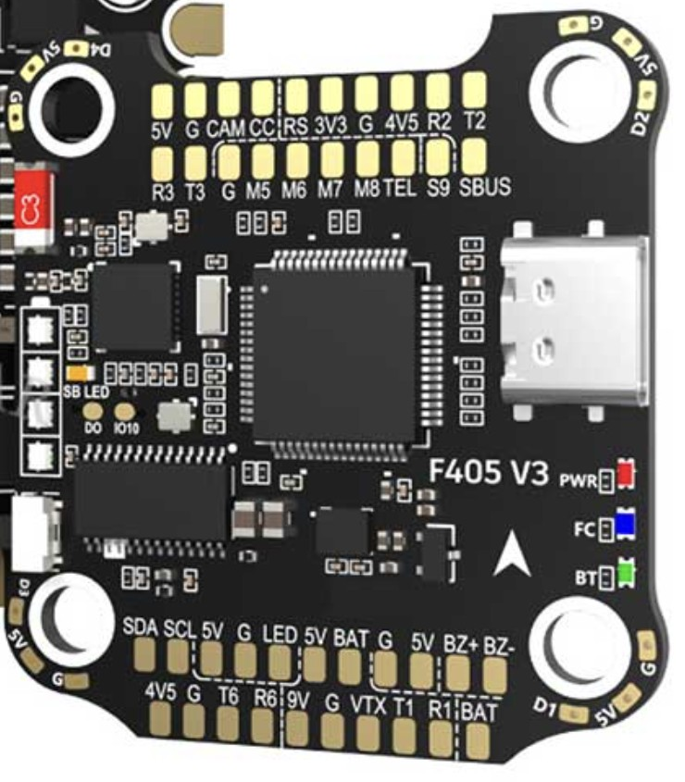
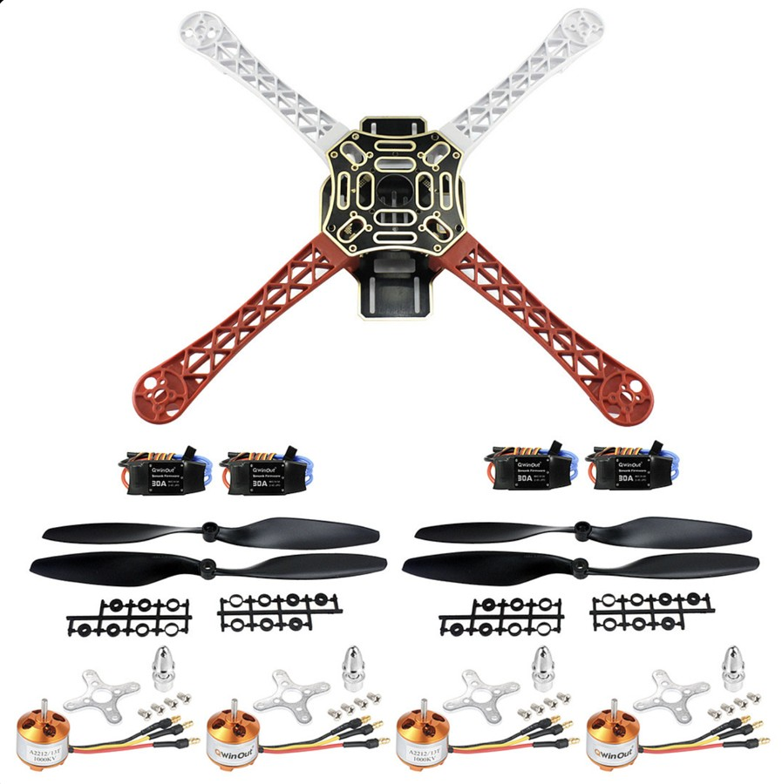
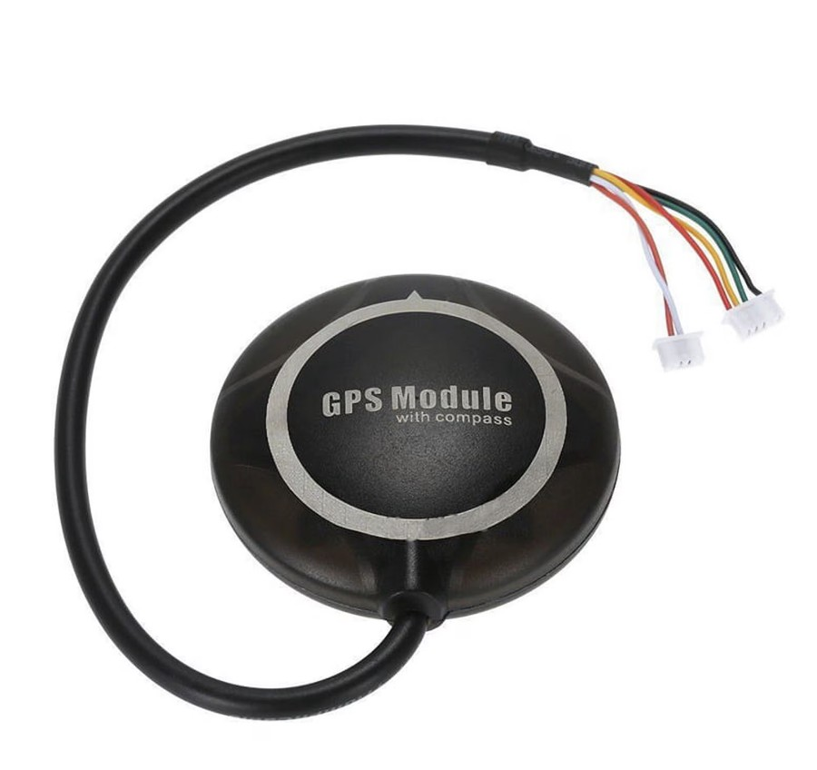
The planned F450 platform uses separate propulsion ESCs
PROJECT NAVI // VIT CHENNAI [SCOPE • SENSE • SMEC] // STAGE 03: HARDWARE
// HARDWARE PLATFORM · DESIGN MODEL
F405 V3 FC · iA6B RX
FLIGHT CONTROL
SpeedyBee F405 V3, FC board only · ArduPilot · iA6B RX (iBUS)
4-IN-1 ESC IN VENDOR PHOTO: REFERENCE ONLY
A2212 + 1045
M8N GPS + COMPASS
POWER MODULE
SiK 433 RADIO
PROPULSION & POWER
F450 + PDB · 4× A2212 1000KV · 4× separate 30A ESCs · 1045 props · 3S 3300 mAh, XT60 (planned)
POSITIONING & LINKS
NEO-M8N GPS + compass on mast · SiK 433 MHz onboard · XT60 power module (V/I sense, 5 V)
30A ESC ×4
3S 3300 mAh
GROUND SUPPORT · NOT ON AIRCRAFT
FS-i6X transmitter · SiK ground radio · iMAX B6AC charger · LiPo safe bag · laptop / Raspberry Pi
DESIGN MODEL: Nominal component geometry and proposed layout. Physical assembly and dimensional verification pending.
STATUS // DESIGN MODEL · PROCUREMENT & ASSEMBLY PENDING
SRC: Summary §4 p5; §6–7 pp5–7; NAVI_CAD/README
[ 11 / 18 ]
Notes:
[TIME 0:55 · SUGGESTED SPEAKER: Carollo Aradhan V (suggestion)]
SAY: This is the assembled design model: a nominal F450 layout from our parametric CAD (NAVI_CAD/navi_drone.py), not a photograph and not a measured build.
CLICK 1 (flight control): SpeedyBee F405 V3, bought as the FC board only, because the F450 kit already includes four separate 30A ESCs. The vendor photo also shows a 4-in-1 ESC (BLS 50A); that board is reference-only and not in our BOM. FlySky iA6B receiver onboard (iBUS).
CLICK 2 (propulsion): F450 frame with integrated power distribution, 4× A2212 1000KV motors, 4× 30A SimonK ESCs (one-time calibration with ArduPilot over PWM), 1045 props, planned 3S 3300 mAh LiPo with XT60. The pictured battery is a reference image whose connector differs from XT60; the final pack must use XT60, and discharge rating is subject to exact-pack verification.
CLICK 3 (positioning & links): NEO-M8N GPS with compass on a rear mast; SiK 433 MHz onboard radio; XT60 power module for voltage/current sensing and regulated 5 V (electrical compatibility to confirm).
GROUND SUPPORT (not on aircraft): FS-i6X transmitter, SiK ground radio, iMAX B6AC balance charger, LiPo safe bag, laptop or Raspberry Pi ground station.
WHAT NOT TO SAY: no RTK, no Pixhawk, no Jetson/RealSense, no onboard Raspberry Pi in the current plan.
SOURCES: Summary §4 (p5), §6 BOM (pp5–7), §7 buying rules (p7: FC alone, not an FC + 4-in-1 stack; receiver must output iBUS/SBUS/PPM; GPS must include compass). CAD README: dimensions nominal (450 mm wheelbase, A2212, 1045, 30A ESC, F405, M8N on mast, iA6B, SiK, 3S 3300, tall gear).
LIKELY QUESTION: "Why the F405 FC only?" → The kit already provides four discrete ESCs; a stack would duplicate them and add cost. The exact board name must appear on firmware.ardupilot.org before ordering.

Slide 12
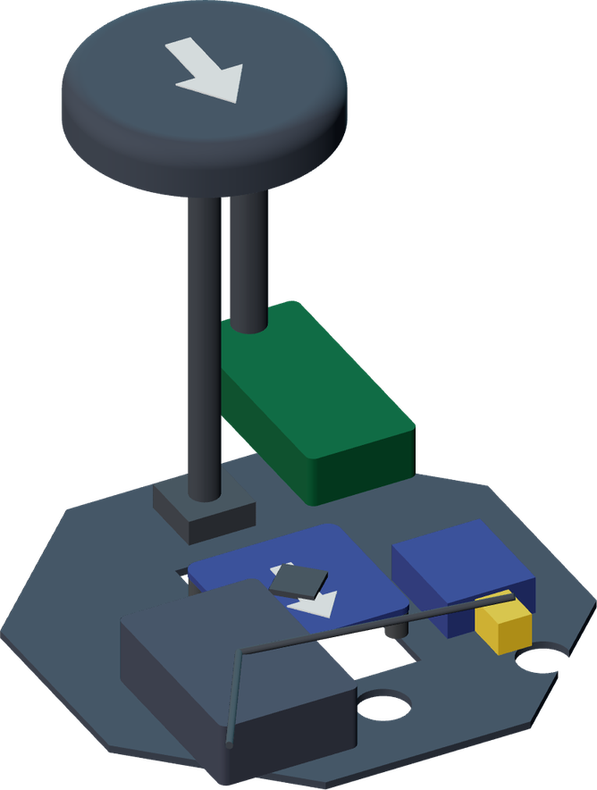
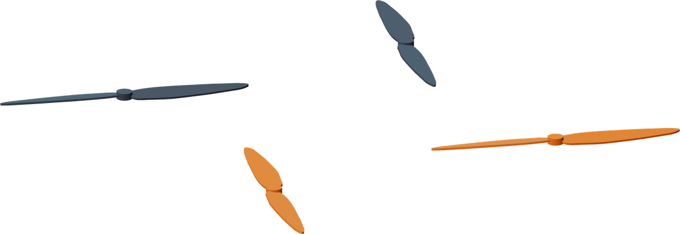
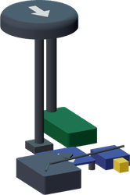
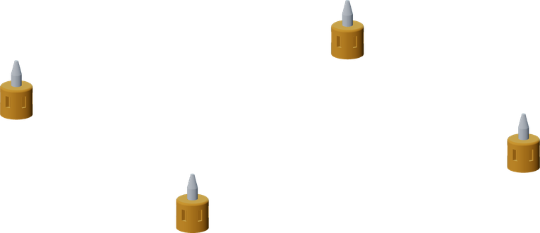
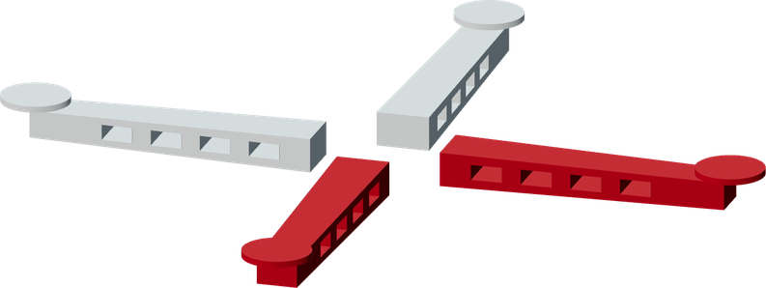
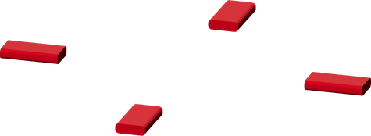


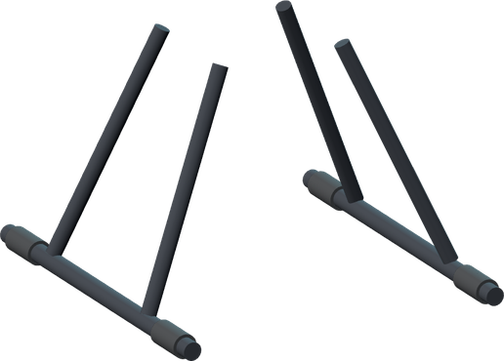

The exploded design model makes integration visible
PROJECT NAVI // VIT CHENNAI [SCOPE • SENSE • SMEC] // STAGE 03: HARDWARE
// EXPLODED DESIGN MODEL
AVIONICS INSET · ASSEMBLED, ENLARGED
1 1045 propellers ×4
2 Adapters + A2212 1000KV motors ×4
3 GPS/compass puck and mast
4 F405 FC + vibration dampers
5 iA6B receiver
6 SiK onboard radio + antenna
7 XT60 power module
8 Upper frame plate
9 F450 arms + motor mounts ×4
10 30A discrete ESCs ×4
11 Lower plate / power distribution
12 3S 3300 mAh battery + straps
13 Tall landing gear
1
3
3
4–7
6
2
9
8
7
4
10
5
11
12
GROUND SUPPORT · OUTSIDE ASSEMBLY
FS-i6X transmitter · SiK ground radio · iMAX B6AC charger · LiPo safe bag
13
DESIGN MODEL: Nominal component geometry and proposed layout. Physical assembly and dimensional verification pending.
STATUS // DESIGN MODEL · NOMINAL GEOMETRY · ASSEMBLY PENDING
SRC: NAVI_CAD navi_drone.py explode offsets
[ 12 / 18 ]
Notes:
[TIME 1:05 · SUGGESTED SPEAKER: Carollo Aradhan V (suggestion)]
SAY: The slide opens on the assembled model. On the first click, the real CAD component groups separate along the model's own explode offsets (props +200 mm, motors +125, avionics +75, top plate +40, arms 0, ESCs −30, lower plate −45, battery −105, landing gear −175; from navi_drone.py). Each group is a separate transparent layer rendered from the same camera, so this is genuine component separation, not a sliced image.
CLICK 1: nine CAD layers move vertically together (0.6 s, ease-out).
CLICK 2: numbered labels 1–13, the avionics inset and the legend appear.
WALK THROUGH: 1 props (1045 ×4) · 2 adapters + A2212 1000KV motors ×4 · 3 GPS/compass puck and mast · 4 F405 FC on vibration-isolation dampers · 5 iA6B receiver · 6 SiK onboard radio and antenna · 7 XT60 power module · 8 upper frame plate · 9 F450 arms and motor mounts ×4 · 10 30A discrete ESCs ×4 (under the arms) · 11 lower plate / power distribution · 12 3S 3300 mAh battery and straps · 13 tall landing gear. Items 3–7 are small, so they are labelled in the enlarged avionics inset rather than forced onto the main view.
GROUND SUPPORT stays outside the assembly: FS-i6X transmitter, SiK ground radio, B6AC charger, LiPo safe bag.
CAVEAT (keep visible): DESIGN MODEL: nominal component geometry and proposed layout. Physical assembly and dimensional verification pending. Shapes are approximate (e.g. ESCs as boxes, battery as a block). No tolerances, mass, structural or aerodynamic analysis are claimed. Black parts are tone-lifted slightly for contrast on the dark slide.
FALLBACK: The static PDF shows the exploded end-state. If animation does not play, describe the separation verbally.
LIKELY QUESTION: "Is this built?" → No. Procurement and assembly are Phase 0–1. The CAD is a layout and integration check.

Slide 13
Routing and pacing operate as distinct modules
PROJECT NAVI // VIT CHENNAI [SCOPE • SENSE • SMEC] // STAGE 04: SOFTWARE
// ALGORITHMS · ROUTING & PACING
ROUTING PIPELINE
PROPOSED PACING LOGIC · SYMBOLIC THRESHOLDS
HAVERSINE
Runtime distances on 260 nodes
REPORTED / SIM
INPUT CHECKS
Sample age & accuracy; reject impossible jumps
ROUTE-PROGRESS PROJECTION
gap = s_aircraft − s_visitor
Progress along the route, not straight-line distance
DIJKSTRA
Pad → nearest entrance
REPORTED / SIM
LEG SPLIT ≤ 350 m
Greedy break at last node; provisional
LEAD
gap ≤ L_hold: fly at visitor pace
HOLD
gap > L_hold or visitor stopped
RTL
stale > 30 s after HOLD
REPORTED / SIM
PAD COVERAGE
Greedy set cover → 6 pads
COMPUTED
HYSTERESIS RESUME only when gap < L_resume < L_hold, so states do not oscillate.
GEOFENCE + 40 m
App rule; fence export pending
PENDING
PRECEDENCE failsafe > geofence > stale data > pacing
STATUS // ROUTING: REPORTED SOFTWARE / SIMULATED · PACING: PROPOSED, SITL PENDING
SRC: Summary §9 p8–9; §11 p10; §14 p12
[ 13 / 18 ]
Notes:
[TIME 1:00 · SUGGESTED SPEAKERS: Muhammed Farhan (routing) → N Arun (pacing) (suggestion)]
LEFT, routing pipeline (source-reported as implemented and running in simulation, Summary §11 p10):
• Haversine distances computed at runtime, so editing a coordinate updates all distances, times and battery estimates.
• Dijkstra over the adjacency list, from the chosen pad to the destination's nearest entrance.
• Greedy leg splitting: add segments until 350 m would be exceeded, then break at the last node. 350 m is a provisional limit.
• Pad coverage: greedy set cover gives six pads. That is a greedy solution, not a proven global minimum.
• Geofence in the app: ray-casting point-in-polygon plus point-to-segment distance; breach declared beyond 40 m outside the OSM polygon (a proposed application rule). Export to ArduPilot's own fence and rally points is pending. A buffered hand-traced polygon is not proof of authorised airspace or obstacle clearance.
RIGHT, proposed pacing logic (not built against real positions):
CLICK 2 reveals it. Visitor samples are checked for age and accuracy; implausible jumps are rejected; the position is projected onto the route to get progress s_v (route progress, not straight-line distance). Gap = s_a − s_v. Hysteresis: HOLD when the gap exceeds L_hold, RESUME only when it falls below L_resume < L_hold, so the aircraft does not oscillate. A stale position (>30 s, design target) forces HOLD and then RTL. Precedence: ArduPilot failsafes > geofence > stale data > pacing. L_hold and L_resume are symbolic until measured phone error is available (Summary §17 measurement 5).
CLICK 1: pipeline nodes trace left to right. CLICK 2: pacing state logic. CLICK 3: precedence bar.
LIKELY QUESTION: "Is snapping to the nearest point an HMM?" → No. Nearest-point projection with consistency checks is simpler than U09's HMM; we cite U09 as the reason sequence-aware matching may be needed if simple projection proves unstable.

Slide 14
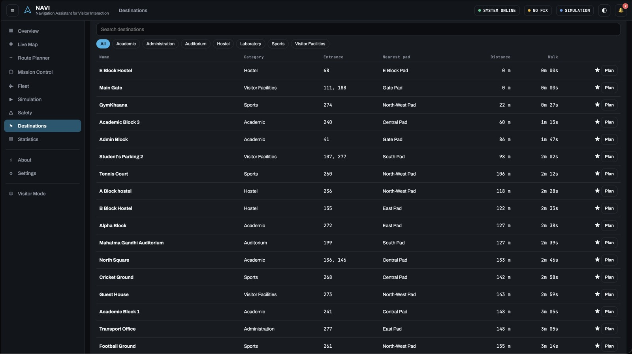
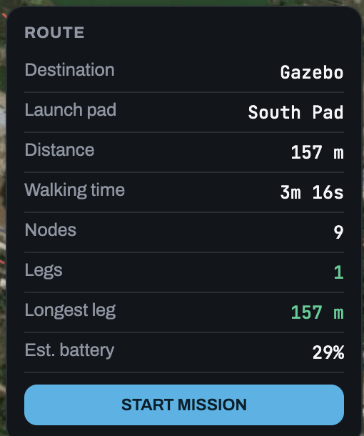
The interfaces exist while aircraft integration remains pending
PROJECT NAVI // VIT CHENNAI [SCOPE • SENSE • SMEC] // STAGE 04: SOFTWARE
// SOFTWARE EVIDENCE · SIMULATION
PROPOSED PACING LOGIC: PSEUDOCODE · NOT THE LIVE CONTROLLER
1 on visitor_sample(p):
2 if age(p) > T_STALE: return state(HOLD)
3 if implausible_jump(p): return # drop
4 s_v = project_onto_route(p)
5 gap = s_aircraft - s_v
6 if gap > L_HOLD: state(HOLD)
7 elif gap < L_RESUME: state(LEAD)
8 on tick():
9 if held_stale > T_STALE: state(RTL)
10 # precedence: failsafe > fence > stale > pace
webpage2.png · inset: webpage1.png route panel
INJECTED (SIM): VISITOR POSITION STALE > 30 s
← APP STATUS: NO FIX · SIMULATION
SAFE
WARNING
HOLD
RETURN_TO_LAUNCH
DELIVERED (REPORTED) 4 web apps; source not in supplied folder
PENDING MAVLink · live pacing · fence export · HTTPS intake
Designed response (Summary §12): hold, then RTL. Firmware configuration and field verification pending.
STATUS // REPORTED SOFTWARE / SIMULATED · LIVE TELEMETRY PENDING
SRC: Summary §11 p10; §12 p11; webpage1/2.png
[ 14 / 18 ]
Notes:
[TIME 1:05 · SUGGESTED SPEAKER: Sayanjeet Das (suggestion)]
EVIDENCE: The screenshots are the NAVI app's Destinations view (webpage2.png) and Live Map route panel (webpage1.png). The status chips read SYSTEM ONLINE · NO FIX · SIMULATION. The route panel shows Gazebo from South Pad: 157 m, 3 m 16 s walking time, 9 nodes, 1 leg. 157 m ÷ 0.8 m/s = 196 s = 3 m 16 s, consistent with the 0.8 m/s planning speed.
DELIVERED (source-reported, Summary §11): full NAVI application (navi_app.html), visitor kiosk (navi_kiosk.html), mission control (navi_control.html), campus map (navi_campus.html). These HTML files were NOT in the supplied mdp folder, so this deck shows screenshots and pseudocode only. We do not claim code access we do not have.
PSEUDOCODE: "Proposed pacing logic: pseudocode". It is not the implemented live controller. Thresholds are symbolic.
CLICK 1: an injected simulated fault, "visitor position stale > 30 s", appears; the matching pseudocode line highlights. CLICK 2: the designed safety state advances SAFE → WARNING → HOLD → RETURN_TO_LAUNCH. The app's simulation reportedly injects six faults: visitor stopped, visitor delayed, GPS loss, telemetry loss, low battery, geofence breach (Summary §11).
STILL TO BUILD (Summary §11): MAVLink link (pymavlink or MAVSDK) replacing simulated telemetry; pacing controller against real positions, first in ArduPilot SITL; export of the 40 m-buffered fence and pads into ArduPilot fence and rally points; phone position intake over HTTPS with filtering, snapping and hysteresis.
DEFECTS FIXED (reported): startup crash from a global window.map clash, and a crash on unknown destination names; a global error handler was added.
LIKELY QUESTION: "What does the 20% review actually demonstrate?" → Software and design groundwork running in simulation: the route graph, coverage analysis, interfaces, and a fault-driven state machine. No live telemetry, no flight.

Slide 15
Six proposed pads cover 36 destinations under the current limit
PROJECT NAVI // VIT CHENNAI [SCOPE • SENSE • SMEC] // STAGE 04: RESULTS
// RESULTS · CAMPUS GRAPH & PAD COVERAGE
260
FLIGHT-GRAPH NODES (OF 278)
8.24 km
303 PATH SEGMENTS
36
DESTINATIONS, 1 COMPONENT
PAD 6 · E BLOCK · BENEATH PANEL →
42.2 ha
OSM POLYGON (36 VERTICES)
6
PADS · GREEDY SET COVER
316 m
LONGEST NEAREST-PAD LEG
PAD | NODE | LATITUDE | LONGITUDE
1 Gate | 111 | 12.840649 | 80.153159
2 Central | 50 | 12.843086 | 80.154410
3 East | 40 | 12.841788 | 80.155996
4 North-West | 7 | 12.843654 | 80.152814
5 South | 27 | 12.840475 | 80.154658
6 E Block | 68 | 12.844735 | 80.160818
GAZEBO ← SOUTH PAD · 157 m
OSM BOUNDARY (RED DASHED) · way 336095563
Boundary © OpenStreetMap contributors, ODbL 1.0 · Paths & entrances: VIT Chennai Way Finder dataset · Imagery © Esri
STATUS // COMPUTED / SOURCE-REPORTED · GREEDY SOLUTION · 350 m PROVISIONAL
SRC: Summary §9–10 pp8–9; App. A–B
[ 15 / 18 ]
Notes:
[TIME 0:55 · SUGGESTED SPEAKER: Muhammed Farhan (suggestion)]
CLICK 1: the campus map with the OSM boundary (red dashed line in the app). CLICK 2: pad markers 1–5 ring in, and pad 6 is flagged beneath the route panel. CLICK 3: one computed route (Gazebo from South Pad, 157 m) traces. CLICK 4: KPI values and the pad table.
RESULTS (COMPUTED / SOURCE-REPORTED, Summary §9–10): 278 source waypoints, 260 retained flight-graph nodes; 303 undirected segments, 8.24 km; 36 destinations in one connected component; 36-vertex OSM polygon (way 336095563), 42.2 ha. Pads placed by greedy set cover with a provisional 350 m leg limit gives six pads; the longest nearest-pad leg is 316 m to VIT-SEDAXIS.
WHAT IT DOES NOT SHOW: It is a greedy coverage solution, not a proven global minimum. Coverage means each destination has a qualifying nearest-pad route. It does not prove one continuous mission can guide every visitor from the main gate, or that inter-pad transfers are feasible. Distances are computed graph lengths, not flown or walked measurements. The 40 m buffer is a proposed application rule; field and geometric validation are pending. Pad clear areas of about 5 m × 5 m are a design target and do not prove landing containment.
MAP OVERLAY: Pad rings were placed by fitting the five visible markers' pixels to the summary's pad coordinates (residual under 1 px). Pad 6 (E Block, node 68, 12.844735, 80.160818) falls beneath the app's route panel in this capture.
ATTRIBUTION: Campus boundary © OpenStreetMap contributors, ODbL 1.0. Path graph and building entrances derived from the VIT Chennai Way Finder dataset. Imagery © Esri (Leaflet), as shown in the screenshot.
LIKELY QUESTION: "What assumptions could change the six-pad result?" → Measured endurance (leg limit), walking speed, stop allowance, reserve treatment, and pad site clearance. Re-run set cover after the timed hover.

Slide 16
The 20% milestone establishes a design and software foundation
PROJECT NAVI // VIT CHENNAI [SCOPE • SENSE • SMEC] // STAGE 04: RESULTS
// RESULTS & ANALYSIS · 20% MILESTONE
COMPLETED GROUNDWORK · SOURCE-REPORTED
Campus graph, routing and pad coverage computed · four web apps running in simulation · fault-driven safety state machine (sim) · F450 platform decision, BOM and CAD design model
PROVISIONAL 350 m LEG LIMIT
PENDING MEASUREMENTS · SUMMARY §17
Timed hover to failsafe · battery capacity · phone GPS error on a known route · overhead obstructions per segment · GPS spot-check at known nodes · hover error vs wind
20% REVIEW MILESTONE · NOT AN AUDITED PERCENTAGE
COMPUTED GRAPH DISTANCES REPORTED IN THE SUMMARY · 0 m = graph co-location, not landing precision
STATUS // 20% REVIEW MILESTONE · NO FLIGHT DATA EXISTS YET
SRC: Summary App. A pp15–16; §9 p8; §17 pp13–14
[ 16 / 18 ]
Notes:
[TIME 0:55 · SUGGESTED SPEAKER: Sayanjeet Das (suggestion)]
CHART: computed graph distances from Summary Appendix A for six selected destinations: main-gate distance vs nearest-pad distance (m). The amber line is the provisional 350 m leg limit. Labels: computed graph distances reported in the summary.
READ IT CORRECTLY: The nearest-pad comparison is about departure-pad selection. It is NOT a measured reduction in a visitor's walk from the gate, nor a flight duration or energy result. E Block Hostel at 0 m means graph co-location of pad and entrance, not landing precision. From the main gate, only 12 of 36 destinations lie within one 350 m leg (Summary §9); with six pads, every nearest-pad leg is ≤316 m.
WALKING TIMES (recalculated, t = d / v at 0.8 m/s, ideal, no allowances): 316 m ≈ 6.58 min; 350 m ≈ 7.29 min; 700 m ≈ 14.58 min. Stop allowance, launch/landing and reserve are additional and shown separately in backup A14.
CLICK 1: chart wipes in from the bottom. CLICK 2: completed vs pending columns. CLICK 3: the 20% REVIEW MILESTONE marker appears once.
20%: This is the review milestone label, not an independently audited completion percentage. We have not invented per-module percentages.
LIKELY QUESTION: "Is the 350 m endurance validated?" → No. It is a provisional planning constraint. The F450 hover estimate of roughly 10–13 min is not measured. A timed hover to failsafe with the real payload will replace it, and the leg limit and pad layout will be recomputed.

Slide 17
Hardware access changed the plan and validation gates
PROJECT NAVI // VIT CHENNAI [SCOPE • SENSE • SMEC] // STAGE 05: PLAN
// HARDWARE DECISION · BUDGET · GATES
ORIGINAL · LAB-DEPENDENT
S500 + Pixhawk 2.4.8 · RTK F9P pair · companion computer · 915 MHz SiK
UNAVAILABLE TO TEAM
NOW · SELF-FUNDED (PLANNED)
F450 + F405 V3 FC · M8N GPS + compass · SiK 433 MHz · ground-station compute
NOT YET PURCHASED
₹25,000 POOL (5 × ₹5,000)
≈ ₹23,500 MIDPOINT WITH SiK
Range ₹21,100–29,900 · reserve ₹1,500–2,000
0
Permission & purchase
1
Assembly & bench
2
Manual flight
3
GPS autonomy
4
Pacing in SITL
5
Integrated trials
GATE
Letter held; Stage 1 parts in hand
GATE
Calibrations pass; failsafes props-off
GATE
Steady hover; timed endurance
GATE
Repeatable route, no intervention
GATE
Validated before any live trial
GATE
Every failsafe observed; guided trips
PENDING
PENDING
PENDING
PENDING
PENDING
PENDING
NEXT MEASUREMENTS Timed hover to failsafe with real payload → recompute leg limit & pads · Phone GPS error on a known route → set lead / hold thresholds
STATUS // PLANNING ESTIMATE · PRICES NOT RECONFIRMED · ALL GATES PENDING
SRC: Summary §3–4 pp4–5; §6 pp5–7; §16 p13
[ 17 / 18 ]
Notes:
[TIME 0:35 · SUGGESTED SPEAKER: Utkarsh Ghorpade (hardware) or Sayanjeet Das (budget tracking) (suggestion)]
SAY: The original plan depended on ADAPT laboratory equipment (S500 with Pixhawk 2.4.8, an RTK F9P pair and a companion computer). That equipment, and the MDP/IDP store, turned out not to be available. After evaluating more than ten alternatives (backup A18), the team chose a self-funded F450 with an F405 FC, M8N GPS and ground-station computation. The test applied: if ArduPilot or PX4 cannot be flashed and the aircraft cannot be commanded over MAVLink, it cannot be NAVI.
BUDGET (PLANNING ESTIMATE, Summary §6): pool ₹25,000 (five × ₹5,000). Supervised-autonomy configuration ₹18,600–25,900 (≈₹20,000 at mid prices); with SiK telemetry ₹21,100–29,900 (≈₹23,500 midpoint). The upper end exceeds the pool, so budget compliance is not guaranteed. Only the airframe kit (₹4,059) was checked against a live listing. Hold back ₹1,500–2,000 as a crash reserve; buy in stages.
CLICK 1: phases 0–5 appear with their gates. All gates are pending.
IMMEDIATE MEASUREMENTS: timed hover to failsafe (replaces the endurance estimate behind 350 m and six pads); phone GPS error on a known route (sets lead and hold thresholds).
PERMISSION: WRITTEN PERMISSION PENDING. The summary reports permission is expected; get it in writing with its conditions (areas, hours, height, observer). Registration requirements for a 250 g–2 kg home-built aircraft must be checked against current official rules.
Details: budget A12, phases A16, alternatives A18.

Slide 18
Next evidence comes from integration and controlled trials
PROJECT NAVI // VIT CHENNAI [SCOPE • SENSE • SMEC] // STAGE 05: CONCLUSION
// CONCLUSION · Q&A
WHAT THE 20% REVIEW SHOWS
Computed route graph and six-pad coverage · four interfaces in simulation · fault-driven state machine · F450 design model and BOM
NEAREST VALIDATION GATES
Written permission and Stage 1 purchase · assembly and props-off failsafe tests · timed hover → recompute 350 m limit and pads
EXPECTED DEMONSTRATION
Supervised guided trip on an inspected route once gates pass; ground robot runs the same software as a backup
LIMITS STAY VISIBLE No flight has been performed. Lead distance, speed and pad size are design targets; endurance, budget and GNSS error are estimates.
Questions
Prepared answers and evidence: backup A09–A21
STATUS // DESIGN & SIMULATION ONLY · NO FLIGHT RESULTS CLAIMED
SRC: Summary §16–17 pp13–14; §15 p12
[ 18 / 18 ]
Notes:
[TIME 0:25 · SUGGESTED SPEAKER: N Arun (suggestion)]
SAY: At 20%, NAVI has a computed campus route graph and pad coverage, simulated interfaces with a fault-driven state machine, and a planned F450 platform with a design model. Nothing has flown. The next evidence comes from Phase 0–2: permission and purchase, props-off bench failsafes, and a timed hover that replaces our endurance estimate. Then we recompute the leg limit and pads before any autonomy. We welcome your questions.
CLICK 1: the three columns appear once, then the slide holds static for Q&A.
BACKUP: A01–A02 references, A03–A08 evidence matrix, A09 roles, A10 photos, A11 BOM, A12 budget, A13 GPS & separation, A14 endurance, A15 safety matrix, A16 phases, A17 CAD limits, A18 alternatives, A19–A21 prepared answers.
BACKUP PLATFORM: The team's existing 4WD ground robot can run the same navigation code if the aircraft is delayed (Summary §15); it would need an ESP32, GPS and compass add-ons (≈₹1,900–2,700).

Slide 19
References: uploaded works
PROJECT NAVI // VIT CHENNAI [SCOPE • SENSE • SMEC] // BACKUP A01
// REFERENCES 1/2
U01 Kuys, B., Haig, A., Mridha, M. (2024). Exploring the Use of Landmarks to Aid Pedestrian Wayfinding. Applied Sciences 14(17), 7814. doi:10.3390/app14177814
U02 Merei, A., Mcheick, H., Ghaddar, A., Rebaine, D. (2025). A Survey on Obstacle Detection and Avoidance Methods for UAVs. Drones 9(3), 203. doi:10.3390/drones9030203
U03 Son, S.J., Kim, H.S., Kim, D.H. (2022). Waypoint and Autonomous Flying Control of an Indoor Drone for GPS-Denied Environments. IAES Int. J. Robotics & Automation 11(3), 233–249. doi:10.11591/ijra.v11i3.pp233-249
U04 Tezza, D., Andujar, M. (2019). The State-of-the-Art of Human–Drone Interaction: A Survey. IEEE Access 7, 167438–167454. doi:10.1109/ACCESS.2019.2953900
U05 Avila Soto, M., Funk, M., Hoppe, M., Boldt, R., Wolf, K., Henze, N. (2017). DroneNavigator: Using Leashed and Free-Floating Quadcopters to Navigate Visually Impaired Travelers. Proc. ASSETS ’17. doi:10.1145/3132525.3132556
U06 Kruse, T., Pandey, A.K., Alami, R., Kirsch, A. (2013). Human-Aware Robot Navigation: A Survey. Robotics and Autonomous Systems 61(12), 1726–1743. doi:10.1016/j.robot.2013.05.007
U07 Rousell, A., Zipf, A. (2017). Towards a Landmark-Based Pedestrian Navigation Service Using OSM Data. ISPRS Int. J. Geo-Information 6(3), 64. doi:10.3390/ijgi6030064
U08 Selvi, H.Z., Bildirici, I.O., Ulugtekin, N. (2016). Landmark Orientation and Map Design for Pedestrians: Prototype of a Selcuk University Campus Area Pedestrian Navigation System. IOP Conf. Ser.: Earth Environ. Sci. 44, 042027. doi:10.1088/1755-1315/44/4/042027
U09 Newson, P., Krumm, J. (2009). Hidden Markov Map Matching Through Noise and Sparseness. Proc. ACM SIGSPATIAL GIS ’09, 336–343. doi:10.1145/1653771.1653818
STATUS // BIBLIOGRAPHY · UPLOADED PDFs
SRC: mdp folder PDFs
[ A01 ]
Notes:
Full references for all 17 works. Recent window 2021–2026: U01, U02, U03, S01–S07 (ten recent papers). Foundational: U04–U10 (2009–2019). Kruse et al. is dated by its 2013 journal publication, not its 2018 HAL deposit. Bibliographic details were taken from the papers' first pages and publisher pages. Two details were not re-verified online and should be confirmed before the final report: U04's page range and U10's DSD page range/DOI. Uploaded PDFs are in the mdp folder; S01–S07 were read online (publisher pages; S06 via the authors' University of Padova repository manuscript; S03 via arXiv 2311.06922v4).

Slide 20
References: U10 and supplemental recent works
PROJECT NAVI // VIT CHENNAI [SCOPE • SENSE • SMEC] // BACKUP A02
// REFERENCES 2/2
U10 Ebeid, E., Skriver, M., Jin, J. (2017). A Survey on Open-Source Flight Control Platforms of Unmanned Aerial Vehicle. Proc. Euromicro DSD 2017, 396–402. doi:10.1109/DSD.2017.30
S01 Wögerbauer, E.M., von Castell, C., Welsch, R., Hecht, H. (2024). Preferred Distance in Human–Drone Interaction. Vision 8(4), 59. doi:10.3390/vision8040059
S02 Gómez-López, A., Maya-López, Y., Olivos-Jara, P., Morales, R. (2026). Human-Drone Interaction in Older Adults: A Systematic Review. Drones 10(5), 389. doi:10.3390/drones10050389
S03 Singamaneni, P.T., Bachiller-Burgos, P., Manso, L.J., Garrell, A., Sanfeliu, A., Spalanzani, A., Alami, R. (2024). A Survey on Socially Aware Robot Navigation: Taxonomy and Future Challenges. Int. J. Robotics Research. doi:10.1177/02783649241230562
S04 Karwowski, J., Szynkiewicz, W., Niewiadomska-Szynkiewicz, E. (2024). Bridging Requirements, Planning, and Evaluation: A Review of Social Robot Navigation. Sensors 24(9), 2794. doi:10.3390/s24092794
S05 Ghambari, S., Golabi, M., Jourdan, L., Lepagnot, J., Idoumghar, L. (2024). UAV Path Planning Techniques: A Survey. RAIRO-Operations Research 58, 2951–2989. doi:10.1051/ro/2024073
S06 Yi, S., Zorzi, M., Jin, X., Su, T. (2024). A Switched Approach for Smartphone-Based Pedestrian Navigation. Sensors 24(16), 5247. doi:10.3390/s24165247
S07 Zhang, J., Yu, B., Ge, Y., Gao, J., Sheng, C. (2024). An Effective GNSS/PDR Fusion Positioning Algorithm on Smartphones for Challenging Scenarios. Sensors 24(5), 1452. doi:10.3390/s24051452
STATUS // BIBLIOGRAPHY · S01–S07 READ ONLINE
SRC: Publisher pages; arXiv; UniPD repository
[ A02 ]
Notes:
Full references for all 17 works. Recent window 2021–2026: U01, U02, U03, S01–S07 (ten recent papers). Foundational: U04–U10 (2009–2019). Kruse et al. is dated by its 2013 journal publication, not its 2018 HAL deposit. Bibliographic details were taken from the papers' first pages and publisher pages. Two details were not re-verified online and should be confirmed before the final report: U04's page range and U10's DSD page range/DOI. Uploaded PDFs are in the mdp folder; S01–S07 were read online (publisher pages; S06 via the authors' University of Padova repository manuscript; S03 via arXiv 2311.06922v4).

Slide 21
Evidence matrix: U01–U03
PROJECT NAVI // VIT CHENNAI [SCOPE • SENSE • SMEC] // BACKUP A03
// LITERATURE EVIDENCE MATRIX 1/6
WORK | VENUE · TYPE | METHOD & CONTEXT | FINDINGS (AS REPORTED) | LIMITS | NAVI IMPLICATION | READ DEPTH
U01 2024 | Applied Sci. · study | 30 adults; landmark booklet vs map screenshots vs paper map; 1.7 km route | Landmark group: more initial survey knowledge; route-drawing weaker | Small N; paper aids; data from 2016 ethics | Arrival cue should name entrance/landmark (proposed) | Abstract, discussion, conclusions
U02 2025 | Drones · survey | ODA methods compared by obstacle, environment, sensors, maps, path status | 66% 3D; 47% static+dynamic; 7.35% energy-aware | Survey; no campus guidance | Obstacle detection out of scope; inspected routes | Abstract, conclusions
U03 2022 | IJRA · experiment | Indoor UWB trilateration + altimeter; CNN corridor flight | Position error within 0.12 m; 90% corridor success at 1.4 m/s | Indoor anchors; GPS-denied | UWB accuracy not transferred to M8N | Abstract, results, conclusion
STATUS // LITERATURE · FINDINGS QUOTED WITH CONDITIONS
SRC: See A01–A02 for full citations
[ A03 ]
Notes:
Evidence matrix rows 1–3. Numerical results are reported with their population, conditions and metric, and not merged across methods. "READ DEPTH" states honestly what was read: partial reads (S03, S04, S07) are not presented as detailed full-paper analyses. Unresolved gap: S07 fusion results were inaccessible (MDPI text truncated at §3; PMC captcha; Europe PMC rate-limited). Either obtain the full text or replace S07 with another verified recent paper before the final report.

Slide 22
Evidence matrix: U04–U06
PROJECT NAVI // VIT CHENNAI [SCOPE • SENSE • SMEC] // BACKUP A04
// LITERATURE EVIDENCE MATRIX 2/6
WORK | VENUE · TYPE | METHOD & CONTEXT | FINDINGS (AS REPORTED) | LIMITS | NAVI IMPLICATION | READ DEPTH
U04 2019 | IEEE Access · survey | HDI survey: control, communication, proxemics, prototypes | Distance depends on culture, design; safety & flight time limits | Pre-2021; few outdoor guide studies | Measure comfort distance & noise in trials | Abstract, proxemics, conclusion
U05 2017 | ASSETS · user study | 14 visually impaired; free-floating vs leashed vs audio; indoor | Free-floating faster (82 vs 99 s); fewer errors with drones | Wizard-of-Oz; 1 m; 20 g drone | Aerial lead is credible; outdoor case untested | Abstract, results, conclusion
U06 2013 | RAS · survey | Human-aware navigation: comfort, naturalness, sociability | Evaluation via discomfort models or questionnaires | Wheeled robots; 2013 | Hysteresis; collect comfort ratings | Abstract, evaluation, conclusion
STATUS // LITERATURE · FINDINGS QUOTED WITH CONDITIONS
SRC: See A01–A02 for full citations
[ A04 ]
Notes:
Evidence matrix rows 4–6. Numerical results are reported with their population, conditions and metric, and not merged across methods. "READ DEPTH" states honestly what was read: partial reads (S03, S04, S07) are not presented as detailed full-paper analyses. Unresolved gap: S07 fusion results were inaccessible (MDPI text truncated at §3; PMC captcha; Europe PMC rate-limited). Either obtain the full text or replace S07 with another verified recent paper before the final report.

Slide 23
Evidence matrix: U07–U09
PROJECT NAVI // VIT CHENNAI [SCOPE • SENSE • SMEC] // BACKUP A05
// LITERATURE EVIDENCE MATRIX 3/6
WORK | VENUE · TYPE | METHOD & CONTEXT | FINDINGS (AS REPORTED) | LIMITS | NAVI IMPLICATION | READ DEPTH
U07 2017 | IJGI · prototype | OSM landmark extraction server + Android instructions | Feasible where OSM complete; weaker where sparse | Short suitability check | OSM only for boundary; wayfinder graph for routes | Abstract, intro, conclusions
U08 2016 | IOP · prototype | Campus app, Voronoi landmark orientation; 14 first-time visitors | Judged useful; landmarks recognised | Questionnaire; one route | Recruit first-time visitors for trials | Full (short paper)
U09 2009 | ACM GIS · algorithm | HMM map matching; 80 km drive ground truth | Perfect at 1 s; robust to 30 s gaps & noise | Vehicle, roads, offline | Sequence-aware snapping if projection unstable | Abstract, results, conclusions
STATUS // LITERATURE · FINDINGS QUOTED WITH CONDITIONS
SRC: See A01–A02 for full citations
[ A05 ]
Notes:
Evidence matrix rows 7–9. Numerical results are reported with their population, conditions and metric, and not merged across methods. "READ DEPTH" states honestly what was read: partial reads (S03, S04, S07) are not presented as detailed full-paper analyses. Unresolved gap: S07 fusion results were inaccessible (MDPI text truncated at §3; PMC captcha; Europe PMC rate-limited). Either obtain the full text or replace S07 with another verified recent paper before the final report.

Slide 24
Evidence matrix: U10–S02
PROJECT NAVI // VIT CHENNAI [SCOPE • SENSE • SMEC] // BACKUP A06
// LITERATURE EVIDENCE MATRIX 4/6
WORK | VENUE · TYPE | METHOD & CONTEXT | FINDINGS (AS REPORTED) | LIMITS | NAVI IMPLICATION | READ DEPTH
U10 2017 | DSD · survey | 15+ open hardware/software flight platforms compared | ArduPilot/PX4 mature open stacks | 2017 board list | Open stack + MAVLink; verify F405 V3 support | Abstract, comparison, conclusion
S01 2024 | Vision · 2 experiments | AR/VR, N=28 & N=20; virtual 25 cm drone; height, angle, look | Means 1.84 m / 1.62 m; larger above eye level | Virtual drone; young samples | Does not validate 15 m; measure | Full text
S02 2026 | Drones · systematic review | PRISMA; 13 studies 2016–2025; adults 65+ | Acceptance ↔ usability, safety, familiarity | Health/home contexts; heterogeneous | Include older visitors; simple UI | Methods, results, conclusions
STATUS // LITERATURE · FINDINGS QUOTED WITH CONDITIONS
SRC: See A01–A02 for full citations
[ A06 ]
Notes:
Evidence matrix rows 10–12. Numerical results are reported with their population, conditions and metric, and not merged across methods. "READ DEPTH" states honestly what was read: partial reads (S03, S04, S07) are not presented as detailed full-paper analyses. Unresolved gap: S07 fusion results were inaccessible (MDPI text truncated at §3; PMC captcha; Europe PMC rate-limited). Either obtain the full text or replace S07 with another verified recent paper before the final report.

Slide 25
Evidence matrix: S03–S05
PROJECT NAVI // VIT CHENNAI [SCOPE • SENSE • SMEC] // BACKUP A07
// LITERATURE EVIDENCE MATRIX 5/6
WORK | VENUE · TYPE | METHOD & CONTEXT | FINDINGS (AS REPORTED) | LIMITS | NAVI IMPLICATION | READ DEPTH
S03 2024 | IJRR · survey | Four taxonomies: robot, planning, awareness, evaluation | ~18 aerial works; rotor noise affects perceived safety | Ground-robot dominated | Altitude & noise as comfort variables | PARTIAL: taxonomy sections
S04 2024 | Sensors · review | Requirements grounded in user studies → planners & metrics | Physical & perceived safety, naturalness, norms | Ground robots | Map acceptance targets to requirements | PARTIAL: §1–3.5
S05 2024 | RAIRO-OR · survey | Classical/exact vs soft-computing vs hybrid planners | No planner optimal in all scenarios | Generic UAV survey | Dijkstra on static inspected graph | Full PDF
STATUS // LITERATURE · FINDINGS QUOTED WITH CONDITIONS
SRC: See A01–A02 for full citations
[ A07 ]
Notes:
Evidence matrix rows 13–15. Numerical results are reported with their population, conditions and metric, and not merged across methods. "READ DEPTH" states honestly what was read: partial reads (S03, S04, S07) are not presented as detailed full-paper analyses. Unresolved gap: S07 fusion results were inaccessible (MDPI text truncated at §3; PMC captcha; Europe PMC rate-limited). Either obtain the full text or replace S07 with another verified recent paper before the final report.

Slide 26
Evidence matrix: S06–S07
PROJECT NAVI // VIT CHENNAI [SCOPE • SENSE • SMEC] // BACKUP A08
// LITERATURE EVIDENCE MATRIX 6/6
WORK | VENUE · TYPE | METHOD & CONTEXT | FINDINGS (AS REPORTED) | LIMITS | NAVI IMPLICATION | READ DEPTH
S06 2024 | Sensors · method + test | Switched adaptive KF, phone IMU + GNSS; 150 m, one phone | 2D RMSE 0.78 / 0.89 m (GNSS lost), 0.31 m whole | Planned-path reference; raw data logging | Browser API lacks raw IMU; measure handsets | Authors’ manuscript (full)
S07 2024 | Sensors · method + test | Android GNSS/PDR fusion; open, semi-open, blocked | PDR parts: steps >96%, heading 5.25° | Fusion results NOT accessed | Native app needed; logged option | PARTIAL: §1–2 only
STATUS // LITERATURE · FINDINGS QUOTED WITH CONDITIONS
SRC: See A01–A02 for full citations
[ A08 ]
Notes:
Evidence matrix rows 16–17. Numerical results are reported with their population, conditions and metric, and not merged across methods. "READ DEPTH" states honestly what was read: partial reads (S03, S04, S07) are not presented as detailed full-paper analyses. Unresolved gap: S07 fusion results were inaccessible (MDPI text truncated at §3; PMC captcha; Europe PMC rate-limited). Either obtain the full text or replace S07 with another verified recent paper before the final report.

Slide 27
Team responsibilities: proposed allocation
PROJECT NAVI // VIT CHENNAI [SCOPE • SENSE • SMEC] // BACKUP A09
// TEAM · PROPOSED ALLOCATION
MEMBER | REG. NO. | SCHOOL | PROPOSED RESPONSIBILITY | SUGGESTED SLIDES
Carollo Aradhan V | 26BMH1173 | SMEC | Airframe integration, propulsion mounting, landing gear, vibration isolation, weight and thrust budget | 11–12
Utkarsh Dilipkumar Ghorpade | 26BEC1215 | SENSE | Power and wiring, GPS/compass, telemetry, battery and charging | 10, 17
N Arun | 26BCE1550 | SCOPE | ArduPilot setup, MAVLink integration, pacing controller, failsafes, SITL | 7–8, 10, 13, 18
Muhammed Farhan | 26BCE1551 | SCOPE | Campus graph, route planning, leg splitting, pad placement, geofence | 6, 9, 13, 15
Sayanjeet Das | 26BCE5502 | SCOPE | Visitor interface, kiosk, validation planning, documentation, budget tracking | 1–5, 14, 16
STATUS // PROPOSED ALLOCATION · NOT COMPLETED INDIVIDUAL ACHIEVEMENTS
SRC: Summary §2 pp3–4
[ A09 ]
Notes:
Roles are the summary's suggested update for the self-funded build; the team should confirm them. Speaking handoffs are suggestions only. Do not present these responsibilities as completed individual achievements.

Slide 28
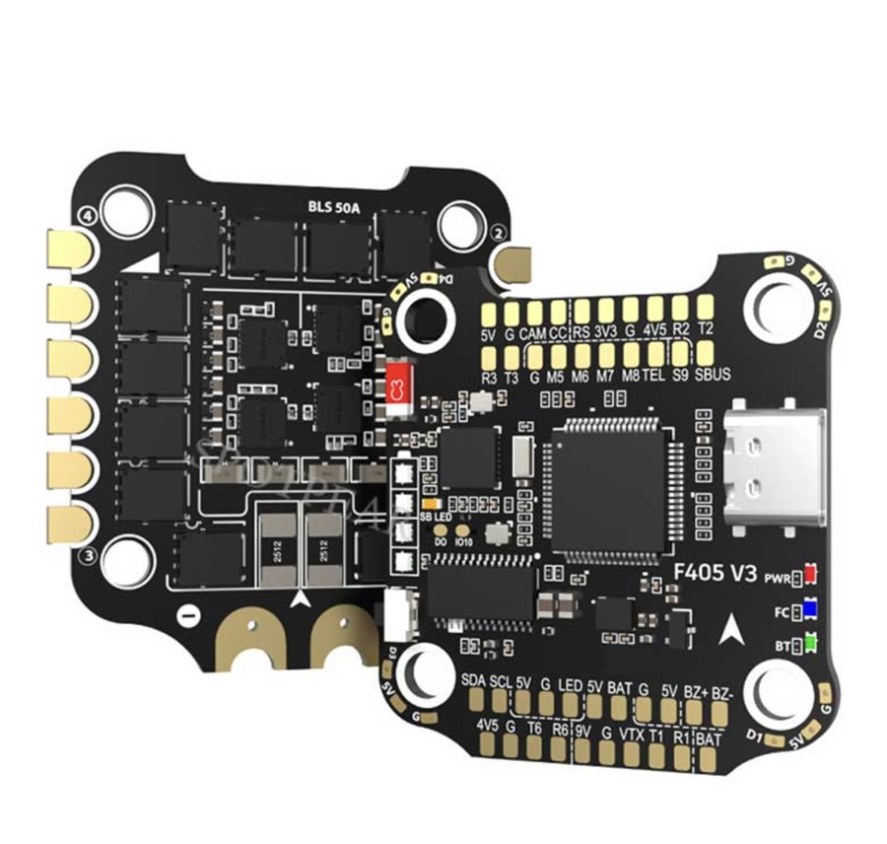

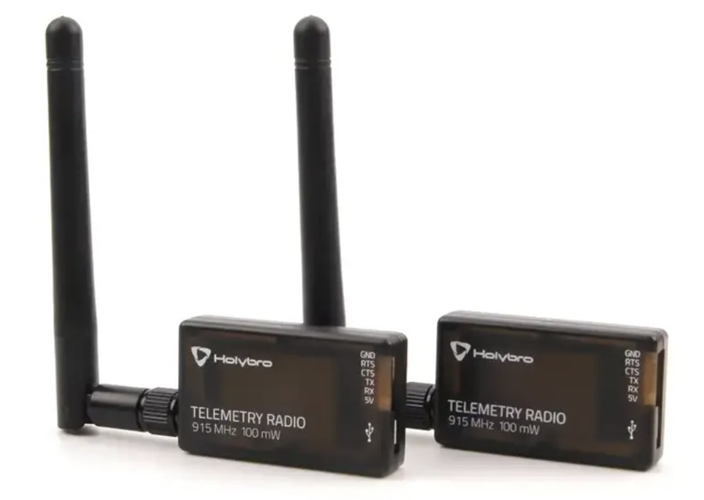
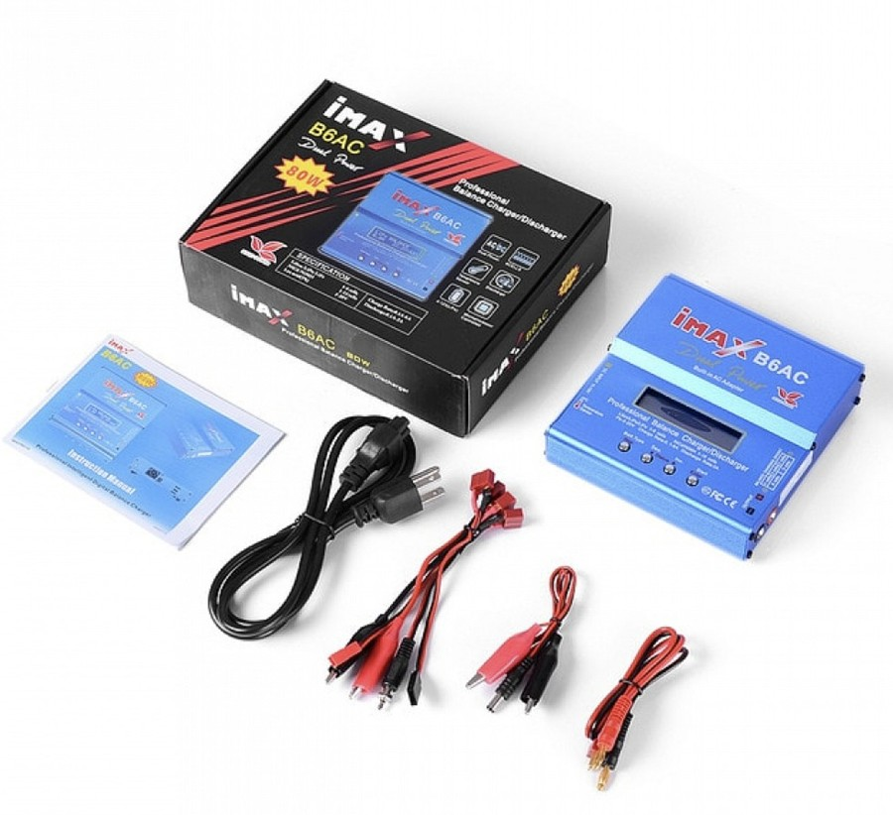
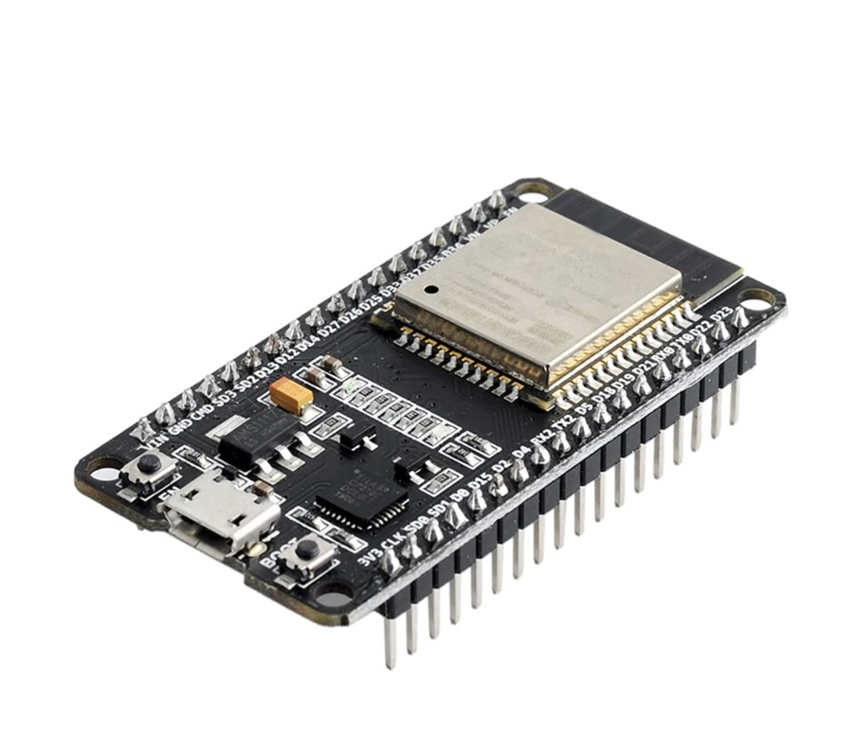
Reference photos with mismatches flagged
PROJECT NAVI // VIT CHENNAI [SCOPE • SENSE • SMEC] // BACKUP A10
// REFERENCE PHOTOS · MISMATCHES
User-supplied component reference images. Supplier not identifiable from the files. Printed markings are not retouched.
F450 KIT
Frame, 4 motors, 4 separate ESCs, props
F405 V3 FC
FC only
M8N GPS + COMPASS
On mast
3S 3300 mAh LiPo
Planned pack
SiK TELEMETRY PAIR
Onboard + ground
iMAX B6AC
Ground charger
ESP32 DevKit
Optional Wi-Fi bridge
4-IN-1 ESC SHOWN IN REFERENCE ONLY
REFERENCE IMAGE. FINAL PACK TO USE XT60
REFERENCE PHOTO: 915 MHz UNIT. PLANNED LINK: 433 MHz
STATUS // REFERENCE IMAGES · NOT PHOTOS OF TEAM HARDWARE
SRC: User-supplied photos; Summary §7
[ A10 ]
Notes:
Photos are user-supplied component references; original suppliers not identifiable from the files. Mismatches: (1) F405 V3 photo also shows a BLS 50A 4-in-1 ESC: reference only, not in BOM, because the F450 kit already has four ESCs (Summary §7). (2) SiK photo is visibly marked 915 MHz; the planned link is 433 MHz, and the printed frequency is not retouched. (3) Battery photo (3300 mAh 50C) shows a non-XT60 connector; the final pack must use XT60. Connector compatibility is not inferred from the image. No photos are shown for the transmitter, receiver, power module, landing gear or safe bag, because none were supplied.

Slide 29
Bill of materials: planning estimates by stage
PROJECT NAVI // VIT CHENNAI [SCOPE • SENSE • SMEC] // BACKUP A11
// COMPONENT BOM · PLANNING ESTIMATES
ITEM | SPEC | APPROX. PRICE | STAGE
F450 kit (frame, 4× A2212 1000KV, 4× 30A ESC, props) | Untick KK2.1.5 board in combo | ₹4,059 (confirmed listing) | Airframe
Flight controller | SpeedyBee F405 V3, FC only; on ArduPilot list | ₹3,000–4,500 | 1
RC radio | FlySky FS-i6X + iA6B (iBUS) | ₹3,500–4,500 | 1
Battery · charger · power module | 3S 3300 mAh XT60 · iMAX B6AC · V/I + 5 V | ₹1,500–2,200 · ₹1,200–2,500 · ₹500–800 | 1
GPS + 2nd battery | NEO-M8N/M10 with compass, mast | ₹1,200–2,000 · ₹1,500–2,200 | 2
Ground link | SiK 433 MHz pair (or ESP32 bridge ₹400–500) | ₹2,500–4,000 | 3
STATUS // PLANNING ESTIMATE · ONLY AIRFRAME KIT PRICE CONFIRMED
SRC: Summary §6 pp5–7; §7 p7
[ A11 ]
Notes:
Prices are planning estimates from Indian hobby-store listings at the time of planning (Summary §6). Only the F450 kit price was confirmed against a live listing. Recheck every link before ordering. Stage 2 and 3 items are bought only after a steady manual hover.

Slide 30
Budget ranges sit around, not inside, the ₹25,000 pool
PROJECT NAVI // VIT CHENNAI [SCOPE • SENSE • SMEC] // BACKUP A12
// BUDGET · STAGED PROCUREMENT
CONFIGURATION | RANGE | AT MID PRICES
Airframe (identified) | ≈ ₹4,600 incl. spare motor & XT60 pairs | —
Stage 1: get it hovering | ₹11,300–17,100 | —
Airframe + Stage 1 + Stage 2 (supervised autonomy) | ₹18,600–25,900 | ≈ ₹20,000
+ SiK telemetry (unattended-capable) | ₹21,100–29,900 | ≈ ₹23,500
Team pool | 5 × ₹5,000 | ₹25,000
Crash reserve to hold back | ₹1,500–2,000 | until proper flight
BUYING RULES (SUMMARY §7)
FC must appear on firmware.ardupilot.org under its exact name · buy the FC alone, not an FC + 4-in-1 ESC stack · no KK2.1 / APM 2.8 boards · GPS must include a compass · receiver must output iBUS, SBUS or PPM · check motor KV and kit contents against photos · radio band legality to be checked against current official rules
STATUS // PLANNING ESTIMATE · PRICES MUST BE RECHECKED BEFORE ORDERING
SRC: Summary §6 pp5–7
[ A12 ]
Notes:
Budget compliance is not guaranteed: the SiK-inclusive range reaches ₹29,900 against a ₹25,000 pool. The ₹23,500 figure is a midpoint estimate, not a quotation, and prices have not been reconfirmed. Staged buying limits exposure: airframe, FC, radio and battery first; GPS, second battery and telemetry only after a steady manual hover. One person keeps a shared spending sheet with receipts.

Slide 31
A 15 m lead is a design target, not proof of safe separation
PROJECT NAVI // VIT CHENNAI [SCOPE • SENSE • SMEC] // BACKUP A13
// POSITIONING · SEPARATION · MEASUREMENT
AIRCRAFT GNSS
2.5–5 m
M8N, no RTK · estimate
VISITOR PHONE
7–13 m
Browser geolocation · estimate
LEAD TARGET
≈15 m
Design target (was 10–12 m)
PAD CLEAR AREA
≈5 × 5 m
Design target · GPS scatter
PROPOSED MITIGATION (DESIGN INTENT) | MEASUREMENT THAT RESOLVES IT
Reject samples implying impossible walking speed; require several consistent samples | Log several handsets on a known route; derive error distribution
Project visitor onto the route graph; hysteresis on hold/resume | Tune L_hold / L_resume in SITL, then with a walking volunteer
Operator phone or dedicated tracker if visitor phone locks or degrades | Test screen-lock throttling on target handsets
Hold whenever readings disagree | GPS spot-check at 5–6 known nodes; hover error vs wind
STATUS // PLANNING ESTIMATES · CONTEXTUAL, NOT CERTIFIED BOUNDS
SRC: Summary §8 p8; §14 p12; §17 pp13–14
[ A13 ]
Notes:
Aircraft GPS error of about 2.5–5 m and phone error of about 7–13 m are contextual estimates from the summary (§14 attributes the phone figure to the team's literature review; the primary source is not in the supplied files). They are not guaranteed campus performance. A naive worst-case sum (5 + 13 = 18 m) already exceeds 15 m, so the lead alone cannot be claimed to absorb the error. Separation also depends on cruise altitude (the summary's flat 15 m altitude is a placeholder pending the per-segment obstruction survey). Thresholds must be set from measured data.

Slide 32
350 m stays provisional until endurance is measured
PROJECT NAVI // VIT CHENNAI [SCOPE • SENSE • SMEC] // BACKUP A14
// ENDURANCE · WALKING TIME · LEG LIMIT
ROUTE | t_walk = d / 0.8 m/s | +15% STOP ALLOWANCE | ÷ 0.8 IF 25% RESERVE HELD BACK
157 m · Gazebo (UI example) | 3.27 min (3 m 16 s) | 3.76 min | 4.70 min
316 m · longest pad leg | 6.58 min | 7.57 min | 9.46 min
350 m · provisional limit | 7.29 min | 8.39 min | 10.48 min
700 m | 14.58 min | 16.77 min | 20.96 min
NOT INCLUDED IN ANY COLUMN: launch, climb, landing, return leg
RULES FOR FUTURE LEG SIZING
1. Define usable endurance explicitly, measured by a timed hover to failsafe with the real payload. 2. State whether reserve is already deducted; apply it once. 3. Add launch, climb, landing and stop allowances separately. 4. Include any return leg. 5. Re-run greedy set cover and re-check every destination after measurement.
STATUS // RECALCULATED FROM SUMMARY ASSUMPTIONS · NOT MEASURED
SRC: Summary §8 p8; §10 p9
[ A14 ]
Notes:
Recalculated with t_walk = distance / speed at 0.8 m/s. The summary's table value of 10.5 min for 350 m equals 7.29 min × 1.15 (stop allowance) ÷ 0.8 (25% reserve held back) ≈ 10.48 min. That is the battery time needed with reserve, not the walking time. The older statement "about 8 minutes of usable flight gives 350 m" does not state its assumptions consistently (7.29 × 1.15 = 8.39 min before reserve), so we do not present it as a derivation. Launch, climb, landing and any return leg are NOT included and must be added. The F450 hover estimate of roughly 10–13 min (3300 mAh) is an estimate, and hover is not the same as slow forward flight. Recompute pad coverage after the timed hover to failsafe.

Slide 33
Failsafe matrix: designed responses, verification pending
PROJECT NAVI // VIT CHENNAI [SCOPE • SENSE • SMEC] // BACKUP A15
// SAFETY · DESIGNED RESPONSES
CONDITION | DESIGNED RESPONSE | SEVERITY | VERIFICATION (PENDING)
GPS fix degraded or lost (EKF failsafe) | Hold if possible, otherwise land | HIGH | Bench props-off; GPS-denied test; RC takeover drill
Telemetry link lost | Return to launch (or land at nearest pad) | HIGH | Unplug ground radio in SITL, then in field
RC link lost (when in use) | Return to launch | HIGH | Transmitter-off test, props-off first
Visitor position stale > 30 s | Hold position, then return to launch | MEDIUM | Simulation now; SITL; walking volunteer
Battery below reserve | Return to launch immediately | HIGH | Bench voltage threshold; timed hover
Geofence breach | Stop and hold, then return | HIGH | Fence export to ArduPilot; SITL breach
Wind or rain above threshold | Do not launch (pre-trip check) | MEDIUM | Hover error vs wind sets threshold
STATE MACHINE SAFE → WARNING → HOLD → RETURN_TO_LAUNCH → EMERGENCY · six faults injected in simulation today
STATUS // DESIGNED RESPONSES · FIRMWARE CONFIG & FIELD VERIFICATION PENDING
SRC: Summary §12 p11; §13 p11
[ A15 ]
Notes:
These are designed responses from the summary, not verified firmware behaviour. GPS degradation may itself prevent a reliable hold or RTL, so we do not promise that every fault ends in a safe return. The response then is to land, with the safety operator ready on the RC link. Principles: hold then return, never continue on stale data; waypoint whitelist; road edges carry a cost multiplier so routes prefer verges and open ground; the visitor walks the footpath, never the carriageway; every failsafe is triggered deliberately, props-off first.

Slide 34
Six phases, each closed by a definition-of-done gate
PROJECT NAVI // VIT CHENNAI [SCOPE • SENSE • SMEC] // BACKUP A16
// WORK PLAN · VERIFICATION GATES
PHASE | WORK | GATE (DEFINITION OF DONE)
0 · Permissions & purchase | Written campus permission; check registration needs; order airframe, FC, radio, battery, charger | Permission letter held; Stage 1 parts in hand
1 · Assembly & bench | Build F450, wire power and FC, flash ArduPilot, calibrate sensors, ESCs and radio; failsafes props-off | All calibrations pass; failsafes verified on bench
2 · Manual flight | Hover in open ground, tune, check vibration logs, timed hover to failsafe | Steady hover; acceptable vibration; measured flight time
3 · GPS autonomy | Add GPS; position hold, RTL, then node-to-node routes with no visitor | Repeatable route flight without intervention
4 · Human pacing | Pacing controller in SITL first, then with a walking volunteer; tune lead and hold | Pacing validated in SITL before any live trial
5 · Integration & trials | Kiosk, phone intake, SiK link, failsafe drills, guided volunteer trials | Every failsafe triggered and observed; successful guided trips
STATUS // PROPOSED PLAN · RELATIVE PHASES · NO DATES SUPPLIED
SRC: Summary §16 p13; §17 pp13–14
[ A16 ]
Notes:
No calendar dates were supplied, so phases are relative. Bring-up rule (Summary §16): assume nothing works until proven; check every connection; test with props removed; calibrate from scratch; get a steady manual hover before any autonomy; let the pacing code crash in SITL first.

Slide 35
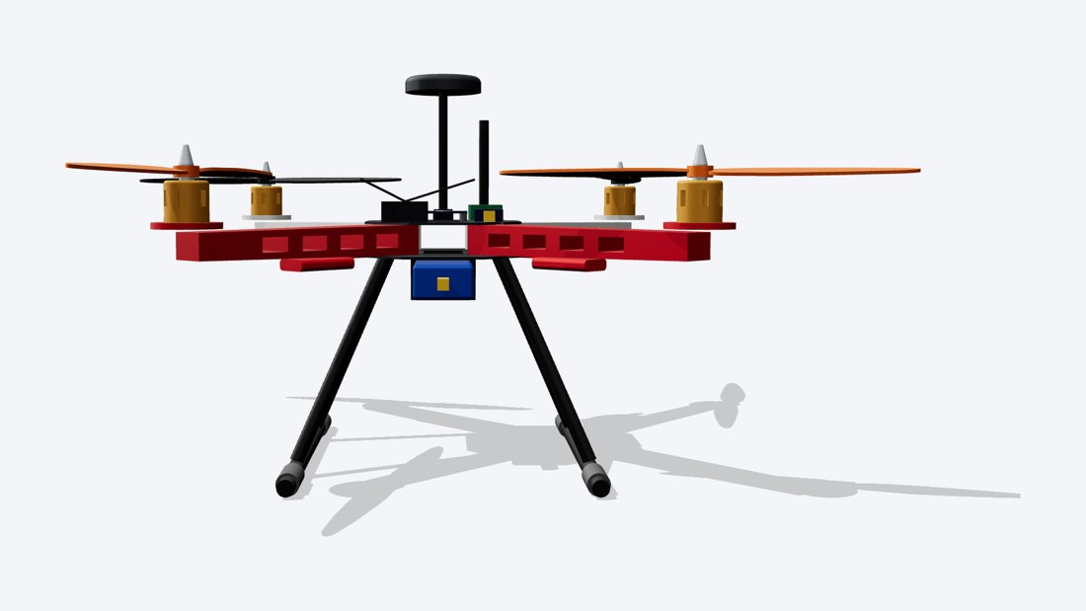
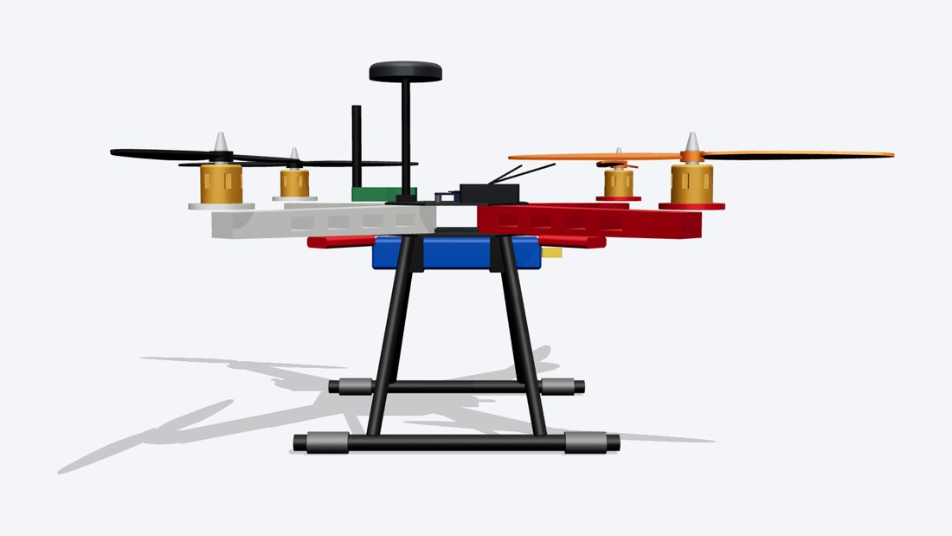
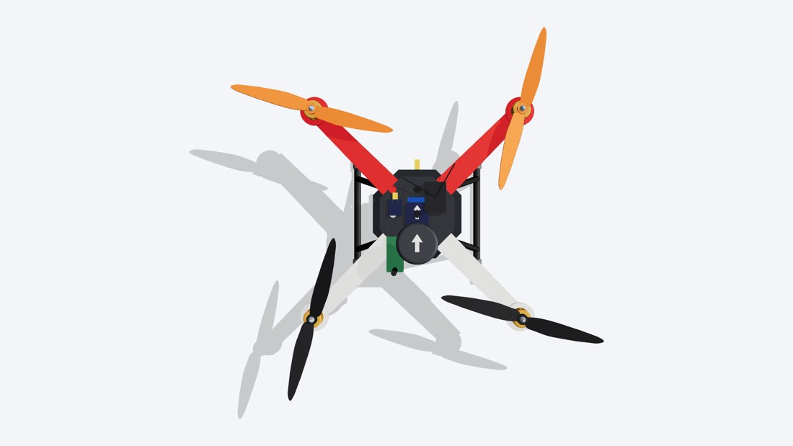
CAD views show orientation, not measured dimensions
PROJECT NAVI // VIT CHENNAI [SCOPE • SENSE • SMEC] // BACKUP A17
// CAD · ORIENTATION · LIMITATIONS
FRONT
SIDE
TOP
NOMINAL PARAMETER (CAD SOURCE) | VALUE | STATUS
Wheelbase (motor-to-motor diagonal) | 450 mm | Nominal F450
Propeller diameter | 254 mm (1045) | Nominal
Landing gear below bottom plate | 150 mm | Nominal · clearance to measure
Battery block | 138 × 43 × 25 mm | Approximate · exact pack pending
Orientation | +X forward (red arms, orange props), Z up | CAD convention
STATUS // DESIGN MODEL · NOMINAL DIMENSIONS · NOT MEASURED
SRC: NAVI_CAD/README.txt; navi_drone.py
[ A17 ]
Notes:
Supplied renders navi_front.png, navi_side.png and navi_top.png. CAD convention: +X forward (red arms, orange props), Z up, units mm. Nominal values in navi_drone.py: 450 mm wheelbase, 254 mm (10 in) props, battery block 138 × 43 × 25 mm, landing gear 150 mm below the bottom plate, arm height 22 mm. These are approximations for layout and visualisation, not measurements of purchased parts. Underside clearance between battery and ground must be measured after assembly.

Slide 36
Ready-made options failed the MAVLink or budget test
PROJECT NAVI // VIT CHENNAI [SCOPE • SENSE • SMEC] // BACKUP A18
// HARDWARE ALTERNATIVES · VERDICT MATRIX
OPTION CONSIDERED | VERDICT | REASON
ADAPT lab hardware (S500, Pixhawk, RTK F9P) | Unavailable | Not obtainable by the team
MDP / IDP component store | Unavailable | Team cannot draw components
LiteWing ESP32 micro drone | Rejected (main) | ~45 g, no GPS, indoor firmware, short range
Indoor drone or robot | Rejected | No GPS indoors; weakens the problem; discards campus work
Outdoor ground robot | Kept as backup | Cheapest; same software; team prefers aerial
ESP32 as flight controller | Rejected | ArduPilot ESP32 port experimental; used only as bridge
Toy camera drone / GPS camera drone | Rejected | Closed firmware, no MAVLink; follow-me follows
Pixhawk 2.4.8 full combo (₹15,599) | Rejected on cost | Build would reach ₹27,000–31,000
FlyRobo kit / Amazon F450 kit | Rejected | KK2.1.5 cannot run ArduPilot / ~₹3,000 dearer
F450 kit from RC store (₹4,059) | SELECTED (PLANNED) | Same parts, lowest price found, in stock
STATUS // DECISION RECORD · SOURCE-REPORTED
SRC: Summary §3 p4
[ A18 ]
Notes:
Test applied (Summary §3): if ArduPilot (or PX4) cannot be flashed and the aircraft cannot be commanded over MAVLink, it cannot be NAVI. Consumer drones run closed firmware, and their follow-me modes follow rather than lead.

