Slide 1
World Climatic Dataset
Last Update : 18/10/2022
Sayan Karmakar

Slide 2
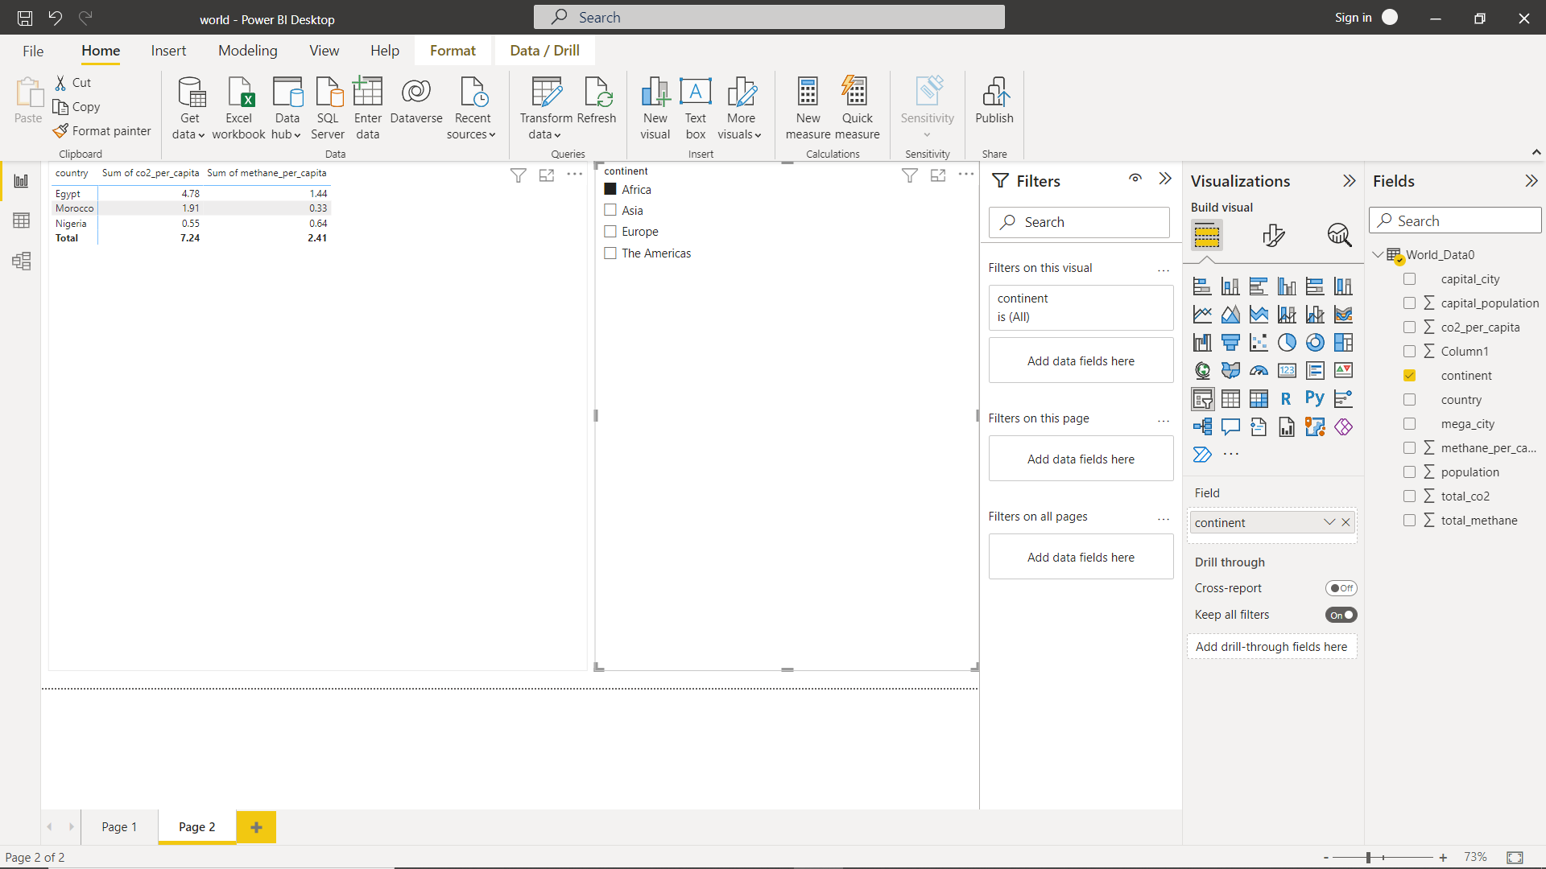
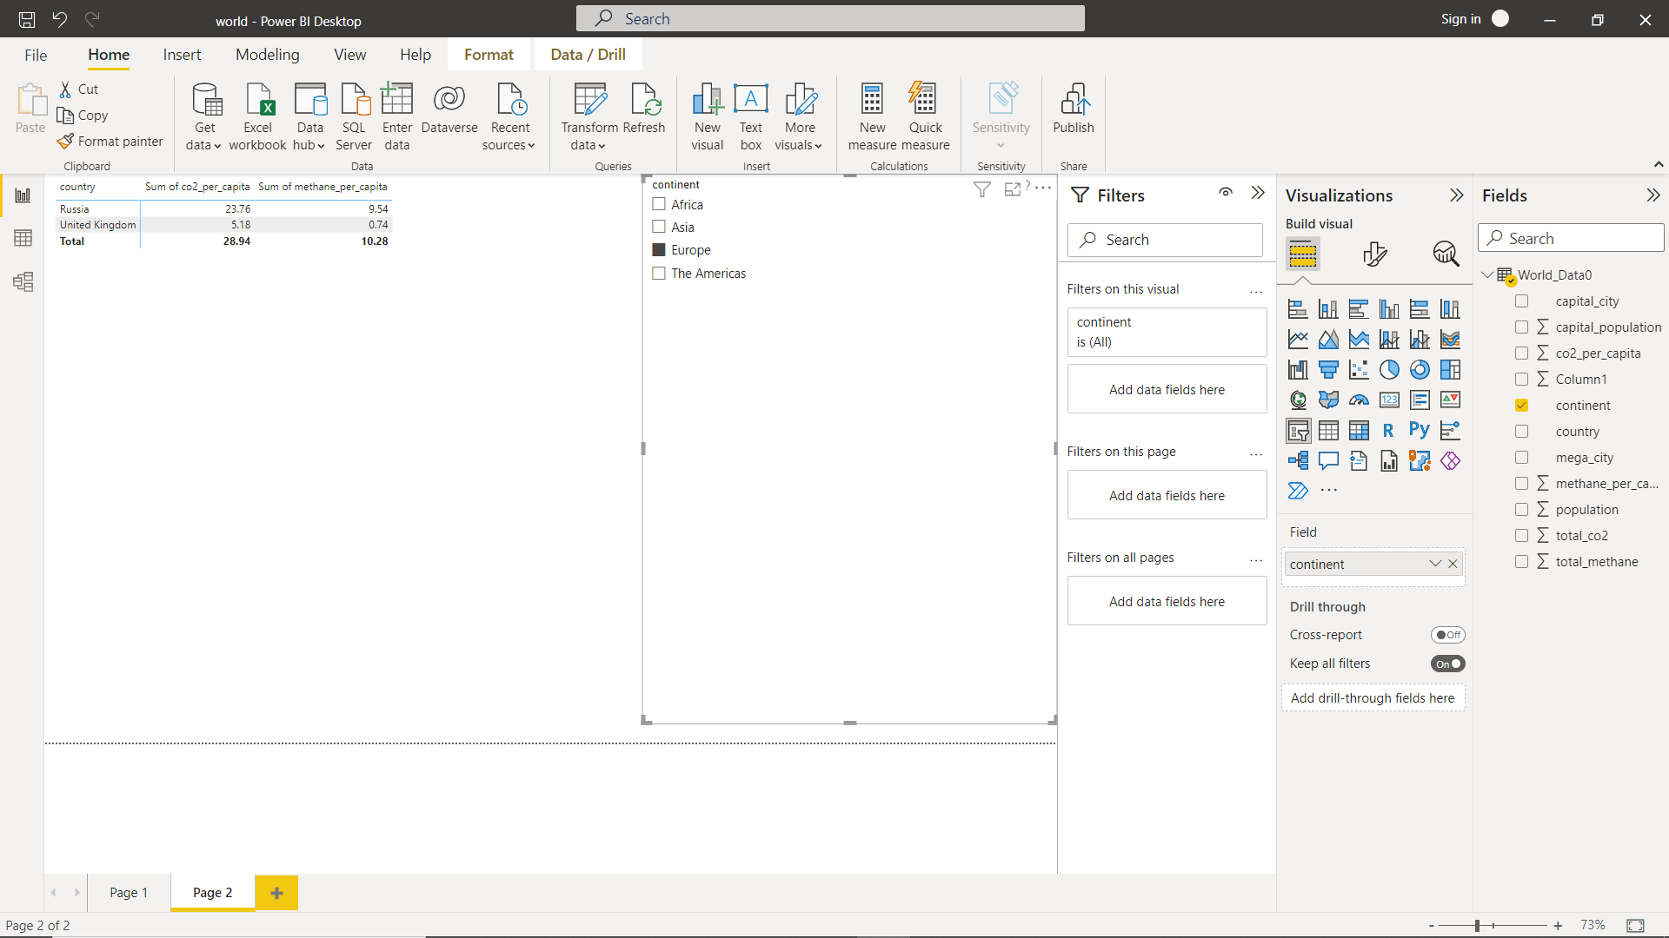
Most Co2 & Methane Per Capita in Africa(Continent) Country's:
Egypt
Morocco
Nigeria
Most Co2 & Methane Per Capita in Europe(Continent) Country's:
Russia
United Kingdom

Slide 3
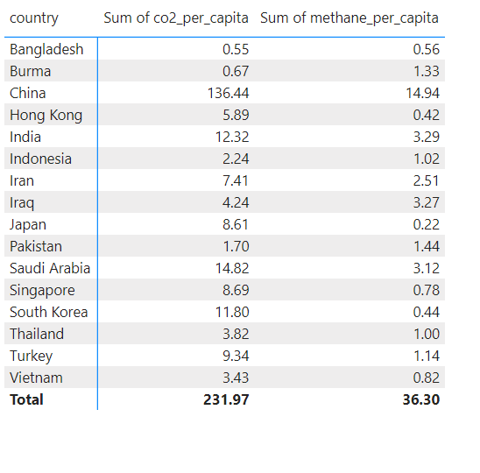
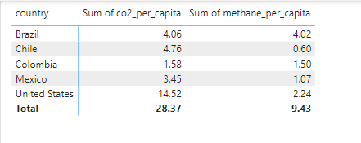
Most Co2 & Methane Per Capita in Asia(Continent) Country’s(Top 10):
Bangladesh
Burma
China
Hong Kong
India
Indonesia
Iran
Iraq
Japan
Pakistan
Most Co2 & Methane Per Capita in Americas(Continent) Country’s
Brazil
Chile
Colombia
Mexico
United States

