Slide 1
Temporal Databases: Concepts and Applications
Managing Data That Changes Over Time
Course: Database Management Systems (BTS30102)
Presented by: Sayantan Bharati | BWU/BTS/25/503 | Section B
Programme: B.Tech (CSE), Batch 2025, AY 2026-27 (Odd Semester 3)
Faculty: Ataul Hoque Mandal
Department of Computer Science & Engineering, Brainware University
Date: 13-10-2026
Notes:
Good morning. I am Sayantan Bharati. My topic is Temporal Databases : how a database can store not just the current value of data, but its entire history over time, and why that matters in the real world.

Slide 2
Introduction : Why Do We Need Time in Databases?
A conventional DBMS keeps only the current state : the old value is overwritten.
But many questions are about the past: "What was the salary in 2023?"
Overwriting data destroys the audit trail and the ability to reproduce past decisions.
Temporal databases store time as a first-class part of every fact.
They answer when a fact was true and when the database believed it was true.
Built on standard DBMS ideas : schema, keys, transactions, indexing : extended with time.
Conventional
Emp101 | Salary = 70000
old value GONE
Temporal
Emp101 | 50000 | 2020–2023
Emp101 | 70000 | 2023–now
history kept
Temporal Databases: Concepts and Applications | Sayantan Bharati | BWU/BTS/25/503 | Section B | BTS30102
2
Notes:
The core problem is simple: a normal database only shows today. The moment we update a salary, the previous salary is gone forever. Temporal databases fix this by keeping every version with a time stamp, so historical questions can still be answered.

Slide 3
Presentation Outline
1
The Need for Time in Data
6
Temporal Querying & Interval Algebra
2
Core Concepts & Time Dimensions
7
Implementation & Indexing
3
Temporal Data Models
8
Worked Example : Salary History
4
Real-World Applications
9
Temporal Databases & Transactions
5
SQL:2011 Temporal Features
10
Challenges, Best Practices & Future
Temporal Databases: Concepts and Applications | Sayantan Bharati | BWU/BTS/25/503 | Section B | BTS30102
3
Notes:
I will start with the motivation, define the two kinds of time, survey the models and the SQL standard, look at real applications, then show implementation, a worked example, and finally the challenges and future of the field.

Slide 4
Why Conventional Databases Fall Short
Conventional DBMS = snapshot database: only the current moment is stored.
An UPDATE or DELETE physically destroys the previous value.
Audit, legal and analytical questions then become impossible or costly.
Common workarounds are weak: history tables, shadow copies, log mining.
History tables duplicate schema, drift over time and are hard to query uniformly.
A temporal DBMS makes history a built-in, queryable dimension.
Snapshot DBMS
50000
70000
old value overwritten
Temporal DBMS
50000
70000
2020
2023
now
Temporal Databases: Concepts and Applications | Sayantan Bharati | BWU/BTS/25/503 | Section B | BTS30102
4
Notes:
Before defining anything, it is worth seeing the gap. Normal updates erase history. People patch this with manual history tables, but those are clumsy and error-prone. A temporal database treats time as a natural part of the schema instead of an afterthought.

Slide 5
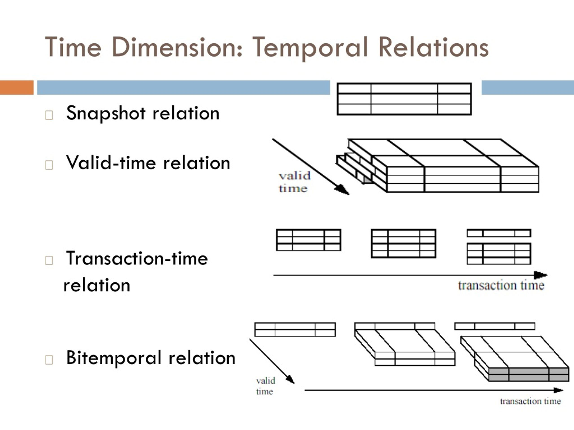
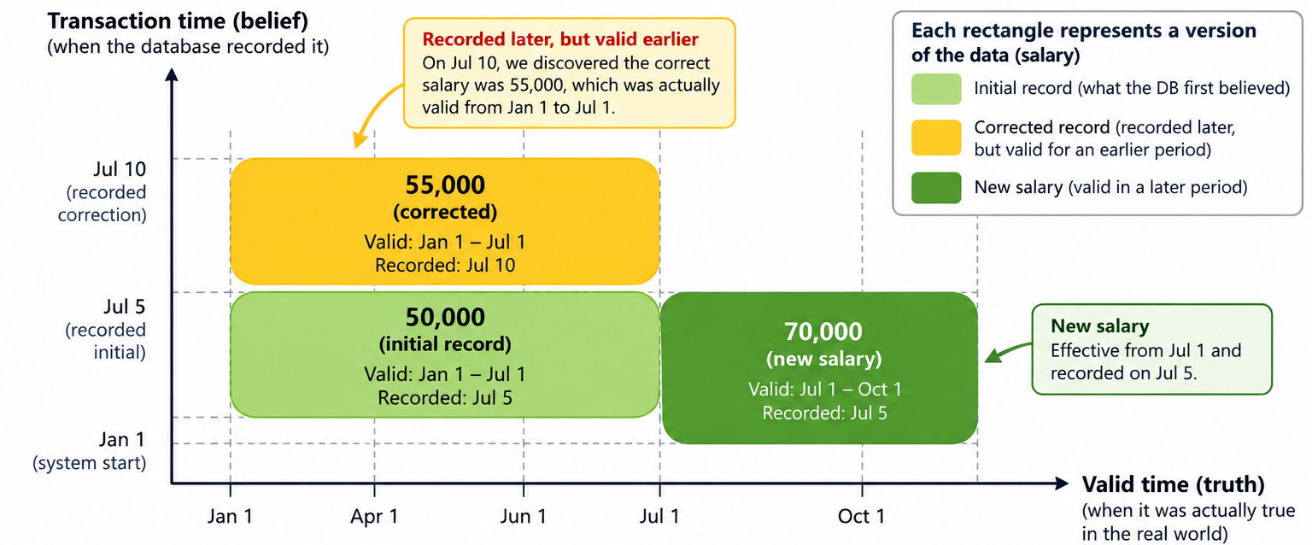
The Two Kinds of Time
Valid time (application time): when the fact is true in the real world.
Transaction time (system time): when the fact was stored/believed by the DBMS.
Bitemporal databases track both at once.
Examples: "the price was valid in March" vs "the price was recorded on 2 April".
Timestamp = a single instant; interval/period = a start and end.
These dimensions give rise to the bitemporal cube of possible questions.
Temporal Databases: Concepts and Applications | Sayantan Bharati | BWU/BTS/25/503 | Section B | BTS30102
5
Notes:
The single most important idea today is that there are two different clocks. Valid time says when something was true in the real world; transaction time says when our database learned it. A bitemporal system keeps both, which lets us ask questions like "what did we believe last month, and what was actually true then?"

Slide 6
Temporal Data Models
Snapshot model : no time; classic DBMS.
Rollback / transaction-time model : versions by when they were stored.
Valid-time (historical) model : versions by real-world validity.
Bitemporal model : both valid and transaction time.
SQL:2011 standardized these as system-versioned and application-time period tables.
Each model trades storage and complexity for richer history.
Model | Valid time | Trans. time | Typical use
Snapshot | – | – | Current-only apps
Rollback | – | Yes | Auditing, recovery
Valid-time | Yes | – | Contract / price history
Bitemporal | Yes | Yes | Regulatory, finance
Temporal Databases: Concepts and Applications | Sayantan Bharati | BWU/BTS/25/503 | Section B | BTS30102
6
Notes:
There is a ladder of models. A snapshot database remembers nothing. A rollback database remembers when data was written. A valid-time database remembers when data was true. Bitemporal combines both. SQL 2011 gave us standard syntax for the first and third of these.

Slide 7
Where Temporal Databases Are Used
Banking & finance
balances, interest rates and transaction histories.
Insurance
policies valid over ranges; claims recorded later.
BF
I
Healthcare
patient conditions valid over time vs when entered.
Audit & compliance
immutable, queryable audit trails.
H
AC
Supply chain & telecom
pricing, inventory and billing history.
Data warehousing
type-2 slowly changing dimensions are temporal by nature.
SC
DW
Temporal Databases: Concepts and Applications | Sayantan Bharati | BWU/BTS/25/503 | Section B | BTS30102
7
Notes:
Temporal databases are not academic. Every time you see a bank statement, an insurance policy history, or a patient record that shows changes over time, you are seeing temporal data. Regulators increasingly require that this history is retained and queryable.

Slide 8
Querying Time with SQL:2011
System-versioned tables start with: WITH SYSTEM VERSIONING.
Application-time period tables declare: PERIOD FOR valid_time (start_date, end_date).
Query a past state: SELECT ... FOR SYSTEM_TIME AS OF TIMESTAMP '2023-06-01'.
Update only a portion of history: UPDATE ... FOR PORTION OF valid_time FROM ... TO ....
Temporal primary keys prevent overlapping valid periods.
This turns history queries into normal SQL instead of hand-written joins.
SQL
CREATE TABLE salary (
emp_id INT,
amount DECIMAL(10,2),
valid_time PERIOD FOR valid_time(from_date, to_date),
PRIMARY KEY (emp_id,valid_time WITHOUT OVERLAPS)
) WITH SYSTEM VERSIONING;
-- What did the system store on 1 June 2023?
SELECT * FROM salary
FOR SYSTEM_TIME AS OF TIMESTAMP '2023-06-01';
AS OF = the database exactly as it looked on any past date
Temporal Databases: Concepts and Applications | Sayantan Bharati | BWU/BTS/25/503 | Section B | BTS30102
8
Notes:
The beauty of SQL 2011 is that it hides all the complexity behind familiar syntax. `FOR SYSTEM_TIME AS OF` gives you the database as it looked on any past date. Application-time periods let updates affect only a slice of history. So the developer writes ordinary SQL.

Slide 9
Asking Questions About Intervals
Time can be an instant (timestamp) or an interval/period (start, end).
Allen's interval algebra defines 13 possible relations between two intervals.
Examples: before, after, meets, overlaps, contains, during, equals.
Temporal SQL extends joins and predicates with these relations.
Finding overlaps is the most common operation (e.g., "who held the role then?").
Efficient interval logic is what separates temporal query languages from plain SQL.
Allen's 13 relations: A (green) vs B (dark)
before
after
meets
met-by
overlaps
overlapped-by
starts
started-by
during
contains
finishes
finished-by
equals
Temporal Databases: Concepts and Applications | Sayantan Bharati | BWU/BTS/25/503 | Section B | BTS30102
9
Notes:
Once time is a period rather than a point, comparisons multiply. Allen's algebra enumerates all thirteen ways two intervals can relate : before, overlaps, contains and so on. Temporal query languages embed these so that "overlapping" queries become one predicate instead of a tangle of greater-than and less-than conditions.

Slide 10
How Temporal Databases Are Built
Tuple versioning: store one row per version, each with start/end timestamps.
Attribute-level timestamping: timestamp individual changed columns (saves space).
Transaction-time gives an append-only, immutable store : high write throughput.
Indexing must handle ranges, not just points : e.g., interval / temporal B+ trees.
Common structures: R-trees for intervals, temporal B+ trees, append-only LSM stores.
MVCC and timestamping (from the concurrency unit) are close cousins of temporal storage.
B+ tree keyed on (id, time)
(101, 2022)
index
index
101|t1
101|t2
101|t3
101|t4
interval scan over highlighted leaves
One row per version: id | value | start | end
Temporal Databases: Concepts and Applications | Sayantan Bharati | BWU/BTS/25/503 | Section B | BTS30102
10
Notes:
Implementation choices matter. The simplest is to store every version as its own row with a start and end time. That makes writes append-only and fast, and it links naturally to MVCC and transaction logging from the concurrency chapter. The tricky part is indexing ranges efficiently, which is why interval-aware trees are used.

Slide 11
Worked Example : Tracking Salaries
Scenario: an employee's salary changes over time; we must answer past questions.
Store each version with from_date, to_date (valid time).
Query 1: salary on a given date → select the row whose period contains it.
Query 2: full raise history → order rows by from_date.
Query 3: total cost over a period → join with interval overlap.
With system versioning, also ask "what did the DB believe on date X?".
50000
70000
2020
2023
9999
Q1 date lookup · Q2 raise history · Q3 cost by overlap
SQL
emp_id amount from_date to_date
101 50000 2020-01-01 2023-01-01
101 70000 2023-01-01 9999-12-31
-- salary on 2021-05-10
SELECT amount FROM salary
WHERE emp_id = 101 AND
DATE '2021-05-10'
BETWEEN from_date AND to_date;
Temporal Databases: Concepts and Applications | Sayantan Bharati | BWU/BTS/25/503 | Section B | BTS30102
11
Notes:
This is the same idea we just discussed, made concrete. Each salary change becomes a new row with a validity period instead of an overwrite. Finding the salary on any date is now just a range check, and the full raise history is simply all the rows in order.

Slide 12
Ties to Transactions & Concurrency
Transaction time is exactly what a transaction log / recovery already records.
MVCC keeps multiple versions of a row : the same versioning idea.
Timestamp-based schedulers already order operations by time.
Temporal storage is naturally append-only, so it is rollback-friendly.
Serializability still applies: history must reflect a consistent order of transactions.
This connects directly to the course's transaction, ACID and recovery modules.
Transaction log
MVCC versions
Bitemporal store
A
C
I
D
Temporal Databases: Concepts and Applications | Sayantan Bharati | BWU/BTS/25/503 | Section B | BTS30102
12
Notes:
Temporal databases are not a completely separate world. Transaction time is essentially the story a transaction log already tells, and multi-version concurrency control already stores several versions of a row. Temporal storage simply promotes that internal mechanism to a first-class, user-queryable feature.

Slide 13
Challenges, Best Practices & Future
Storage growth : every change becomes a permanent version.
Performance : range/interval indexes are costlier than point indexes.
Complexity : developers must reason about two timelines.
Privacy : "right to be forgotten" conflicts with immutable history; needs crypto-shredding.
Best practices: define retention policy, choose the right model, index intervals, separate hot/cold data.
Future: cloud temporal services, ML on history, blockchain-anchored audit trails.
Benefits
Challenges
Full audit trail
Time-travel queries
Regulatory ready
Storage growth
Costlier indexes
Two timelines
Privacy
Future → cloud temporal services, ML on history, blockchain-anchored audit
Temporal Databases: Concepts and Applications | Sayantan Bharati | BWU/BTS/25/503 | Section B | BTS30102
13
Notes:
Every powerful idea has a cost. Keeping all history means storage grows forever, interval queries are slower than point queries, and privacy law can clash with immutability. The practical answer is a clear retention policy and the right model, and the field is moving toward cloud-hosted temporal services.

Slide 14
References & Thank You
A. Silberschatz, H. Korth, S. Sudarshan : Database System Concepts (7th ed.), McGraw Hill.
R. Elmasri & S. Navathe : Fundamentals of Database Systems, Addison-Wesley.
ISO/IEC 9075 : SQL:2011 temporal features (system-versioned & application-time tables).
R. T. Snodgrass : Developing Time-Oriented Database Applications in SQL.
Course lecture notes : DBMS Modules 1–3 (data models, transactions, storage).
Thank you.
Sayantan Bharati | BWU/BTS/25/503 | Section B
Temporal Databases: Concepts and Applications | Sayantan Bharati | BWU/BTS/25/503 | Section B | BTS30102
14
Notes:
These are the standard references behind this presentation. Thank you for listening : I am happy to take any questions.

