Slide 1
Supermarket Management System using C++
This slide introduces the project, a console-based application that simulates a supermarket system.
It highlights the roles of the users in the system: Owner, Worker, and Customer.
The slide also emphasizes that the system is built using object-oriented programming principles to handle role-specific functionalities.
By Sayantan Das, 24BSA10042

Slide 2
Class Structure Overview
Item Class: Represents the inventory items in the supermarket. It stores the item's name, price, and quantity.
User Class: An abstract class that acts as a base for role-specific classes. It declares a pure virtual function menu(), which must be implemented by the derived classes.
Supermarket Class: Manages core supermarket data such as inventory, sales, and expenses. It also handles file I/O operations for saving and loading the data.

Slide 3
OOP Concepts Overview
Abstraction: This is achieved through the abstract User class, which contains a pure virtual function menu(). This function will be implemented differently for each user role.
Encapsulation: The Supermarket class encapsulates all the necessary data, such as inventory, expenses, and sales. It hides the implementation details and only exposes necessary methods to interact with the data.
Inheritance: The Owner, Worker, and Customer classes inherit from the User class and the Supermarket class. This means that these classes share common behaviors and can add their specific functionalities.
Polymorphism: Achieved through the overridden menu() function in the derived classes. Even though the menu() function is called in the base class (User), each derived class implements its own version of the menu, based on the role of the user.

Slide 4
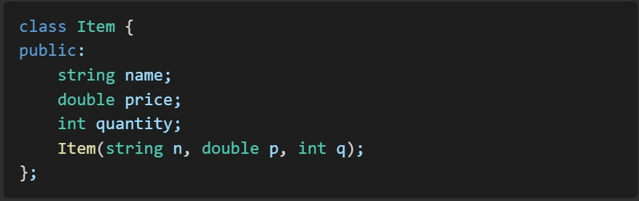
Item Class
This slide shows the Item class that holds the details of each inventory item.
The constructor initializes the name, price, and quantity of each item.
This class is used by all roles in the system.

Slide 5
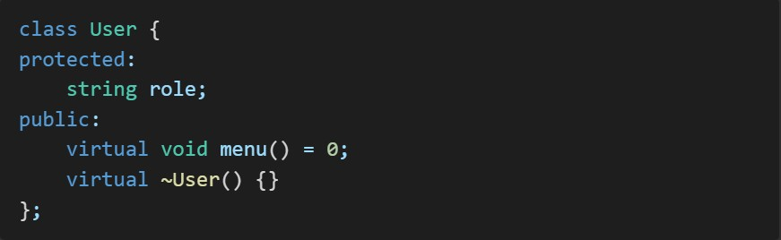
Abstract User Class
The User class is abstract, meaning it cannot be instantiated on its own.
It contains a pure virtual function menu(), which each derived class (Owner, Worker, Customer) will implement based on their specific needs.
The role of the user is stored as a string in the role member.

Slide 6
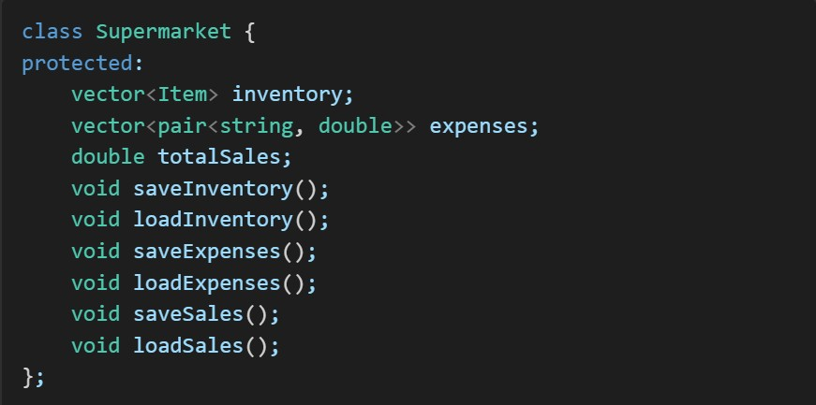
Supermarket Class Responsibilities
This slide describes the Supermarket class, which is responsible for managing inventory, expenses, and sales.
It includes methods for saving and loading inventory, expenses, and sales from CSV files.
The methods such as saveInventory(), loadInventory(), etc., are used for file operations, keeping the data persistent.

Slide 7
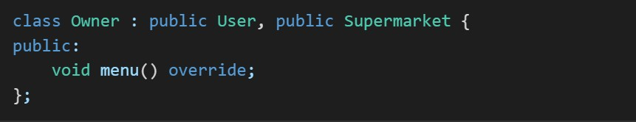
Owner Class Features
The Owner class extends User and Supermarket.
It implements the menu() function to provide the Owner role's functionalities:
Add items to inventory 2.View current inventory 3. Add expenses 4. Add expenses
View total sales
These actions are available to the Owner as they have full control over the supermarket.

Slide 8
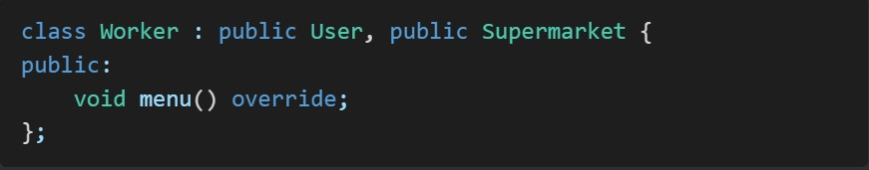
Worker Class Features
The Worker class also extends User and Supermarket.
It implements the menu() function for the Worker role, allowing workers to:
Sell items from the inventory
View available inventory
Workers are primarily focused on selling items and monitoring the stock available.

Slide 9
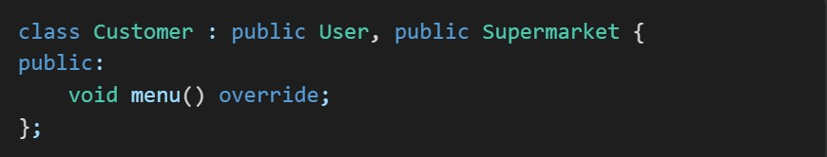
Customer Class Features
The Customer class extends User and Supermarket.
It implements the menu() function for the Customer role, allowing customers to:
View available items in the store
Customers do not have permissions to modify any data (e.g., they cannot sell items or change inventory).

Slide 10
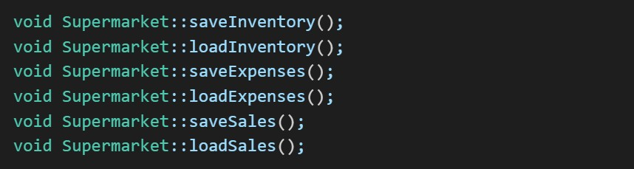
File I/O and Persistence
This slide explains how the Supermarket class saves and loads data from CSV files. The data includes:
Inventory: Stores the name, price, and quantity of items.
Expenses: Stores the description and amount of expenses.
Sales: Stores the total sales value.
The methods saveInventory(), loadInventory(), etc., ensure that all data is persisted between program runs.

Slide 11
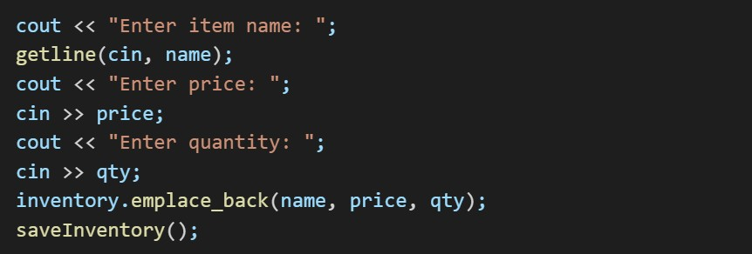
Code Snippets - Add Item (Owner)
This slide shows the code snippet where the Owner adds a new item to the inventory.
It involves asking the user for the item name, price, and quantity.
After receiving the input, the item is added to the inventory, and the updated inventory is saved to the CSV file.

Slide 12
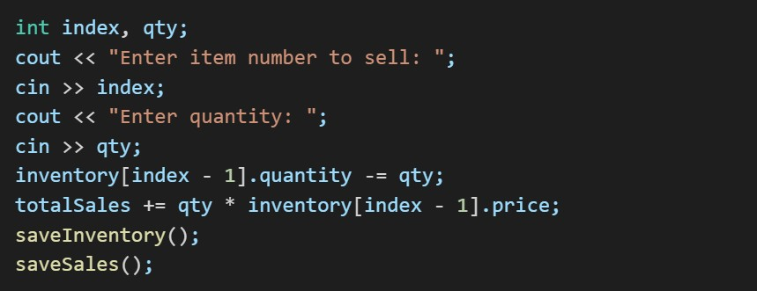
Code Snippets - Sell Item (Worker)
This slide shows the code snippet where the Worker sells an item.
The Worker chooses an item from the inventory by entering the item number and specifies the quantity to sell.
The item quantity in the inventory is updated, and the total sales are updated accordingly.
The updated inventory and sales data are saved to the CSV files.

Slide 13
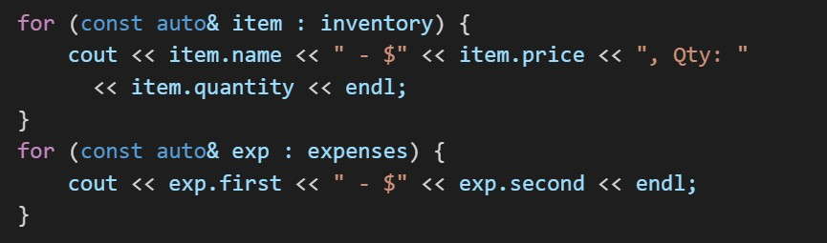
Code Snippets - View Inventory and Expenses
This slide shows how the inventory and expenses are displayed.
The inventory is listed by item name, price, and quantity.
The expenses are displayed with their description and amount.
This is used by both the Owner and Worker roles to keep track of inventory and expenses.

Slide 14
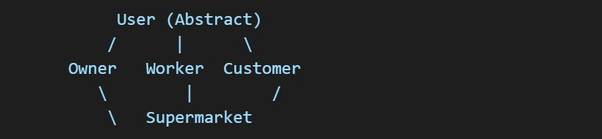
Inheritance Hierarchy
This slide illustrates the inheritance hierarchy in the system.
The User class is the base class for all user roles (Owner, Worker, and Customer).
The Supermarket class is inherited by all roles, which means that all roles share common functionality related to inventory, sales, and expenses.
This hierarchical structure promotes modular design and reuse of code.

Slide 15
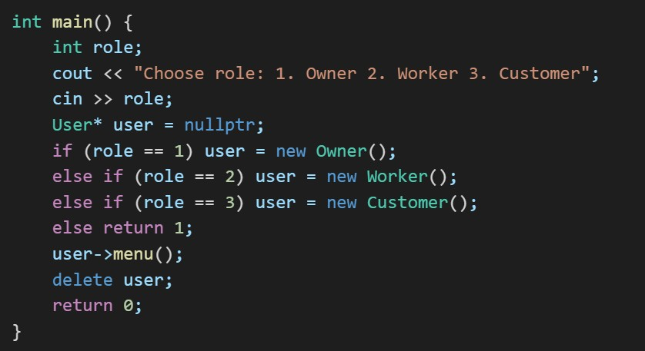
Main Function Workflow
The main function asks the user to select their role (Owner, Worker, or Customer).
Based on the selected role, a corresponding class object is created, and the menu() function of that class is called.
The menu() function handles the role-specific actions.
Once the user completes their tasks, the object is deleted to free memory.

Slide 16
Key Takeaways
The system demonstrates key object-oriented programming concepts like inheritance, abstraction, encapsulation, and polymorphism.
It uses CSV files for persistent storage of inventory, expenses, and sales.
The modular design makes the system easily extensible, meaning additional features can be added without major changes to the existing code.

Slide 17
Future Improvements
Login authentication: Secure user access with login functionality.
GUI: Implement a graphical user interface for easier interaction.
Database: Replace CSV file storage with a more robust database system (e.g., MySQL or SQLite).
Analytics and reporting: Add advanced reporting features to track sales trends, expenses, and inventory performance.

Slide 18
Real-World Applications
Useful for small retail businesses managing inventory and sales
Can be deployed in kiosks or POS systems
Can serve as backend logic for e-commerce websites
Can be extended for departmental stores or cafes

Slide 19
How This Helps Me
Strengthens understanding of OOP and C++ programming
Practical experience with file handling and data management
Builds a portfolio-ready project showcasing real-world application design
Improves problem-solving and system design thinking
Lays foundation for learning databases, GUI, and full-stack development
Forms a strong base for transitioning into roles in backend development, software engineering, or full-stack development in the future

Slide 20


