Slide 1
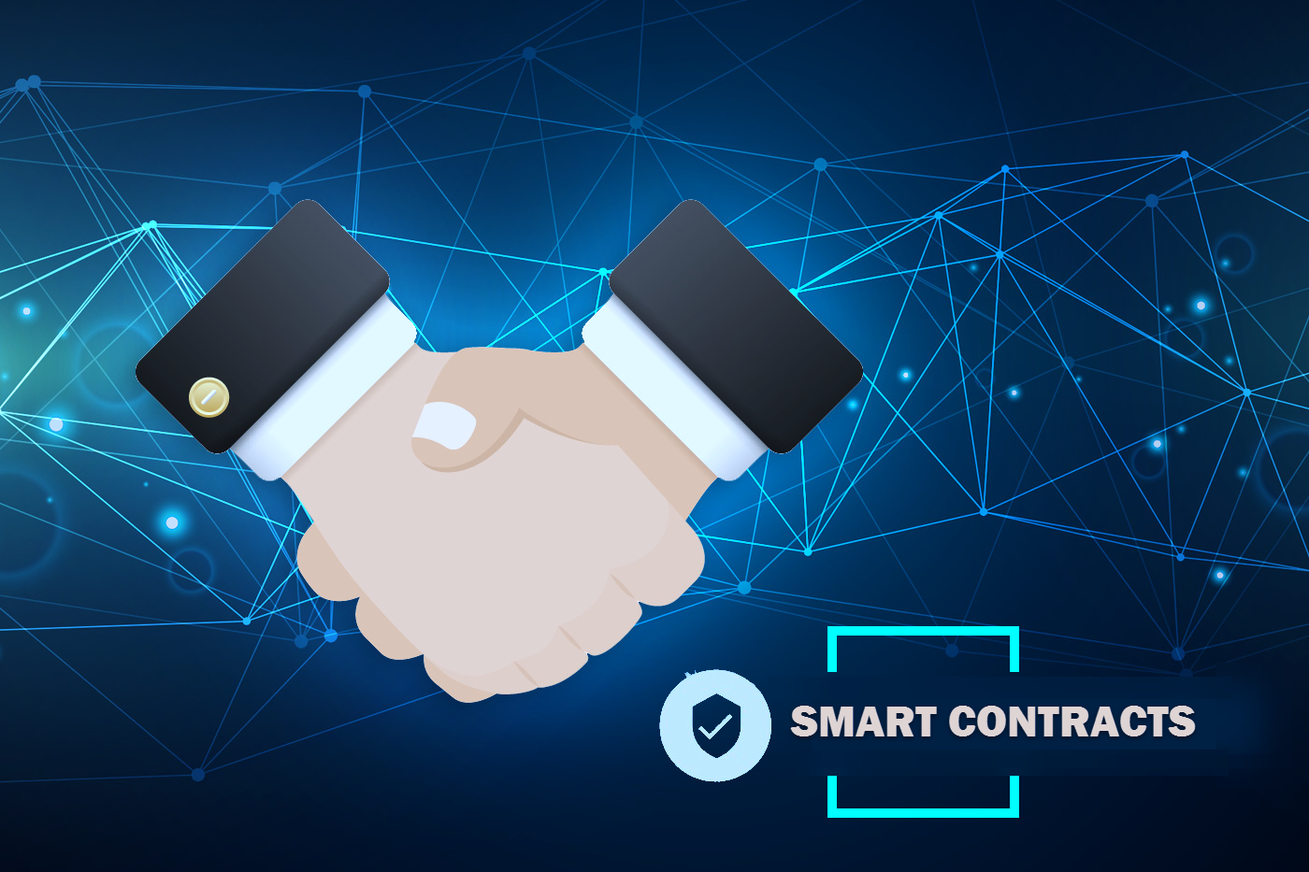
Building Smart Contracts on public cloud that pay
Srini Karlekar – Director Specialist, Software Architecture, KPMG.
Twitter: @skarlekar
LinkedIn: skarlekar

Slide 2
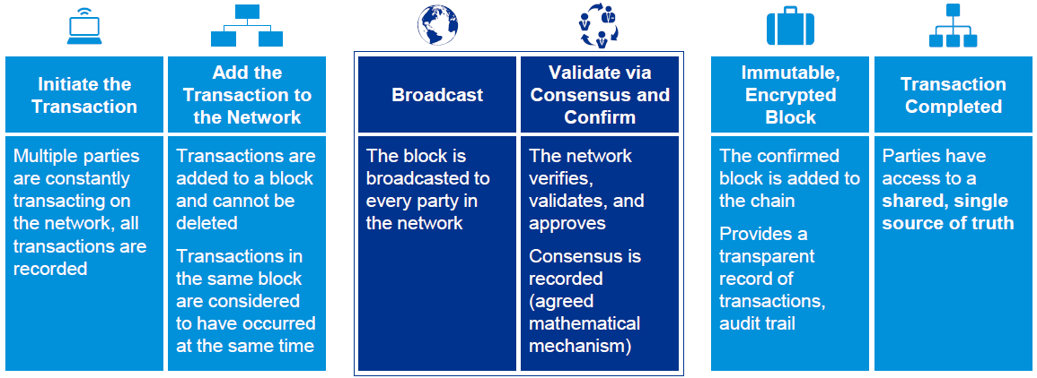
Demystifying Blockchain
Blockchain, or distributed ledger technology, is a digital record of transactions and ownership that is continually reconciled and replicated among many different nodes in a peer-to-peer network. Each transaction is uniquely signed with a private key.
This "chain" maintains a continuously growing list of records, called blocks, which are inherently resistant to modification – once recorded, the data cannot be altered retroactively.
Notes:
Just as a traditional ledger is a book of transactions maintained by an organization which contains all its debt and credits, a Blockchain is a digital ledger on a peer-to-peer network built in such a way that you can write transaction entries into it or read from it. You cannot update the transactions once it is written. Additionally, each transaction is signed by a cryptographic private key that only the owner should know. Hence, once the transaction is written the party who initiated the transaction cannot repudiate it. Also before the transaction is finalized, it has to be validated by a 51% of the nodes in the network. Once the consensus is reached the block containing the transaction is added to the chain.

Slide 3









How Blockchain solves Business Pain Points
Blockchain technology can simplify the management of trusted information such as information about individuals, organizations, their assets and activities making it easier for organizations to access and use critical information while enabling individuals and organizations to authorize who can access them while maintaining the security of the information.
Transparency
01
Provenance & Lineage
Increasing customer & shareholder demands for transparency into how funds are being spent and customer data is being used and shared
Increasing interest for recording asset ownership, lineage of data used for supporting its ownership, valuation, depreciation, disposal and changes to its location over time while improving system interfaces to access this information
05
Drivers
02
Data Sharing
Increasing demand for data consistency and sharing of data among business partners
Regulatory Compliance
Confidentiality
Increasing need to efficiently create, update, and enforce regulations or resolve disputes with use of tamper-proof mechanisms and improve the resiliency of public sector transactions
04
03
Growing concerns around trust, security and keeping personally identifiable information private.
Trust – No need for intermediaries, Secure – all records can be individually encrypted, Immutable – Any validated records are irreversible and cannot be changed
Distributed – all network participants have a full copy of the data, Consensus - All network participants agree to the validity of each of the records.
Transaction timestamp is recorded in a block. Assets and transactions assets are linked to prove provenance
Distributed - All network participants have a full copy of the ledger for full transparency
Blockchain is programmable through Smart Contracts
Notes:
The core aspects of blockchain and its underlying technologies presents an opportunity to transform organization’s ability to enforce regulations across departments, share data, remove friction in customer interactions, enhance fraud detection, strengthen security, prove provenance, and manage assets efficiently.
Transparency : Distributed - All network participants have a full copy of the ledger for full transparency
Provenance : Time-stamped - Transaction timestamp is recorded in a block, Linked – Assets can be linked.
Regulatory Compliance : Programmable – Blockchain is programmable through Smart Contracts
Confidentiality: Trust – No need for intermediaries, Secure – all records can be individually encrypted, Immutable – Any validated records are irreversible and cannot be changed.
Data Sharing : Distributed – all network participants have a full copy of the data, Consensus - All network participants agree to the validity of each of the records.

Slide 4
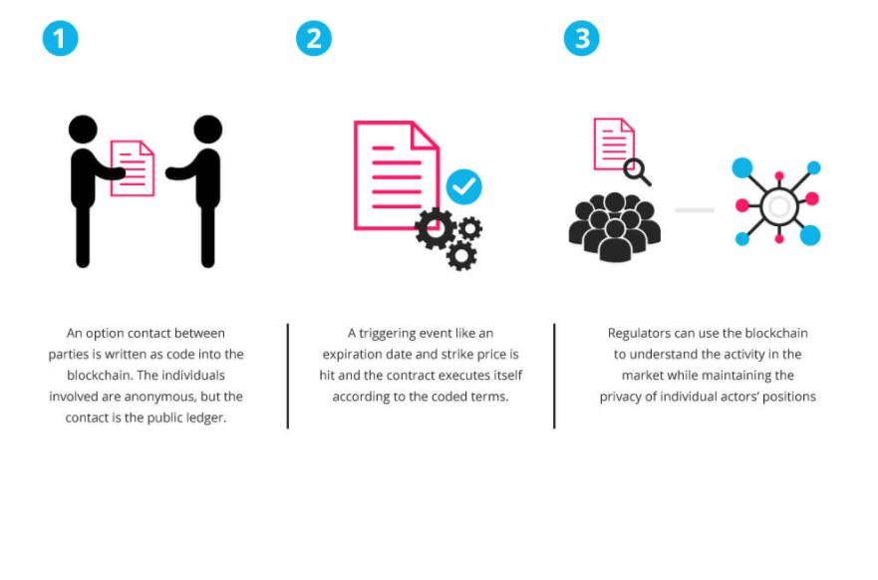
Smart Contracts - Putting Blockchain To Use
Smart Contracts are self-executing contracts with terms of agreements between counterparties that is written into code on the Blockchain and is triggered by an event. As a result, Smart Contracts secure, enforce and execute settlement of recorded agreements in a predefined manner within a secure boundary without the need for a third-party involvement and verification.
CONTRACT
Code written into Blockchain
Contract is in ledger
TRIGGERING EVENT
- Contract executes itself according to coded terms
REGULATORS
- Regulators can understand the activity and easily audit the data
- Maintain the data integrity

Slide 5

An attempt to Demystify smart contracts using a movie theater transaction

Slide 6
Movie Theater Example - 1
Contract: Usher exchanging money for allowing entry into the theater.
Implication:
Allows entry.
Not enough seats.
Cannot reserve seats.
Is the customer using authentic currency to pay?

Slide 7
Movie Theater Example - 2
Contract: Purchasing tickets over-the-counter.
Implication:
Solves issues from case 1, but the trust issue still exists.
Is the ticket a duplicate of one that is already issued?
Will the customer exit the premise after watching one movie?
Point #2 is not usually an issue because customers trust the theater management, otherwise the theater is going to loose business.
Here the ticket acts as a token for proving that the customer has paid for the screening. Trust is one way in this scenario.

Slide 8
Movie Theater Example - 3
Contract: Purchasing tickets online.
Implication:
Customers have to trust the website selling tickets is associated with the theater.
Is the website using certificates issued by a trusted authority?
If I have to sell the ticket to a third-party, will the buyer trust that I am selling a valid ticket?
Even if it is a valid ticket, what is the assurance that I am not double-selling the same tickets to multiple parties?

Slide 9
How Smart Contracts fit in
Transactions are signed by both buyer and seller using private keys.
Within the transaction buyer sends crypto to seller.
Seller provides a non-fungible token that contains the identity of the buyer.
A transaction can only use crypto from a previous transaction – which has already been verified.
Transactions are verified by multiple nodes in the Blockchain.
Movie theater allows entry for the customer after verifying the identity on the token with the customer’s digital identity.
Once the token is presented, it is marked as used and the transaction logged.

Slide 10
An attempt to Demystify smart contracts using a supply chain example

Slide 11
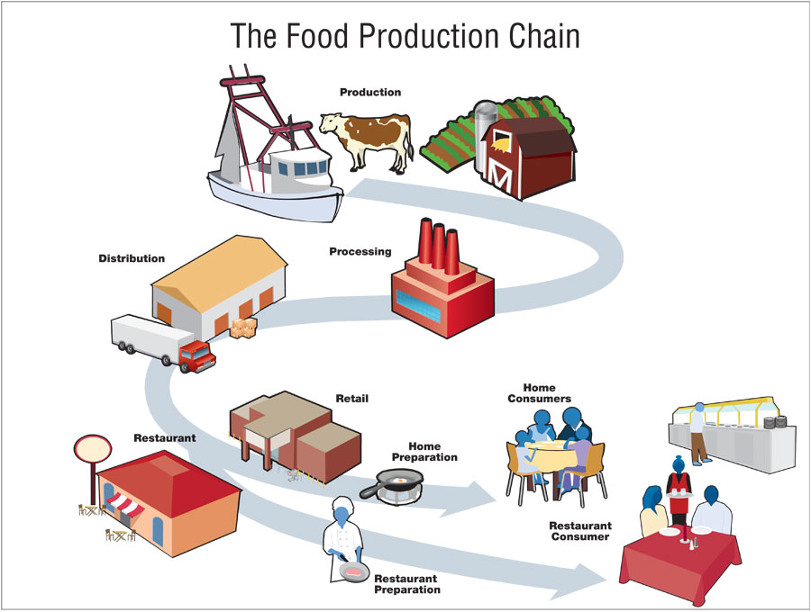
Food Supply chain Example
Challenges:
Tracking the product and its state.
Customs check.
Bureaucracy & lack of trust among parties.
Multiple data bases
Expensive data migrations.
No clear authority.
7. …

Slide 12
How Smart Contracts fit in
Buyer and seller enters an escrow-style agreement. Buyer puts crypto in an escrow account. Escrow is released to the seller after buyer receives the product based on the condition of the product.
Raw material serial numbers are tokenized and new non-fungible tokens are generated using these tokens when products are assembled (see https://cryptokitties.io & https://cryptozombies.io/)
Data is maintained in Blockchain and can be updated only using Smart Contracts.
Audit-trail from farm-to-table.

Slide 13


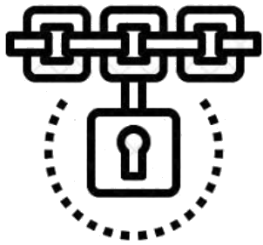

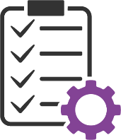

Better Business through Networked Services
Blockchain technologies such as Distributed Ledgers and Digital Identity can be used by organizations and public sector to provide networked services to customers. Customers could define which agencies can have access to their data and when.
Deliver
Government agencies & organizations deliver data services to their customers, and other organizations.
Record & Review
Agencies can read & write data into Blockchain ledgers secured through public/private cryptography. Data could involve tax, social security, home, vehicle and agency interaction records
Organizations
Regulations
Control
Customers & organizations provide control to agencies defining what data of theirs are accessible by whom, when and where through rules on Smart Contracts
Blockchain
Review
Customers can review what information of theirs is available on the Blockchain
Permit
Smart Contracts define situations when agencies could gain permissions to access customers data
Regulate
Regulations defines rules that affect information sharing among all participants
This
Customers
Smart Contracts
Organizations
Notes:
While we all know that Blockchain can make financial & insurance services easier and efficient, many of the Blockchain technologies working together as networked services can simplify the management of information among organizations. Business licensing, birth, death & marriage certificates and property records are just a few that can be digitized and managed through a secure infrastructure allowing agencies, organizations and citizens to manage and share with third-parties and others.
Regulations define what data can and cannot be shared across the board. Citizens and businesses can control what data of theirs can be shared, with who and for how long. This information can be codified into smart contracts. Smart contracts will then enforce who can gain access what data on the Blockchain. Agencies can digitize records, encrypt and store them on or off the chain knowing well that the Smart Contracts prevents unauthorized access of such data. Given this information on the Blockchain, the agencies can now deliver their services efficiently to its constituents and other agencies. As an when needed, citizens can review their data and share their data among agencies to expedite services turnaround time as data need not be migrated across agencies or organizations.

Slide 14

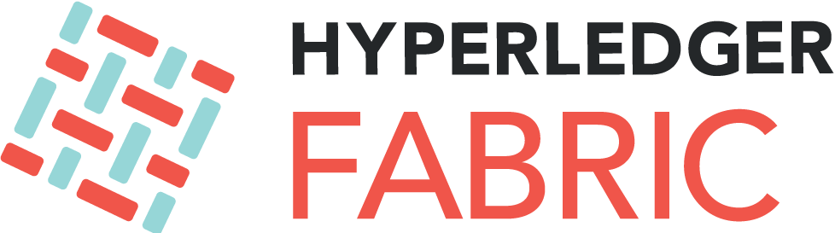

Slide 15
Hyperledger Fabric
Hyperledger Fabric is a blockchain framework implementation and one of the Hyperledger projects hosted by The Linux Foundation.
Intended as a foundation for developing applications or solutions with a modular architecture, Hyperledger Fabric allows components, such as consensus and membership services, to be plug-and-play.
Hyperledger Fabric leverages container technology to host smart contracts called “chaincode” that comprise the application logic of the system.
Hyperledger Fabric was initially contributed by Digital Asset and IBM.
Created for developing enterprise applications

Slide 16
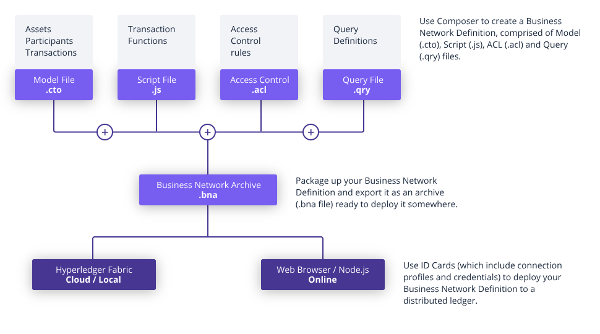
Anatomy of Hyperledger Fabric BNA
In the world of Hyperledger Fabric, DApps are called BNA or Business Network Applications.
Participiants - Participants represents users who interact with assets.
Assets - Assets represents entities which could represent place or things.
Transactions - Transactions are actions that participants can carry out on assets.
Events - Events are emitted by Hyperledger Composer as a result of transactions.
Queries - SQL-like queries that can be used to search for assets based on its attributes.
Access Control - Access Control provides declarative access control over the elements of the domain model.

Slide 17
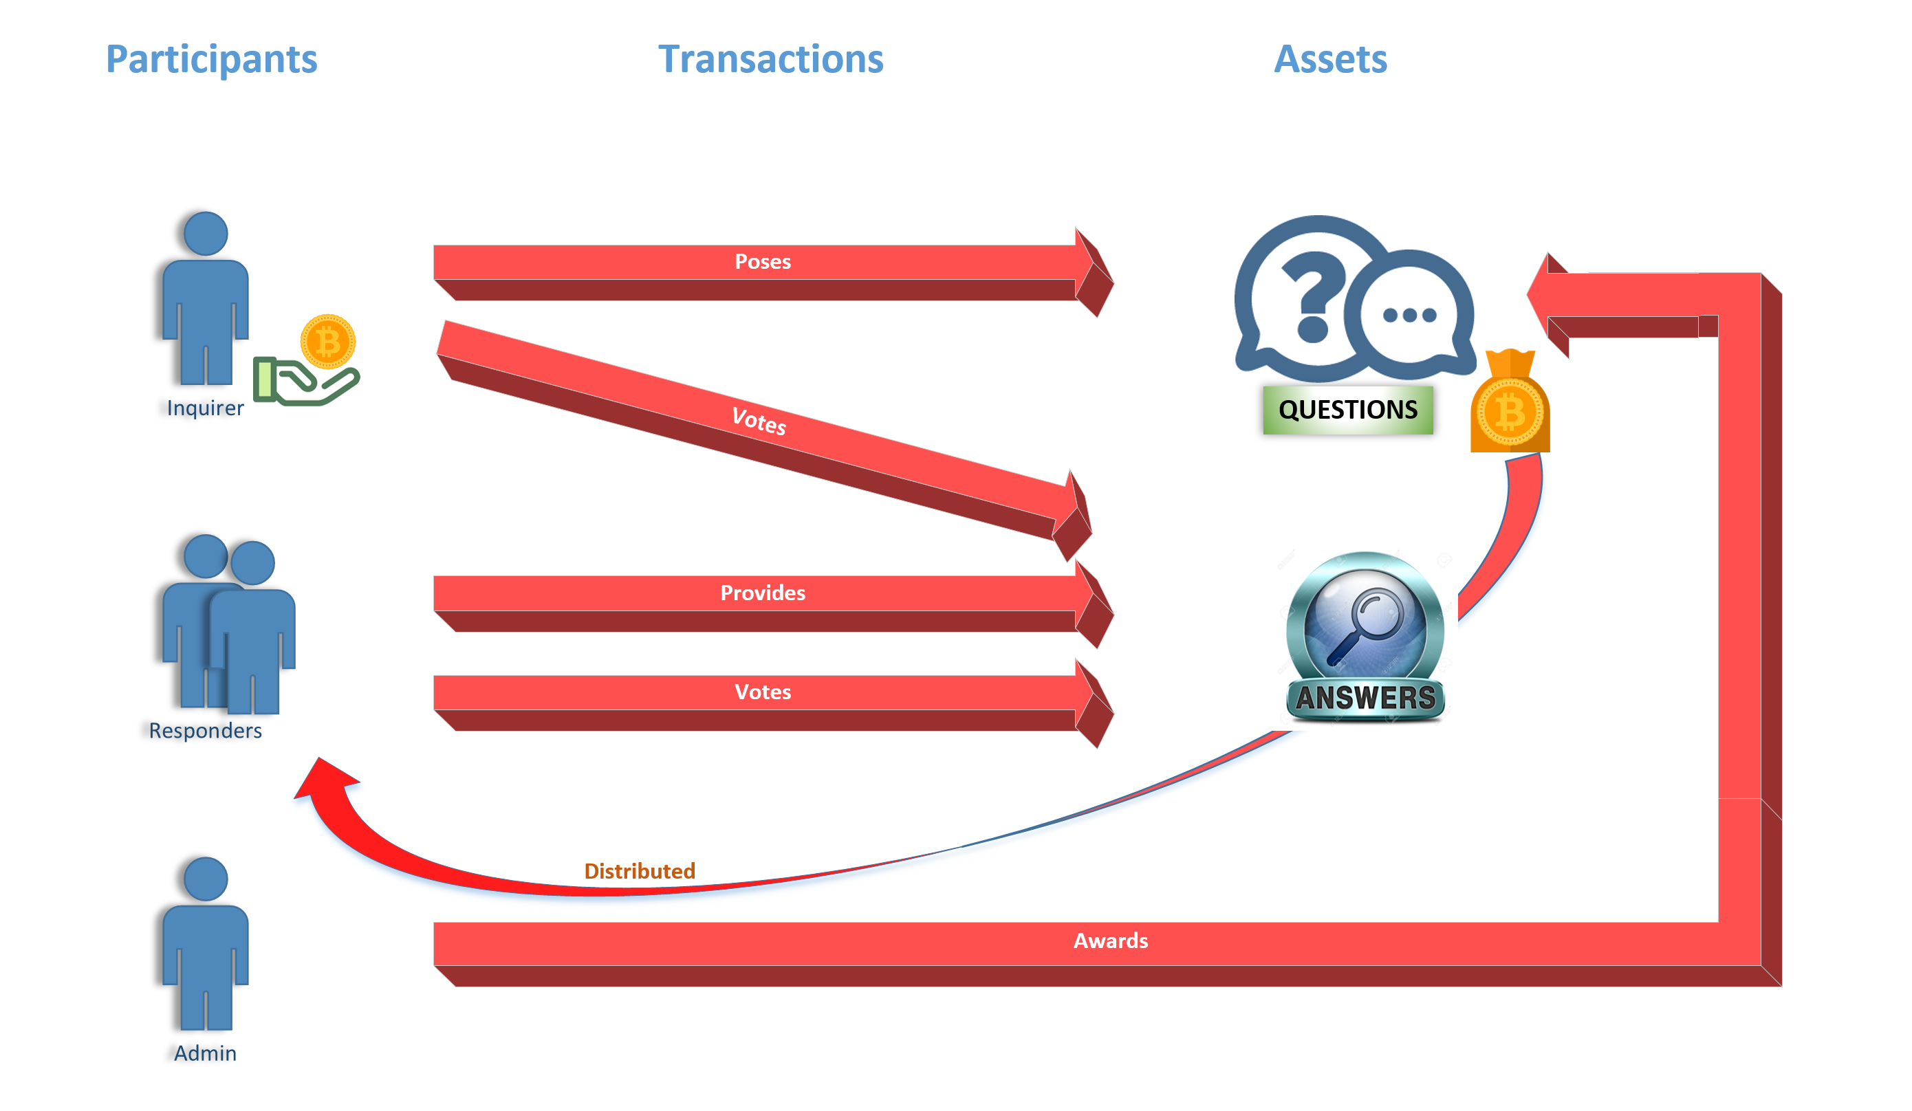
Smartquora domain model

Slide 18
Smartquora Participants
There are three types of Participants in SmartQuora BNA.
Inquirers
Responders
Administrators
Inquirers and Responders are represented as QuoraUsers in the application because their function can interchange - an inquirer can respond to questions from other inquirers or a respondent for a question can pose his/her own questions.
Participants maintain tokens that is placed as a stake when asking questions.

Slide 19
Smartquora Rules
The following rules are enforced by the SmartQuora smart contracts:
Inquirers cannot answer their own questions.
Responders cannot vote for their own answers.
Responders cannot vote more than once for the same answer.
Answers will not be accepted after the due date.
Only administrators can award questions and distribute the reward among the voted answers after the due date.

Slide 20
Smartquora Assets
There are two types of Assets modeled in the SmartQuora application. They are:
Question - A question consists of an unique id, question description, owner, status (CREATED, ANSWERED, AWARDED, or DEFAULTED), reward amount and a list of answers. If a question is answered and is voted for, the stake is equally distributed among the owners of the voted answers.
Answer - An answer consists of an unique id, answer description, owner, status (CREATED, VOTED, AWARDED), earnings, and a list of voters. When a question is awarded, the earnings attribute reflect the earnings that was generated by that particular answer for the respondent.

Slide 21
Smartquora transactions
CreateQuestion - A CreateQuestion transaction is invoked by the Inquirer to pose a question. The reward amount and time by which answers are due has to accompany the request.
CreateAnswer - A CreateAnswer transaction is invoked when a respondent provides an answer to an existing question. This transaction ensures that the question owners cannot answer their own questions.
VoteAnswer - A VoteAnswer transaction is invoked to vote up or vote down an existing answer. This transaction ensures that respondents cannot vote for their own answers or vote multiple tims for an answer.
AwardQuestion - A AwardQuestion transaction is invoked to find out the highest voted answers and distribute the reward proportionately amongst the voted answers.

Slide 22
Smartquora events
Events in a Hyperledger Fabric BNA is pushed on a Web Socket. Any system listening to the Web Socket will get notified of all the events. As a result, the listeners have to filter out events that are not relevant to it.
SmartQuora events are as follows:
QuestionCreated - Generated by the CreateQuestion transaction.
AnswerCreated - Generated by the CreateAnswer transaction.
AnswerVoted - Generated by the VoteAnswer transaction.
QuestionAwarded - Generated by the AwardQuestion transaction.

Slide 23
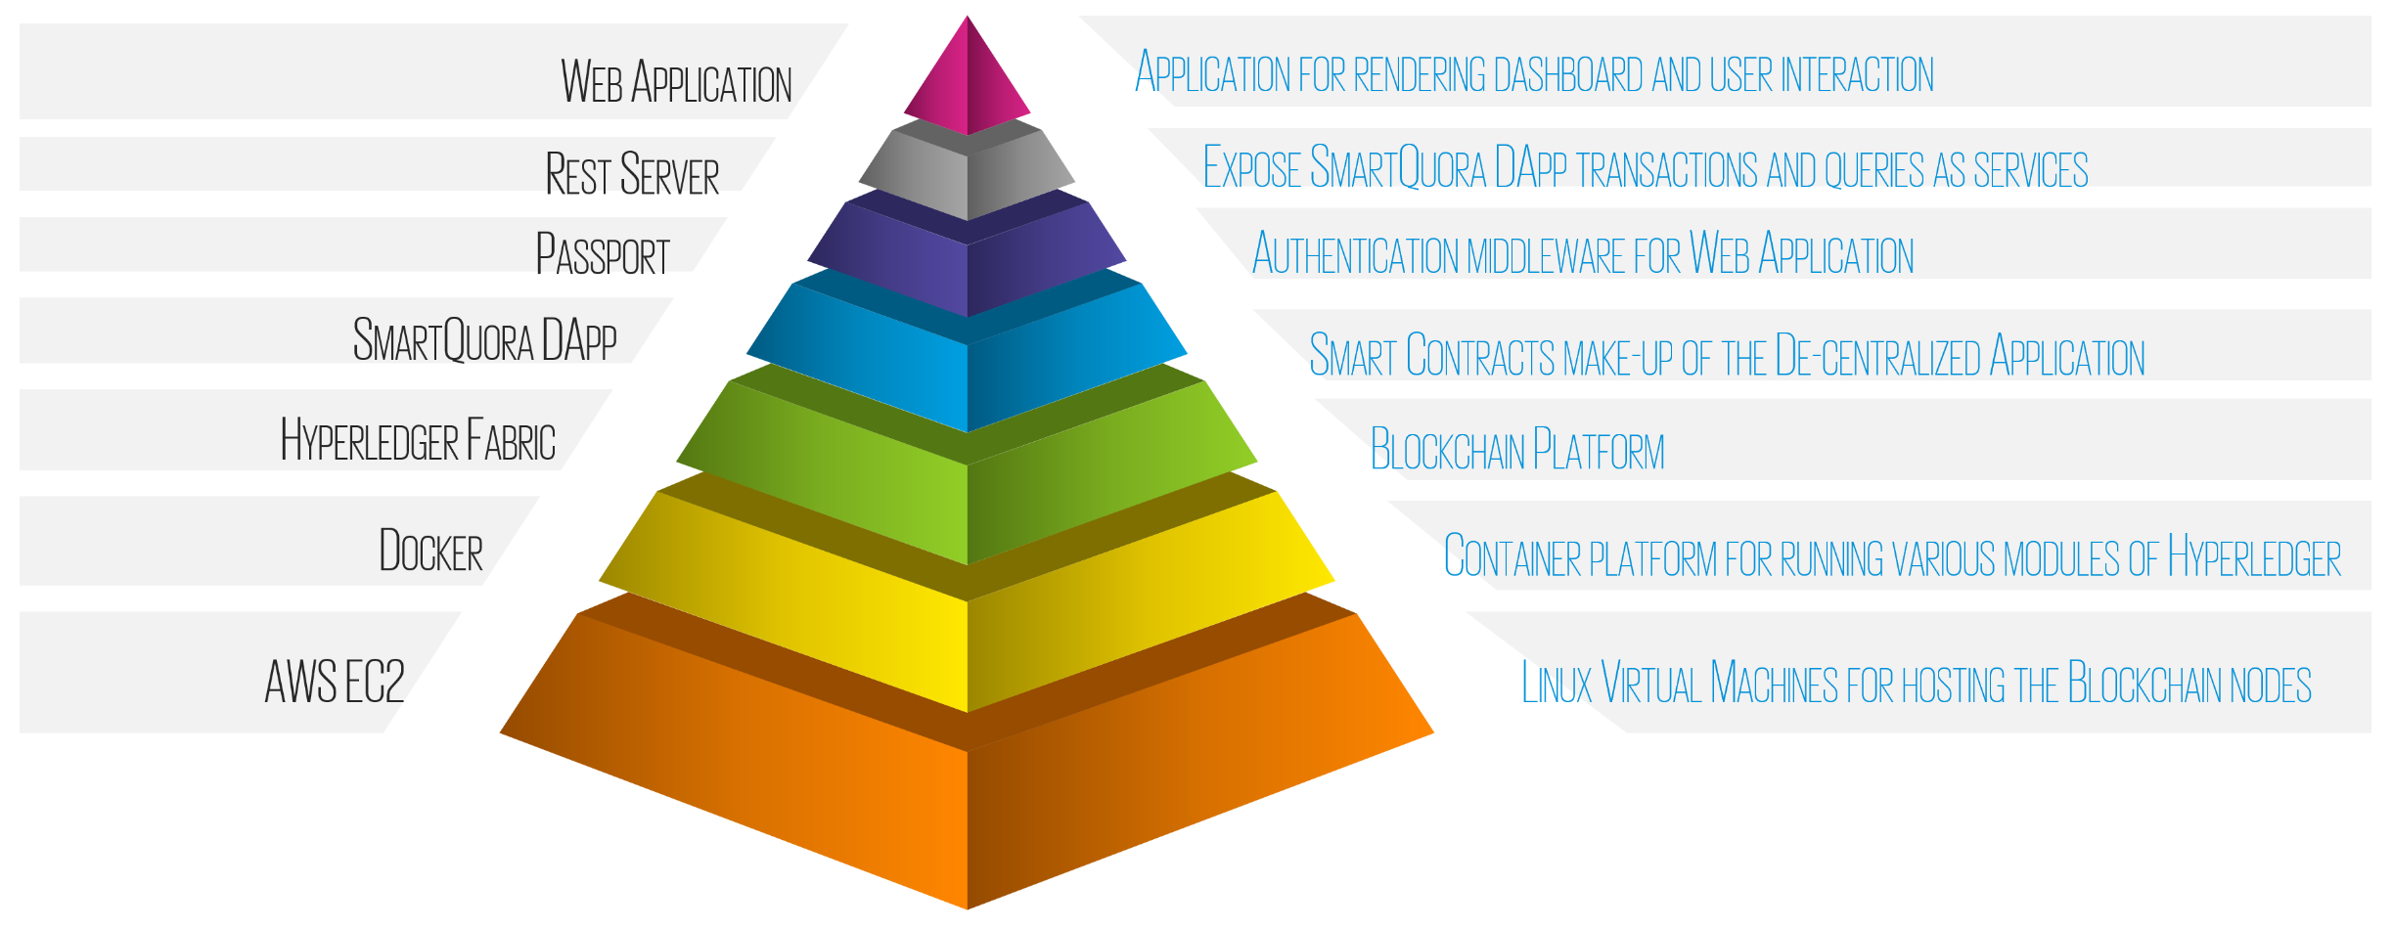
Smartquora system components

Slide 24
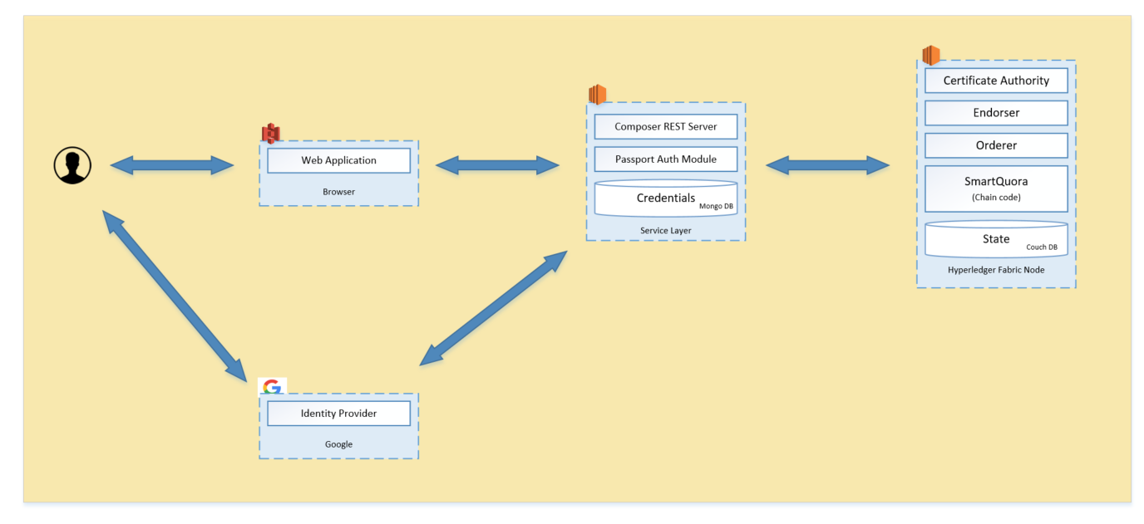
Smartquora Architecture

Slide 25
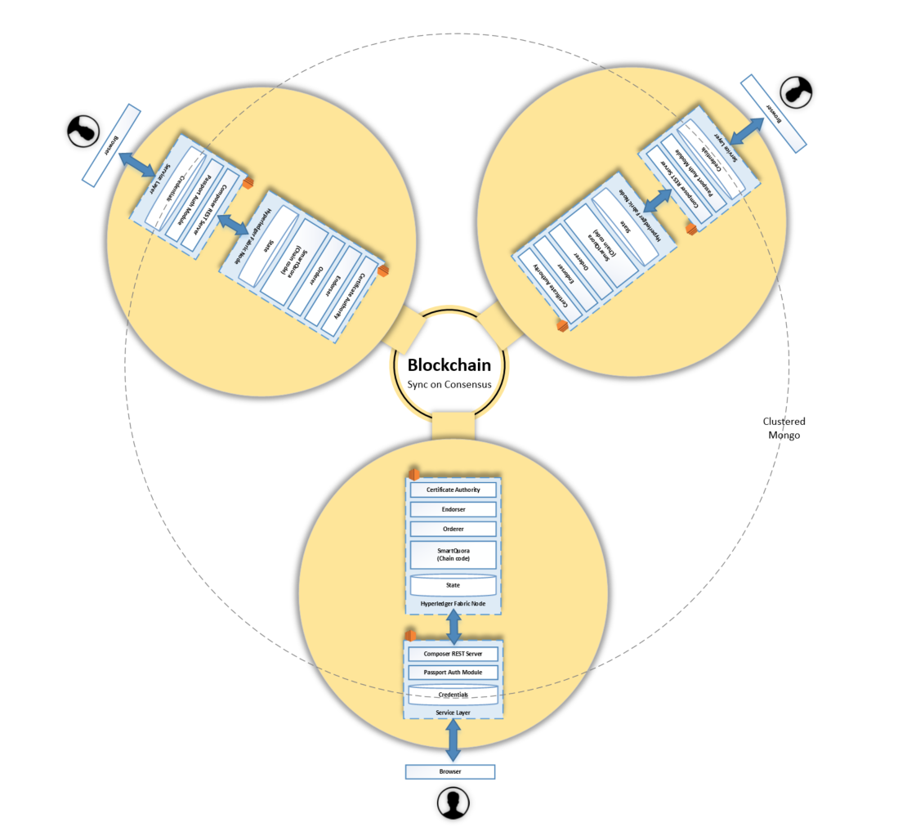
Smartquora Architecture

Slide 26
SmartQuora - Application DEMO

Slide 27
Smartquora – Code Walk-Through
The SmartQuora application can be cloned from:
https://github.com/skarlekar/smart-quora
For Installation, Deployment and Usage instructions go to:
http://bit.ly/sqreadme

Slide 28
Further READING
To understand the concept of Blockchain and Smart Contracts and explore the differences between various Blockchain frameworks go to:
http://bit.ly/blkchn2018

