Slide 1

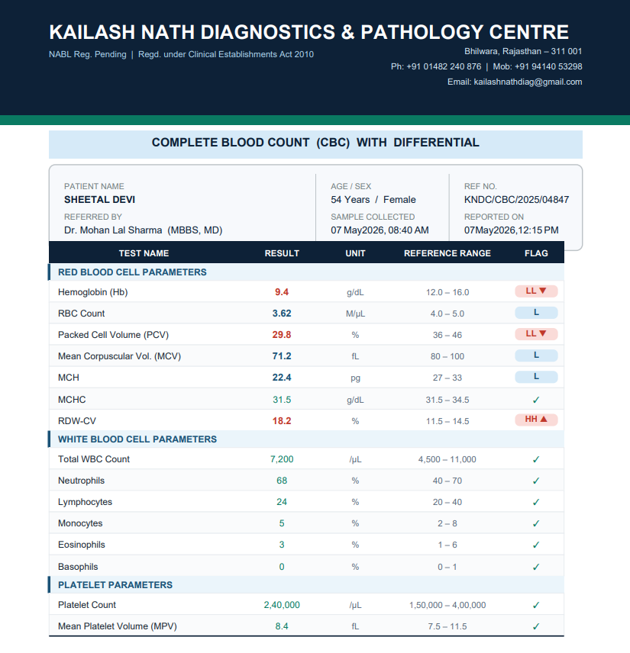

Slide 2
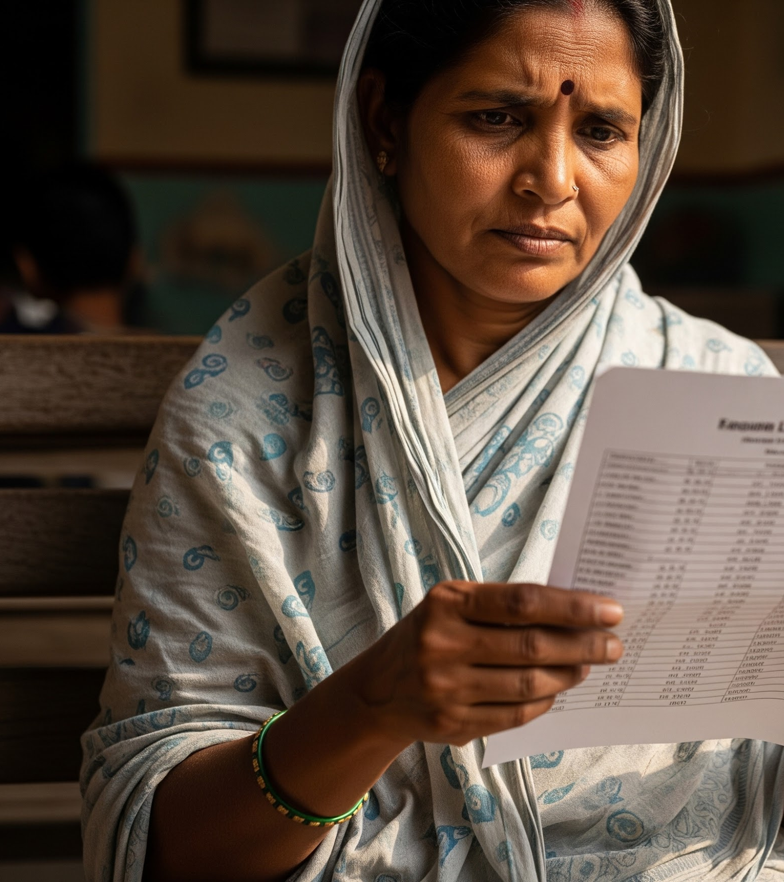
THE PROBLEM WE SOLVE
She stared at these numbers for 2 hours. She still doesn't know if she's okay.
This happened yesterday. To someone's mother. In every city, town, and village across India.
LabIntel

Slide 3

LabIntel
1,00,000+
3 Hours
500 Million
Independent labs in India running on MS Word or paper. Zero intelligent software. Zero patient communication.
Wasted every morning on manual report typing. Per lab. Every day. 700 hours per year. Gone.
Indians who leave a lab every year holding a report they do not understand. Not one person to explain it.
Three separate crises. One broken system. Zero solutions built for the people who suffer most.

Slide 4


WHAT A PATIENT RECEIVES TODAY
WHAT SHE ACTUALLY NEEDS
LABORATORY REPORT
Hemoglobin: 9.4 g/dL
Range: 12.0 – 16.0
Serum Creatinine: 3.8 mg/dL
Range: 0.7 – 1.2
WBC Count: 7200 /µL
Range: 4500 – 11000
✓ What does this number mean for my body?
✓ Is this dangerous or is this okay?
✓ What should I do next?
Dense numbers. Clinical jargon. Zero context.
Patient goes home.
Patient worries alone.
No lab software in India answers these questions.
Until now.
LabIntel

Slide 5

LabIntel
Reimagining Healthcare for Every Indian
The lab's complete operations platform. The patient's lifelong health record. One system. Every lab in India. Every patient they serve.
2-Minute
Reports
Lightning-fast digital delivery from tier-2 cities to rural districts.
AI Insights
on every result
Powered by intelligent reporting built specifically for Indian labs.
Health Spine
Cross-lab patient records
A unified clinical history that follows the patient everywhere.

Slide 6

The Feature That No One Else Has
mic
Voice Report Narration
The patient presses one button. Their entire report is read aloud in Hindi, Bengali, Tamil, or Telugu in a natural conversational voice.
Why it matters
300 million Indians cannot fully read a medical report. Every single one can hear it.
photo_camera
Upload Any Report
Photograph any paper lab report. Gemini Vision reads it and returns a complete plain-language explanation in 15 seconds.
Why it matters
Every confused patient in India — regardless of which lab they use — is now a LabIntel user.
show_chart
Health Risk Score
Across all labs, all visits, all time — LabIntel generates a dynamic biomarker risk score showing trends across vital organs.
Why it matters
The first time in India that a patient can see their health as a story, not isolated events.
These three features do not exist in any Indian lab software today. We built all three. They are live.

Slide 7
How We Built It
In 10 days. 3 groups. 10 engineers. Zero infrastructure cost.
BROWSER (React 18 + Vite)
labintel.in • slug.labintel.in
Patient App | Lab Portal App
Multi-Tenant
Every lab is isolated. Staff at Lab A cannot see Lab B data at the database layer. Supabase Row-Level Security enforces it.
HTTPS / REST
Dual Auth System
Staff: Supabase Auth (email+pass). Patients: Custom JWT (phone+OTP). Two separate flows, one backend.
EXPRESS API (Node.js 20)
Auth • Patients • Reports • Analytics • Settings
Groq AI ⟷ Puppeteer PDF
Global Patient Record
Universal identity via Phone. One patient, any lab, full history. Always accessible across the platform.
Supabase
PostgreSQL + Storage Auth (RLS Enforced)
External APIs
Groq AI (LLM) Twilio (OTP) • WhatsApp
Free Tier Stack
Vercel + Render + Supabase + Groq. ₹0 infrastructure cost to build and pilot this entire platform.
LabIntel

Slide 8

Unit Economics & Market
₹999/mo replaces ₹0 tech & 700 hours wasted
LabIntel
Subscription Tiers
Addressable Market
1,00,000 independent labs in India × ₹2,499 avg monthly plan
₹250 Cr
Monthly potential
STARTER ₹999 / mo
Up to 200 reports · AI summaries · PDF · Patient portal
MOST POPULAR
GROWTH ₹2,499 / mo
Up to 1,000 reports · SMS delivery · Timeline · Alerts
Realistic Target (Year 2)
10,000 labs (10% market) × ₹2,499 price
₹2.5 Cr
MRR
₹30 Cr
ARR
PRO ₹4,999 / mo
Unlimited · Multi-branch · API · Priority support
"We are not building a feature. We are building infrastructure. The labs that adopt LabIntel first will never switch — because their patient data lives here."

Slide 9

"We used to spend 3 hours on reports every morning. Now it takes 20 minutes."
— Lab owner, Siliguri
"My mother received her report on Mobile. She played the voice narration three times. She said — finally, someone explained it to me."
— Patient's son, Haldia
"I have been running this lab for 12 years. I never knew which tests were growing my business. Now I know. Every morning. Before chai."
— Lab Director, Haldia
These are the people we built this for. This is why we built it.

Slide 10

She got home. She opened LabIntel. She understood her report. For the first time. In her life.
"She's okay. She knows it. Because of us."
LabIntel is live. The demo you saw was real. The lab in Haldia is real.
labintelorg.vercel.app
https://github.com/Labintel-dev/Labintel
We are LabIntel. We built this for 500 million Indians. Thank you.
The paper report on page 1 belongs to a real person. She got her results today. She understood them.

