Slide 1

Project Title - Seasonal Agriculture Performance Analysis
[Student Name:- Sayantan Mondal,
College Name-HALDIA INSTITUTE OF TECHNOLOGY ]
AICTE STU ID : (STU6885d8c3d48bd1753602243)

Slide 2

PROBLEM STATEMENT
(Agricultural activities are influenced by seasonal variations in environmental conditions,
farming practices, resource availability and market conditions. As a result, agricultural
performance may differ from one season to another.
However, raw agricultural data does not clearly explain how agricultural performance changes
across seasons or what patterns can be observed in different seasonal conditions.
The problem is to analyze the given agricultural dataset and investigate seasonal differences
in agricultural performance by identifying meaningful patterns, trends, relationships and
variations within the available data.

Slide 3
Project Description( Seasonal Agriculture Performance Analysis is an end-to-end data analytics and machine learning project designed to evaluate and compare agricultural performance across Kharif, Rabi, and Zaid seasons. The project uses a structured agricultural dataset containing information related to crop production, yield, profitability, irrigation, resource consumption, environmental conditions, and disease/pest risk. The project begins with data preprocessing and quality assessment, including dataset profiling, data-type validation, missing-value detection and treatment, duplicate identification, range validation, and consistency checks. Feature engineering is then performed to derive meaningful analytical variables such as Profit per Hectare, Revenue per Hectare, Water Usage per Hectare, and Total NPK, enabling more detailed performance evaluation. Extensive Exploratory Data Analysis (EDA) is conducted using Pandas, NumPy, Matplotlib, and Seaborn to identify distributions, trends, seasonal variations, crop-level differences, regional patterns, and relationships between agricultural variables. Comparative analysis is performed across seasons, crops, states, and irrigation methods to identify high- and low-performing combinations. For quantitative validation, the project applies statistical analysis using SciPy, including ANOVA, Kruskal-Wallis testing, Mann-Whitney pairwise comparisons with Bonferroni correction, and effect-size analysis. Correlation analysis is also used to investigate relationships between environmental conditions, resource usage, and agricultural outcomes. A Random Forest Regression model using Scikit-learn is additionally implemented to predict agricultural yield and evaluate feature importance. Model performance is assessed using metrics such as R² and Mean Absolute Error (MAE), providing a machine-learning perspective on yield prediction. The final analysis transforms raw agricultural data into actionable insights, highlighting seasonal performance differences and supporting data-driven recommendations for crop selection, resource allocation, irrigation management, and region-specific agricultural planning.)

Slide 4

WHO ARE THE END USERS?
Farmers: Use insights for crop selection, seasonal planning, yield improvement, and efficient resource utilization.
Agricultural Planners: Analyze seasonal and regional performance to improve crop planning and resource allocation.
Government & Agriculture Departments: Support agricultural policies, schemes, resource distribution, and sustainable farming initiatives.
Researchers: Study seasonal variations, crop performance, environmental factors, and agricultural trends.
Data Analysts: Use the dataset and analytical results to identify patterns, relationships, and performance indicators.
Agribusinesses: Identify profitable crop-season combinations and improve production and investment decisions.
Irrigation Managers: Analyze water usage and efficiency to support better irrigation planning.
Environmental & Sustainability Teams: Evaluate resource consumption and environmental conditions to encourage sustainable agricultural practices.

Slide 5

Technology Used
Python – Core programming language used for data analysis, preprocessing, statistical analysis, and machine learning.
Google Colab / Jupyter Notebook – Used as the development environment to execute, document, and present the complete analysis.
Pandas – Used for data loading, cleaning, transformation, aggregation, and analysis.
NumPy – Used for numerical operations and feature calculations.
Matplotlib – Used to create analytical charts and visualizations.
Seaborn – Used for advanced statistical visualizations such as box plots, heatmaps, and comparative charts.
SciPy – Used for statistical hypothesis testing, including ANOVA, Kruskal-Wallis, and Mann-Whitney tests.
Scikit-learn – Used to build and evaluate the Random Forest Regression model for yield prediction.
Random Forest – Used to identify important predictive features and estimate agricultural yield.
Statistical Analysis – Used to validate seasonal differences and determine statistical significance.
Correlation Analysis – Used to examine relationships between environmental, resource, and agricultural variables.
Feature Engineering – Used to create metrics such as profit per hectare, revenue per hectare, water usage per hectare, and total NPK.
CSV / Excel Data – Used as the source format for storing and processing the agricultural dataset.

Slide 6
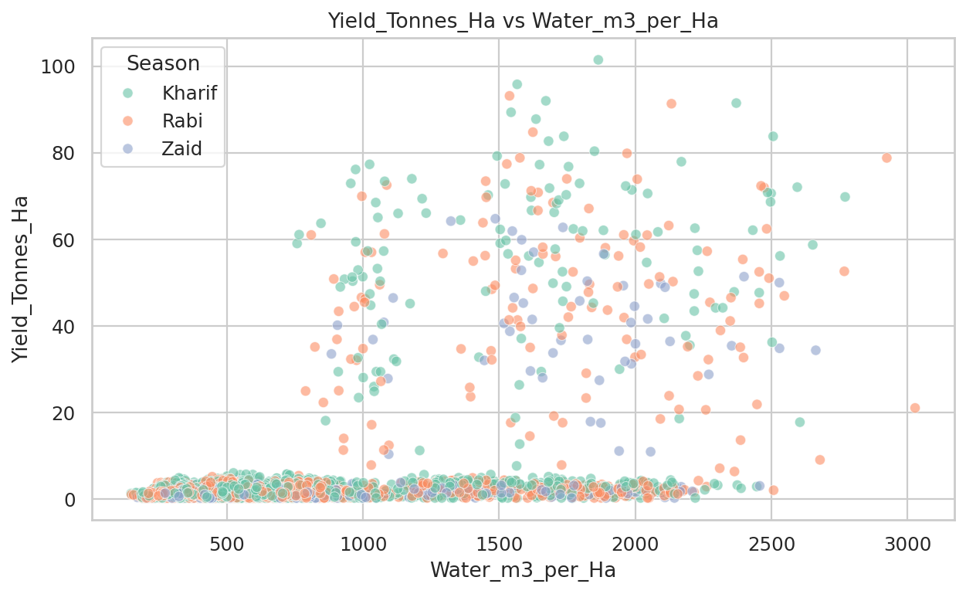
RESULTS
[Water availability appears to be the most important factor associated with crop yield among the variables shown. The correlation of 0.48 indicates a moderate positive relationship, meaning that higher water use is generally associated with higher yield. Water also has a positive relationship with profit (0.13) and water efficiency (0.25 ]

Slide 7
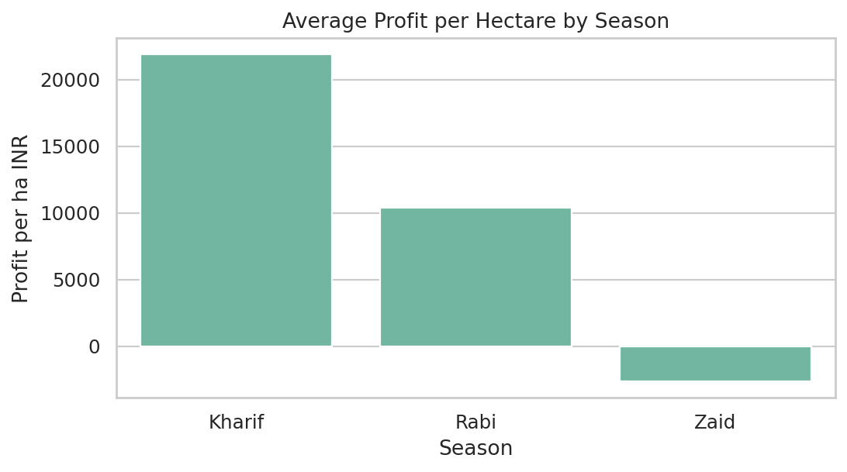
RESULTS
[Result: Average profit is approximately ₹21,800/ha in Kharif, compared with about ₹10,400/ha in Rabi, while Zaid has a negative average profit of roughly ₹−2,600/ha.
Description: Kharif is the most financially successful season in the dataset. Rabi remains profitable on average but at a considerably lower level, whereas Zaid records an average loss. The profit distributions also show substantial variability and numerous high-profit outliers, particularly in Kharif
]

Slide 8
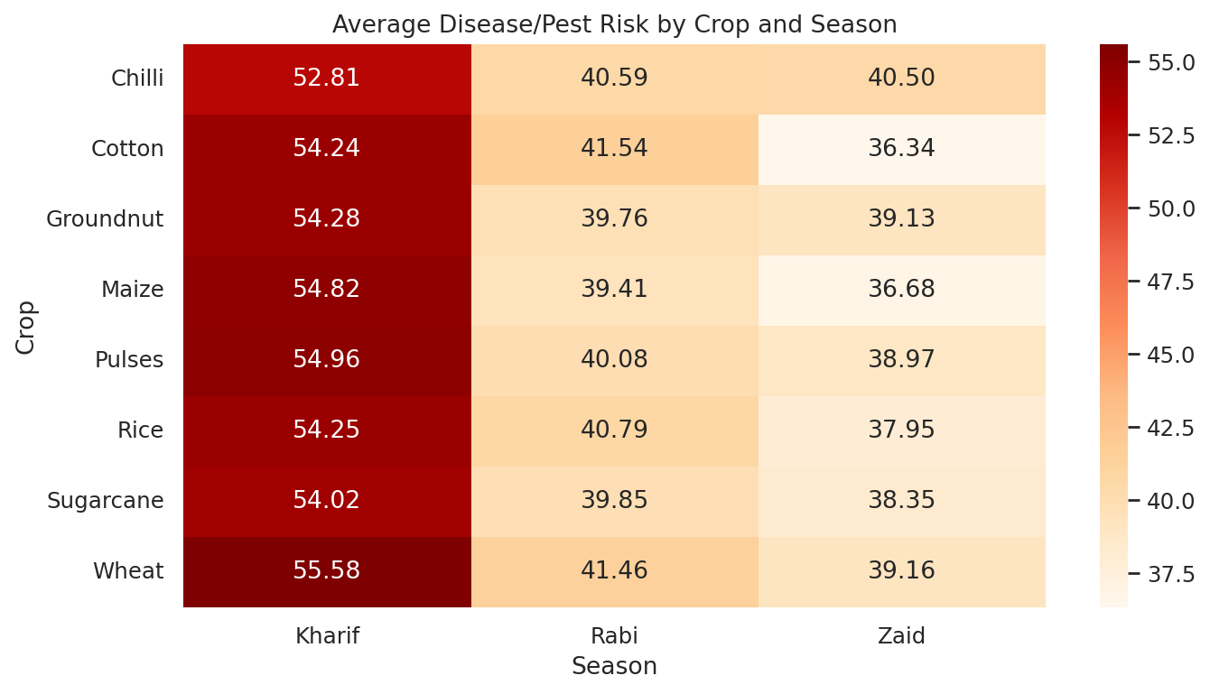
RESULTS
Result: Average disease/pest risk is about 54% in Kharif, compared with 40% in Rabi and 38% in Zaid.
Description: Kharif achieves the strongest yield, profit, and water-efficiency performance, but it also experiences the highest disease and pest risk. This indicates an important trade-off: the season with the best overall agricultural performance also requires greater attention to pest and disease management.
Overall conclusion

Slide 9
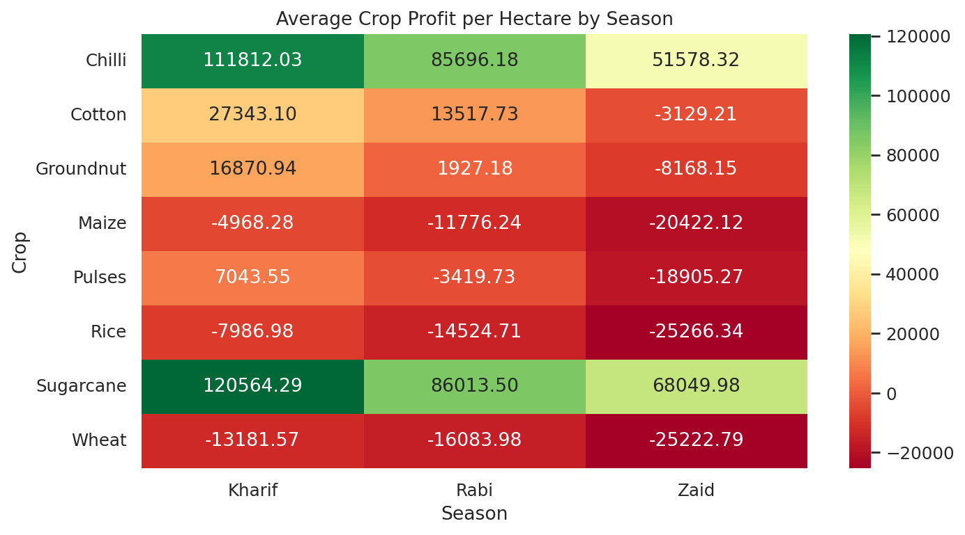
RESULTS
The heatmap shows that Sugarcane and Chilli are the most profitable crops, particularly during the Kharif season. Sugarcane records the highest average profit at ₹120,564/ha in Kharif, followed by Chilli at ₹111,812/ha.
Profit generally decreases from Kharif → Rabi → Zaid for most crops. In contrast, Maize, Rice, and Wheat show negative average profits across all three seasons, with their losses becoming larger during Zaid. Rice records a loss of ₹25,266/ha in Zaid, while Wheat records ₹25,223/ha.
Key finding: Kharif is the most profitable season overall, with Sugarcane being the highest-profit crop, while Zaid shows the weakest financial performance across most crops.

Slide 10
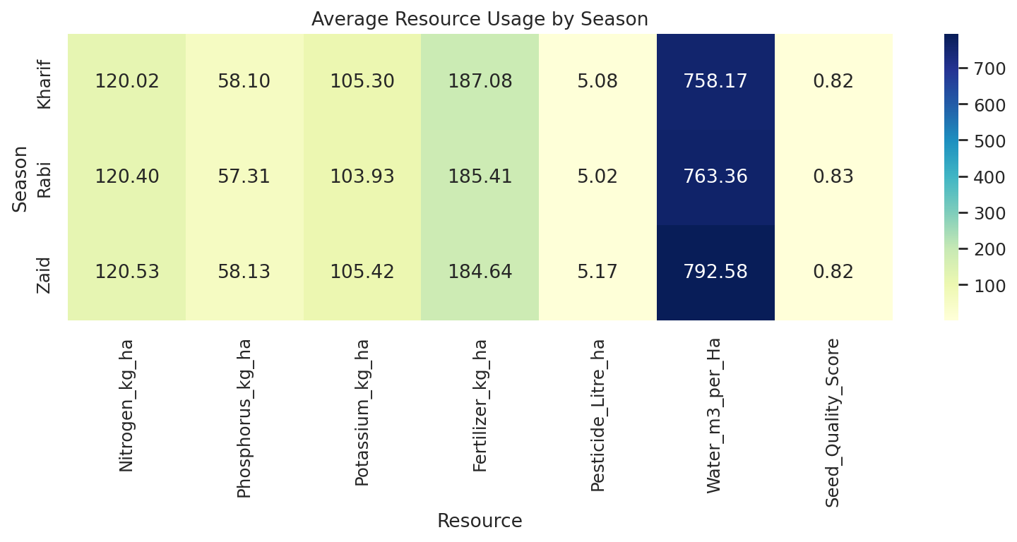
RESULTS
The heatmap compares average consumption of Nitrogen, Phosphorus, Potassium, Fertilizer, Pesticide, Water, and Seed Quality Score across seasons. Water usage is particularly high, with Zaid recording the highest average water requirement. The results help identify seasonal differences in resource demand and support more efficient resource allocation

Slide 11
FETURE SCOPE Seasonal Analysis: Compare agricultural performance across Kharif, Rabi, and Zaid seasons. Crop Profitability: Identify the most profitable and loss-making crop-season combinations. Yield Prediction: Predict crop yield using environmental, soil, and resource-related factors. Crop Recommendation: Suggest suitable crops based on season, expected yield, profitability, and resource availability. Water Management: Analyze water consumption and improve water-use efficiency. Risk Analysis: Evaluate disease and pest risks across crops and seasons. Resource Optimization: Improve the use of water, fertilizer, pesticide, and other agricultural inputs. Regional Analysis: Compare crop performance and profitability across different states. Interactive Dashboard: Present key insights through charts, rankings, heatmaps, and performance indicators. Future Scope: Extend the system with real-time weather data, market prices, advanced ML models, and personalized farmer recommendations.

Slide 12
GitHub Link https://github.com/Sayantanx-code/Seasonal-Agriculture-Performance-Analysis

Slide 13

VOIS Course completion certificate - Course name- Data Visualization

Slide 14
Thank you
THANK YOU FOR THIS OPPORTUNITY
.
.

