Slide 1
SOCIAL TAGGING
A Collaborative Content Organization Technique
NAME : SAYANTIKA MONDAL
ROLL NO : 205124085

Slide 2
INTRODUCTION
Social tagging is the practice of users attaching metadata in the form of labels or "tags" to online content.
Examples of platforms :
On Delicious, users tag bookmarked URLs.
On Flickr, users tag photos.
On Twitter, hashtags are used to categorize tweets.
On YouTube, users tag videos to describe their content.
On blogs, authors add tags to their posts to indicate topics.

Slide 3
The Problem with Traditional Systems
Manual Metadata
Costly and time-consuming
Vocabulary mismatch with users/designers
Fixed Taxonomies
Rigid, centralized, conservative
Hard to adapt to evolving content
User Impact
Forces rigid category choices, causes confusion ("analysis paralysis")
Ignores variety in user needs and views

Slide 4
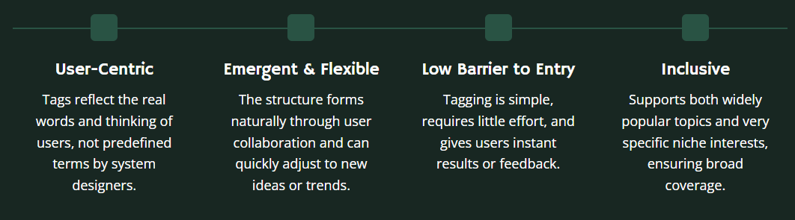
The Solution : Folksonomies
Folksonomy is a user-generated classification system, coined by Thomas Vander Wal, where people freely tag resources and collectively build a shared vocabulary.

Slide 5



How does it work?
The process can be visualized as a triangle connecting three core elements:
User: The person applying the tag.
Resource: The content being tagged (e.g., a photo, a link, a video).
Tag: The keyword or label itself.
This creates a tripartite network structure, which is a rich source for analysis.

Slide 6
How Communities influence Tagging
Tagging is Social: The tags people choose are often guided by their social circle. Seeing what tags their contacts use exposes them to a shared vocabulary.
A Shared Language Forms: This leads to social groups developing a common set of words for tagging. Users within a group are far more likely to use the same tags as each other.
"Tagging Communities" Emerge: This similar behavior creates strong connections between users, forming dense groups or "tagging communities" within the network.
Why This Is Important: By analyzing these connections, we can find influential communities and understand how ideas spread—all without needing a "friends list.“
To visualize this process, let's turn to a code simulation…

Slide 7
Categorizers vs. Describers
Categorizers: They tag for personal use with a limited vocabulary and low tag entropy. | Describers : They tag for others, large vocabulary with synonyms.
Identifying Categorizers vs Describers
Many tags used only once : likely a describer.
Rapid vocabulary growth : likely a describer.
Tag entropy low : likely a categorizer.

Slide 8
Tag Generation Model
Polya Urn Model : Tags likely to repeat; new tags not captured.
Yule-Simon Model: Adds new tags with low probability (linear growth); follows Heaps’ law.
Yule-Simon with Long-Term Memory : Considers tag order; favors recent tags; reproduces frequency-rank slopes.
Information Value Model : Combines tag imitation and information value for resource selection; partial reproduction of tag growth.
Fine-Tuned Parameter Model : Uses probabilities for imitation, background knowledge, and popular tags; simulates co-occurrence and resource streams effectively.

Slide 9

Tag Match Ratio
$$e\left(T,U\right)=\frac{\sum_{t_{k}∈T∩U}{w\left(t_{k}\right)}}{\sum_{t_{i}}{w\left(t_{i}\right)}}$$
T = set of tags assigned to the URL
U = terms in the document (URL text)
w(t) = weight of tag t (e.g., frequency, importance, or relevance score)
Numerator = total weight of tags that appear in both the tag set and the document
Denominator = total weight of all tags assigned

Slide 10
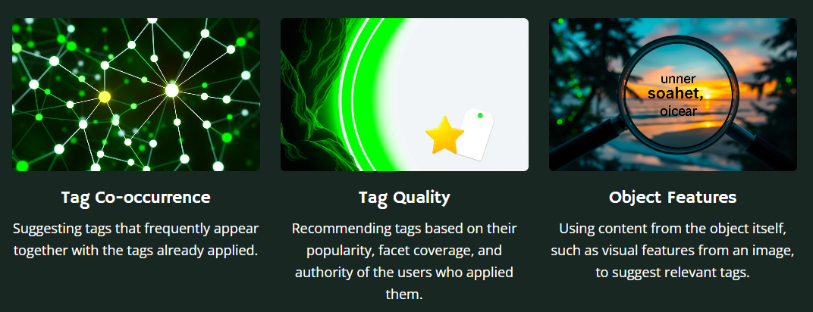

Tag Recommendations
To improve user experience and annotation quality, many systems recommend tags to users. These recommendations are generated using several techniques:

Slide 11
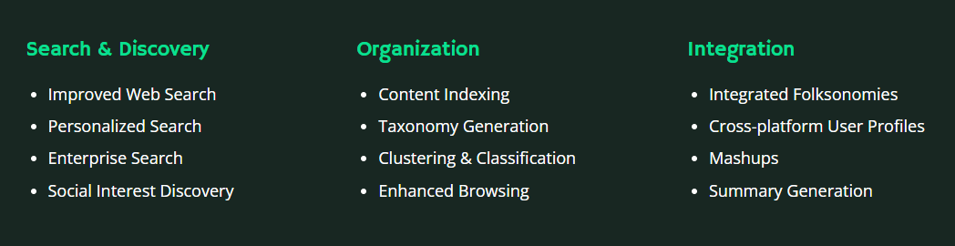
Applications of Social Tagging

Slide 12
Challenges
Spamming: Malicious users mis-tagging resources to promote their own interests.
Canonicalization & Ambiguity:
Different users use different words for the same concept.
Synonyms: tv vs. television
Plurals: book vs. books
Homonyms: apple (the fruit) vs. apple (the company)
Sparsity: Many web pages are not tagged at all.
Lack of Consensus: Users may not agree on the best tags for a resource.

Slide 13
Future Directions
New Systems: Analyzing tagging in microblogs (e.g., Twitter hashtags).
Improved Design: Supporting hierarchical or structured tags (e.g., location : london).
Personalized Recommendations: Tailoring tag suggestions to a user's role (describer vs. organizer) and social context.
New Applications: Using tags for summary generation, intent detection, and establishing website trustworthiness.

Slide 14
THANK YOU

