Slide 1

PRE-IDEATHON TEMPLATE
GENESIS
IDEATHON
TEAM & DOMAIN
Introduce your team and the domain you have chosen
Team Name – CODEWAVE
Team Members – Sayantika Das - CB.SC.U4CSE26353
Seevaanee E - CB.SC.U4CSE26452
Himani K - CB.SC.U4CSE26326
Debangshi Bhattacharya - CB.EN.U4CCE26004
Selected Domain – INTELLIGENT SYSTEMS AND DIGITAL FUTURES
Problem Statement – How can we prevent AI assistance from becoming cognitive dependency?

Slide 2
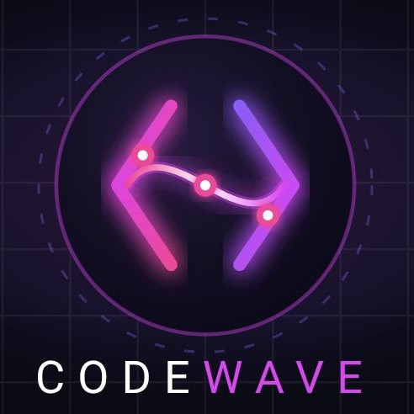

DOMAIN PROBLEM IN OUR WORDS
TEAM
CODEWAVE
Explain the problem in your domain simply, in your own words
What exactly needs to be solved?
AI is increasingly performing tasks like reasoning, recalling, writing and problem-solving for us. This can appear like a positive approach in the fast-running world, But this over-reliance may gradually reduce the need to exercise these cognitive skills ourselves. To be precise, we are moving from building machines to machines building us.
Why is it important right now?
AI is easily accessible even by a kid, which ultimately depletes the cognition of a young mind. AI was basically introduced to save time. Now the students and professionals increasingly use AI to write, solve, research, code and make decisions. The more often a task is delegated, the less opportunity we get to practice that cognitive skill independently. As AI becomes more capable, the risk isn't simply “AI replacing humans”—it could be humans gradually losing the ability or habit to think without AI.

Slide 3
WHO IS AFFECTED?
TEAM
CODEWAVE
Target users, stakeholders, beneficiaries
PRIMARY USERS
Learners who regularly use generative AI to study, practise, solve problems, code, write or research.
SECONDARY STAKEHOLDERS
Educators
Institutions
Parents / Mentors
WHO BENEFITS?
Learners → stronger independent reasoning
Educators → clearer evidence of genuine learning
Institutions → more responsible AI-assisted learning

Slide 4
CURRENT SITUATION & CONTEXT
TEAM
CODEWAVE
Existing scenario, background and how things work today
TODAY'S AI-ASSISTED LEARNING LOOP
Task / problem → Learner gets stuck → AI is prompted → AI generates an answer or solution → Learner accepts / adapts it → Task is completed
Learners increasingly use AI to solve problems, write, code and understand concepts. While AI improves convenience, it can also replace independent thinking.
RELEVANT FACTS
AI can support learning when used with proper guidance.
Unstructured use may encourage cognitive offloading.
Correct answers do not necessarily indicate genuine understanding.
THE SHIFT
Traditional: Attempt → Struggle → Feedback → Correction → Understanding
AI-assisted: Prompt → Answer → Completion
KEY QUESTION: Is AI helping learners think, or thinking on their behalf?

Slide 5
KEY CHALLENGES
TEAM
CODEWAVE
Main difficulties, bottlenecks, root causes and consequences
MAIN DIFFICULTIES
Task vs. Learning: Completing tasks doesn't guarantee skill development.
Over-Assistance: AI may provide answers instead of guiding reasoning.
Reduced Practice: Repeated delegation may limit independent thinking.
Hidden Knowledge Gaps: Correct answers can mask weak understanding.
ROOT CAUSES
Convenience-driven AI use
Answer-focused AI systems
Lack of adaptive, learner-centred assistance
CONSEQUENCES
Increased reliance on AI
Weaker independent problem-solving practice
Difficulty applying knowledge without AI
Core Challenge: How can AI support learning without replacing the thinking required to learn?

Slide 6
EXISTING SOLUTIONS / APPROACHES
TEAM
CODEWAVE
What is already being done, and where it falls short
AI literacy programs teach users to verify AI outputs and think critically. Socratic AI tutors guide learners through questions instead of directly giving answers. Schools also use independent problem-solving exercises and active learning to strengthen reasoning skills.
Most existing approaches do not specifically track which cognitive skills users repeatedly delegate to AI. They may not measure whether users can solve similar problems independently afterward. This creates an opportunity for adaptive systems that encourage independent thinking.
Current AI systems prioritise speed and task completion over long-term cognitive development. They often provide direct answers instead of encouraging independent reasoning, lack mechanisms to track users’ cognitive dependency, and offer limited adaptive guidance. The key failure is that completing tasks with AI does not guarantee the ability to perform them independently.

Slide 7
PROBLEM INSIGHTS & OPPORTUNITY AREAS
TEAM
CODEWAVE
Resources required to solve the problem
Hardware Requirements:
> Laptop, desktop or smartphone for users to interact with the system.
> Cloud servers or a local server to process user interactions and store learning progress.
> Optional GPU resources for running or fine-tuning AI models.
Software Requirements:
> An AI model/API to provide adaptive guidance and hints.
> A programming framework such as Python with Flask or FastAPI for backend development.
> A database to track independent performance, skill progress and AI assistance usage.
> An assessment module to evaluate independent problem-solving and adjust the level of AI assistance.
Other resources (Including Human Resources):
> Technical Resources: Computers, servers, AI models/APIs, programming frameworks, databases and
assessment tools to monitor independent problem-solving and adapt AI assistance.
> Human & Supporting Resources: AI developers, cognitive-science experts, educators, student volunteers,
research studies, funding and data-privacy safeguards for developing and testing the system.

Slide 8
INITIAL DIRECTION & EXPECTED OUTCOME
TEAM
CODEWAVE
What Is Your Expected Outcome?
We intend to develop an adaptive AI system that encourages independent thinking by providing hints and guided questions instead of immediately giving answers.
What we want to improve: Reduce over-reliance on AI and strengthen reasoning, critical thinking and independent problem-solving skills.
We wish to build a healthier, cognitively empowered society that embraces AI without sacrificing human reasoning, creativity, memory and independent decision-making. We aim to ensure that technological progress strengthens human potential rather than diminishes it, reminding society that no human-created software can replace the depth and potential of human cognition. Even as civilisation advances, we believe that human intelligence must remain grounded in humility before God, the supreme creator, and that technology should serve humanity rather than define its limits.

