Slide 1

AI-Powered Policy Compliance Intelligence Assistant
Enterprise AI System for Policy Retrieval, Risk Analysis & Compliance Guidance
Sayar Chakraborty

Slide 2
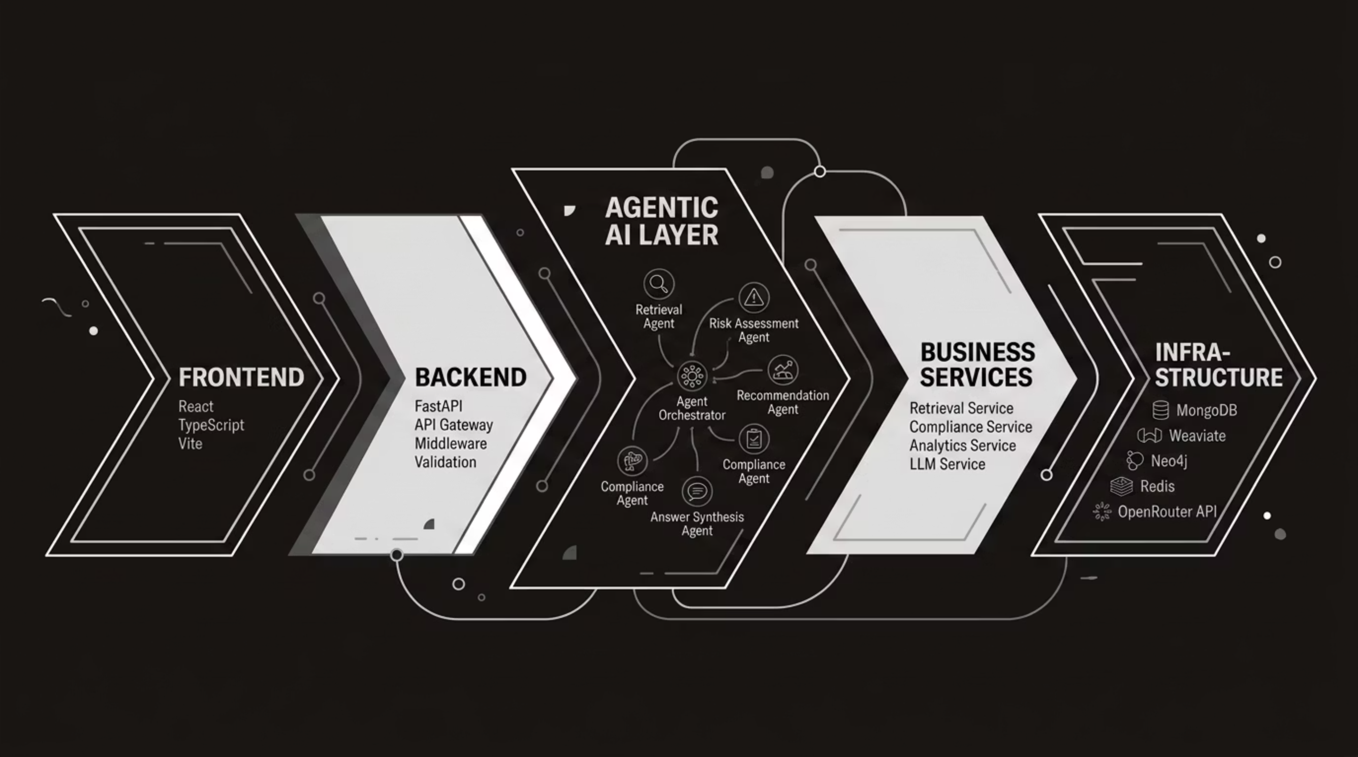

High-Level System Architecture
End-to-end data flow from user-facing frontend through agentic AI orchestration to persistent infrastructure — designed for modularity, auditability, and enterprise-scale compliance workloads.

Slide 3
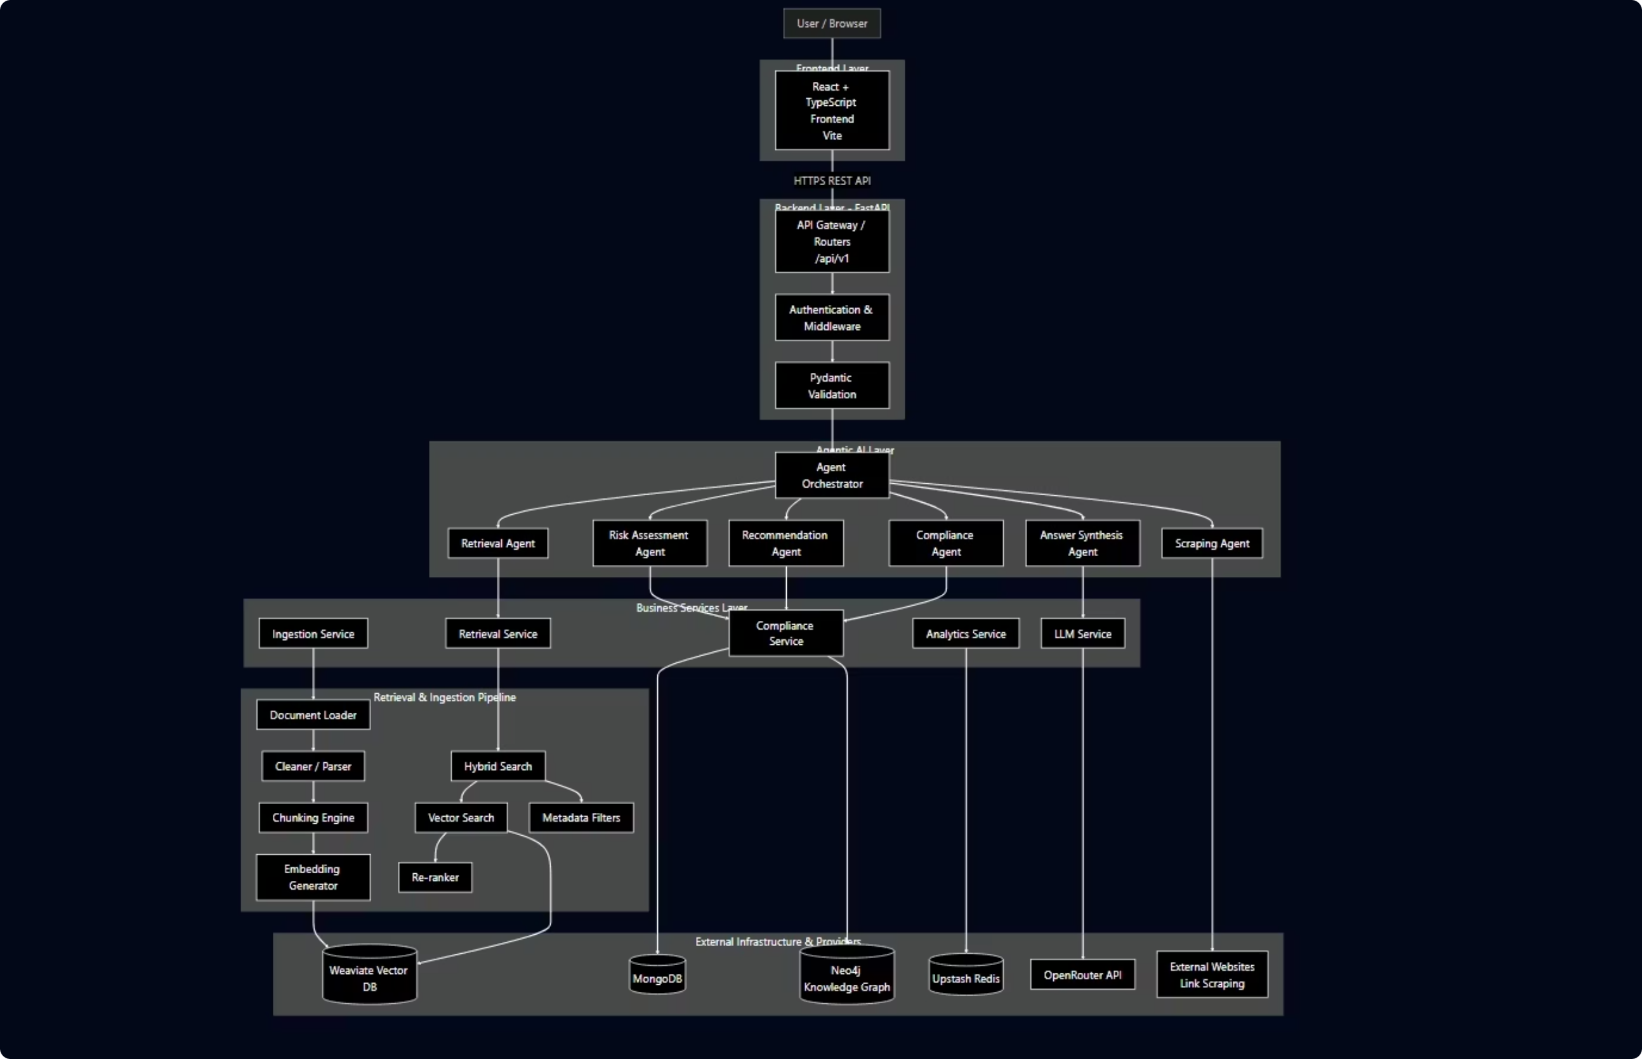
Low Level Architecture Diagram

Slide 4

AI Workflow
Agent Orchestration Workflow
Recommendation Engine
Retrieval Agent
Multi-agent retrieval and risk assessment.
Rank results and synthesize with LLM.
User Query Input
Explainable Response
Submit query with guardrails and validation.
Produce final audited, explainable reply.
Every query passes through structured guardrails, multi-agent retrieval, and risk assessment before a grounded, explainable response is synthesized — ensuring full auditability at each step.

Slide 5

RAG Retrieval Pipeline
Ingest & Chunk
Search & Rerank
Collect documents and split into chunks
Hybrid retrieval and result reranking
Embed & Index
Grounded Response
Generate embeddings and build vector index
Compose answer with citations and audit trail
Documents are chunked, embedded, and indexed for hybrid semantic-plus-lexical search. Reranking ensures the most relevant evidence is surfaced and cited in every AI-generated response.

Slide 6
Key Engineering Decisions
Hybrid Search
LangGraph Orchestration
Semantic + lexical retrieval for precision and recall across diverse policy documents
Graph-based agent workflows with explicit state management and full traceability
Deterministic Risk Scoring
Local-First Architecture
Rule-based, auditable scoring — not probabilistic black-box inference
On-premise capable with pluggable LLM provider abstraction for flexibility
Guardrail Security
Input validation, output filtering at every layer

Slide 7
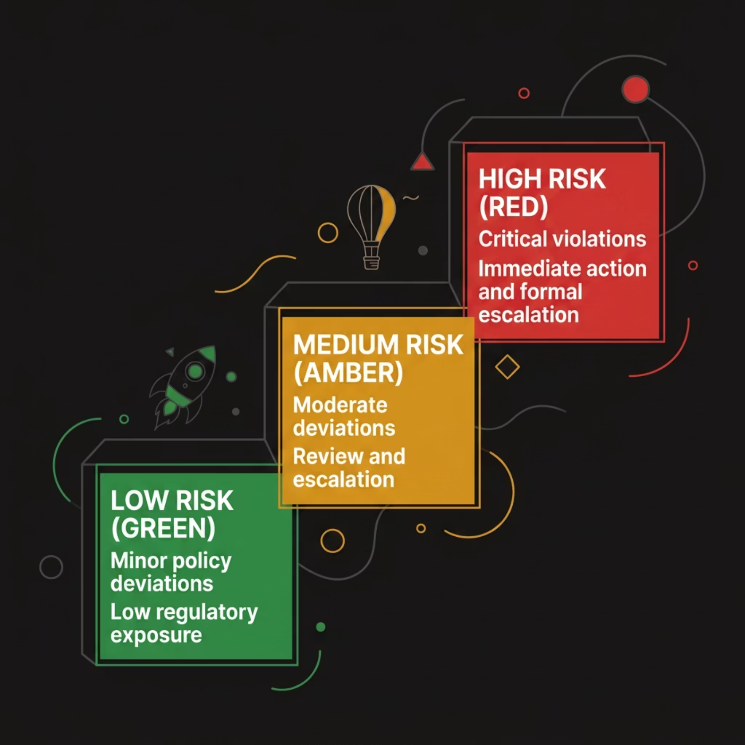

Risk Scoring & Security Architecture
Compliance Risk Engine
Keyword taxonomy mapped to regulatory clauses
Evidence boosting for high-confidence policy matches
Three-tier risk levels: LOW · MEDIUM · HIGH
Fully explainable scoring with source citations

Slide 8

Technology Stack
Current Technology Stack
Frontend
Backend
React · TypeScript · Vite
FastAPI · Python
AI / Retrieval
Databases
LangGraph · OpenRouter · Weaviate
MongoDB · Neo4j · Redis

Slide 9

Thank You

