Slide 1
SIGNATURE GLOBAL
RESIDENTIAL COMMUNITY
SECTOR-37D
VASTU STRATEGIC ANALYSIS-01
Recommendation on-04th April, 2026

Slide 2
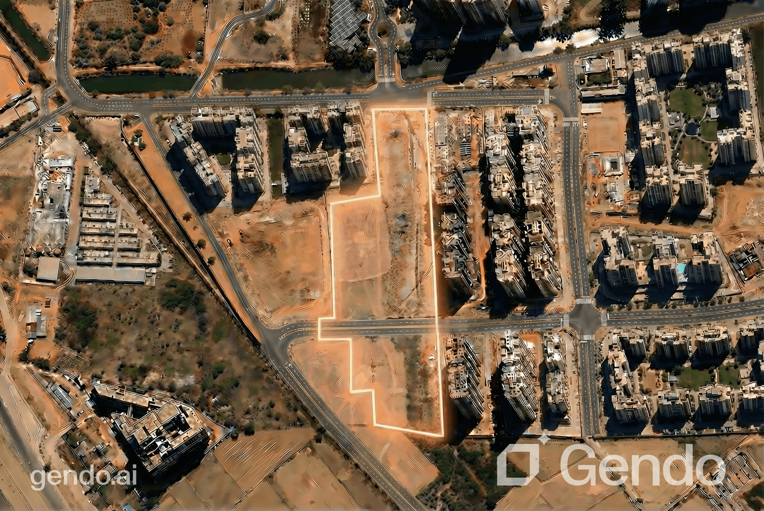

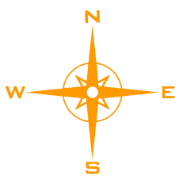


NORTH ALIGNMENT
SATISH GUPTA & YASH GUPTA
(VASTU CONSULTANTS)

Slide 3
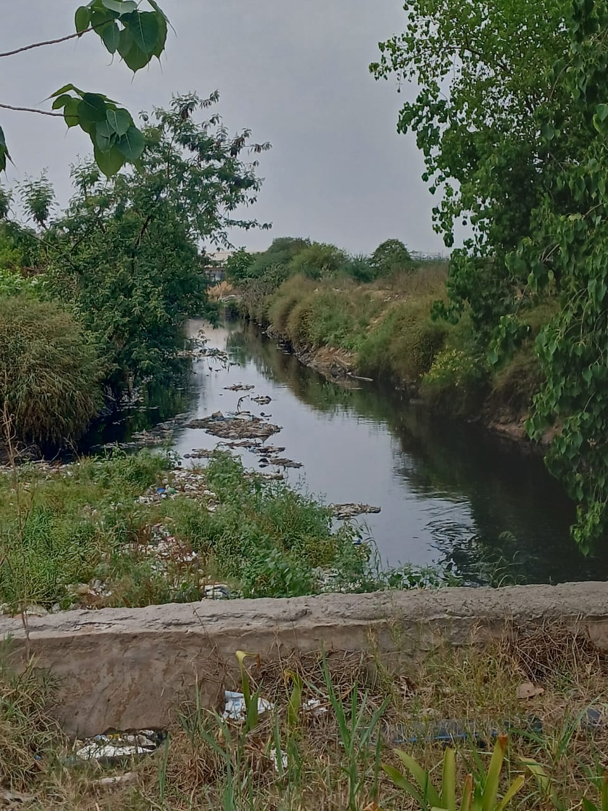
1. PLOT ORIENTATION
The plot is North-East facing, which is considered highly favorable as per Vastu principles.
The plot has a diagonal orientation, aligning it with the ordinal directions.
Water feature in the north zone is suitable and beneficial according to Vastu
Additionally, a 24-meter-wide road in the North-East zone further strengthens the Vastu compliance of the property and supports positive energy flow.
CANAL
CANAL
N
E
24M WIDE ROAD
N
E
W
S
W
S
SATISH GUPTA & YASH GUPTA
(VASTU CONSULTANTS)

