Slide 1
PRESENTATION TO CI/CD
By ENG :Elsayed Saper

Slide 2
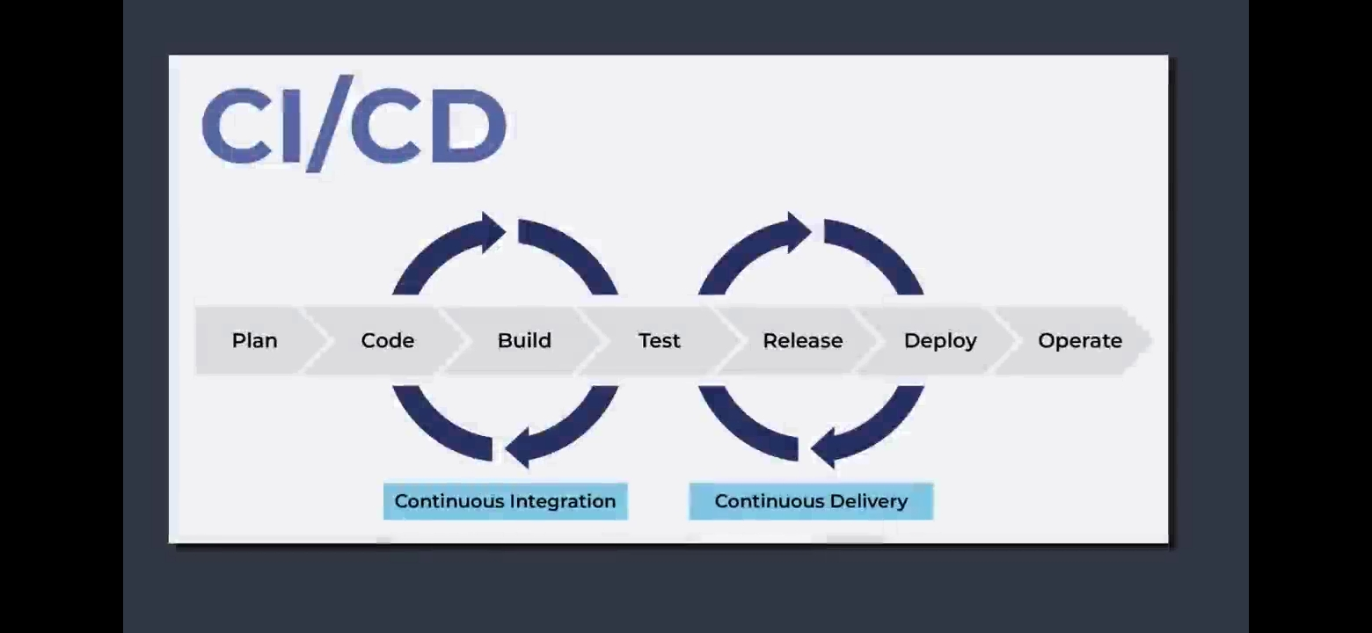

Slide 3
01
Benefits & Revenue
Why want to used CI/CD in the project & what benfits to add ?
1- Avoiding Cost
2-Reducing Cost
3-Increasing Revenue
4-Protecting Revenue
5-faster to add new update or Version

Slide 4
CI :
CD :
CI :
CD :
- The practice of merging all developers' working copies to a shared mainline several times a day. It's the process of "Making".
- Everything related to the code fits here, and it all culminates in the ultimate goal of CI: a high quality, deployable artifact!
- Some common CI-related phases might include:
- Compile
- Unit Test
- Static Analysis
- Dependency vulnerability testing
- Store artifact
- A software engineering approach in which the value is delivered frequently through automated deployments.
- Everything related to deploying the artifact autonomously fits here. It's the process of "Moving" the artifact from the shelf to the spotlight without human intervention.
- Some common CD-related phases might include:
- Creating and configuring infrastructure
- Promoting to production
- Smoke Testing (aka Verify)
- Rollbacks in case if any failure
- Automatically kick off a new release when new code is checked in
- Build and test code in a consistent ,repeatable environment
-Continually have an artifact ready for deployment
- Continually close feedback loop when build fails
- Automatically deploy new changes to staging environment for testing .
-Deploy to production safely without impacting customers,increase deployment frequency and reduce change lead time and change failure rate

Slide 5
Benefits of CI/CD to achieve build and deploy automation within our company's products .
Reducing Cost .
Increasing Revenue .
faster to add new update or Version.
Protecting Revenue .

Slide 6
THANK YOU

