Slide 1

SiMPLE CALCULATOR
Team 2

Slide 2
introduction to our project
what's our project
the concepts that we will talk about
explaining the lcd in our project
explaining the keybad in our project
explaining arduino code
simulated our project

Slide 3
what's our project
our project is an application of arduino using keybad and lcd
our project depends on display what we write from keybad to lcd
and we will explain how can we do this project step by step
first of all we will talk about the components that we used in our project
then we will explain the arduino code of our project
finally we will simulate our project to you

Slide 4
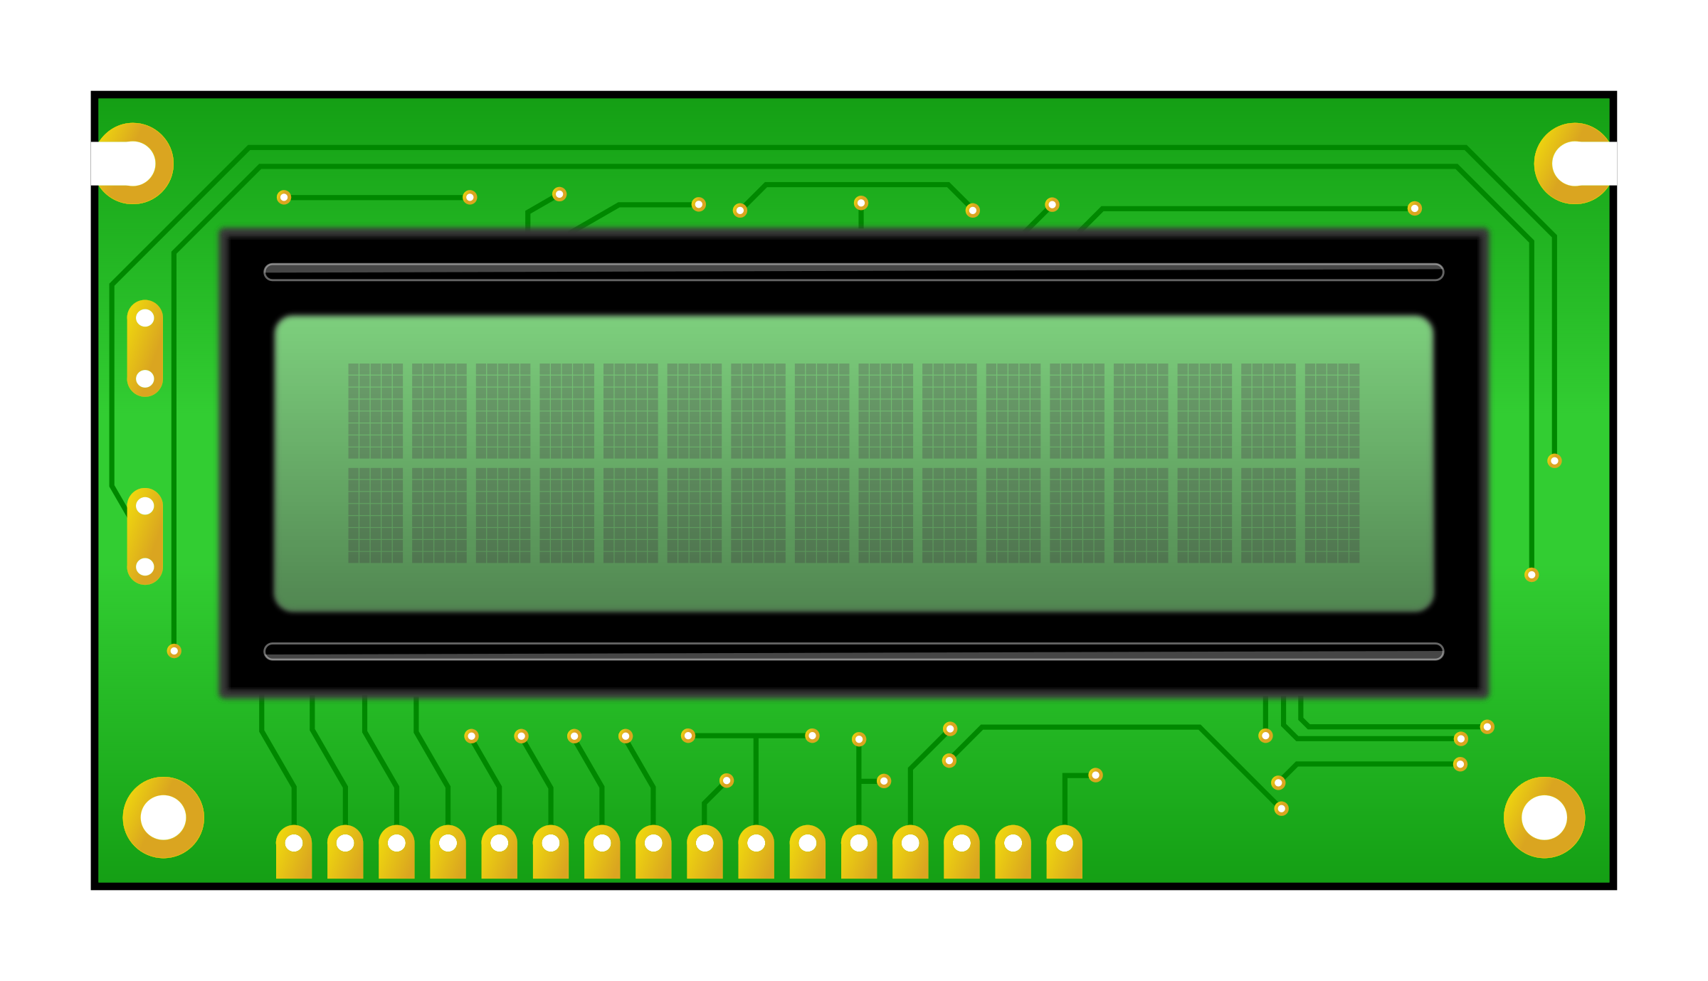
LCD

Slide 5
LCD :.
What is in an LCD display?
How lcd work?
pins and their function related to arduino

Slide 6
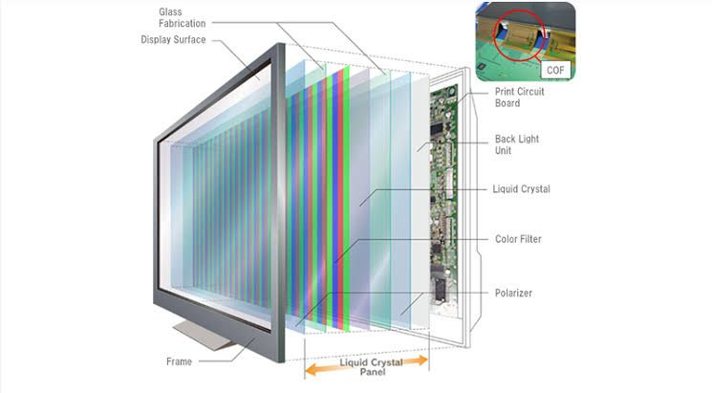
What is in an LCD display?
A liquid-crystal display (LCD) is a flat-panel display or other electronically modulated optical device that uses the light-modulating properties of liquid crystals combined with polarizers. Liquid crystals do not emit light directly but instead use a backlight or reflector to produce images in color or monochrome.

Slide 7
How LCDs work?
A display is made up of millions of pixels. The quality of a display commonly refers to the number of pixels.

Slide 8
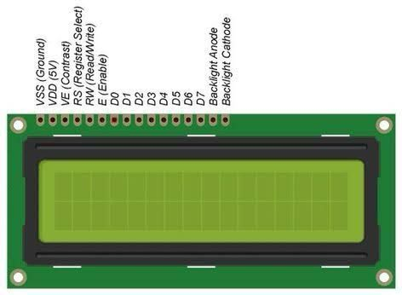
when it connected to arduino ,IT receives group of data from arduino among their pins .
and changes these data into characters(digits,letters) on its screen

Slide 9
*VSS &VDD
give volt to micro controller of lcd
microcontroller(function)
*VO
IT CONNECTED to changeable resistance (potentiometer) connected then to volt WHY??? to control the contrast of the screen
*RS(register select)
command register (low)
data register (high)

Slide 10
*RW
read
write (for printing on lcd )connected to ground
*E
it must be activated
*D0 to D7
pins which recieve data from arduino
*A&K
backlight of screen

Slide 11
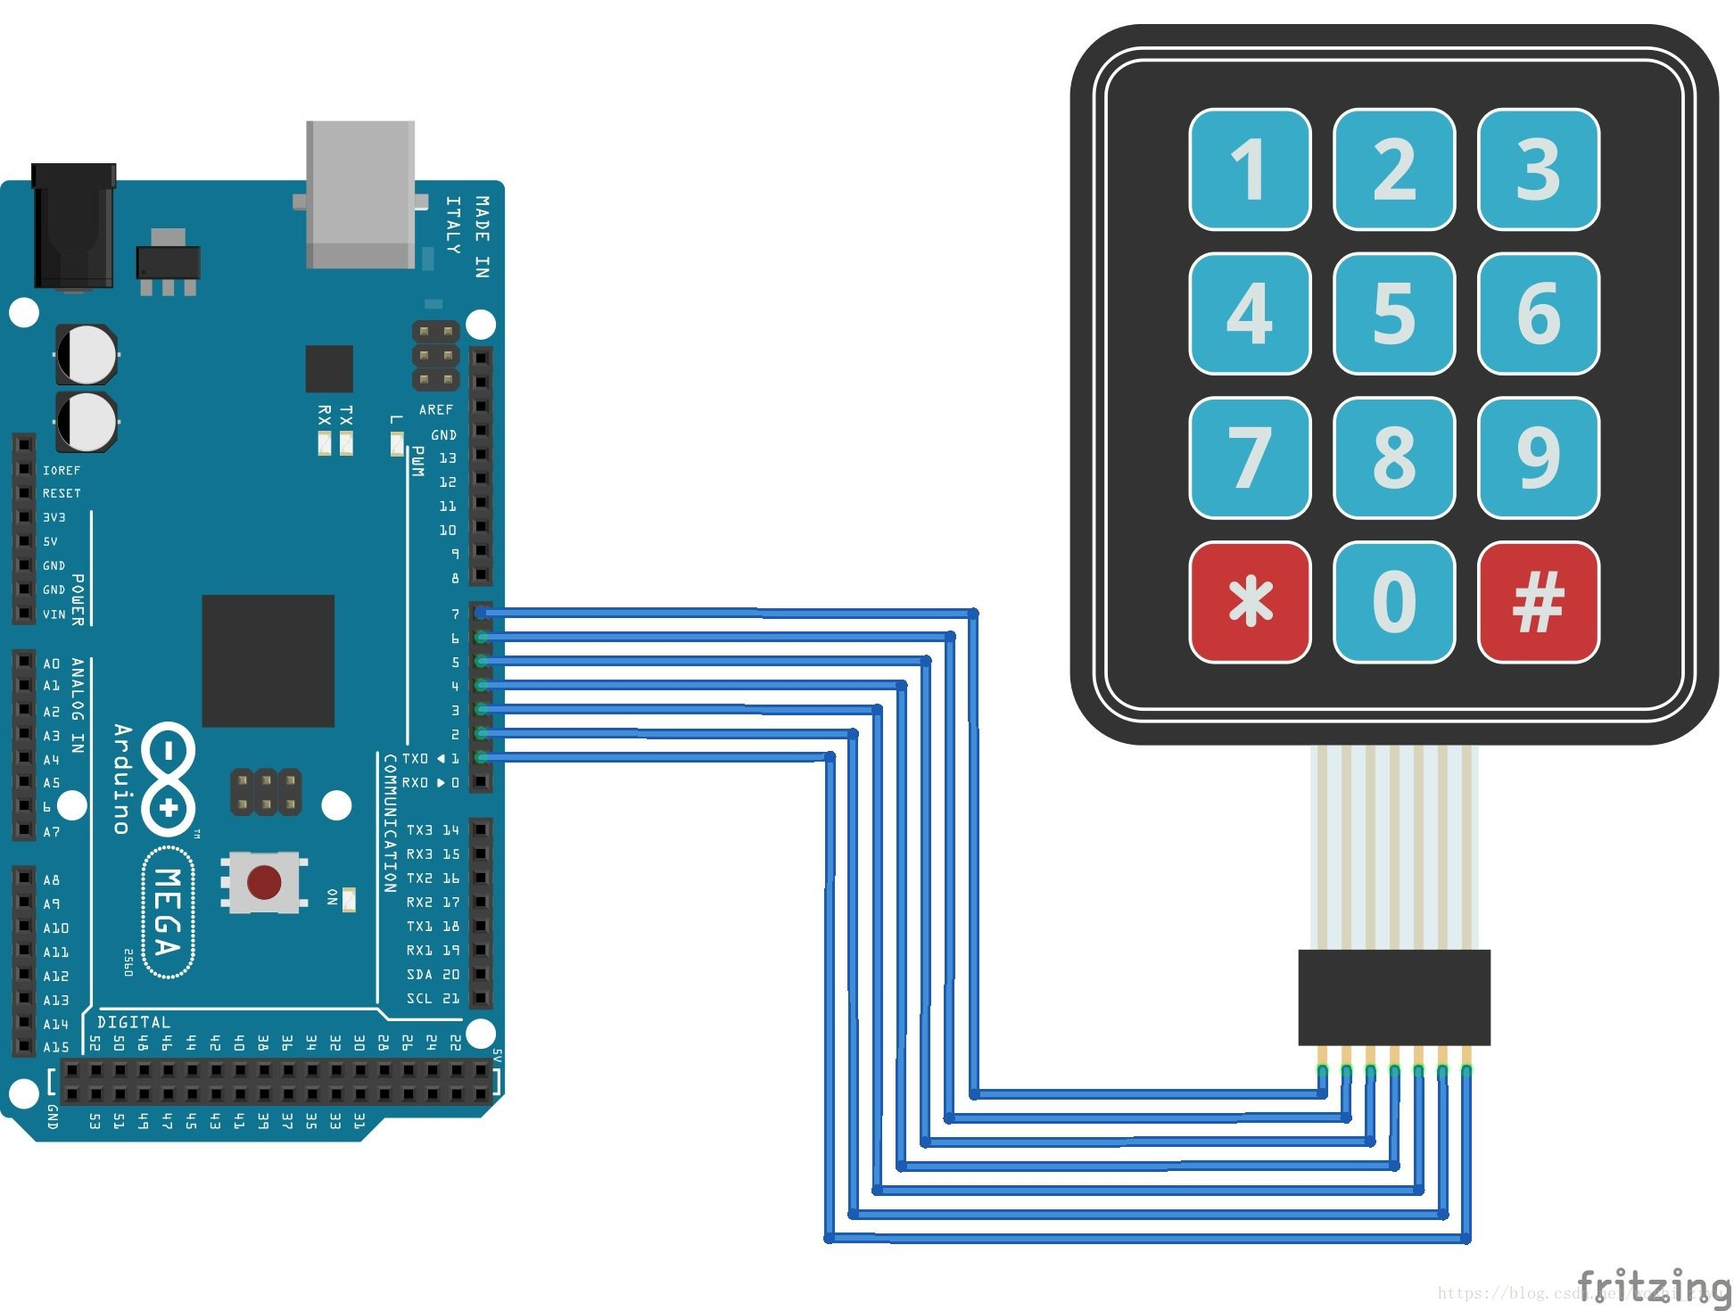
keypad

Slide 12
keypad
keypad
keypad wiring
keypad logic table
keypad interfacing

Slide 13
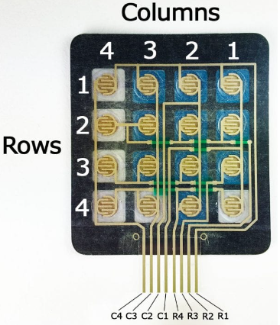
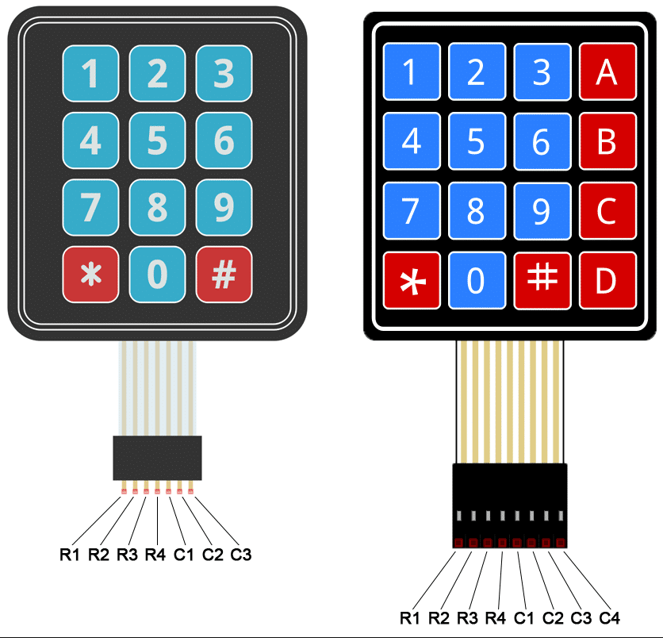
keypad
one of the microcontroller functions is to receive input
the input can be entered through 16-key membrane switch keypad

Slide 14
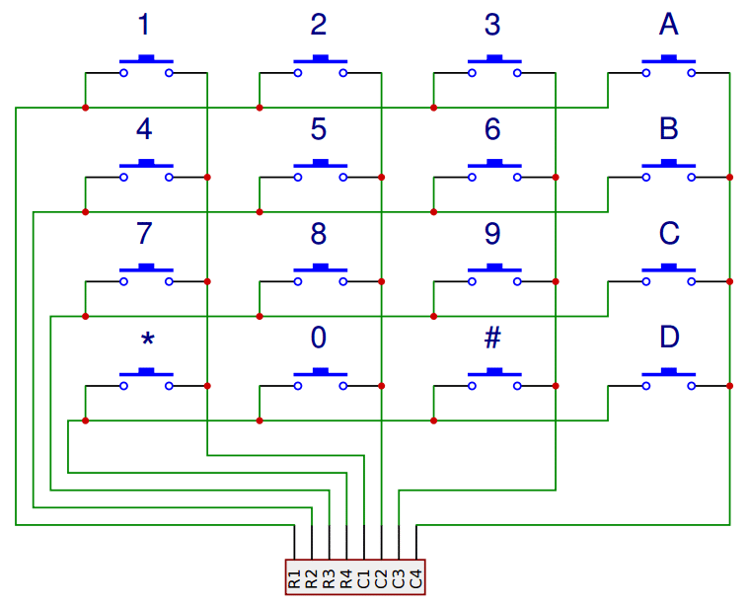
keypad wiring
4x4 matrix contain 16 switch
4 Columns & 4 Rows
if we entered one of them as an input other
would be outputh

Slide 15
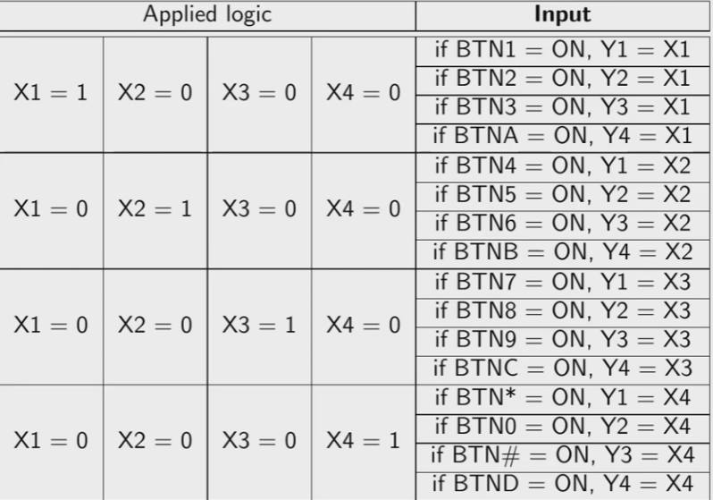
logic table
The Arduino detects which button is pressed by detecting
the row and column pin that’s connected to the button.
when no buttons are pressed, all of the column pins
are held HIGH (output),
and all of the row pins are held LOW(input)

Slide 16
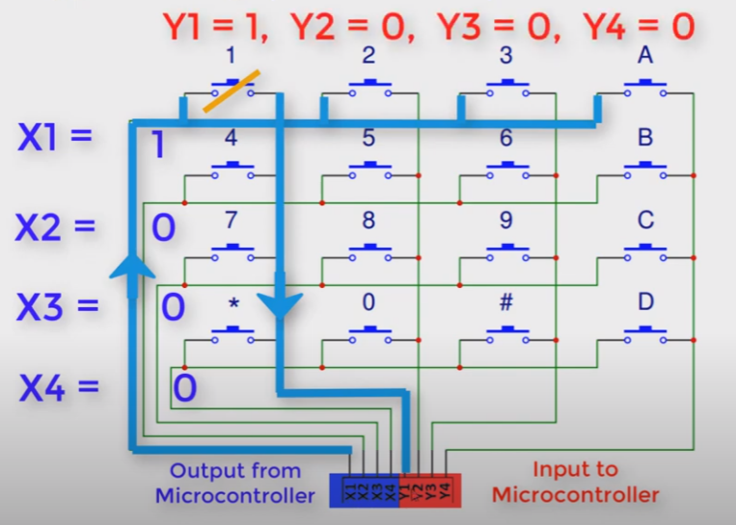
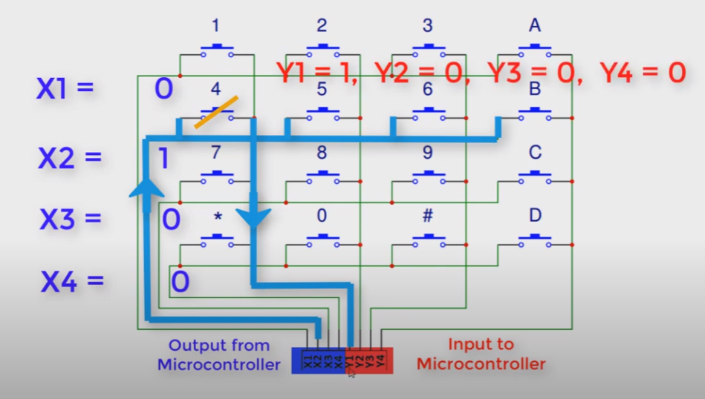
how it work

Slide 17
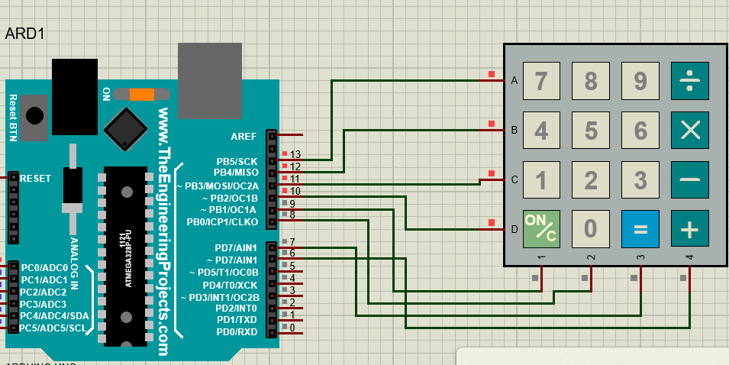
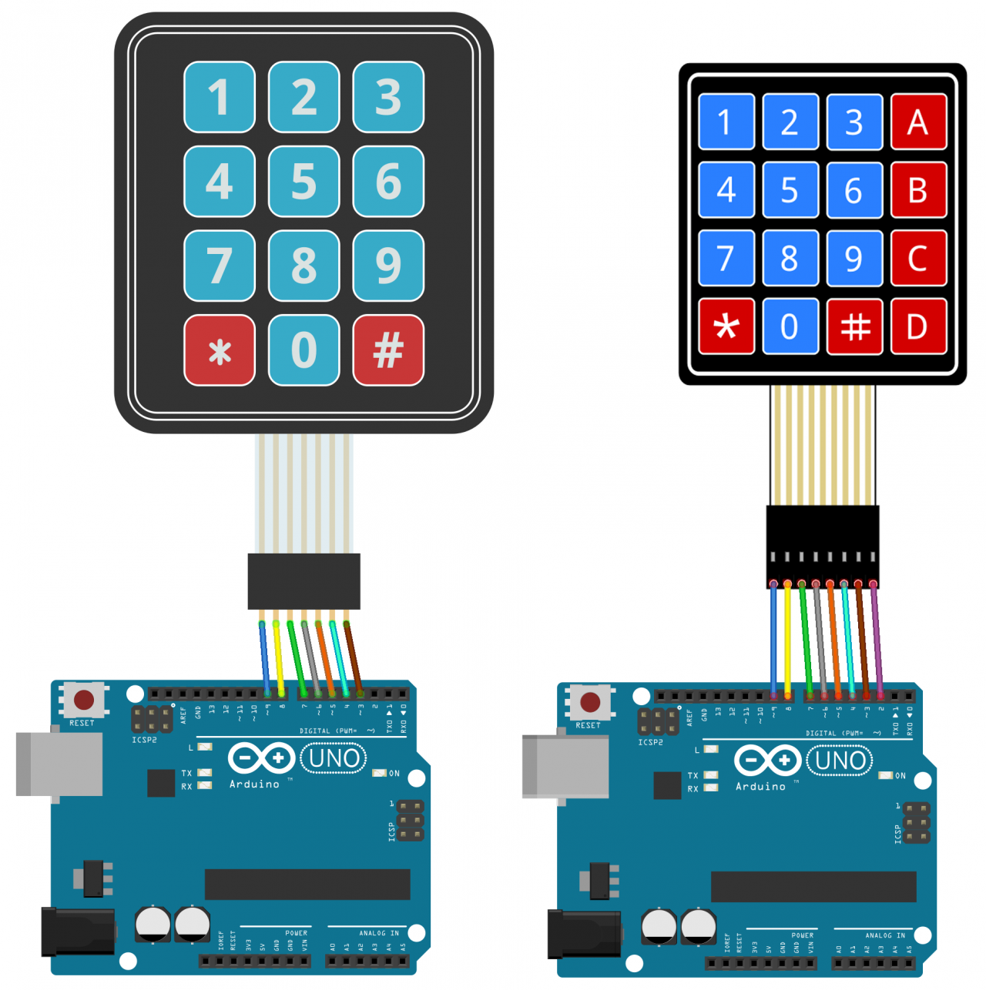
keypad interfacing
Keypad(makeKeymap(key), rowPins, colPins, ROWS, COLS)

Slide 18


Slide 19
#include <LiquidCrystal.h>
#include <Keypad.h>
const byte ROWS = 4;
const byte COLS = 4; char keys[ROWS][COLS] = {
// {'1','2','3','A'},
// {'4','5','6','B'},
// {'7','8','9','C'},
// {'*','0','#','D’}
{'7','8','9',’/'}, {'4','5','6',’*’}
{'1','2','3',’-’},
{‘C','0',’=',’+'}
};
byte rowPins[ROWS] = {9,8,7,6};
byte colPins[COLS] = {13,12,11,10};
LiquidCrystal lcd(A0,A1,A2,A3,A4,A5);
Keypad keypad = Keypad (makeKeymap (keys),rowPins ,colPins, ROWS, ROWS);
double Num1,Num2,Number;
char key,action;
boolean result = false; void setup() {
lcd.begin(16, 2);
lcd.print("CALCULATOR");
delay(2000);
lcd.clear();
} void loop() { key = keypad.getKey();

Slide 20
if (key!=NO_KEY) DetectButtons(); if (result==true) CalculateResult(); DisplayResult();
} void DetectButtons(){
lcd.clear();
if (key=='*’) {
Number=Num1=Num2=0; result=false;}
if (key == ‘1‘ || key == ‘2’ || key ==‘3’
|| key==‘4’ || key == ‘5’ || key ==
‘6’ || key ==‘7’ || key ==‘8’ || key ==
‘9’ || key ==‘0’) {
if (Number==0)
number = float (key);
else
Number = (Number*10) + float (key);
}
if (key == ‘=')
{
Num2=Number;
result = true;
}

Slide 21
if (key == ‘/' || key == ‘*' || key == ‘-' || key == ‘+') { Num1 = Number; Number =0; if (key == ‘+') { action = '+';} if (key == ‘-') { action = '-'; } if (key == ‘*')
{ action = '*';}
if (key == ‘/')
{
action = '/';} delay(100);
}
}
void CalculateResult(){ if (action=='+') Number = Num1+Num2; if (action=='-') Number = Num1-Num2; if (action=='*') Number = Num1*Num2; if (action=='/') Number = Num1/Num2; } void DisplayResult(){ lcd.setCursor(0, 0); lcd.print(Num1);
lcd.print(action);
lcd.print(Num2); if (result==true) {lcd.print(" =");
lcd.print(Number);} lcd.setCursor(0, 1);
lcd.print(Number);
}

Slide 22
simulate our project

Slide 23


