Slide 1
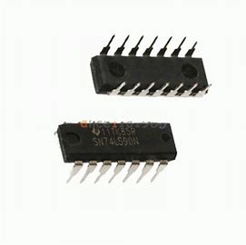

counter

Slide 2
Types of counter.
Synchronous counter.
Decade counter.
Ring counter.
Johnson counter.

Slide 3
What type is the 74LS90?
Decade and binary counter.

Slide 4
Decade counter.
A decade counter is a binary counter designed to count to 1001 (decimal 9). An ordinary four-stage counter can be easily modified to a decade counter by adding a NAND gate as in the schematic to the right. Notice that FF2 and FF4 provide the inputs to the NAND gate.
The NAND gate outputs are connected to the CLR input of each of the FFs.
It counts from 0 to 9 and then resets to zero.
The counter output can be set to zero by pulsing the reset line low.
The count then increments on each clock pulse until it reaches 1001 (decimal 9).
When it increments to 1010 (decimal 10), both inputs of the NAND gate go high. The result is that the NAND output goes low, and resets the counter to zero.
D going low can be a CARRY OUT signal, indicating that there has been a count of ten.

Slide 5
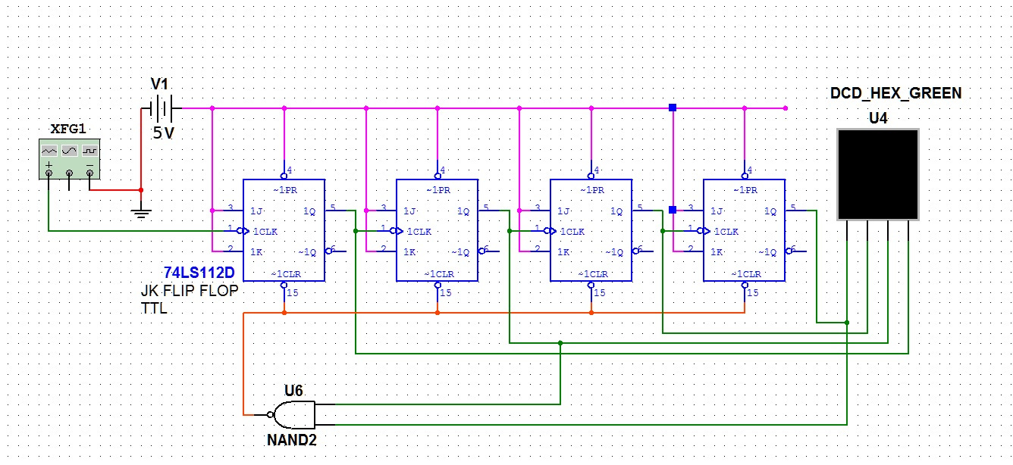
Example

Slide 6

Timer 555.

Slide 7
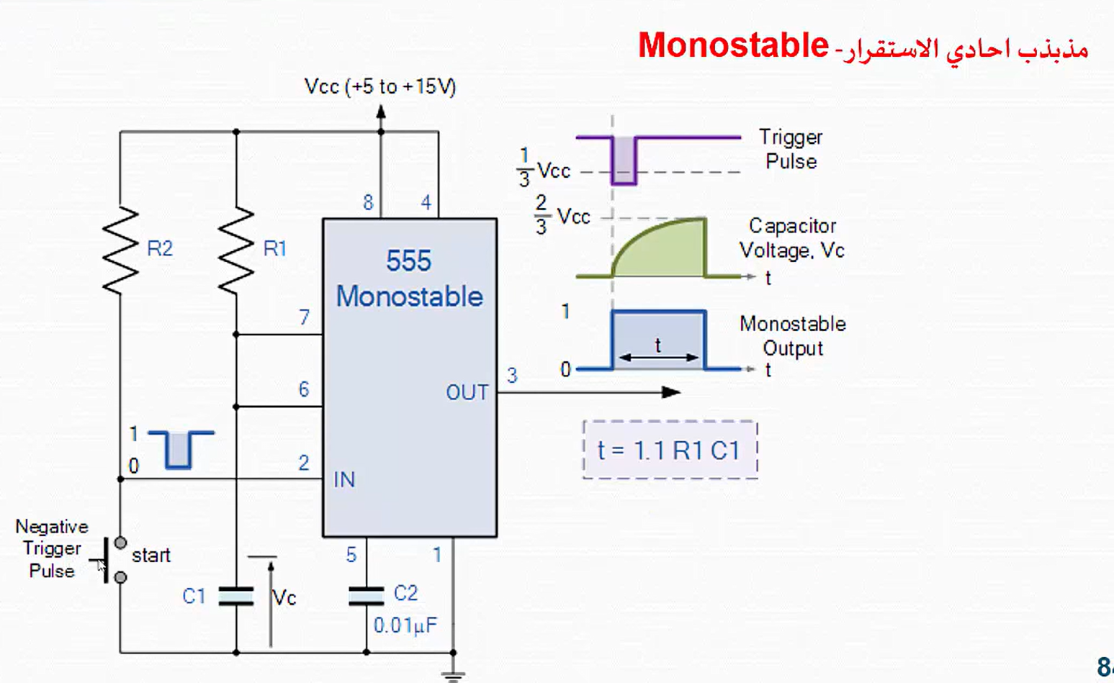
multivibrators are Circuits that work to output a specific variable signal that is controlled by time.
It have three types
Monostable multivibrator.
Bistable multivibrator.
Astable multivibrator.
Monostable multivibrator
Gives a signal for a time
extension.

Slide 8
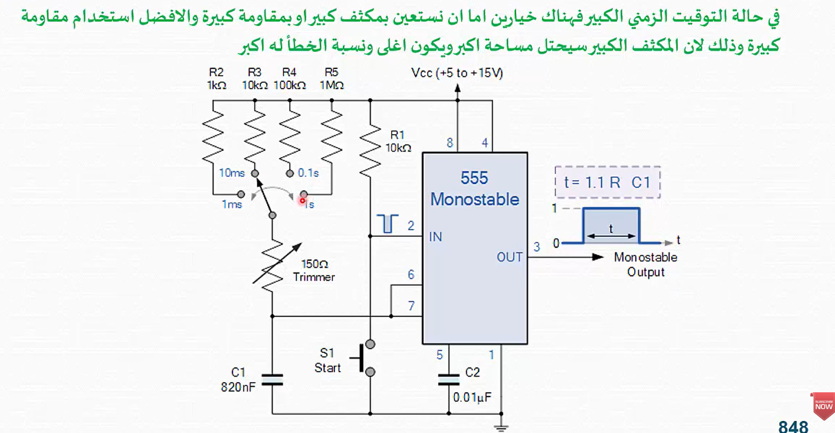

Slide 9
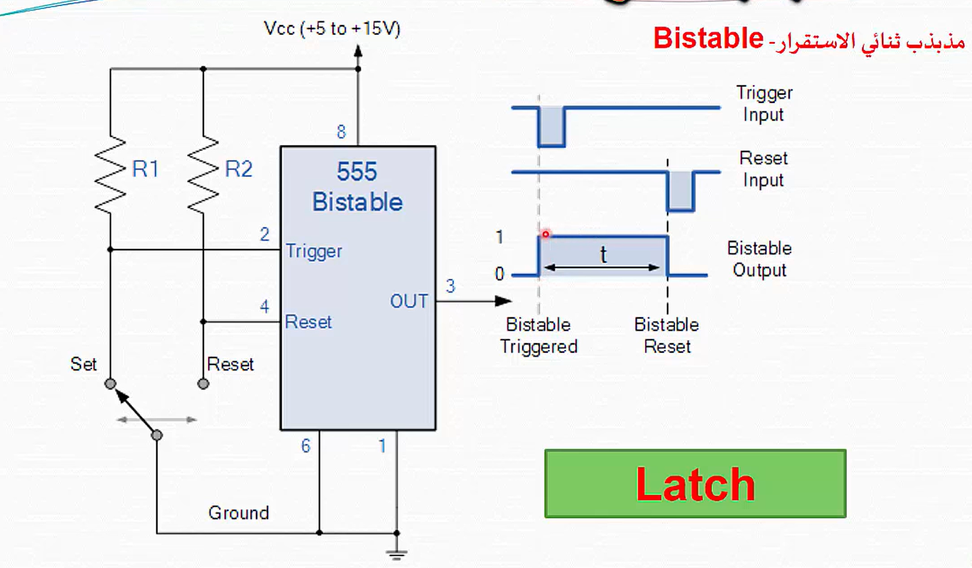
Bistable multivibrator.
Fixes the signal until it is changed

Slide 10
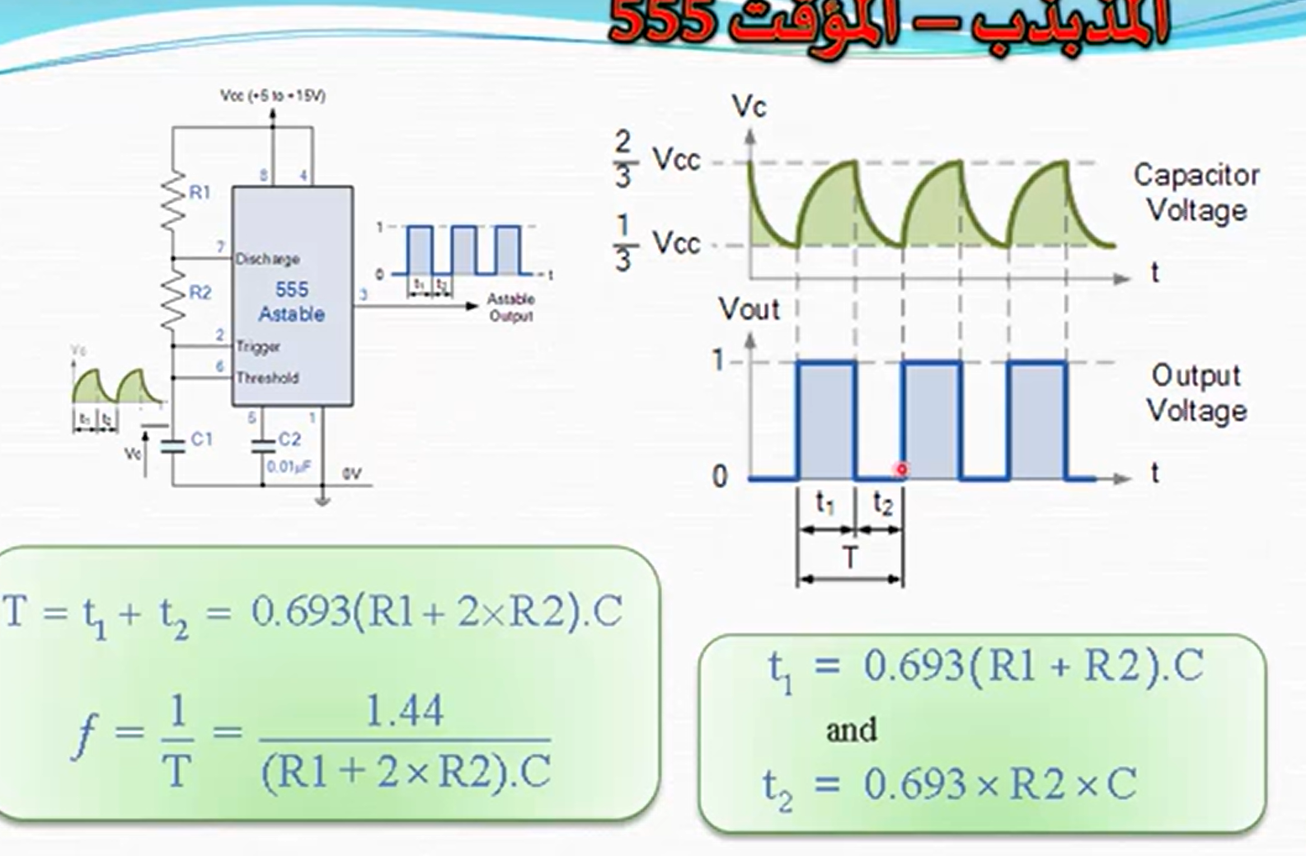
Astable multivibrator.
In this type the signal changes automatically for a certain period of time

