Slide 1
4-Quadrant VFD Hoist Drive

Slide 2

CONTENTS
01
Active Load Challenge
02
Power Stage Topology
03
Dynamic Braking Guard
04
Scalar Control Scheme
05
Time-Domain Results

Slide 3
06
Four-Quadrant Map
CONTENTS
07
Conclusions

Slide 4
01
Active Load Challenge

Slide 5

Gravity-Driven Load Dynamics
Lifting (Motoring)
The motor works against gravity, converting electrical energy to potential energy.
A hoist presents a unique control challenge: it is an active load governed by gravity, demanding bidirectional power flow.
Lowering (Regeneration)
Gravity pulls the load; the motor must brake to control descent, acting as a generator.

Slide 6
02
Power Stage Topology

Slide 7
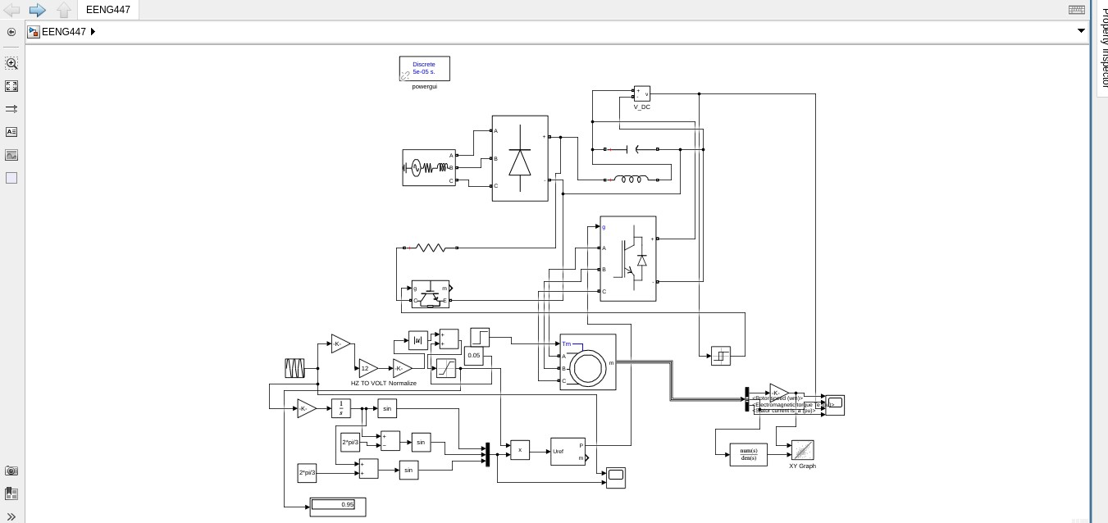
The Simulink Diagram

Slide 8
AC-DC-AC Conversion Chain
Grid
Rectifier
DC Link
Inverter
Motor
500V, 50Hz
Stiff Source
Uncontrolled
Diode Bridge
2200 µF
Capacitor
2-Level
IGBT Bridge
4kW
Induction Motor

Slide 9
03
Dynamic Braking Guard

Slide 10
Braking Chopper Protection
Rising VDC
The unidirectional diode rectifier cannot return energy to the grid. During lowering, the motor acts as a generator, which would cause a dangerous rise in DC bus voltage.
Hysteresis Control
If VDC > 700V: IGBT ON
If VDC < 650V: IGBT OFF
The Solution: Dynamic Braking
A hysteresis-controlled IGBT chopper and resistor bank act as a safety valve, dissipating excess regenerative energy to protect the DC link components.
Energy Dissipated in 60 Ω Resistor

Slide 11
04
Scalar Control Scheme

Slide 12
V/f Control with SPWM Modulation
Scalar V/f Control
Sinusoidal PWM (SPWM)
An open-loop strategy to maintain constant air-gap flux by keeping the ratio of stator voltage to frequency constant.
A high-frequency (1 kHz) triangular carrier wave is compared with a low-frequency sine wave reference to generate gating pulses for the IGBTs.
$$\frac{V}{f}≈Constant$$
Reference Sine
Triangular Carrier
SPWM Pulses
(Desired Freq.)
(1 kHz)

Slide 13
05
Time-Domain Results

Slide 14
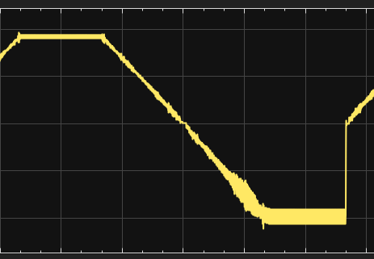
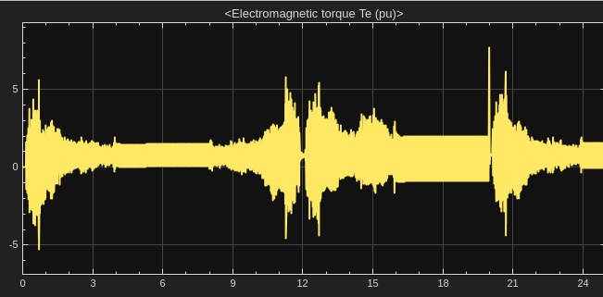
Speed & Torque Response
Rotor Speed
Electromagnetic Torque
The motor accelerates to +10 rad/sec, decelerating to a stop, and then reversing to -10 rad/sec.

Slide 15
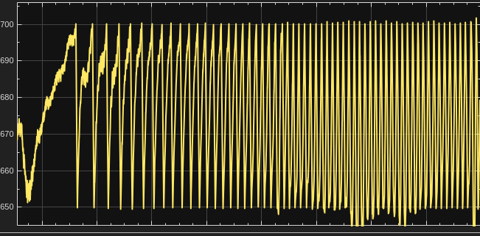
DC Bus Voltage Clamping
During regeneration, the DC bus voltage is actively clamped by the braking chopper, preventing catastrophic over-voltage.
650 V
700 V
Lower Limit
(Chopper OFF)
Upper Limit
(Chopper ON)

Slide 16
06
Four-Quadrant Map

Slide 17
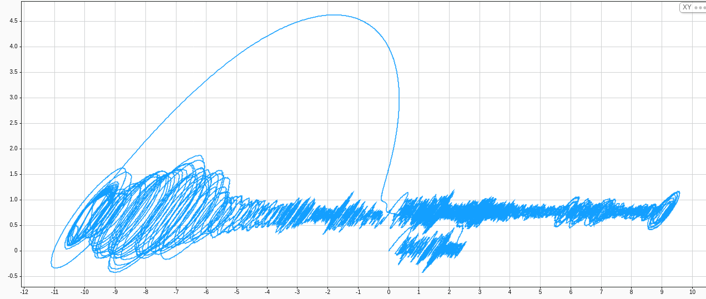
Torque-Speed Quadrant Loop
The XY plot of Torque (Y) vs. Speed (X) provides a clear visualization of the machine's four-quadrant operation.
Quadrant I (Forward Motoring)
+Speed, +Torque. Power is positive. Energy flows from grid to motor.
Quadrant II (Reverse Regeneration)
-Speed, +Torque. Power is negative. Energy flows from load to DC bus, confirming regeneration.

Slide 18
07
Conclusions

Slide 19
Validated Drive Performance
Stable Torque Control
Effective Protection
Industrial Suitability
The drive successfully maintains positive torque against gravity in both motoring and regenerative modes.
The dynamic braking chopper successfully clamped the DC bus voltage, preventing component damage.
The VFD topology is proven suitable for safe and reliable operation in industrial hoist and crane applications.

Slide 20
THANK YOU

