Slide 1
DESIGN AND APPLICATION OF IIR AND FIR DIGITAL FILTERS
Noise Removal and Audio Signal Restoration
Sayed Ali Murtadah Alawi
ID: 202002704 | EENG 479

Slide 2
OBJECTIVE
PART A
PART B
PART C
PARTS D & E
Project Objective & Approach
Objective
Methodology
Design, apply, and evaluate digital filters to restore corrupted audio signals. Progress from simple tones to complex real-world noise.
Manual mathematical derivations progressing to automated MATLAB processing. Both IIR and FIR filter designs evaluated.
Evaluation Metrics
QUANTITATIVE
QUALITATIVE
APPROACH
MSE & SNR
Perceptual Listening
Progressive Complexity
Mean Squared Error and Signal-to-Noise Ratio for objective filter comparison
Audio intelligibility assessment through human perceptual evaluation
Simple tones to harmonics to broadband to real-world analog noise
"The goal was to see how different digital filters handle everything from simple artificial jamming to complex real-world analog noise."
2 / 7

Slide 3
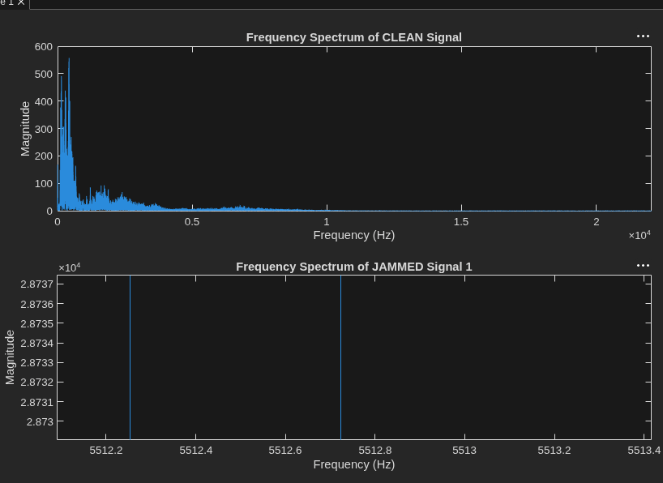
OBJECTIVE
PART A
PART B
PART C
PARTS D & E
Part A — Simple Unjamming (Single-Tone)
THE PROBLEM
A massive, unnatural jamming spike precisely at 5512.5 Hz in the corrupted signal.
THE SOLUTION
IIR: 2nd-Order Notch Filter (Pole-Zero method)
FIR: 61st-Order Bandstop Filter (Hamming Window)
Both manually derived and implemented in MATLAB
THE RESULT
Both filters eliminated the ringing noise successfully.
INITIAL SNR
-24.73 dB
FILTERED SNR
~ -9.7 dB
→
IIR MSE: 0.02385 | FIR MSE: 0.02356
Figure 1: Frequency spectrum showing single-tone jamming spike at 5512.5 Hz
3 / 7

Slide 4
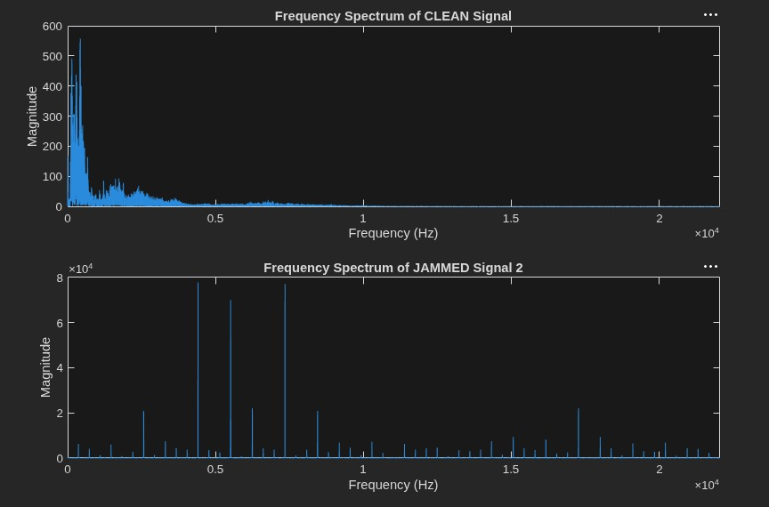
OBJECTIVE
PART A
PART B
PART C
PARTS D & E
Part B — Intermediate Unjamming (Harmonics)
THE PROBLEM
A complex periodic jamming signal with 7 distinct high-magnitude spikes.
THE SOLUTION (AUTOMATED)
Manual design would require a 14th-order polynomial.
Used MATLAB's findpeaks to auto-isolate the 7 true spikes (threshold: 20,000).
Cascaded 7 distinct 2nd-order IIR Notch filters via canned iirnotch.
THE RESULT
Complete removal of the "comb-noise" while perfectly preserving human dialogue.
SNR IMPROVED FROM -24.67 dB → -8.89 dB
MSE: 0.7407 → 0.0195
Figure 2: Frequency spectrum showing 7 periodic harmonic spikes
4 / 7

Slide 5
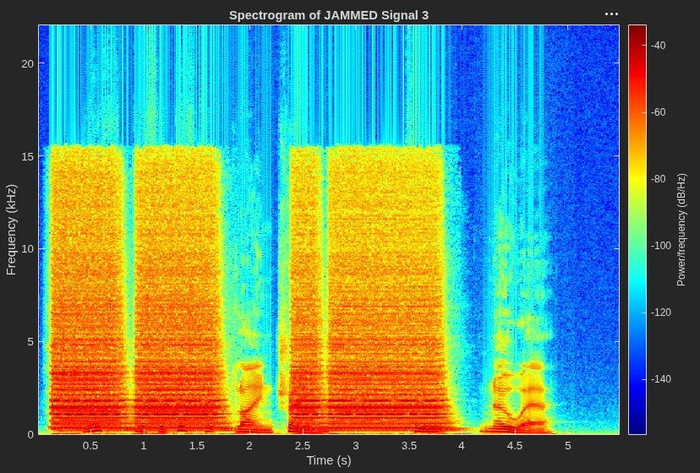
OBJECTIVE
PART A
PART B
PART C
PARTS D & E
Part C — Complex Unjamming (Broadband)
THE PROBLEM
Heavy bursts of broadband noise across the entire spectrum up to 15.5 kHz. Notch filters are useless here.
THE SOLUTION
Human voice primarily occupies frequencies below 4 kHz.
Applied Lowpass filters with 4 kHz cutoff:
• IIR: 6th-order Butterworth
• FIR: 80th-order Windowed
THE RESULT
SNR improved by only ~0.6 dB, but qualitative improvement was massive.
KEY TAKEAWAY
SNR is an inadequate metric for broadband noise that overlaps with desired frequencies.
Figure 3: Spectrogram showing heavy broadband noise bursts up to 15.5 kHz
5 / 7

Slide 6
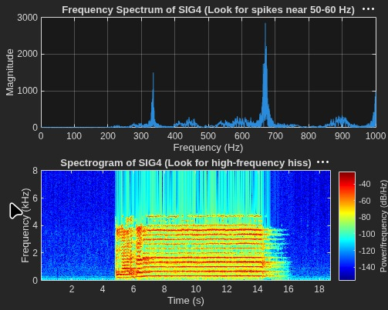
OBJECTIVE
PART A
PART B
PART C
PARTS D & E
Parts D & E — Practical Tape Restoration
THE PROBLEM
Real-world historical analog recordings with no clean reference signal. Plagued by low-end rumble and high-frequency tape hiss.
THE SOLUTION
4th-order IIR Butterworth Bandpass Filter
• Lower cutoff: 80 Hz (removes sub-bass rumble)
• Upper cutoff: 4000 Hz (removes tape hiss)
THE RESULT
Removed the sub-bass rumble and high-end hiss, resulting in significantly warmer and clearer historical audio.
Same filter applied to both SIG4 and SIG5.
No quantitative metrics available — no clean reference signal exists for historical recordings.
Figure 4: Spectral analysis highlighting high-frequency tape hiss and low-end instability
6 / 7

Slide 7
Conclusion & Filter Trade-offs
IIR Filters
FIR Filters
The "Cheat Code"
Highly efficient — achieve cutoffs at much lower orders (e.g., 6th-order vs 80th-order).
Trade-off: Introduce phase distortion.
Guarantee absolute stability and linear phase.
Trade-off: Require very high filter orders.
MATLAB's filtfilt (zero-phase filtering) mitigates IIR phase distortion.
Winner: IIR for offline audio processing.
PERFORMANCE SUMMARY
Project Part | Filter Type | Order | Initial SNR (dB) | Final SNR (dB) | MSE
Part A (Simple) | IIR Notch | 2 | -24.73 | -9.75 | 0.02385
 | FIR Bandstop | 61 |  | -9.70 | 0.02356
Part B (Intermediate) | Cascaded IIR Notch | 14* | -24.67 | -8.89 | 0.01953
Part C (Complex) | IIR Lowpass | 6 | -7.41 | -6.84 | —
 | FIR Lowpass | 80 |  | -6.82 | —
* Seven distinct 2nd-order IIR notch filters cascaded (effective 14th-order system)
THANK YOU
Audio samples available | Questions welcome
7 / 7

