Slide 1

SIC8
REAL-TIME
PAYMENT INGESTION
Zero DB inserts. Sub-10ms fraud scoring. One Medallion Lakehouse.
AWS S3 × DATABRICKS × MSK

Slide 2
THE INGESTION DILEMMA
High transaction velocity turns a familiar RDBMS into a shared choke point.
PAYMENTS
APIs + EVENTS
CUSTOMERS
POSTGRESQL
REFERENCE
DAILY FILES
RDBMS
WRITE EXHAUSTION
LOCKS • I/O • POLLING • DOUBLE-WRITES

Slide 3
DECOUPLE INGESTION FROM PERSISTENCE
Four paths, one event contract, zero relational inserts on the payment hot path.
A REAL-TIME
EVENTS
B POSTGRES
CDC
C BATCH
REFERENCE
D FRAUD
INFERENCE
MEDALLION LAKEHOUSE
LINEAR SCALE + INSTANT PROTECTION

Slide 4
ONE TOPOLOGY. FOUR DATA PATHS.
PAYMENT
PRODUCERS
AMAZON MSK
REDIS +
LIGHTGBM
FRAUD OPS +
ANALYTICS
S3 BRONZE
SILVER / GOLD

Slide 5
A — ZERO-DB STREAMING
Payment events bypass relational persistence and land directly in durable streaming infrastructure.
PAYMENT API
AVRO CONTRACT
AMAZON MSK
S3 MICRO-BATCH
BRONZE
NO RELATIONAL WRITE ON THE HOT PATH

Slide 6
B — POSTGRESQL CDC
Debezium 2.5 tails WAL logs: no polling, no double-write, no application coupling.
POSTGRESQL
WAL LOG
DEBEZIUM 2.5
CDC TOPIC
SILVER CUSTOMER
NO RELATIONAL WRITE ON THE HOT PATH

Slide 7
C — SCHEDULED REFERENCE INGESTION
Airflow snapshots dimensions into compact, query-efficient Parquet.
AIRFLOW DAG
EXTRACT
VALIDATE
PARQUET + SNAPPY
S3 LANDING
NO RELATIONAL WRITE ON THE HOT PATH

Slide 8
D — SUB-10MS FRAUD INFERENCE
In-flight scoring hydrates behavioral state before a payment reaches authorization.
EVENT
REDIS FEATURES
LIGHTGBM
SCORE GATE
ALLOW / BLOCK
P95 TARGET < 10ms

Slide 9
LINEAGE IS CODE, NOT A DIAGRAM
Provenance is explicit from source offset through every Delta transformation.
MSK OFFSET
+ SCHEMA ID
BRONZE
AUTOLOADER
SILVER
CONTRACT v2.1
GOLD
FRAUD MARTS
QUARANTINE DLQ
REASON + PAYLOAD + TRACE

Slide 10
MEDALLION STORAGE, BUILT FOR REPLAY
BRONZE / IMMUTABLE RAW / EVENT TIME + INGEST TIME
SILVER / CONTRACT v2.1 / DEDUPED + TYPED
GOLD / FRAUD + FINANCE MARTS

Slide 11
RAW SIGNAL → BEHAVIORAL INTELLIGENCE
Streaming transforms convert telemetry into high-predictive-value features in milliseconds.
AMOUNT + MCC
DEVICE + GEO
VELOCITY
1m / 5m / 1h
DISTANCE
IMPOSSIBLE TRAVEL
BEHAVIOR
MERCHANT NOVELTY
MODEL VECTOR
VERSIONED

Slide 12
AIRFLOW CONDUCTS; STREAMING KEEPS PLAYING
Orchestration coordinates checks and jobs without becoming the payment data plane.
APACHE AIRFLOW
CONTROL PLANE
STREAM HEALTH
EVERY 5 MIN
REFERENCE SNAPSHOT
DAILY
DATABRICKS JOBS
DEPENDENCY-AWARE

Slide 13
FAIL CLOSED? FAIL OPEN? FAIL TRACEABLY.
Each failure mode has an explicit containment path and recovery contract.
MALFORMED
PAYLOAD
REDIS
DOWNTIME
CONSUMER
LAG
QUARANTINE DLQ
CIRCUIT BREAKER
+ SAFE POLICY
BACKPRESSURE
+ REPLAY

Slide 14
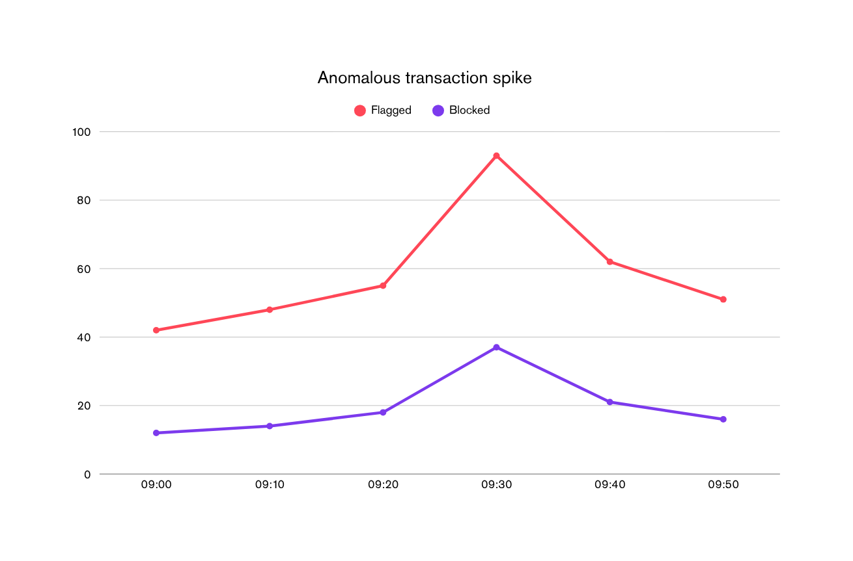
EXECUTIVE FRAUD OPERATIONS
96.4%
PRECISION
$2.8M
BLOCKED
7.6ms
P95 SCORE

Slide 15
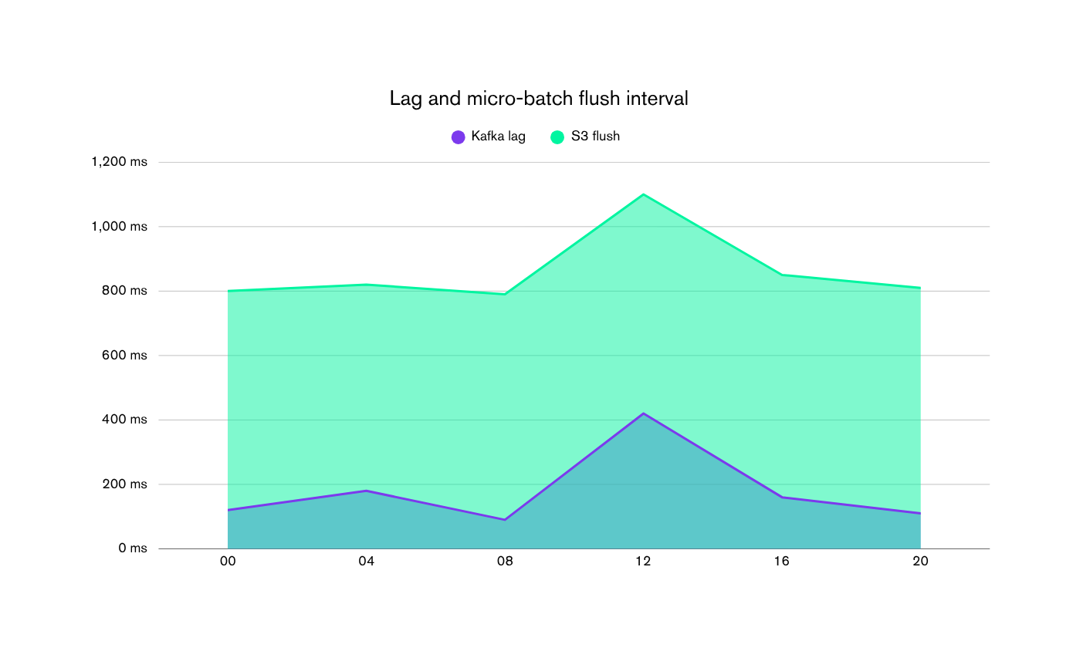
INGESTION & PIPELINE HEALTH
0.42s
TOPIC LAG
0.81s
S3 FLUSH
68%
CLUSTER

Slide 16
DELIBERATE TRADE-OFFS
DIRECT TO MSK
RDBMS FIRST
Linear scale wins
DEBEZIUM WAL
APP POLLING
Lower coupling wins
DELTA LAKE
PLAIN PARQUET
Reliable mutation wins

Slide 17
TEST THE SYSTEM, NOT JUST THE FUNCTIONS
Parity across generators, transport, state, transformations and orchestration.
DATA
GENERATORS
STREAMING
PIPELINES
ML STATE
STORE
AIRFLOW
DAGS
CONTRACT
REPLAY
TTL + FALLBACK
DEPENDENCIES
UNIT → INTEGRATION → CHAOS → RECOVERY

Slide 18
SHIPPED FOR SCALE. READY FOR HARDENING.
RESULTS
LIMITS
NEXT
Zero DB inserts
Sub-10ms scoring
Replayable lineage
Single-region baseline
Feature freshness risk
Manual model promotion
Multi-region MSK
Online feature store
Automated model gates
SIC8 turns payment velocity into a competitive advantage.

