Slide 1

Smart Sales & International Cold Chain Monitoring System for Dream Cloud Ice Cream
Presented by: Team 2

Slide 2
Background & Challenges: Ensuring Freshness, Scaling Globally
Local-Level Challenges
New Challenges: Expansion to Europe
Ice creams spoiling due to fridge failure
Long-distance cold chain shipping required
Areas being missed or skipped by vendors
Must comply with EU food safety regulations (e.g. HACCP)
Residents unaware that delivery was available
Customs delays could impact product freshness
No visibility into what was sold, where, and when
Regional flavour preferences vary widely
No flavour-wise analytics for stock planning
Need for localization (language, currency, formats)

Slide 3




Phase 1: Solution Architecture - Core Components
Smart Bicycle Unit
Vendor App
GPS, temperature sensor, barcode scanner for on-the-go data.
Inventory scan, real-time sale logging, GPS + temp sync.
IoT Gateway & Cloud
Admin Dashboard
Transmits data, stores information, runs analytics engine.
Flavor heatmaps, zone reports, real-time alerts for management.
These integrated components form the backbone of our monitoring system, providing actionable insights from the point of sale to the central dashboard.

Slide 4
Phase 1: Solution Architecture - Global Expansion Modules
Cold Chain Export Module
Compliance Engine
Smart cargo sensors for international shipping, ensuring product integrity.
Automated EU food regulation compliance (e.g., HACCP temperature logging).
Customs Tracker
Localization Layer
Real-time updates on international shipping and customs clearance, mitigating delays.
Multi-language and currency support for seamless global operation.
These specialised modules are crucial for our seamless expansion into the European market, addressing specific challenges of international logistics and regulatory compliance.

Slide 5
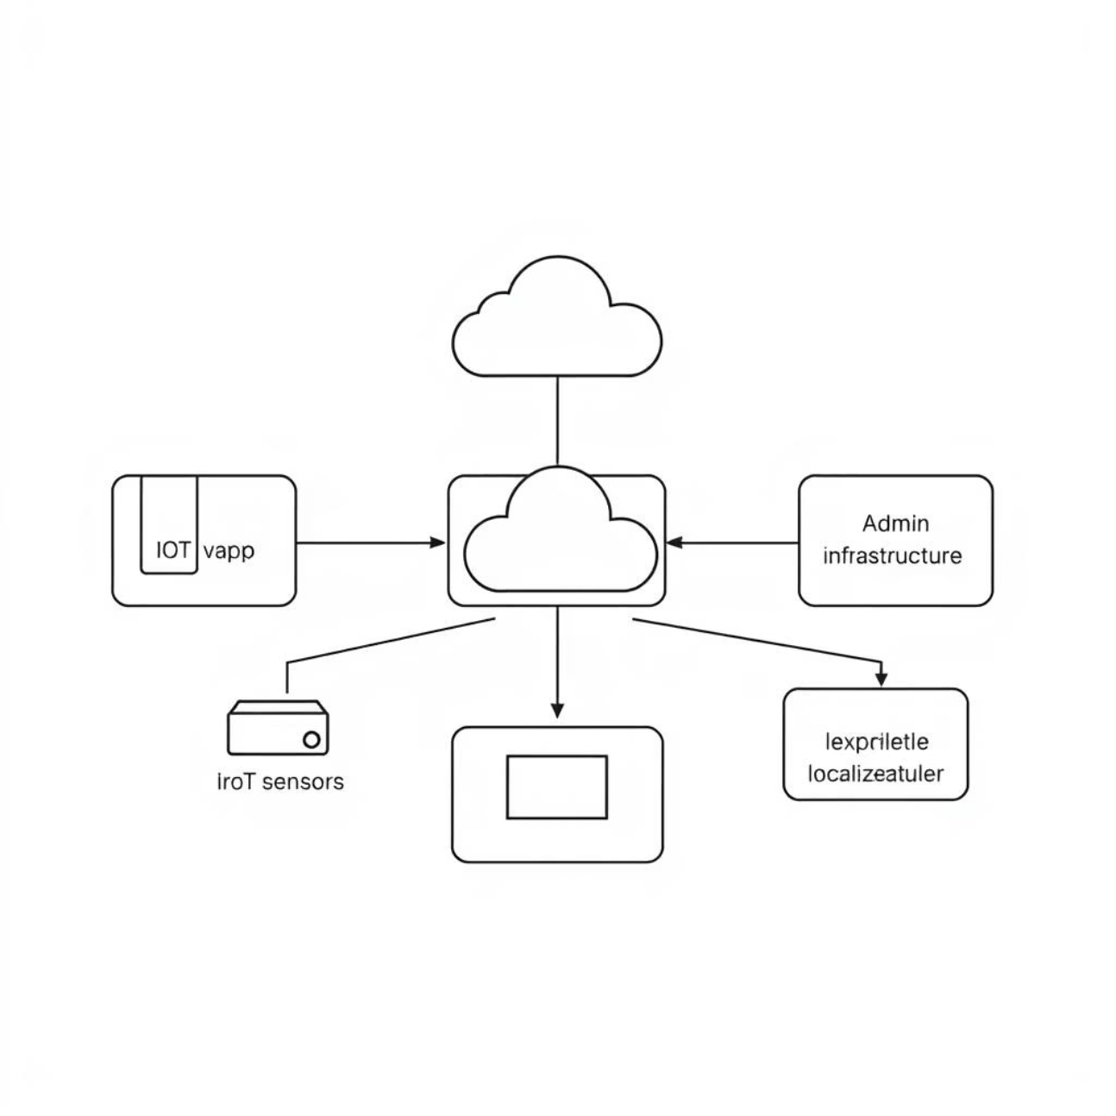
Phase 2: High-Level Design - System Modules
Our system's design is modular, allowing for robust performance and future scalability. Each module plays a distinct role in ensuring end-to-end operational efficiency.
Vendor Mobile App: Flavour scanning, inventory tracking, real-time GPS + temperature sync, daily sales closure & summary.
IoT Sensors & Gateways: On bicycle + in cargo containers, tracks temperature, location, shock events for critical data.
Cloud Infrastructure: Real-time database (Firebase, AWS), analytics engine for sales trends & spoilage risks.

Slide 6
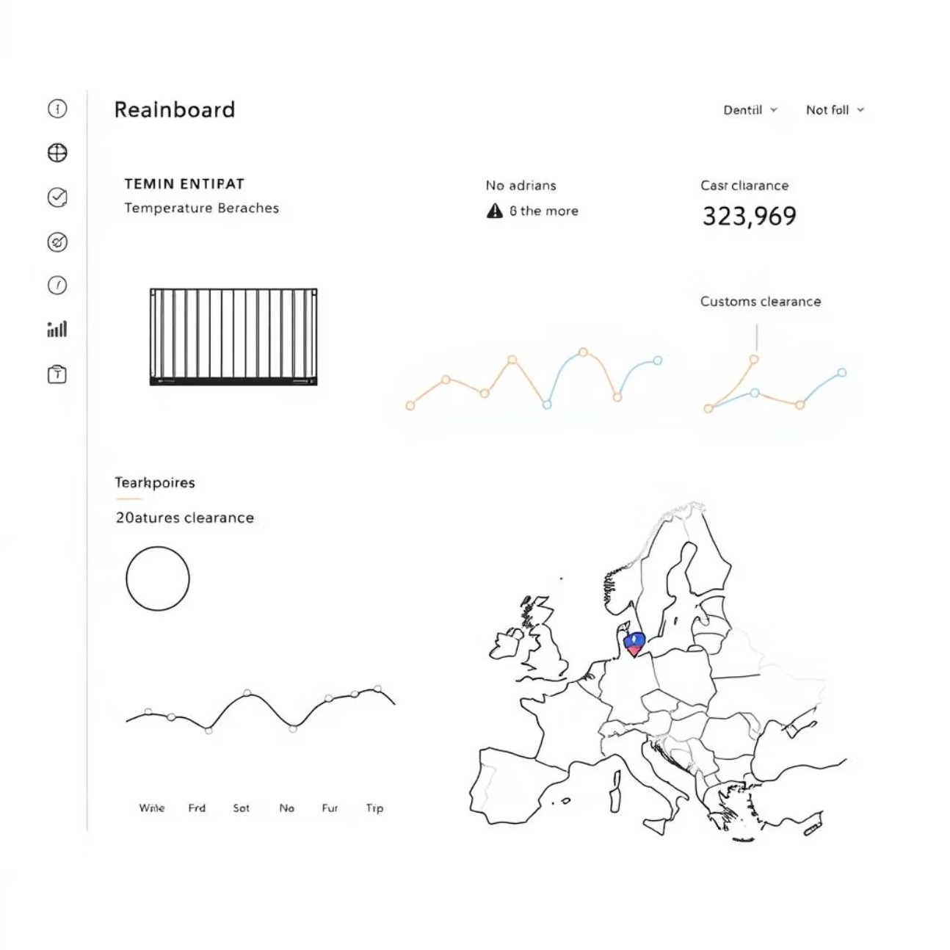
Phase 2: High-Level Design - International & Compliance Modules
Admin Web Portal: Live tracking of vendors and shipments, alerts for refrigeration issues and skipped areas, EU compliance monitoring dashboard.
Export Logistics System: Real-time container tracking, customs integration via APIs (DHL, FedEx, etc.) for streamlined international delivery.
Localization Module: Multi-language UI (English, German, French), currency formatting and compliance templates for EU regions.
These modules are critical for our global expansion, ensuring adherence to international standards and offering a seamless user experience across diverse markets.

Slide 7



Phase 3: Detailed Flowchart - Local Sales Process
Start of Day
During Sale
End of Day
Vendor logs in, app checks temperature, inventory scanned and verified.
Flavor scanned, data logged (time, flavor, location, temperature) for real-time insights.
Vendor closes shift, daily report uploaded to cloud, summaries generated.
This streamlined local sales flow ensures efficient operations, real-time data capture, and accurate reporting, leading to better stock management and reduced spoilage.

Slide 8
Phase 3: Detailed Flowchart - International Export Process
Start of Export
1
Products loaded with IoT sensors into shipping containers (sea/air).
2
In Transit
Sensors monitor temp, humidity, shock; alerts sent to HQ if temp breaches limits.
At Customs
3
Customs API updates fetched; delay alerts generated, ensuring proactive issue resolution.
4
Upon Arrival
Compliance Engine validates logs; EU-ready HACCP report auto-generated for quick clearance.
Our robust international export flow guarantees product quality, compliance, and transparency throughout the long-distance cold chain, from origin to destination.

Slide 9
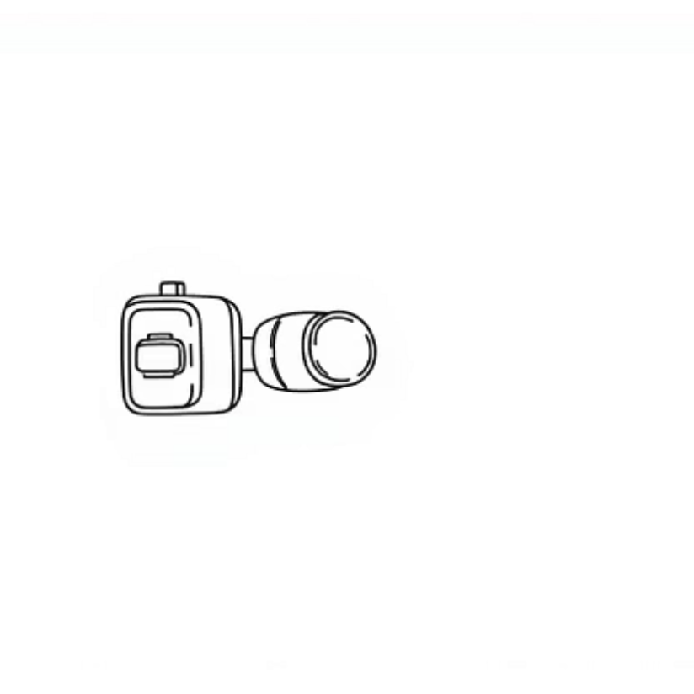
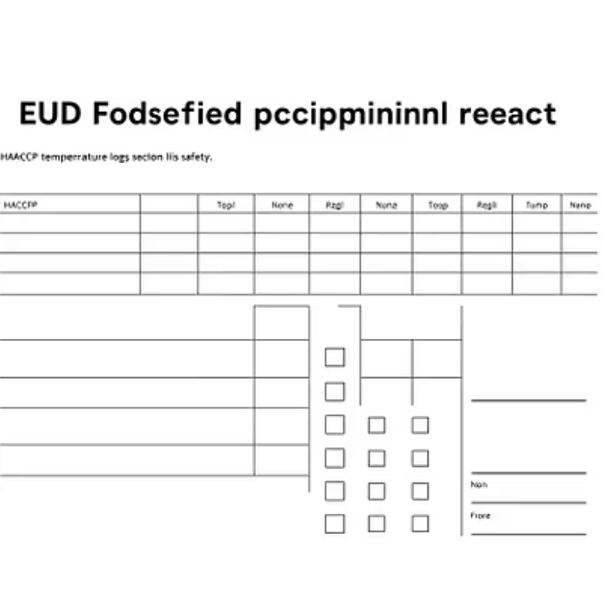
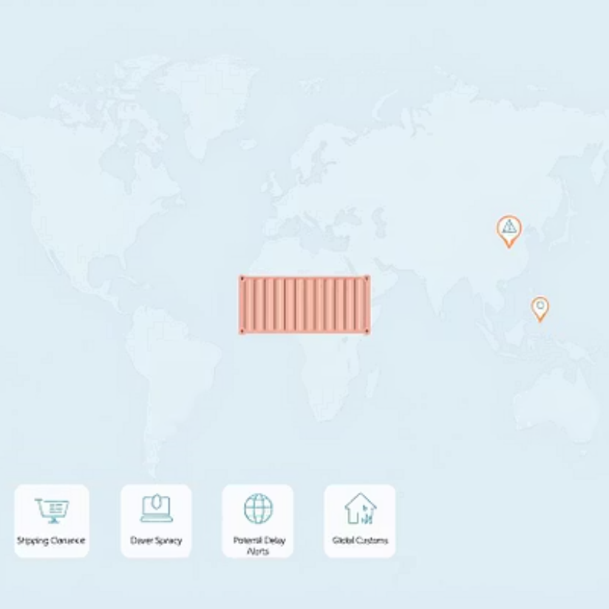
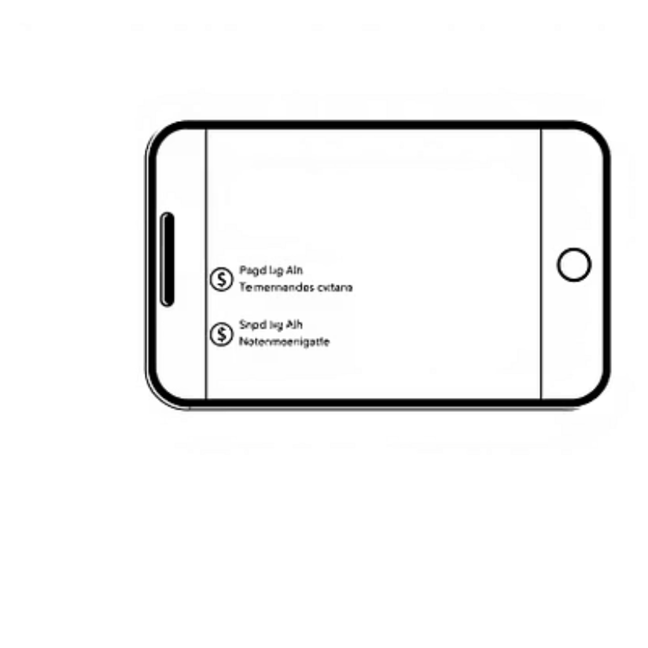
Phase 4: International Expansion Readiness - Global-Ready Enhancements
These enhancements are designed to ensure Dream Cloud Ice Cream's seamless entry and compliant operation within the European market, addressing critical logistical and regulatory challenges.

Slide 10
Key Takeaways & Next Steps
Our Smart Sales & International Cold Chain Monitoring System offers an integrated, scalable solution for Dream Cloud Ice Cream, ensuring product freshness, optimizing local sales, and enabling compliant global expansion.
Key Takeaways:
Real-time visibility and control over local and international cold chains.
Automated compliance with stringent EU food safety regulations.
Enhanced operational efficiency and data-driven decision-making.
Mitigation of spoilage and customs delays, protecting product integrity and profitability.
Seamless localisation for diverse European markets.
Next Steps: We propose a detailed pilot program in a selected EU market to validate system performance and gather user feedback. This will be followed by a phased rollout across target regions, ensuring a controlled and successful expansion.

