Slide 1
Data Structures code:CS2001 Pre-Lecture 01
Data Structures of Primitive types in C++ and 1-D Array
Samin Ahmed
FAST-NUCES
Peshawar Campus

Slide 2
Memory [unsigned] (Range & Storage)
n bits can store 2^{n} values.
Examples (unsigned)
2 bits can store 2² = 4 values.
2 1
weights
0
1
2
3
0
0
Smallest number
0
1
In unsigned memory all bits are used for data.
Can only store zero & positive numbers
1
0
1
1
= 2² - 1
Largest number
In binary the smallest possible number is “all zero” (unsigned memory) & largest is “all ones”.

Slide 3
Memory [unsigned] (Range & Storage)
4 2 1
weights
n bits can store 2^{n} values.
Examples:
3 bits can store 2³ = 8 values.
0
1
2
3
4
5
6
7
0
0
0
Smallest number
0
0
1
0
1
0
In unsigned memory all bits are used for data.
Can only store zero & positive numbers
0
1
1
1
0
0
1
0
1
In binary smallest number is “all zero” (unsigned memory) & largest is “all ones”.
1
1
0
1
1
1
= 2³ - 1
Largest number

Slide 4
Memory [unsigned] (Range & Storage) 4 bits 2⁴=16
8 4 2 1
weights
8 4 2 1
weights
0
1
2
3
4
5
6
7
0
0
0
0
1
0
0
0
Smallest number
8
9
A
B
C
D
E
F
0
0
0
1
1
0
0
1
conclusion
0
0
1
0
1
0
1
0
Range of n bits unsigned memory = 2^{n}
Smallest = 0
Largest = 2^{n}-1
0
0
1
1
1
0
1
1
0
1
0
0
1
1
0
0
0
1
0
1
1
1
0
1
0
1
1
0
1
1
1
0
0
1
1
1
1
1
1
1
Largest number
= 2⁴ - 1

Slide 5
Memory [signed] (Range & Storage)
Example 1
1
1
0
1
Binary number
0
0
1
0
1’s Complement
1
+
In signed memory last bit (most significant bit [MSB] or left most bit) is used to store sign.
0 represents Positive Number
1 represents Negative Number
Remaining bits are used for data.
Negative numbers are stored in the form of 2’s complement.
2’s complement are simply obtained by inverting each bit of the binary number (1’s complement)
add 1 to the inverted number’s least significant bit (answer is 2’s complement).
All bits now treated as magnitude: -3
0
0
1
1
Example 2
1
0
0
0
Binary number
0
1
1
1
1’s Complement
1
+
All bits now treated as magnitude: - 8
1
0
0
0

Slide 6
Memory [signed] (Range & Storage)
2 1
weights
1
0
n bits can store 2^{n} values.
Examples (signed)
2 bits can store 2² = 4 values.
0
1
-2
-1
0
0
0
1
1’s Complement
= 2¹-1
0
1
Largest number
1
+
In signed memory last bit stores sign.
Remaining bits store data.
1
0
Smallest number
1
0
Magnitude
1
1
= -(2¹)
1
1
Sign
0 +
1 -
Data bit
In binary smallest number is “all zeroes for data with sign bit as 1”
largest is “all ones” for data bits and zero for sign bit.
0
0
1’s Complement
1
+
0
1
Magnitude

Slide 7
Memory [signed] (Range & Storage)
1
1
1
4 2 1
weights
n bits can store 2^{n} values.
Examples:
3 bits can store 2³ = 8 values.
0
0
0
0
1
2
3
- 4
- 3
- 2
- 1
0
0
0
1
0
0
1
+
0
0
1
0
1
0
= 2²-1
0
1
1
Largest number
1
0
0
1
0
1
1
1
0
1
0
0
Smallest number
0
1
1
0
1
0
0
0
1
1
0
1
= - (2²)
1
1
1
+
+
+
1
1
0
1
0
0
0
1
1
0
1
0
1
1
1
Sign
Data

Slide 8
Memory [signed] (Range & Storage) 4 bits 2⁴=16
8 4 2 1
weights
8 4 2 1
= - (2³)
0
1
2
3
4
5
6
7
0
0
0
0
1
0
0
0
-8
-7
-6
-5
-4
-3
-2
-1
Smallest number
0
0
0
1
1
0
0
1
0
0
1
0
1
0
1
0
0
0
1
1
1
0
1
1
conclusion
0
1
0
0
1
1
0
0
Range of n bits unsigned memory = 2^{n}
Smallest = - 2^{n}
Largest = 2^{n}-1
0
1
0
1
1
1
0
1
0
1
1
0
1
1
1
0
0
1
1
1
1
1
1
1
Largest number
Sign
Data
= 2³ - 1
Sign
Data

Slide 9
Variable
Rules: variable name can :
contain only alphabets, digits & underscore ( _ )
begin with an alphabet or underscore
not contain space or any special symbol (except underscore)
not have same name incase of multiple variables.
A named memory location.
Modifiers applied on variable:
signed (can store both positive & negative values)
unsigned (can store only positive values)
Size of Values that can be stored in a variable:
signed variable can store.
- (2^{n}) to 2^{n} -1
unsigned variable can store.
0 to 2^{n}-1
short & long are also modifiers that can shorten (reduces in half) or extend (doubles) the size of a variable, as the name suggests.
(on most compilers)
n is the number of bits for data

Slide 10
Declaration Instruction
The order of the modifier and datatype can be changed.
Are used to declare a variable.
Syntax: modifier data-type variable-name;
Default modifier is signed.
“char” can store characters (a single character in single quotes).
“int” can store integers (numbers without decimal point)
“float” & “double” can store real numbers or floating-point numbers (with decimal point)
4 primitive types available in C
char
1Byte
On most compilers
int
4Bytes
float
4Bytes
double
8Bytes
short can be applied to only integers, reduces size in half.
long can be applied to double and integer, doubles the size of double data type.
signed & unsigned can only be applied to “int“ & “char”

Slide 11
Declaration Instruction (examples)
valid variables
Invalid variables?
int x; signed int X;
unsigned int y; int unsigned Y;
float number;
double abc;
short int _name or signed short int _Name; unsigned short int _Name;
long int Big_number9;
long double BIg_number9;
int 9xxa, #bat;
float obtained marks;
char bec*d;
unsigned short char name;
long float abc;
unsigned double Qq;
Multiple variables of same type are separated by comma; e.g. int x, y , z ;

Slide 12
sizeof Operator (tells the size of datatype)
#include <iostream>
using namespace std;
int main( )
{
cout<<"size of int: “<< sizeof(int);
cout<<"size of float: “<< sizeof(float);
cout<<"size of double: “<< sizeof(double);
cout<<"size of char: “<< sizeof(char);
cout<<"size of int: “<< sizeof(short int);
cout<<"size of long int: “<< sizeof(long int);
cout<<"size of long long int: “<<sizeof(long long int);
cout<<"size of long double: “<< sizeof(long double);
return 0;
}

Slide 13

1-D Arrays
0
1
2
A
40
50
30

Slide 14
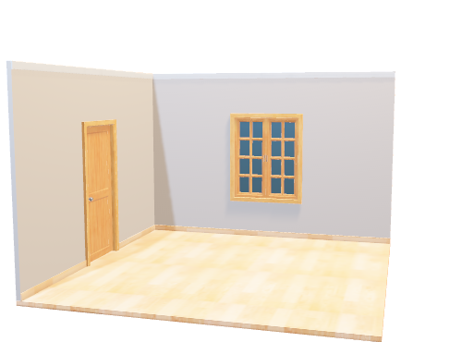
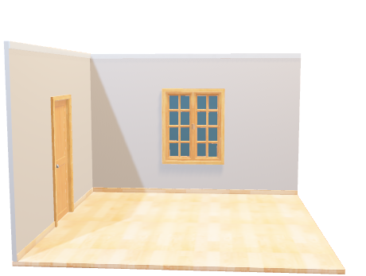
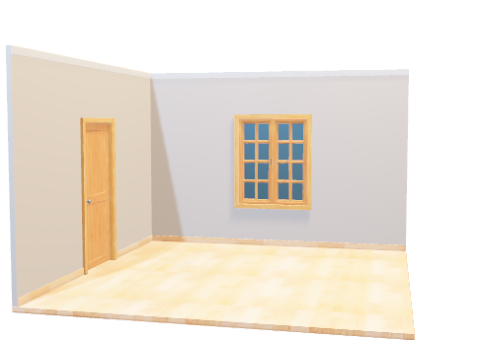
Each location can hold a value of same data type.
Each location is numbered, and the numbering starts from zero.
Arrays:
Named collection of contiguous memory locations,
20
30
40
50
2.1
3.5
4.0
0.5
‘a’
‘b’
‘c’
‘d’
0
1
2
3
A

Slide 15
Array Declaration Syntax, Example1
Data type
Array Name
[
size
] ;
int
A
[
4
] ;
Size In Bytes = 4 * 4
Size = 16 bytes
A
0
1
2
3

Slide 16
Array Declaration Syntax: Example2
Data type
Array Name
[
size
] ;
double
b
[
3
] ;
Size In Bytes = 8 * 3
Size = 24 bytes
b
0
1
2

Slide 17
Array Declaration Syntax: Example3
Data type
Array Name
[
size
] ;
char
c
[
4
] ;
c
Size in Bytes = 1 * 4
Size = 4 bytes
0
1
2
3

Slide 18
Array Size in Bytes
Array Size = size of data type * # of locations
long long int numbers[6];
Array Size = 8 * 6
Array Size = 48 bytes

Slide 19
A
int
A
[
4
] ;
30
40
50
55
0
1
2
3
Element Access
Array Name
[
Location #
]
=
Value ;
A
[
0
]
=
30 ;
cout<<A[0];
A
[
1
]
=
40 ;
cout<<A[1];
A
[
2
]
=
50 ;
cout<<A[2];
A
[
3
]
=
55 ;
cout<<A[3];

Slide 20
Using Loops for Element Access
int
A
[
3
] ;
A
30
40
50
0
1
2
for
(
int i=0;
i < 3;
i++
)
{
A[0]
A[1]
cin>>A[i];
A[2]
i
3
2
1
0
}

Slide 21
int
A
[
3
] ;
for
(
int i=0;
i < 3;
i++
)
{
A
40
50
30
cin>>A[i];
0
1
2
}
Smallest
int smallest = A [ o ] ;
40
Finding smallest number
30
for
(
int i=1;
i < 3;
i++
)
{
if ( A[i] < smallest ) {
i
Smallest = A [ i ] ;
1
2
3
}
}
cout<<“\n smallest number in the Array = “<<smallest;

Slide 22
Thank you
Please make sure to understand all the slides thoroughly before attending the first lecture
Q&A ( if any left will be discussed in the first lecture )

