Slide 1
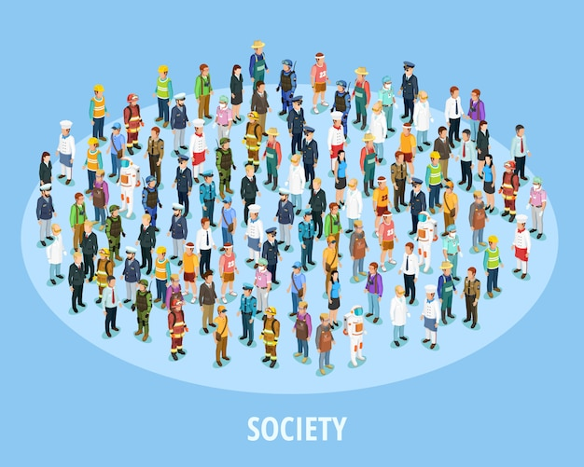

Slide 2

Definition
Society refers to a group of individuals who share a common geographic territory, interact with one another, and are bound together by a shared culture, institutions, and social relationships.

Slide 3

Characteristics
Population:
A society consists of a group of people living in a defined geographic area.
Example: The Kalash society in the Chitral district of Pakistan.
Shared Culture:
Members of a society share common beliefs, values, norms, traditions, and practices.
Example: The Kalash community's unique religious rituals and festivals.

Slide 4

Characteristics
Social Interaction:
Individuals in a society interact with one another through relationships, roles, and institutions.
Example: Family ties, friendships, and economic exchanges in the Kalash valleys.
Social Structure:
Society is organized into institutions and systems that govern behavior and relationships.
Example: Family, education, religion, economy, and government.

Slide 5
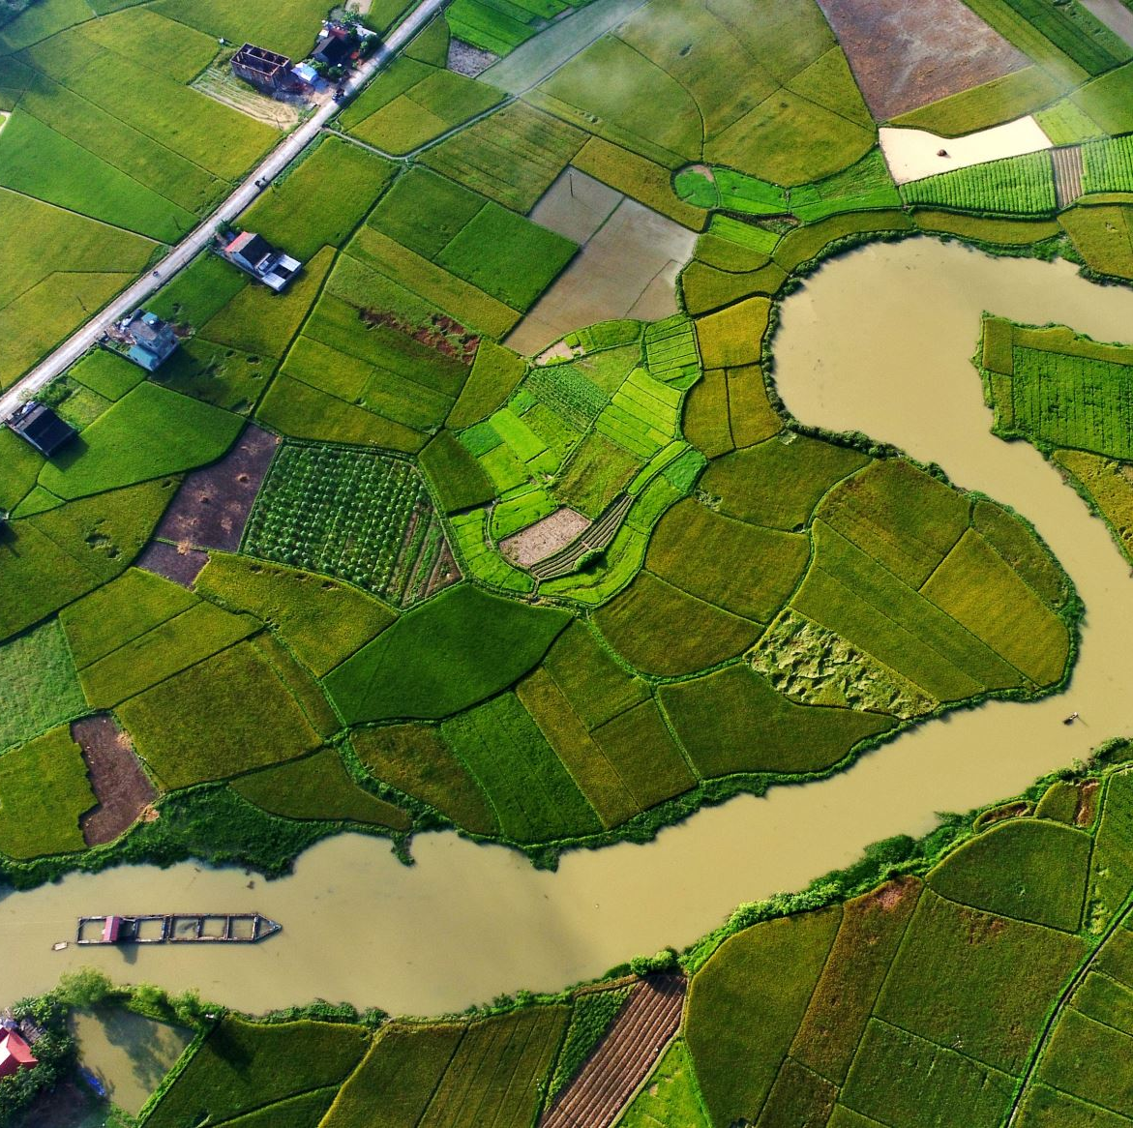
Characteristics
Territory:
A society is often associated with a specific geographic area where its members reside.
Example: The three valleys of Bumburet, Rumbur, and Birir for the Kalash community.
Interdependence:
Members of a society depend on one another for survival, cooperation, and the fulfillment of needs.
Example: The Kalash rely on collective farming and community support for their livelihoods.
Continuity and Change:
Societies persist over time but also evolve due to internal and external influences.
Example: The Kalash society has preserved its traditions while adapting to modernization and tourism.

Slide 6
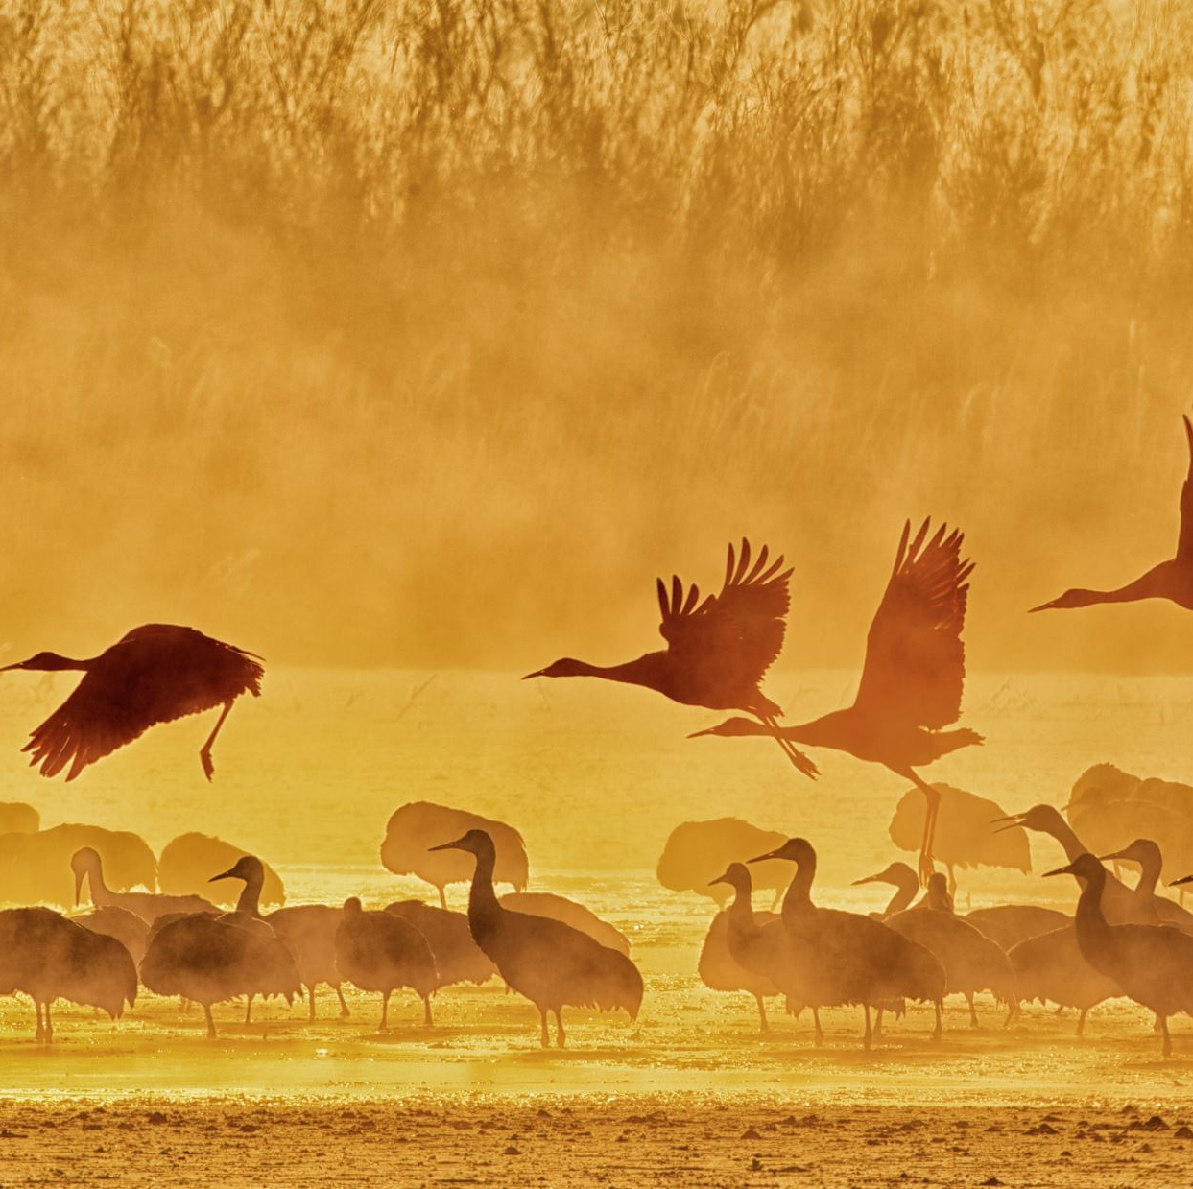
Types
Types of Societies:
Societies can be categorized based on their level of development, economic systems, or social organization. Some common types include:
Hunter-Gatherer Societies:
Small, nomadic groups that rely on hunting, fishing, and gathering for survival.
Example: Indigenous tribes in the Amazon rainforest.
Agricultural Societies:
Societies based on farming and domestication of animals.
Example: Traditional rural communities in developing countries.

Slide 7
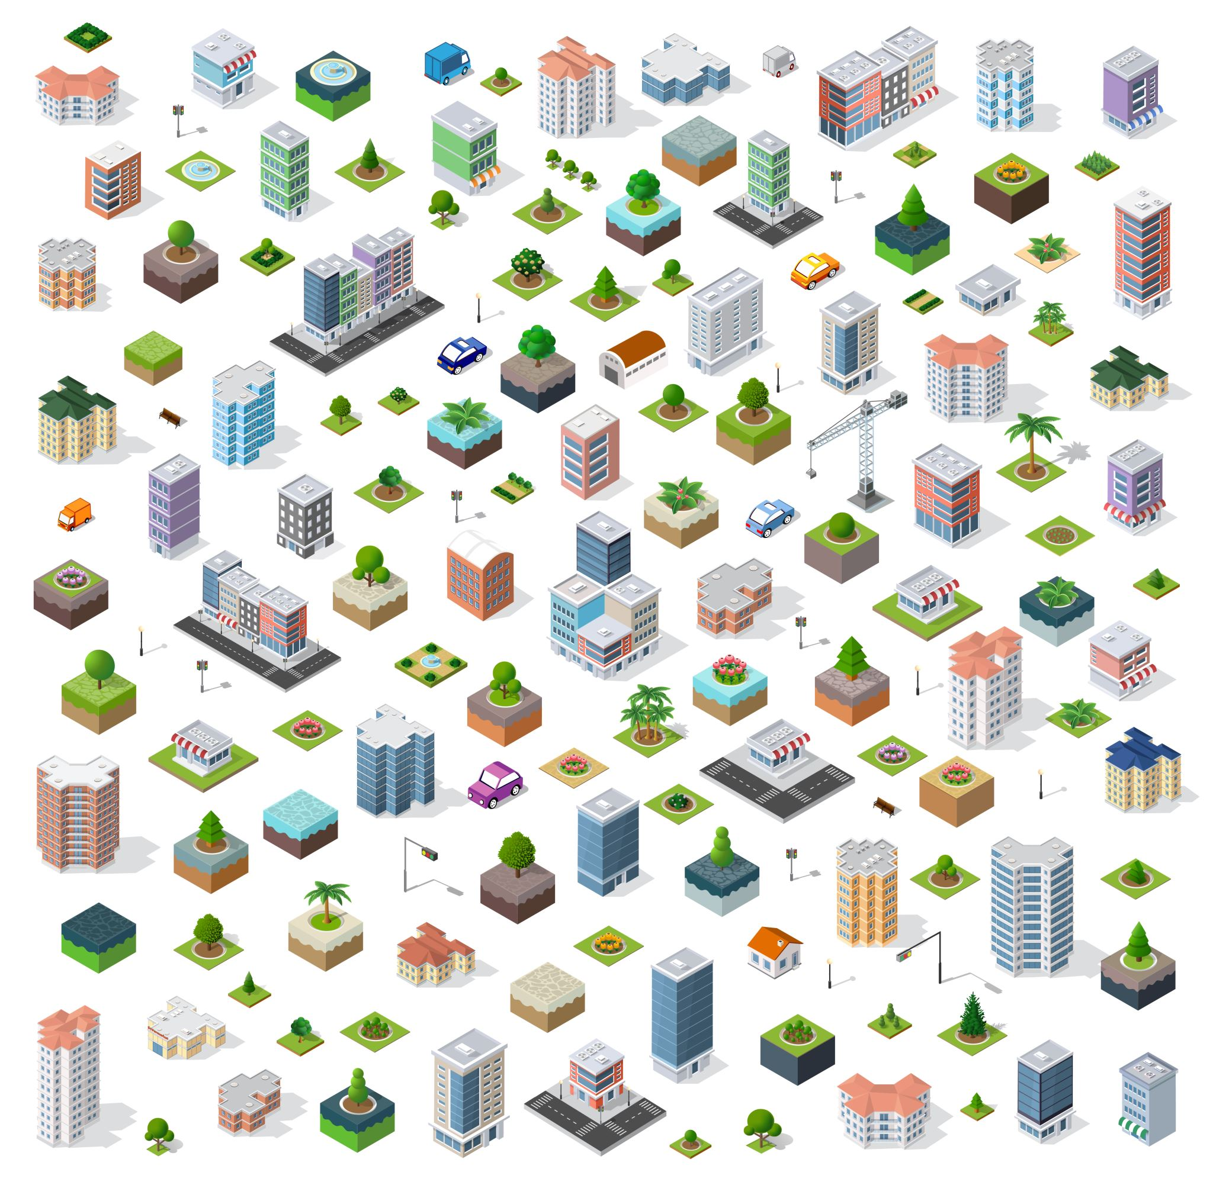
Types
Industrial Societies:
Societies driven by industrialization, urbanization, and technological advancements.
Example: Modern cities in developed countries.
Post-Industrial Societies:
Societies focused on information, services, and technology rather than manufacturing.
Example: Countries like the United States and Japan.

Slide 8

Community
A community is a social group of people who share common characteristics, interests, values, or goals and are connected by social relationships, geographic proximity, or a sense of belonging.
Communities can be based on location, culture, religion, profession, or shared experiences. They provide a sense of identity, support, and mutual cooperation among their members.

