Slide 1

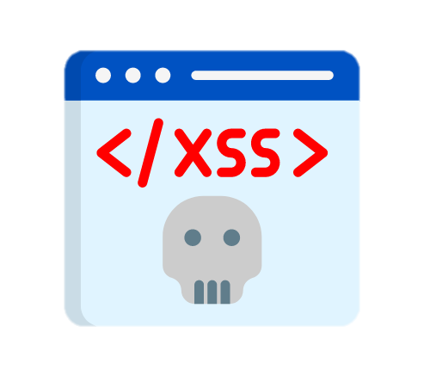

Cross-site Scripting

Slide 2

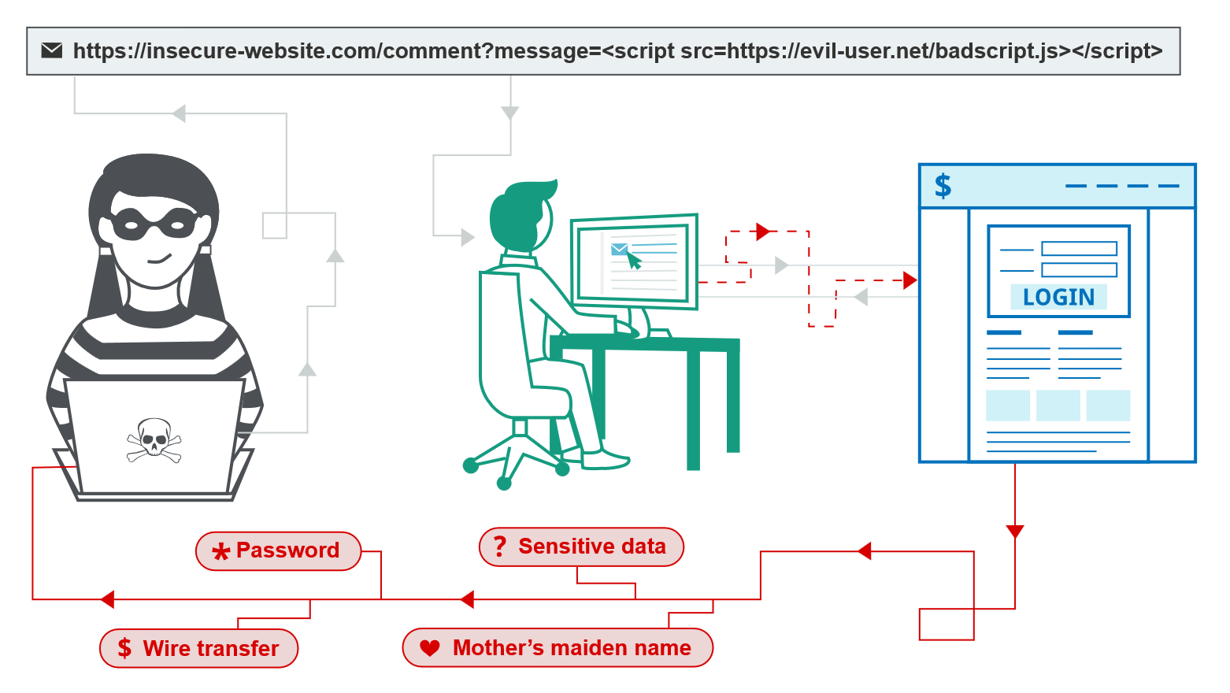



Slide 3
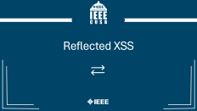




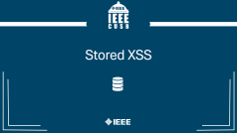
AGENDA

Slide 4



Introduction

Slide 5

WHAT
Injecting and executing malicious JavaScript code in victim's browser

Slide 6





HOW
Vulnerable page accepts parameter
http://vuln.com?search=abc
Attacker injects malicious payload
http://vuln.com?search=malicious
Victim clicks on (visits) malicious URL
http://vuln.com?search=malicious
Malicious JavaScript gets executed in victim browser
DEMO

Slide 7
WHY
Malware Distribution
Credential Harvesting
Account Takeover
Session Hijacking
Admin Panel Abuse
CSRF Bypass
Internal Systems
Data Exfiltration

Slide 8





TYPES
Reflected
Blind
Stored
DOM

Slide 9

Reflected XSS

Slide 10




Reflected XSS
visits URL
GET Request
http://vuln.com?search=cats
يوزر غلبان
Response & Render
</>
Prepare response
cats

Slide 11


Reflected XSS
visits URL
GET Request
http://vuln.com?search=malicious
يوزر غلبان
Crafts bad URL
Response & Render
</>
Injection
malicious
هاكر شرير
DEMO

Slide 12

Payloads
Basic
<script>alert(document.cookie)</script>
Event Handler
<img src=x onerror="alert(document.cookie)">
JavaScript Protocol
<a href="javascript:alert(document.cookie)">
click me
</a>
And MORE
Understand context & Get smarter
More Payloads

Slide 13

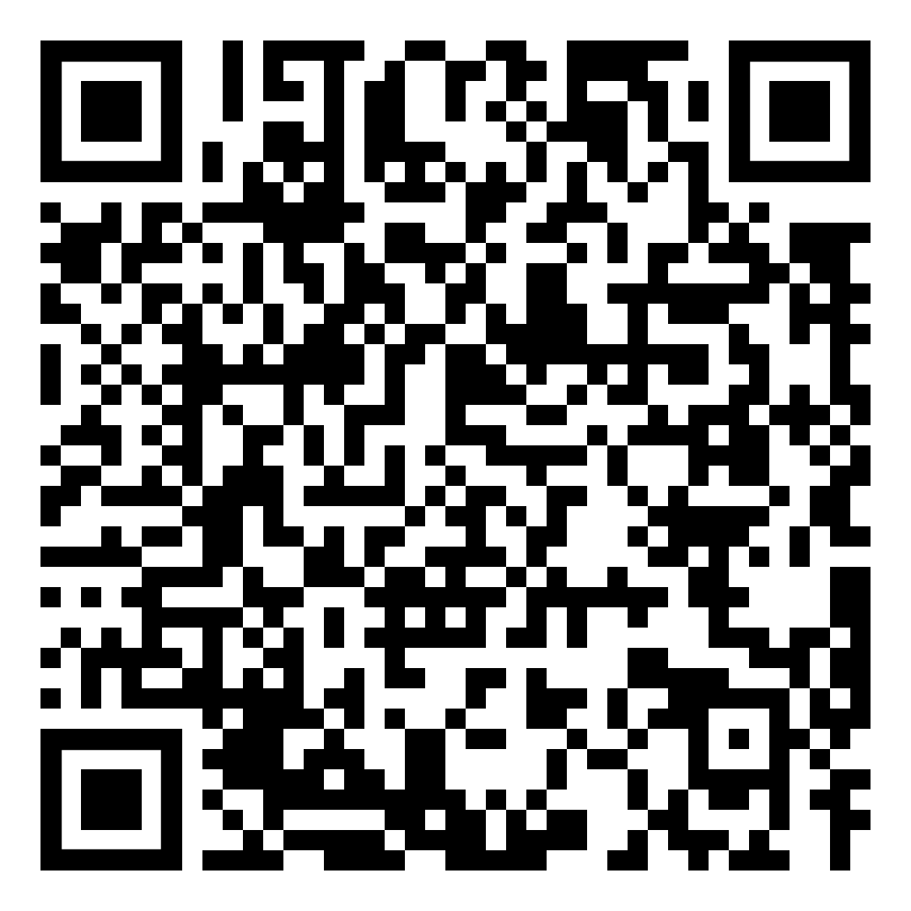
CHALLENGE
Reflected XSS CHallenge

Slide 14

Stored XSS

Slide 15


Stored XSS
Adds a bad comment
Insert new comment
POST /comments/add
malicious
Storing
هاكر شرير
Injection Step

Slide 16

Stored XSS
visits /comments
Fetch comments
GET Request
GET /comments
يوزر غلبان
comments
Response & Render
</>
Injection
malicious
Fire Step
DEMO

Slide 17
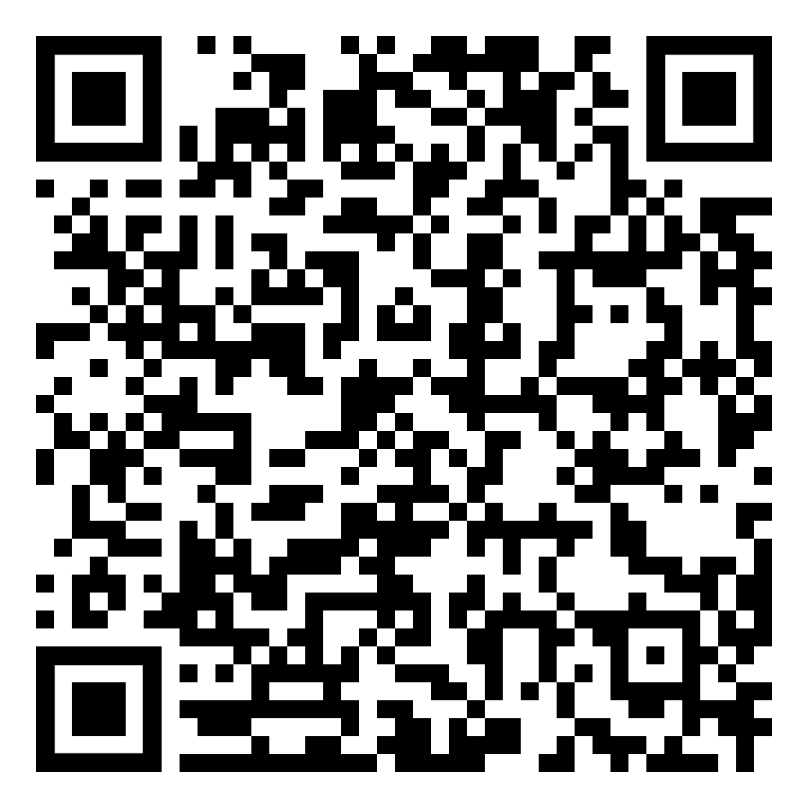
CHALLENGE
Stored XSS CHallenge

Slide 18

DOM XSS

Slide 19
DOM
Document Object Model (DOM) represents page rendered elements in a tree structure

Slide 20
DOM
Document Object Model (DOM) represents page rendered elements in a tree structure
<html>
<body>
<h1>
“Hello, World”
<head>
<title>
“Document”
<html>
<head>
<title>Document</title>
</head>
<body>
<h1>Hello, World!</h1>
</body>
</html>

Slide 21
DOM XSS
XSS attack wherein the attack payload is executed as a result of modifying the DOM unsafely in the victim’s browser

Slide 22
SPOT DOM XSS
<html>
<head>
<title>DOM XSS</title>
</head>
<body>
<h2>Welcome Page</h2>
<div id="output"></div>
<script>
var userInput = location.hash.substring(1);
document.getElementById("output").innerHTML = userInput;
</script>
</body>
</html>

Slide 23

DOM XSS
visits URL
document.write(“malicious”)
http://vuln.com?search=malicious
Modify DOM
يوزر غلبان
Crafts bad URL
هاكر شرير
DEMO

Slide 24
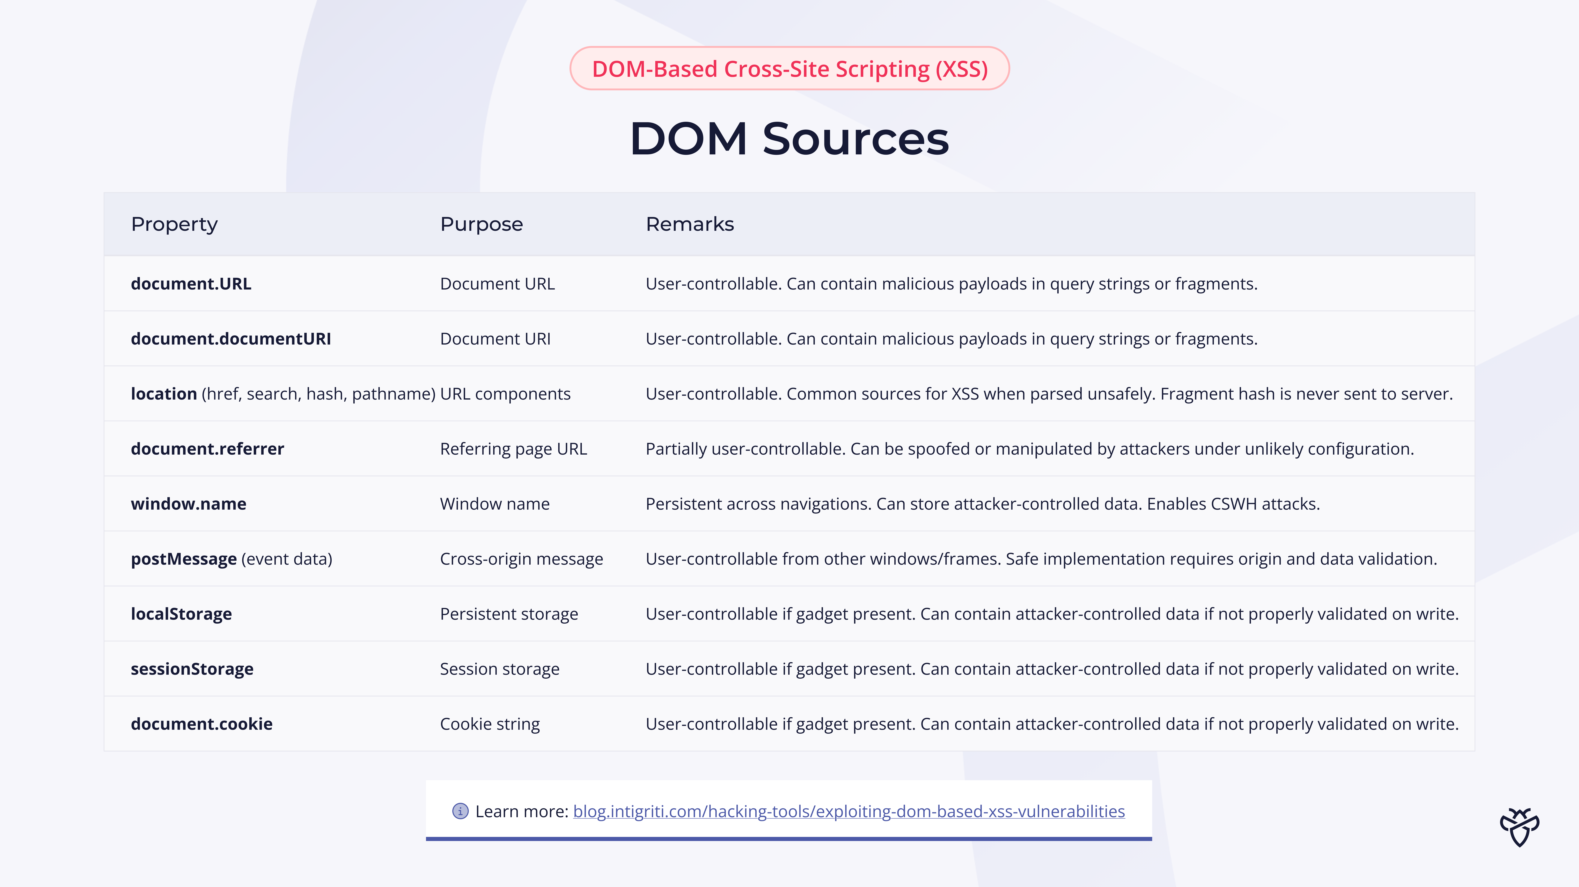
DOM XSS Sources
JavaScript properties that contain user-controllable data, which attackers can manipulate

Slide 25
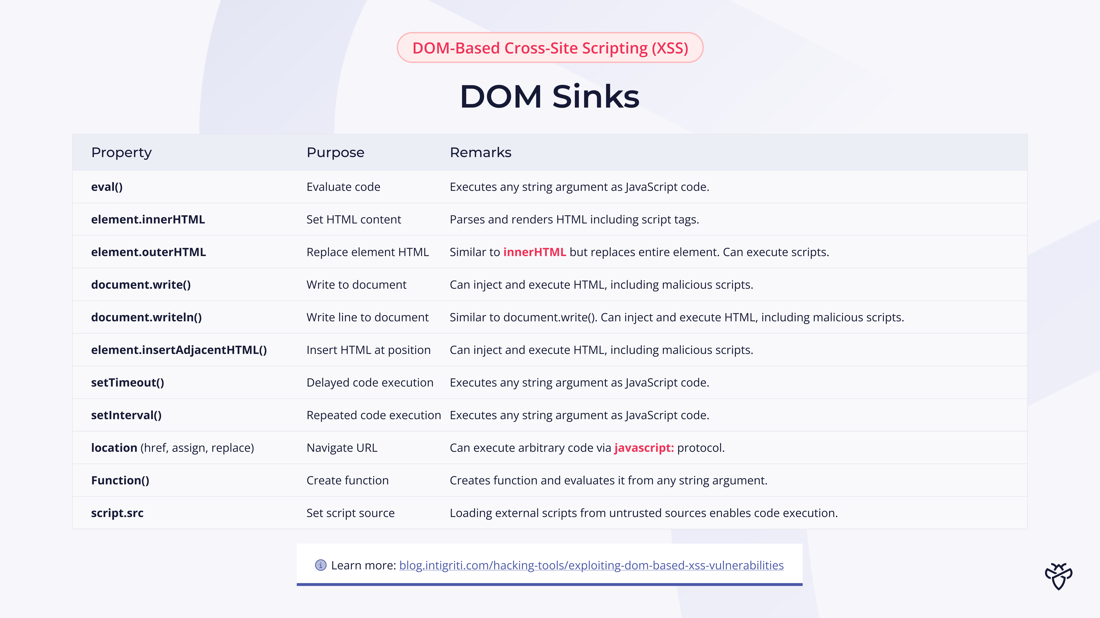
DOM XSS Sinks
JavaScript functions that can execute or render user-controllable data.

Slide 26



Detect DOM XSS
DOM runtime interception
Static code analysis
1) Type some input in DOM source
Analyze each JS source code files
2) Open browser Inspector to catch DOM sinks
Difficult and time consuming
View page source
AI can help
DEMO

Slide 27
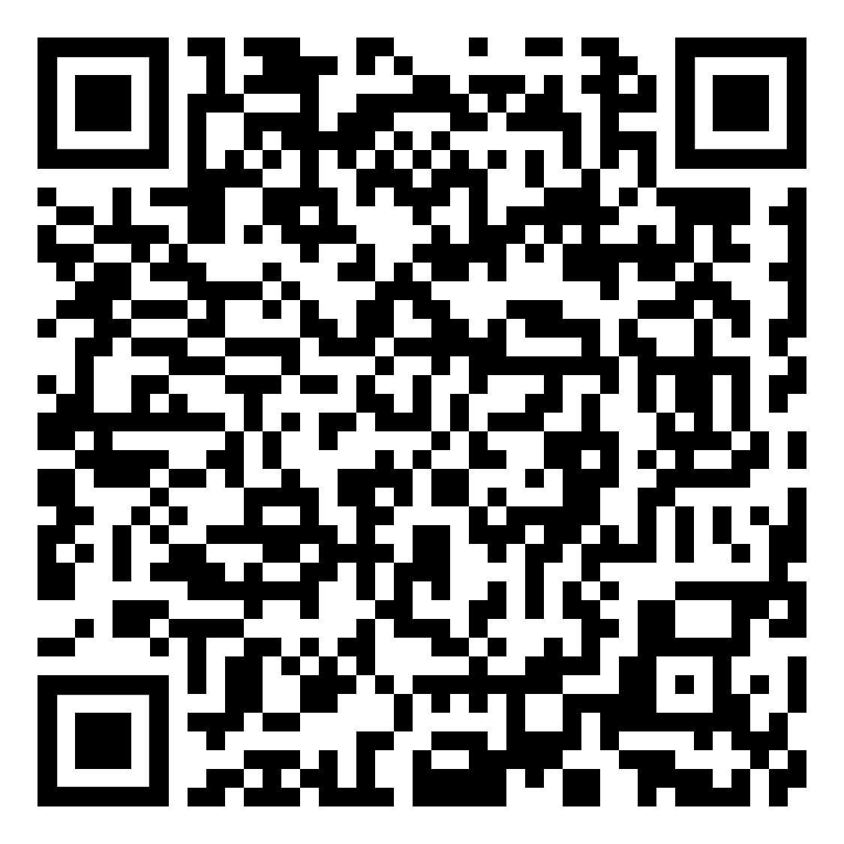
CHALLENGE
DOM XSS CHallenge

Slide 28

Blind XSS

Slide 29
Blind XSS
A type of XSS where attacker doesn’t see payload executing (only executes on victim)

Slide 30
Blind XSS
Where to Find?
Ticket support
Contact forms
And More…
Feedback form

Slide 31
Blind XSS
Sends feedback to admin browser
Sends malicious feedback
هاكر شرير
POST /feedback/add
malicious
View feedbacks
أدمن غلبان

Slide 32

Mitigation

Slide 33
Mitigation
Validation & Sanitization
Input Encoding
Content Security Policy

Slide 34
Validation & Sanitization
Validation
Sanitization
Validation checks whether input meets strict rules. (No modification)
Sanitization modifies input to remove or neutralize dangerous parts.
Vs
<?php
$username = $_POST['username'];
if (!preg_match('/^[a-zA-Z0-9_]{3,20}$/', $username))
{
die("Invalid username");
}
?>
<?php
$comment = $_POST['comment’];
$cleanComment = strip_tags($comment);
?>

Slide 35
Input Encoding
Convert all HTML special characters to HTML encoded characters

Slide 36
Input Encoding
Convert all HTML special characters to HTML encoded characters
<?php
$name = $_GET['name'];
?>
<h1>
Hello <?= htmlspecialchars($name) ?>
</h1>
&lt;script&gt;alert(1)&lt;/script&gt;

Slide 37
Content Security Policy (CSP)
Header sent by server to the browser to control which resources, JavaScript resources, a document is allowed to load

Slide 38
Content Security Policy (CSP)
Header sent by server to the browser to control which resources, JavaScript resources, a document is allowed to load
Visits a website
GET request
http://attacker.com/malicious.js
هاكر عبيط
(blocked:csp)
Content-Security-Policy: default-src example.com

Slide 39

CSP Example
HTTP/1.1 200 OK
Content-Type: text/html; charset=UTF-8
Content-Security-Policy: default-src 'self';
script-src 'self' https://cdn.jsdelivr.net;
style-src 'self' https://fonts.googleapis.com;
font-src https://fonts.gstatic.com;
img-src 'self' data:;
object-src 'none’;
base-uri 'self';
Set-Cookie: session=abc123; HttpOnly; Secure;
GET /dashboard HTTP/1.1 Host: example.com User-Agent: Mozilla/5.0 Accept: text/html

Slide 40
سُبْحَانَكَ اللَّهُمَّ وَبِحَمْدِكَ، أَشْهَدُ أَنْ لاَ إِلَهَ إِلاَّ أَنْتَ، أَسْتَغْفِرُكَ وَأَتُوبُ إِلَيْكَ

