Slide 1



Smart Irrigation System using Soil Moisture and Weather Data
PATAN SAYED SAB VALI
Internship ID:
INTERNSHIP_175040797468551b2636342
Student ID:
STU64ef1f499e78c1693392713

Slide 2

Learning Objectives :
Understand the application of machine learning in agriculture, particularly in irrigation automation.
Learn how to preprocess and handle real-world sensor data for
training classification models.
Build and train a multi-output machine learning model using Random-Forest to predict multiple outputs simultaneously.
Apply AI techniques to solve water wastage problems through
precise sprinkler control decisions.
Use Stream-lit to develop a real-time, interactive web-based system for farmers to input sensor values and get sprinkler status instantly.
Develop practical skills in Python, pandas, scikit-learn, and job-lib
for building and deploying end-to-end AI solutions.
Source : www.freepik.com/
GOAL

Slide 3
Tools and Technology used :
Programming & Development:
Python 3.11 – Programming language used for all backend logic
Jupyter Notebook – Used for initial model training and experimentation
Visual Studio Code (VS Code) – Used to build and organize the final app
Libraries & Frameworks:
Pandas –
Numpy –
scikit-learn
Joblib –
Streamlit –
For handling sensor data and preprocessing For converting input arrays before prediction
– For model training (RandomForest + MultiOutputClassifier)
To save and load the trained .pkl model file
For developing the interactive web interface with sliders
Deployment & Execution:
Streamlit Localhost – Used to test and run the web app on browser
Command Prompt / Terminal – To execute the app.py

Slide 4
Methodology :
Data Collection :
→ Collected a dataset with 20 sensor (0 – 1 values)
Data Preprocessing :
→ Separated input (X) and output (y), checked for clean data
Model Training :
→ Trained a Random Forest model to predict sprinkler ON/OFF status
Model Saving :
→ Saved the trained model using .pkl(Farm_Irrigation_System.pkl) file
Deployment :
→ Built a web app using Streamlit to input sensor values and show output
Testing :
→ Tested by changing slider values and checking predicted results
Final Review - Verified system accuracy and user-friendly working of the app

Slide 5
Problem Statement:
Traditional irrigation methods often lead to overwatering or underwatering, causing water wastage, crop stress, and reduced agricultural productivity.
Farmers manually operate sprinklers based on guesswork or fixed schedules, without real-time data
from the field.
There is a critical need for a smart, automated irrigation system that can make data-driven decisions using soil sensor readings to control water usage efficiently.
Finally - Traditional irrigation lacks real-time decision-making, leading to water wastage and reduced crop productivity — highlighting the need for a smart, sensor-driven automated irrigation system.

Slide 6
Solution:
Developed a smart irrigation system using machine learning
Used soil sensor data (20 inputs) to monitor field conditions
Predicted ON/OFF status sprinklers automatically
Built an interactive web app using Streamlit for real-time input and output
Reduced water wastage and manual intervention in irrigation
GitHub Link : https://github.com/Sayedsabvali/Smart_irrigation/blob/main/Irrigation_System.ipynb

Slide 7
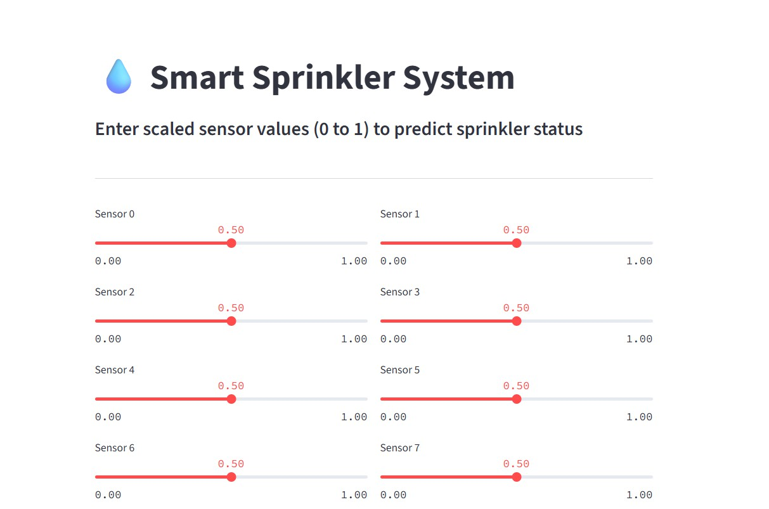
Screenshot of Output:

Slide 8
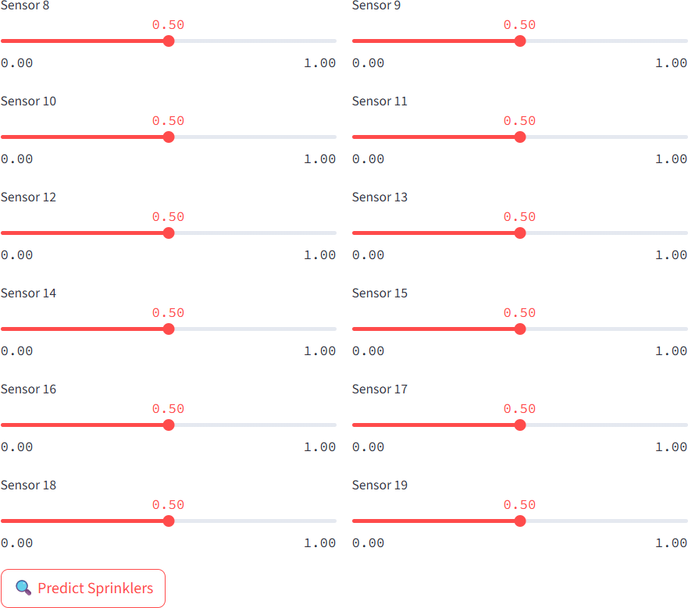

Slide 9
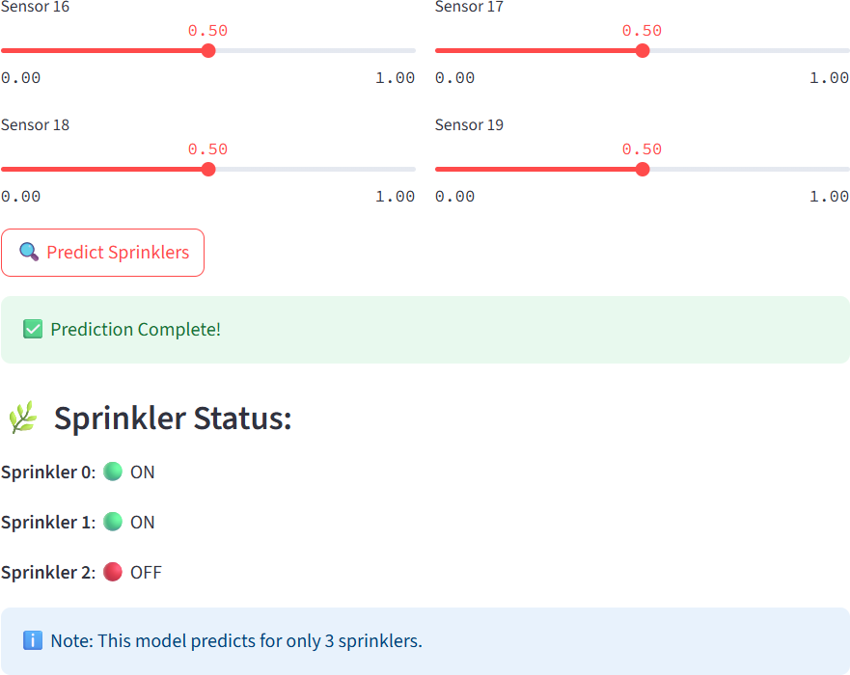

Slide 10
Conclusion:
Successfully built a smart irrigation system using machine learning
The system predicts sprinkler status based on real-time sensor values
Automates irrigation decisions, reducing water wastage and human effort
Built a Streamlit app with sliders for real-time input
Helps save water and reduce manual work in farming
Demonstrated practical use of AI and web apps in solving real-world problems

