Slide 1


CARBON FOOTPRINT IN SUPPLY CHAIN
Team Leader : Sayee Bankhele
Team Member 1: Samiksha Kapse
Team Member 2: Ananya shahare
Mentor Name: Mr. Sagar Yadav
College Name – Dr. D.Y Patil School Of Science And Technology
Notes:
Let's delve deeper into the exciting world of sustainability and AI.
In this chapter, we'll explore how artificial intelligence can be a powerful tool for addressing environmental challenges and promoting sustainable practices. We'll discuss specific applications of AI in various sectors and analyze its potential to drive positive change.
Get ready to discover the innovative ways AI is contributing to a more sustainable future!

Slide 2

Project Objectives
Problem Statement
Project Overview – Introduction
End Users
Wow Factor in Project
Modelling/Block Diagram/Flow of Project
Result/outcomes
Conclusion
Future Perspective
Notes:
Let's outline what you'll learn in this presentation.
By the end, you'll be able to:
Understand how AI helps solve problems like climate change, resource depletion, and biodiversity loss.
Identify key AI uses in energy efficiency, waste management, and climate change.
Analyze AI's role in sustainable agriculture and cities.
Evaluate AI's use in environmental monitoring using satellites, real-time data, and predictions.
Apply AI strategies in logistics and transportation to make them more sustainable.
Get ready to discover how AI can help create a greener future!

Slide 3
Problem Statement
To reduce the significant carbon emissions produced by global supply chains, there is a need for an accurate, machine-learning–based tool that can precisely predict logistics-related emissions and support companies in making more sustainable and cost-efficient operational decisions.
Notes:
Sustainability and AI
Sustainability is important because it helps meet our needs now and in the future. It includes protecting the environment, reducing pollution, and improving economic and social well-being.
AI can help us achieve sustainability. AI can process data, make predictions, and optimize systems to solve problems like resource management, environmental conservation, and energy efficiency.
Examples:
Smart grids: Reduce energy consumption.
Agriculture: Optimize water and fertilizer use.
Biodiversity: Monitor wildlife to protect biodiversity.
AI is a powerful tool for creating a more sustainable future.

Slide 4
Project Overview – Introduction
Built a Machine Learning pipeline to predict CO₂ emissions from shipment data.
Dataset includes: Distance, Weight, Cost, Transport Mode, Fuel Type
Target: CO₂ Emissions (continuous regression).
Approach: Preprocessing → Feature Engineering → Modeling → Evaluation..
Notes:
Sustainability and AI
Sustainability is important because it helps meet our needs now and in the future. It includes protecting the environment, reducing pollution, and improving economic and social well-being.
AI can help us achieve sustainability. AI can process data, make predictions, and optimize systems to solve problems like resource management, environmental conservation, and energy efficiency.
Examples:
Smart grids: Reduce energy consumption.
Agriculture: Optimize water and fertilizer use.
Biodiversity: Monitor wildlife to protect biodiversity.
AI is a powerful tool for creating a more sustainable future.

Slide 5
End Users
Logistics companies → optimize routes and reduce emissions.
Supply chain managers → balance cost vs environmental impact.
Policy makers & sustainability teams → track carbon footprint compliance.
Academics & students → learn ML applications in sustainability.
Notes:
Sustainability and AI
Sustainability is important because it helps meet our needs now and in the future. It includes protecting the environment, reducing pollution, and improving economic and social well-being.
AI can help us achieve sustainability. AI can process data, make predictions, and optimize systems to solve problems like resource management, environmental conservation, and energy efficiency.
Examples:
Smart grids: Reduce energy consumption.
Agriculture: Optimize water and fertilizer use.
Biodiversity: Monitor wildlife to protect biodiversity.
AI is a powerful tool for creating a more sustainable future.

Slide 6
Wow Factors in Project
Dual modeling: Regression (predict exact emissions) + Classification (flag high vs low emission shipments)
Feature engineering: adds business meaning (Fuel Efficiency, Cost Efficiency).
Cleaning: ML pipeline with reproducible train/test splits
Practical impact: aligns with green supply chain initiative

Slide 7
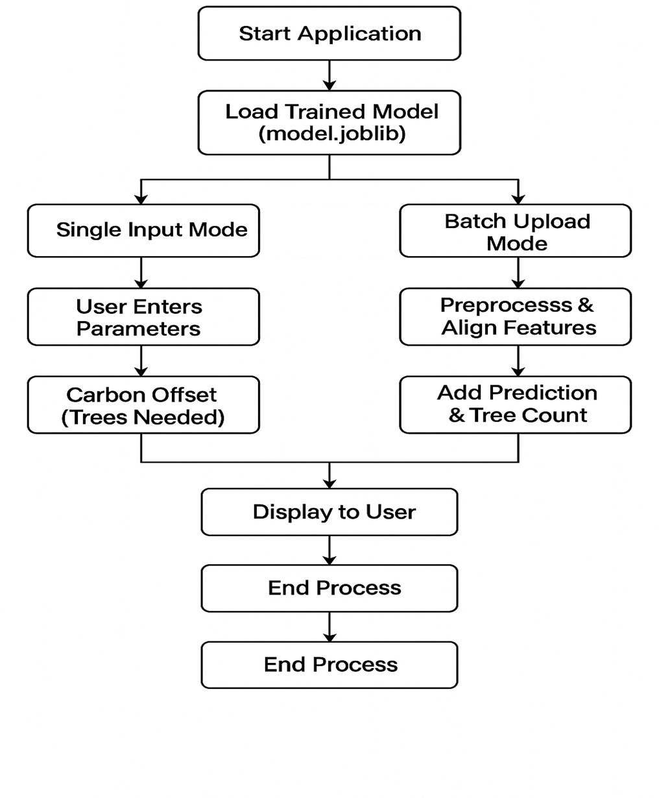
Flow of the project

Slide 8
Modelling/Block Diagram/Flow of Project
1. Read Dataset
-Supply Chain Dataset
2. Preprocessing
-Clean missing values, Encode categorical, Drop Shipment_ID
3. Feature Engineering
-High_Emission_Flag, Fuel_Efficiency, Cost_Efficiency
4. Feature Selection
-Retain meaningful features, Remove non‑informative
5. Train/Test Split
-80% Training, 20% Testing
-
6. Model Definitions
-Linear Regression Pipeline (scaling), Random Forest
7. Model Training & Testing
-Fit models on training, Predict on test
8. Results & Evaluation
-R², MAE, RMSE, Compare models
9. Insights & Conclusion
-Environmental + Economic efficiency, Regression vs Classification outcomes
10. Future Perspective
-Advanced models, Dashboard deployment, Real‑world expansion

Slide 9
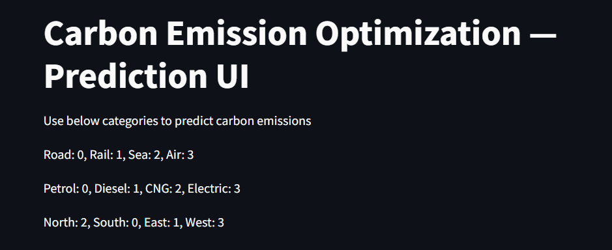
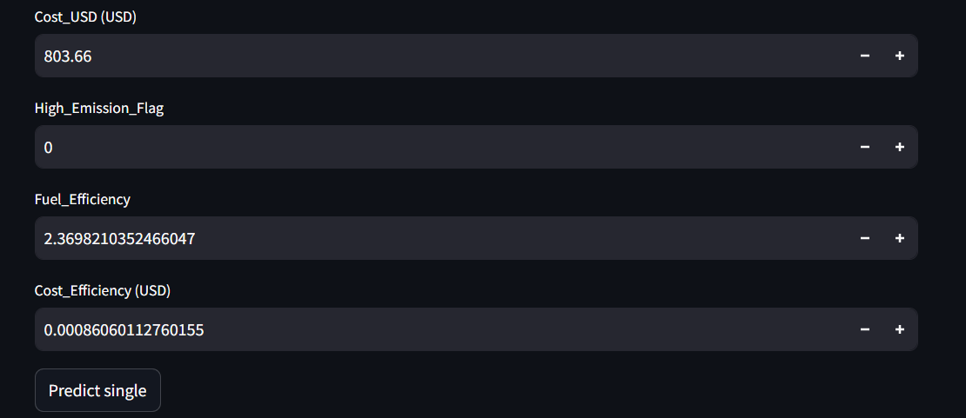
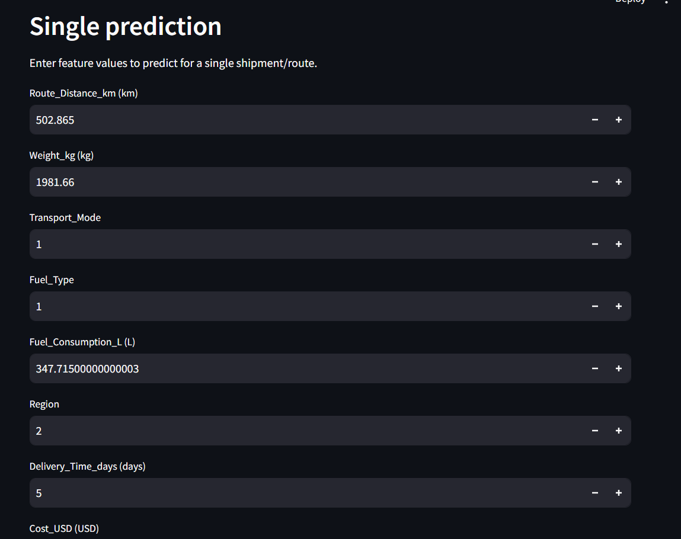
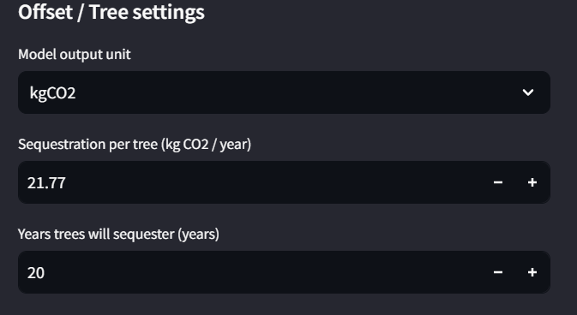
Result/Outcomes
• Linear Regression → baseline model, interpretable coefficients.
• Random Forest → captured non‑linear patterns, higher accuracy.
• Key insights:
⁠◦ Fuel Efficiency strongly correlated with emissions.
⁠◦ Cost Efficiency highlighted trade‑off between economics and environment.
• Outcome: Reliable prediction of CO₂ emissions with actionable insights.
Notes:
Sustainability and AI
Sustainability is important because it helps meet our needs now and in the future. It includes protecting the environment, reducing pollution, and improving economic and social well-being.
AI can help us achieve sustainability. AI can process data, make predictions, and optimize systems to solve problems like resource management, environmental conservation, and energy efficiency.
Examples:
Smart grids: Reduce energy consumption.
Agriculture: Optimize water and fertilizer use.
Biodiversity: Monitor wildlife to protect biodiversity.
AI is a powerful tool for creating a more sustainable future.

Slide 10
Conclusion
Developed a scalable ML pipeline for carbon-footprint prediction using enhanced feature engineering, demonstrating both regression and classification approaches, with Random Forest outperforming Linear Regression in accuracy.
Notes:
Sustainability and AI
Sustainability is important because it helps meet our needs now and in the future. It includes protecting the environment, reducing pollution, and improving economic and social well-being.
AI can help us achieve sustainability. AI can process data, make predictions, and optimize systems to solve problems like resource management, environmental conservation, and energy efficiency.
Examples:
Smart grids: Reduce energy consumption.
Agriculture: Optimize water and fertilizer use.
Biodiversity: Monitor wildlife to protect biodiversity.
AI is a powerful tool for creating a more sustainable future.

Slide 11
Future Perspective
Expand dataset with real‑world variables (vehicle type, weather, traffic).
Try advanced models (Gradient Boosting, Neural Networks,Tensorflow).
Deploy as a dashboard or API for real‑time monitoring.
Potential integration into corporate sustainability reporting systems.
Notes:
Sustainability and AI
Sustainability is important because it helps meet our needs now and in the future. It includes protecting the environment, reducing pollution, and improving economic and social well-being.
AI can help us achieve sustainability. AI can process data, make predictions, and optimize systems to solve problems like resource management, environmental conservation, and energy efficiency.
Examples:
Smart grids: Reduce energy consumption.
Agriculture: Optimize water and fertilizer use.
Biodiversity: Monitor wildlife to protect biodiversity.
AI is a powerful tool for creating a more sustainable future.

Slide 12
Thank You
Notes:
Thank You !!

