Slide 1
Welcome To Our Session
Implementation Of GSM Based Fire Alarm and Protection System
Date: 23rd April 2018

Slide 2

Implementation Of GSM Based Fire Alarm and Protection System
Bangladesh University of Business and Technology

Slide 3
Content
Introduction
Objectives
Block Diagram
Flowchart
Full Schematic
Required Instrument
Hardware Layout and Design
Working Principal
Application
Benefits
Limitation
Next Step/Future Work Scope
Conclusion

Slide 4
Introduction
Now we are going to build a very interesting project – a Fire Alarm System which will send SMS to a set of Mobile Numbers when fire occurs in a particular location. This fire alarm project make use of modern communication technologies.

Slide 5
Objective
To design and implement Advance Smoke Detection & Fire Alarm System.
To design and implement GSM Notification System.
To design and implement Fire accident Protection System.

Slide 6
Block Diagram
Sending Message & call
MQ 2 SENSOR
ARDUINO NANO
GSM MODULE
DISPLAY
BUZZER
Motor

Slide 7
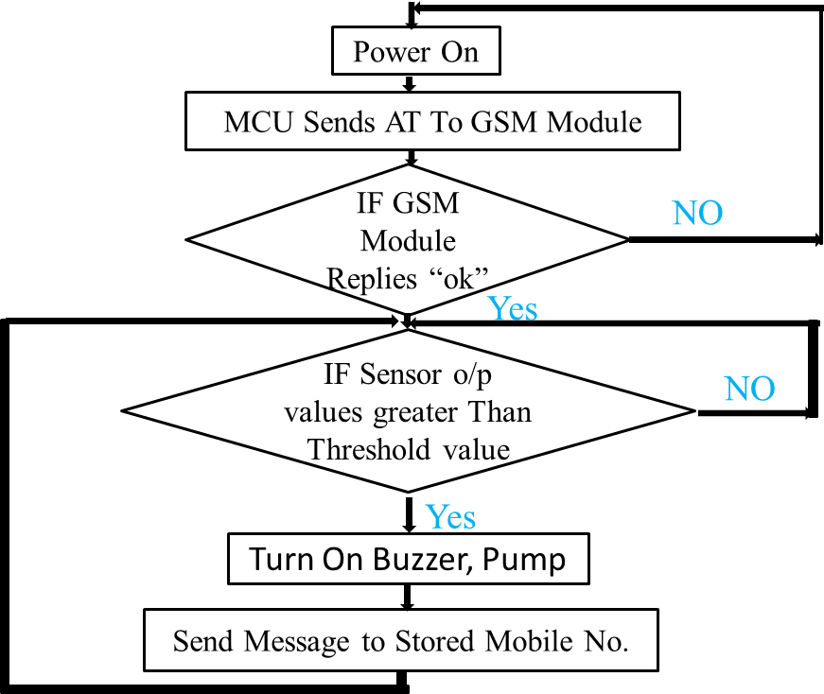
Flow Chart of Fire Alarm System
Start

Slide 8
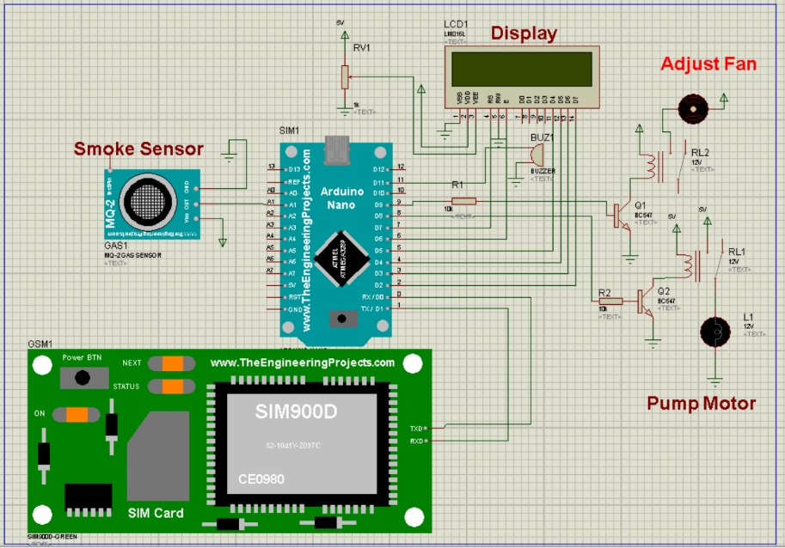
Full Schematic

Slide 9
Required Instrument
Basic Requirements:
Arduino NANO
GSM Module (SIM 900A)
16*2 LCD Display
MQ 2
Buzzer
Pump Motor
Power Supply Unit

Slide 10
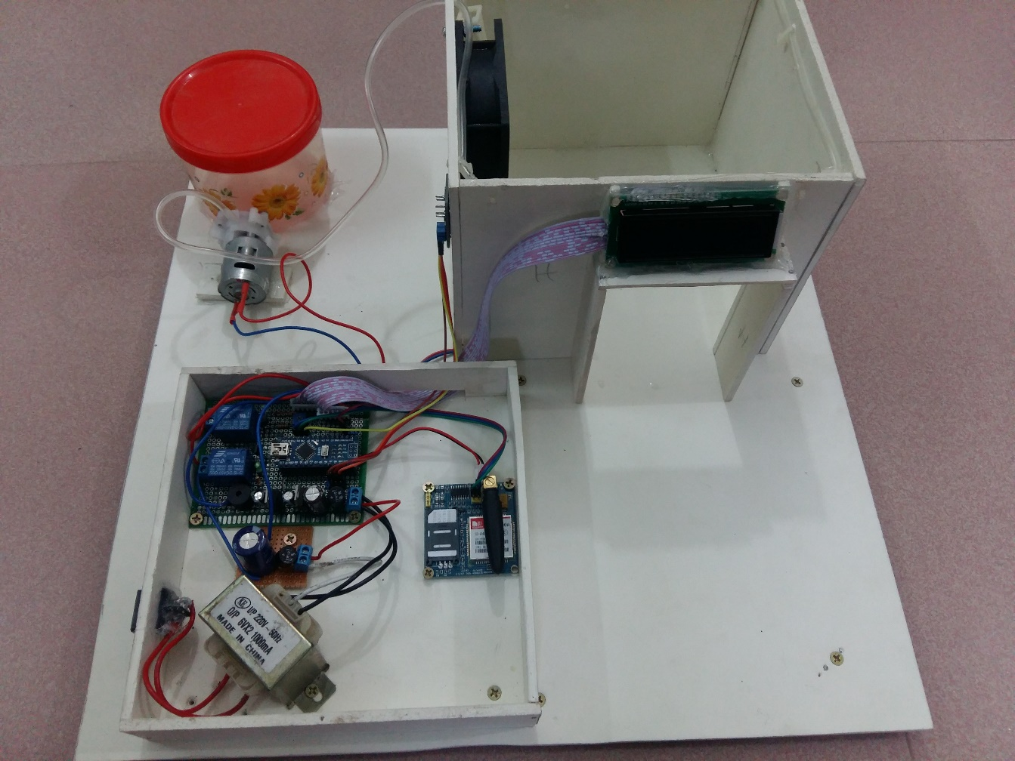
Hardware Layout and Design

Slide 11
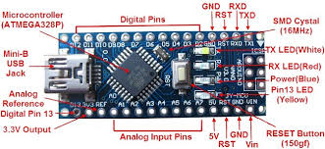
Arduino Nano
The Arduino Nano is a small, complete, and breadboard-friendly board based on the ATmega328. It has 14 digital input/output pins (of which 6 can be used as PWM outputs), 6 analog inputs, a 16 MHz quartz crystal, a USB connection, a power jack, an ICSP(IN-Circuit Serial Programing) header and a reset button.

Slide 12
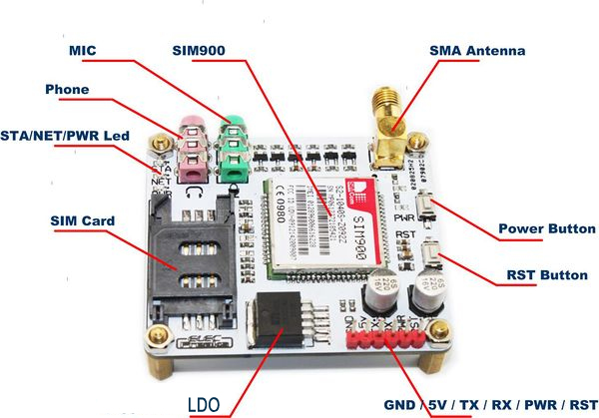
GSM Module SIM 900A
This is an ultra compact and reliable wireless module. The SIM900A is a complete Dual-band GSM/GPRS solution in a SMT module which can be embedded in the customer SIM900A can fit in almost all the space requirements in user applications, especially for slim and compact demand of design.

Slide 13
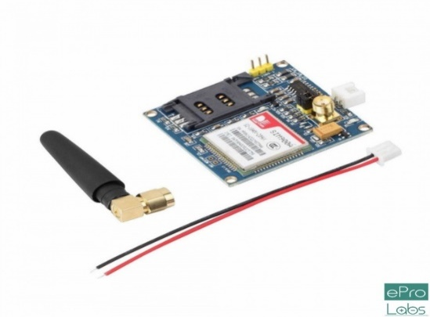
GSM Module SIM 900A
Dual-Band 900/ 1800 MHz
GPRS multi-slot class 10/8GPRS mobile station class B
Compliant to GSM phase 2/2+Class 4 (2 W @850/ 900 MHz)
Class 1 (1 W @ 1800/1900MHz)
Control via AT commands (GSM 07.07 ,07.05 and SIMCOM enhanced AT Commands)
Low power consumption: 1.5mA(sleep mode)'
Operation temperature: -40°C to +85 °C

Slide 14
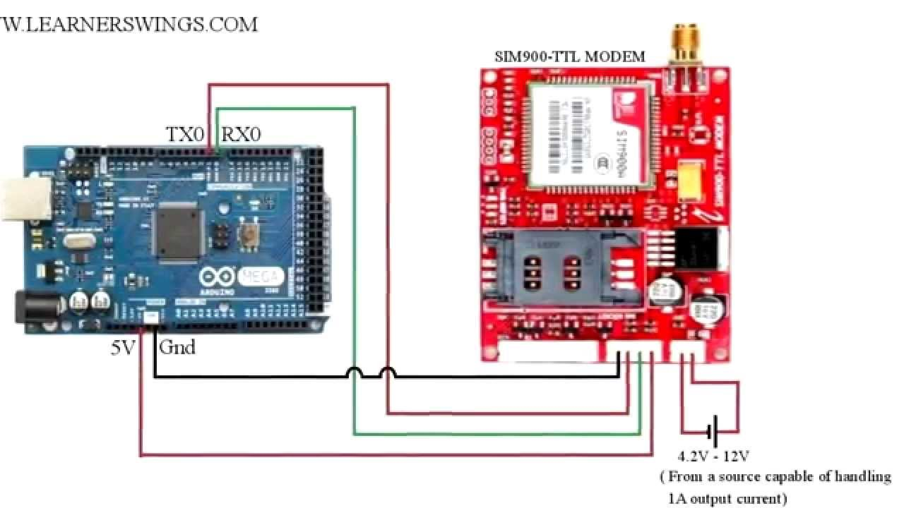
GSM Module Interfacing With Arduino

Slide 15
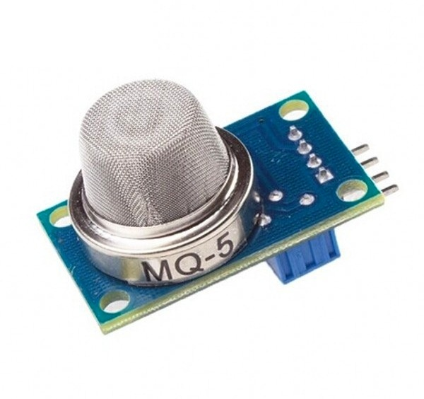
MQ 5 Smoke & Gas Sensor
This is pretty simple. Connect the D0 pin of MQ5 module to any digital pin of arduino. Lets connect D0 to pin 7 of arduino. Now we need to give power supply (Vcc) and complete the circuit by connecting to ground (Gnd). Refer the circuit diagram given below. Take a +5V connection from arduino and connect it to Vcc of MQ5 module. Finally connect the GND pin of MQ5 module to GND of arduino. That’s all and we have finished the circuit.

Slide 16
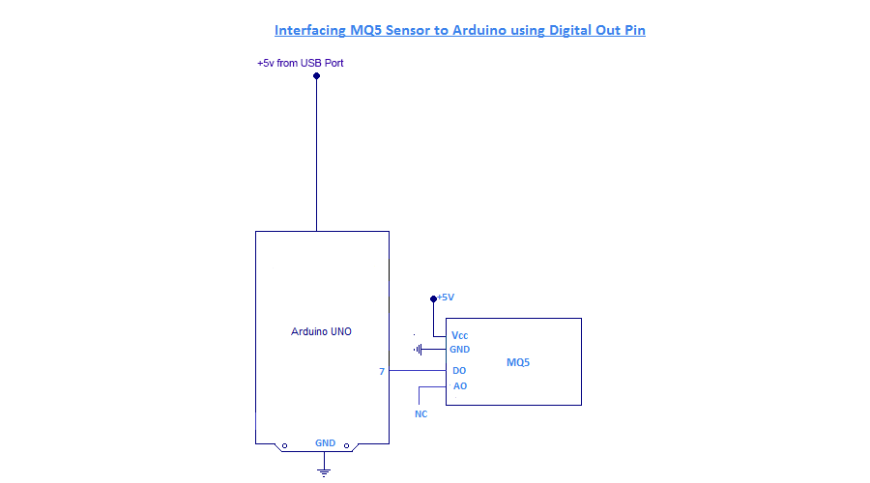
Interfacing MQ 5 Sensor With Arduino

Slide 17
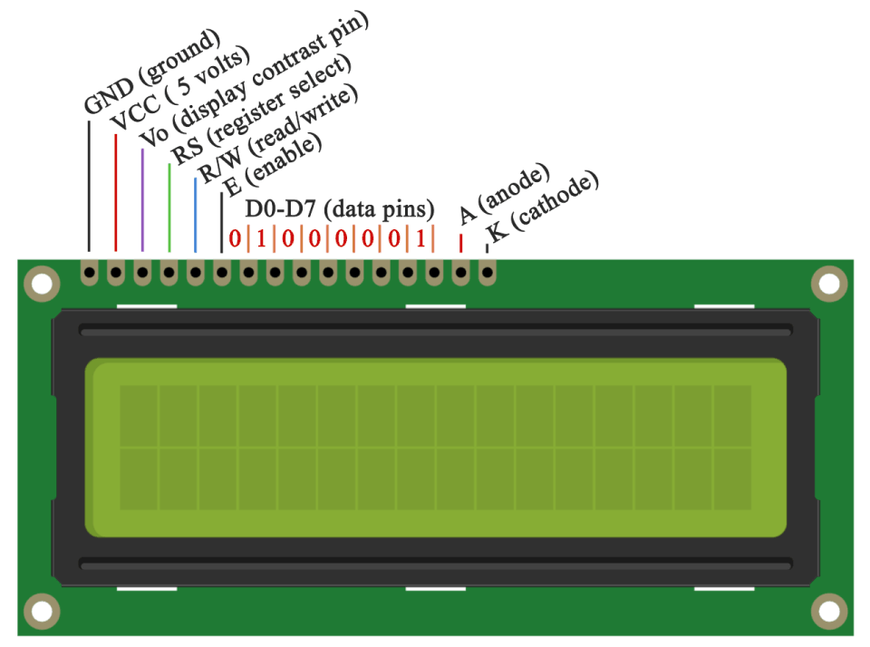
16*2 LCD Display
LCD: Liquid-crystal display

Slide 18
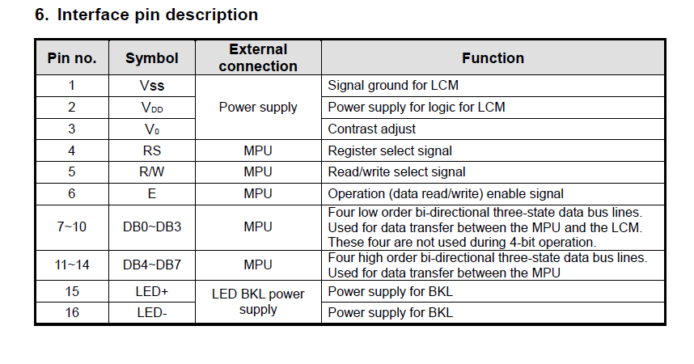
LCD Display PIN Description

Slide 19
Working Principal
When the smoke sensor detects smoke then it pass the information to the Arduino nano. Arduino nano control all the system.

Slide 20
Applications
This project can be used in Industries, Shopping malls, Office.
Warehouses & large covered areas.
Large foyers, halls & reception areas.
Cinemas, theatres, concert halls.
Sports halls & large waiting areas.
Hotel rooms and changing rooms where steam and water mist can cause problems.
Production facilities where large quantities of dust are produced.
Farm buildings with high levels of dust and other airborne materials.

Slide 21
Benefits
SMS based Fire Alarm system are very useful in remote locations where human interaction is limited. Such systems are useful in mines, industrial areas, factories etc.
We all know owls don’t sleep during night. SMS based Fire Alarm system helps to monitor locations and alert during fire that occurs in night time.
SMS based Fire Alert system gives warning immediately to multiple mobile numbers and hence remedy actions can be taken quickly. This helps to prevent major damages and losses created by a fire accident.
Immediately can be protected from fire accidents.

Slide 22
Benefits
It can be used to detect burnable gas like methane, LPG etc.
The system can be further developed with added features like web server interconnect, fire area tracking and fire extinguisher interfacing etc.
It is low cost to apply on a household or in a office or factory.
Having a fire alarm system saves lives and protects assets from being destroyed.
Farm buildings with high levels of dust and other airborne materials.

Slide 23
Limitations
Barriers such as closed or partially closed doors, walls, or chimneys may inhibit flow.
Smoke particles may become “cold” and stratify, and may not reach the ceiling or upper walls where detectors are located.
Smoke particles may be blown away from detectors by air outlets.
Smoke particles may be drawn into air returns before reaching the detector.
The amount of “smoke” present may be insufficient to alarm smoke detectors. Smoke detectors are designed to alarm at various levels of smoke density.

Slide 24
Future Work Scope
This project gives us an opportunity to do a big project in future. The applications stated above are some demo applications that are absolutely possible with its future development. Initially for the limitation of time and required fund we were able to develop just a Smoke detector alarm system. The system will also work using GSM communication. It will more efficient by using 16x2 LCD display. So, we have a big work scope in this sector. We hope that, we will be able to complete all the features needed for its ultimate applications.

Slide 25
Conclusion
The Smoke detector alarm system using GSM communication has been designed and developed for making our life more easy and secured. We use 5V from Arduino board and use 12V DC power supply for GSM shield. We use the GSM module for receiving signal from an Arduino. Finally, we have designed and developed the whole control system and tested using Smoke detector. We fix all the problems encountered during the design and testing of the system. Finally, we successfully achieved our goals. In this study, the application of microcontroller with improved algorithm of extended specifications has increased the use of GSM shield and improves the controlling the smoke. So, our Smoke detector alarm system using GSM communication is suitable.

Slide 26


