Slide 1
Light Speed Cinema
Data Analysis

Slide 2
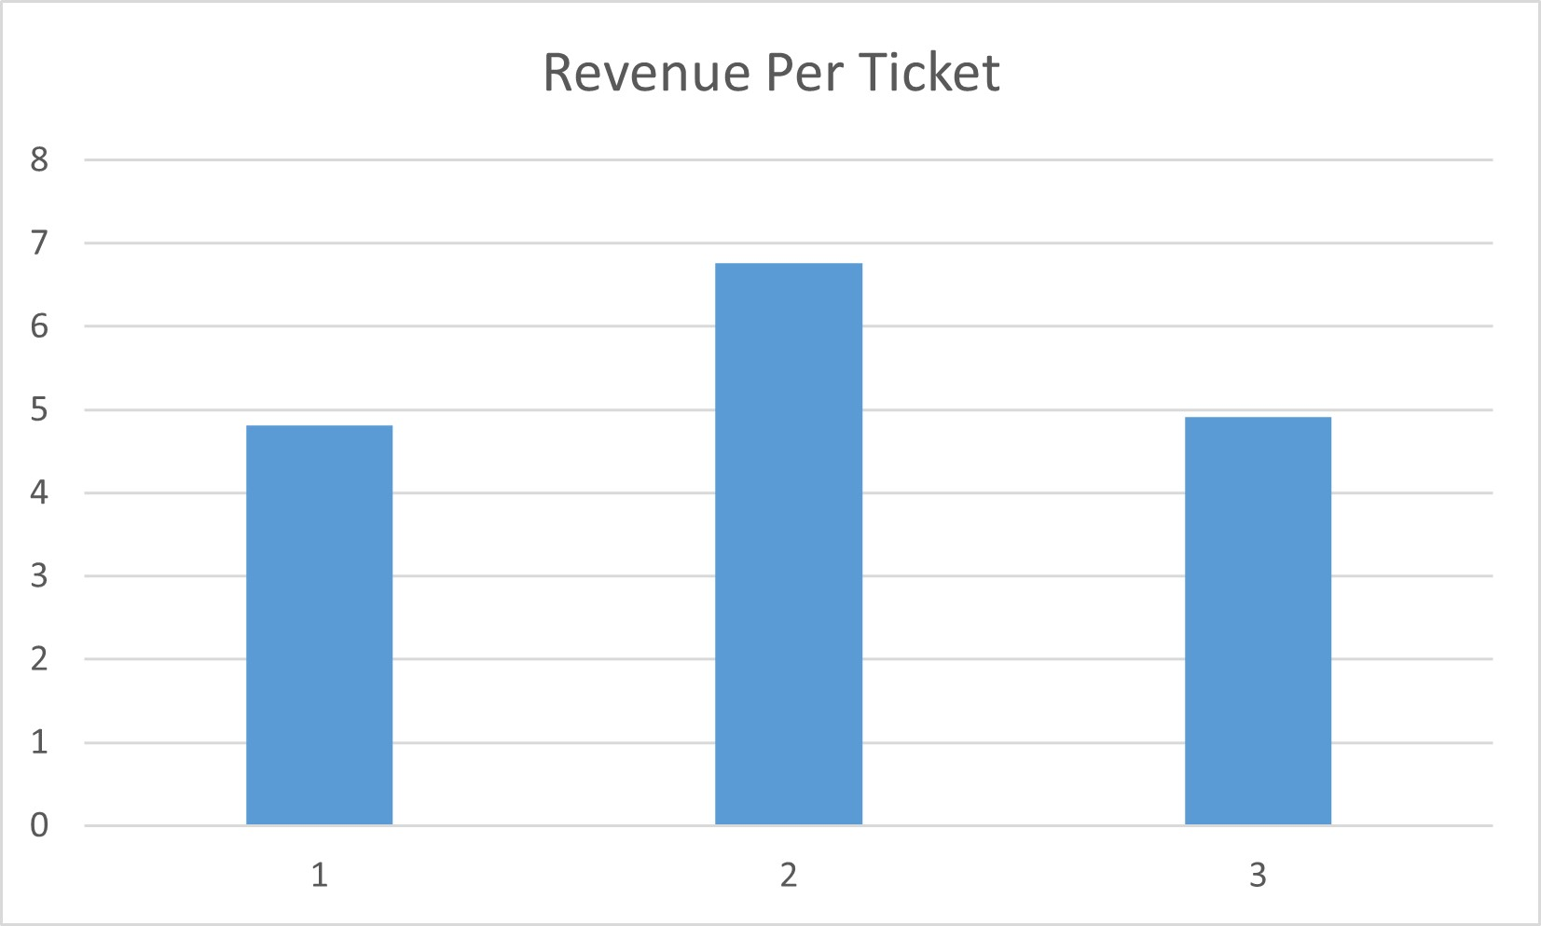
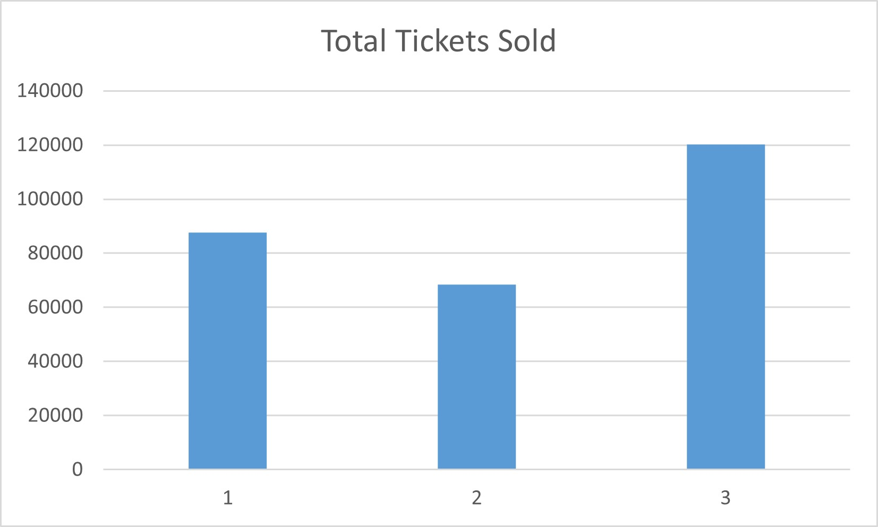
Cinema 2 is performing the best
Cinema 2 is performing the best as it is generating the highest revenue per ticket. Refer the following two supporting graphs.

Slide 3
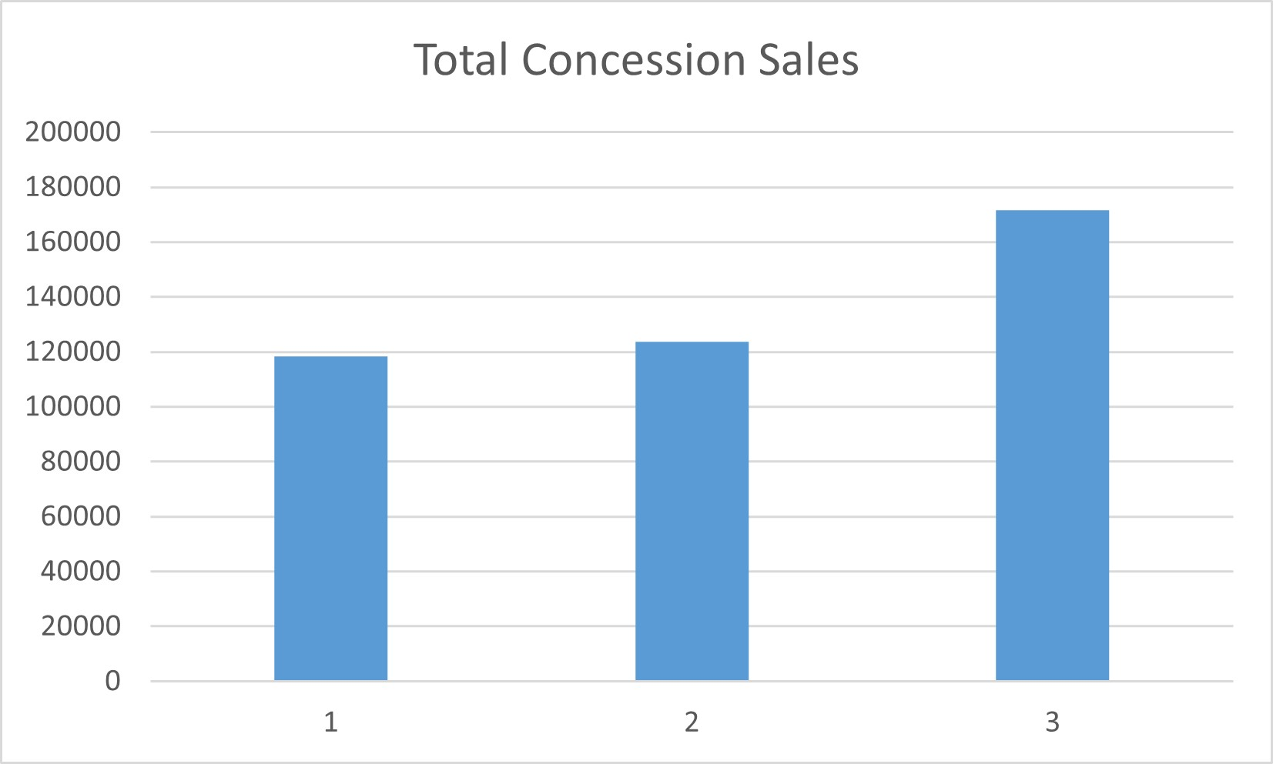
Cinema 2 is the most successful concession stand
Cinema 2 is the best concession stand. Refer to the two graphs below.

Slide 4
Cinema 3 is the best among the three cinema
Cinema 3 sells the most ticket which is the bread and butter for any cinema with good Concession sales number.

Slide 5
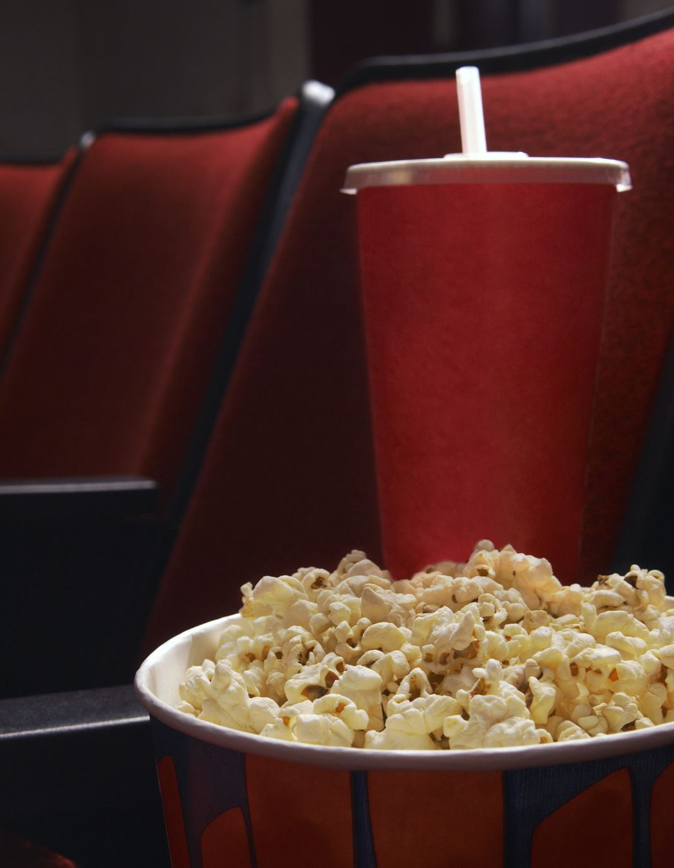
Cinema 3 Concession Improvements
Cinema 3 must adopt cinema 2 prices for concession stand.
Reasons:
Cinema 2 is the best performer in terms of sales and revenue generated per ticket sold.
Cinema 2 has the following prices:
Popcorn - Cinema 1 > Cinema 2 > Cinema 3
Highest Price - $4.50
Soda - Cinema 2 > Cinema 3 > Cinema 1
Highest Price - $3.50
Candy - Cinema 2 > Cinema 1 > Cinema 3
Highest Price - $2.85
Cinema 2 has its concession stands priced very well as popcorn sales the most in the concession stand with Soda being the second and Candy being the least preferred.
People who buy a movie are highly likely to buy a popcorn and there is a good chance that they would also buy Soda along with it.

