Slide 1

Amazon Web Services
EC2 - Elastic Cloud Compute

Slide 2
EC2 : Elastic Cloud Compute
Elastic Cloud Compute provides Resizable Compute Capacity in the Cloud.
Virtual Machine in the Cloud.

Slide 3
What is Amazon EC2
Amazon Elastic Compute Cloud (Amazon EC2) provides scalable computing capacity in the Amazon Web Services (AWS) cloud.
Using Amazon EC2 eliminates your need to invest in hardware upfront, so you can develop and deploy
applications faster.
You can use Amazon EC2 to launch as many or as few virtual servers as you need, configure security and networking, and manage storage.
Amazon EC2 enables you to scale up or down to handle changes in requirements or spikes in popularity, reducing your need to forecast traffic.
Pay only for capacity you actually use
Choose Linux or windows
Choose across regions and availability zones for reliability

Slide 4
Features of Amazon EC2
Virtual computing environments, known as instances
Preconfigured templates for your instances, known as Amazon Machine Images (AMIs), that package the bits you need for your server (including the operating system and additional software)
Various configurations of CPU, memory, storage, and networking capacity for your instances, known as instance types
Secure login information for your instances using key pairs (AWS stores the public key, and you store the private key in a secure place)
Storage volumes for temporary data that's deleted when you stop or terminate your instance, known as instance store volumes
Persistent storage volumes for your data using Amazon Elastic Block Store (Amazon EBS), known as Amazon EBS volumes

Slide 5
Features of Amazon EC2
Multiple physical locations for your resources, such as instances and Amazon EBS volumes, known as regions and Availability Zones
A firewall that enables you to specify the protocols, ports, and source IP ranges that can reach your instances using security groups
Static IPv4 addresses for dynamic cloud computing, known as Elastic IP addresses
Metadata, known as tags, that you can create and assign to your Amazon EC2 resources
Virtual networks you can create that are logically isolated from the rest of the AWS cloud, and that you can optionally connect to your own network, known as virtual private clouds(VPCs)

Slide 6
Overview
The instance is an Amazon EBS-backed instance (meaning that the root volume is an EBS volume). You can either specify the Availability Zone in which your instance runs, or let Amazon EC2 select an Availability Zone for you.
When you launch your instance, you secure it by specifying a key pair and security group.
When you connect to your instance, you must specify the private key of the key pair that you specified when launching your instance.

Slide 7
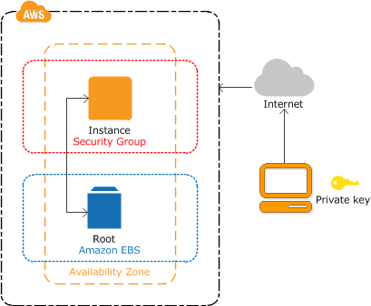
Overview

Slide 8
EC2 Options
On Demand : Pay a fixed rate by the hour with no commitment.
For users wishing for low cost and flexibility without any upfront payment or long term commitment.
Applications with short term, spiky and unpredictable workloads.
Ideal for Startups
Reserved: Capacity Reservation based on baselining, and hence significant discount on the hourly charge for an instance. 1 year or 3 year terms.
Steady and Predictable usage applications.
Applications requiring Reserved Capacity.
Spot : Bid for price one wishes to pay for Instance Capacity, Greater savings for applications having flexible start and end times.
Applications with flexible start and end times.
Very low cost Compute, No cost for the hour in which AWs terminates the instance.
Dedicated Hosts: Physical EC2 servers dedicated for use. Useful in case of Server bound licenses for regulatory requirements. On demand pricing and cheap if reserved.

Slide 9
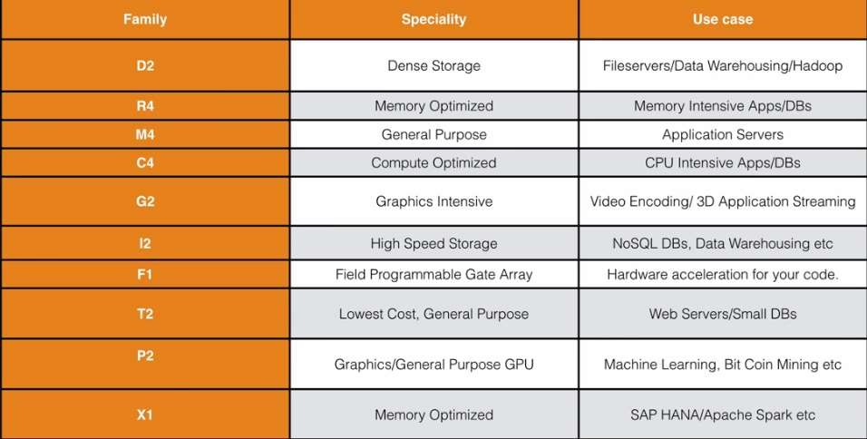
EC2 : Different EC2 Family Types
●
Visit : www.zekeLabs.com for more details.

Slide 10
Storage
File Storage
Elastic File Store (EFS)
Block Storage
Elastic Block Store (EBS)
Object Storage
Simple Storage Service (S3)
Glacier

Slide 11
ELASTIC BLOCK STORAGE - EBS Volumes
Storage Volumes that can be attached to Amazon EC2 instances.
File Systems and Databases can be run.
Automatic Replication within the AZ’s.
Note : One EBS Volume can not be mounted to multiple EC2 instances, USE EFS in such cases.

Slide 12
Elastic Block Store vs EC2 Instance Store
Amazon EBS
Data stored on Amazon EBS volume can persist independently of the life of the instance
Storage is persistent
Amazon EC2 instance store
Data stored on local instance store persists only as long as instance is alive
Storage is ephemeral

Slide 13
EBS - Volume Types
General Purpose SSD (GP2)
Balance of Price and Performance.
Ratio of 3 IOPS per GB with up to 10,000 IOPS and the ability to burst up to 3000 IOPS for volumes under 1 Gib
Provisioned IOPS SSD (IO1)
For I/O intensive applications like larger Relational or NoSql Database.
Used if the requirement is more than 10,000 IOPS & can provision up to 20,000 IOPS per volume.
Throughput Optimized HDD(ST1): Magnetic Disks : For Sequential Data that is frequently accessed.
Big Data, Data Warehouses, Log Processing Etc.
Can not be the BOOT Volume
Cold HDD(SC1)
Lowest Cost Storage for infrequently accessed workloads.
File Server
Can not be Boot Volume.
Magnetic (Standard)
Bootable and used for infrequently accessed data.

Slide 14
Lab on EC2

Slide 15
EC2 - Important Points
IOPS
Root Volume is not encrypted by default. 3rd Party tool (Eg. Bitlocker) to encrypt the root volume.
Additional Volumes can be encrypted by default.
Security Groups - Virtual Firewalls
Termination Protection turned off by default.
On an EBS- backed instance, the default action is for the root EBS volume to be deleted when the instance is terminated.

Slide 16
Launch an EC2 Instance via Web Console
Determine the AWS region in which you want to launch the Amazon EC2 Instance.
Launch an Amazon EC2 instance from a preconfigured Amazon Machine Image (AMI).
Choose an instance type based on memory, storage, CPU and network requirements
Configure network, IP address, security groups, tags and key pairs

Slide 17
Security Groups

Slide 18
EC2 Security Group Basics
Security Group is like a virtual firewall.
Ingress(Inbound) and Egress(Outbound)
Changes in Security Groups configuration acts immediately.
It is our first line of defence.

Slide 19
Security Groups
By default everything on Aws is private. All inbound traffic is blocked by default.
If we do not allow a particular protocol no one will be able to access our instance
using that protocol
Any rule edit on security group have immediate effect.
Inbound rules also apply over outbound automatically (Stateful)
You can't deny traffic by using rule. By default everything is denied
You can allow the source to be itself.
There can be multiple security groups on an ec2 instance
Can not block an specific ip address using security group but by using a network access list.

Slide 20
Lab on Security Group

Slide 21
Security Groups Lab
Log in to EC2 server.
Install Apache Server : yum install httpd -y
Turn On the Server: service httpd status => service httpd start => chkconfig httpd on
Go to root directory of the web server : cd /var/www/html
Create a html page using vi or nano index.html
Try accessing with different variations of security groups.
All Inbound is denied by default and Outbound is open to world.
Security groups are STATEFUL.

Slide 22
Volumes and Snapshots

Slide 23
Volumes vs Snapshots
Volume exists on EBS. It’s more or less Virtual Hard Disk.
Snapshots exists on S3.
Snapshot of Volume can be taken and stored on S3.
Snapshots are point in time copies of Volumes.
Snapshots are incremental backups. Only changed blocks are moved to S3.
First snapshot takes time.
Snapshots excludes data held in the cache by applications and the OS.
●
You can track the status of your EBS snapshots through CloudWatch Events

Slide 24
Lab on Snapshots & Volume

Slide 25
Lab on Snapshots & Volume
Create a volume and attach it to the EC2 instance.
lsblk : Check the volumes and the mount points.
file -s /dev/xvdf
mkfs -t ext4 /dev/xvdf
mkdir /fileserver
mount /dev/xvdf /fileserver
umount /dev/xvdf
Detach the Volume.
Create the snapshot.
Create a Volume from the snapshot. Mount and Unmount again.

Slide 26
Volumes and Snapshot Security
Snapshots of Encrypted Volumes are encrypted automatically.
Unencrypted Snapshots can be shared with other AWS Accounts or can even be made public.
To create a snapshot for Amazon EBS Volumes that serve as root devices, instance should be stopped before taking the snapshot.
Amazon EBS encryption uses AWS Key Management Service (AWS KMS) master keys when creating encrypted volumes and any snapshots created from your encrypted volumes.

Slide 27
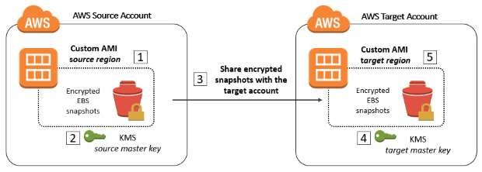
Volumes and Snapshot Security

Slide 28
AMAZON MACHINE IMAGES (AMI)

Slide 29
Amazon Machine Image
An Amazon Machine Image (AMI) provides the information required to launch an instance, which is a virtual server in the cloud.
An AMI includes the following
A template for the root volume for the instance (for example, an operating system, an
application server, and applications)
Launch permissions that control which AWS accounts can use the AMI to launch instances
A block device mapping that specifies the volumes to attach to the instance when it's launched
Select the AMI based on the following
Region
Operating Systems
Launch Permissions
Architecture (32 bit or 64 bit)
Storage for the root bit

Slide 30
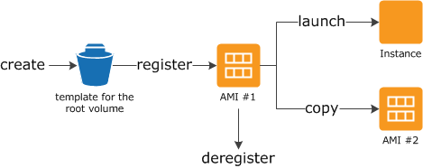
Using an AMI

Slide 31
EBS Root Volumes & Instance Store Volumes
Instance Store or Ephemeral Storage : Can’t be stopped, Lesser durability.
Data loss in case underlying host fails.
EBS backed Volumes: Can be Stopped, Snapshots & Volumes can be reattached.
Both of the instance types can be rebooted.

Slide 32
Elastic Load Balancers (ELB’s)

Slide 33
Elastic Load Balancers
Elastic Load Balancing automatically distributes incoming application traffic across multiple targets,
such as Amazon EC2 instances, containers, and IP addresses.
A load balancer accepts incoming traffic from clients and routes requests to its registered EC2
instances in one or more Availability Zones.
The load balancer also monitors the health of its registered instances and ensures that it routes traffic only to healthy instances.
When the load balancer detects an unhealthy instance, it stops routing traffic to that instance, and then resumes routing traffic to that instance when it detects that the instance is healthy again.
You configure your load balancer to accept incoming traffic by specifying one or more listeners. A
listener is a process that checks for connection requests.
It is configured with a protocol and port number for connections from clients to the load balancer and a protocol and port number for connections from the load balancer to the instances.

Slide 34
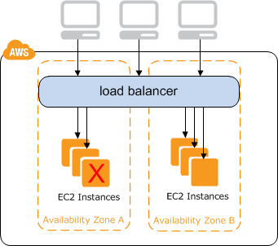
Elastic Load Balancer

Slide 35
Elastic Load Balancer Types
3 types of load balancers
Classic Load Balancers
Application Load Balancer
Network Load Balancer

Slide 36
Classic Load Balancer
The AWS Classic Load Balancer (CLB) operates at Layer 4 (Transport Layer) of the OSI model. What this means is that the load balancer routes traffic between clients and backend servers based on IP address and TCP port.
For example, an ELB at a given IP address receives a request from a client on TCP port 80 (HTTP). It will then route that request based on the rules previously configured when setting up the load balancer to a specified port on one of a pool of backend servers. In this example, the port on which the load balancer routes to the target server will often be port 80 (HTTP) or 443 (HTTPS).
The backend destination server will then fulfill the client request, and send the requested data back to the ELB, which will then forward the backend server reply to the client. From the client’s perspective, this request will appear to have been entirely fulfilled by the ELB. The client will have no knowledge of the backend server or servers fulfilling client requests.

Slide 37
Application Load Balancers
AWS Application Load Balancer (ALB) operates at Layer 7 (Application Layer) of the OSI model. At Layer 7, the ELB has the ability to inspect application-level content, not just IP and port. This lets it route based on more complex rules than with the Classic Load Balancer.
In another example, an ELB at a given IP will receive a request from the client on port 443 (HTTPS). The Application Load Balancer will process the request, not only by receiving port, but also by looking at the destination URL.
Multiple services can share a single load balancer using path-based routing. In the example given here, the client could request any of the following URLs:
http://www.example.com/blog
http://www.example.com/video
The Application Load Balancer will be aware of each of these URLs based on patterns set up when configuring the load balancer, and can route to different clusters of servers depending on application need.

Slide 38
Network Load Balancers
Network Load Balancer has been designed to handle sudden and volatile traffic patterns, making it ideal for load balancing TCP traffic. It is capable of handling millions of requests per second while maintaining low latencies and doesn’t have to be “pre-warmed” before traffic arrives.
Best use cases for Network Load Balancer:
When you need to seamlessly support spiky or high-volume inbound TCP requests.
When you need to support a static or elastic IP address.

Slide 39
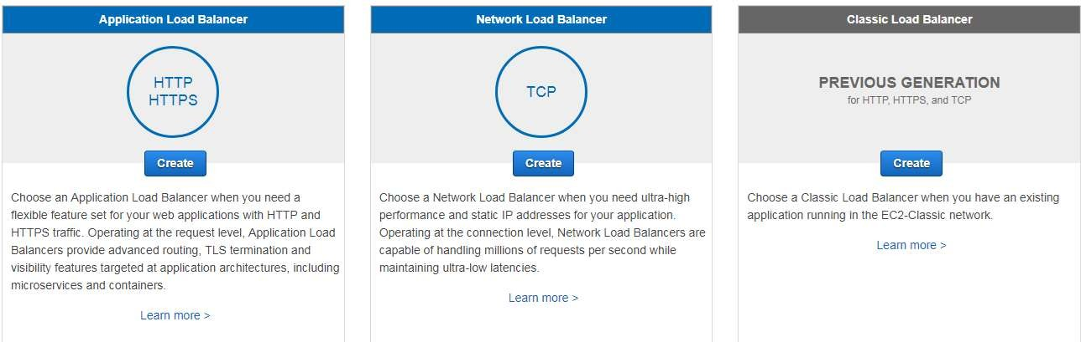
Load Balancers

Slide 40
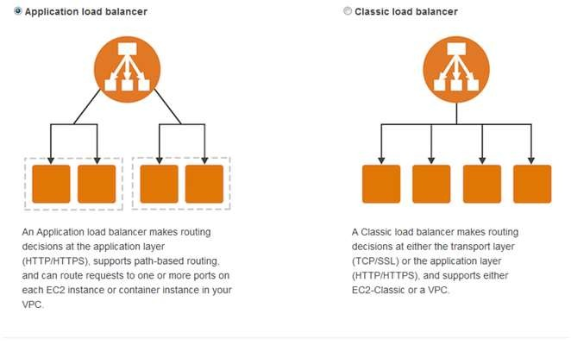
Classic and Application Load Balancers

Slide 41
Command Line Interface (CLI)

Slide 42
AWS CLI
Configure the CLI:
aws configure
After configuring aws service help
Roles : Secure compared to storing the Key and Key ID on the EC2 server.
Roles permissions can be changed later but they can only be attached to EC2 during the launch.

Slide 43
EC2 Metadata

Slide 44
EC2 Metadata
Instance metadata is data about your instance that you can use to configure or manage the
running instance.
How to retrieve the data about the data. curl http://169.254.169.254/latest/meta-data

Slide 45
Amazon Autoscaling Groups

Slide 46
Auto Scaling
Contains a collection of EC2 instances that share similar characteristics and are treated as a
logical grouping for the purposes of instance scaling and management.
For example, if a single application operates across multiple instances, you might want to increase the number of instances in that group to improve the performance of the application, or decrease the number of instances to reduce costs when demand is low.
Auto Scaling groups are used to scale the number of instances automatically based on criteria that you specify, or to maintain a fixed number of instances even if an instance becomes unhealthy.

Slide 47
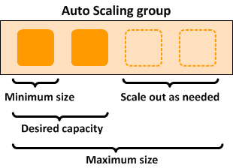
Auto Scaling Groups

Slide 48
Auto Scaling
Manages Amazon EC2 capacity automatically.
Maintains the right number of instances for your application.
Operates a healthy group of instances, and scales it according to your needs.
Launch Configurations: Reusable configuration or templates of instances for auto scaling. Custom AMI’s or AMI’s that are created from already running instances can also be used.
Launch configuration can be changed at any point of time.
Auto Scaling Group: Specify how many instances you want to run in it.Your group will maintain this number of instances, and replace any that become unhealthy or impaired.
You can optionally configure your group to adjust in capacity according to demand, in response to
Amazon CloudWatch metrics.

Slide 49
EC2 Placement Groups

Slide 50
Placement Groups
Logical grouping of instances within a single Availability zone. Multiple AZ’s not possible.
Applications that need low latency, speeds upto 10Gbps can be achieved.
Recommended for applications needing Low Network Latency, High Network Throughput or both.
Suitable for Hadoop Clustering, Cassandra nodes etc.
Placement Group name must be unique in the AWS Account.
Only certain types of instances can be launched in a placement group (Optimized - Mem, GPU,
Storage)
Homogenous instances recommended and Placements Groups can’t be merged.
Existing instances can’t be moved into Placement Group. (Possible only through AMI’s)

