Slide 1
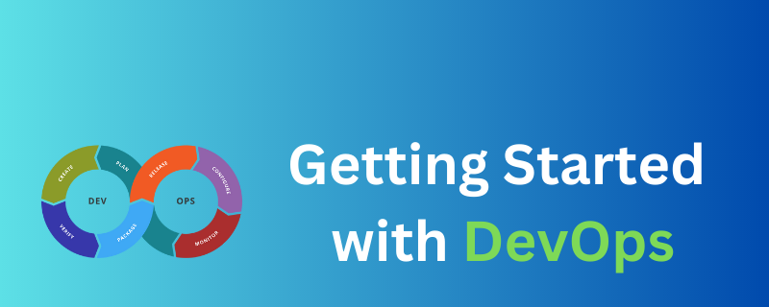

Slide 2
When developers and operations teams work together, they can identify and solve problems more quickly. This helps them deliver software to users faster and with fewer errors.
This general practice is called DevOps. It involves using tools and techniques to automate tasks and make software development and deployment more efficient.

Slide 3
When developers and operations teams work together, they can identify and solve problems more quickly. This helps them deliver software to users faster and with fewer errors.
This general practice is called DevOps. It involves using tools and techniques to automate tasks and make software development and deployment more efficient.

Slide 4
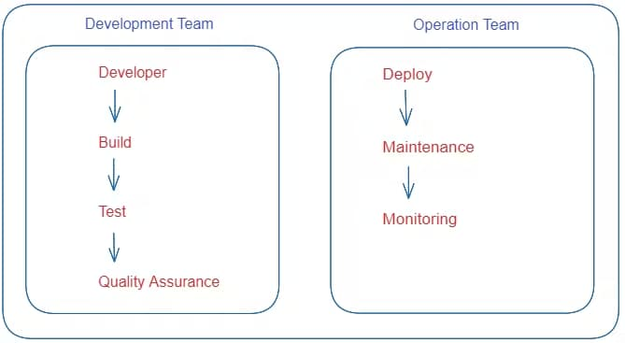
Development Team & Operations Team working separately

Slide 5
DevOps is a methodology that allows a single team to manage the entire application development life cycle – that is development, testing, deployment, and operations.
This approach can help your team produce superior quality software quickly and with more reliability.

Slide 6
How Does DevOps Work?
Before DevOps, the development team and the operations team worked separately. This often created a lot of issues in production because both teams were working separately without consulting each other and integrating best practices.
Suppose the operations team has an issue during deployment and they want to communicate with the deployment team. But the deployment team isn't available at that time, so they have to wait a while. Not only that, but the entire process was manual.

Slide 7
How Does DevOps Work?
Because of all of these issues, the DevOps team got created. Again, it combines the Development Team and the Operations Team and automates
every step of the process.

Slide 8
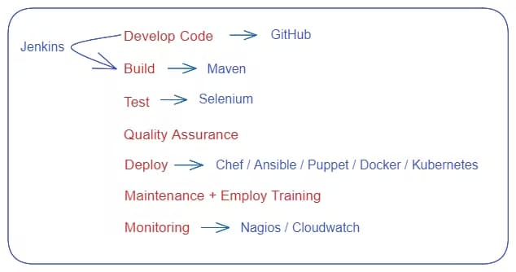
Let's look at a sample workflow a DevOps team might follow:

Slide 9
DevOps Life Cycle
When building a product, teams go through what is known as the Software Development Life Cycle (SDLC). It's a process used by software development teams to design, develop, test, and deploy software applications.
It is helps to ensure that software is delivered on time, within budget, and meets the requirements of stakeholders.

Slide 10
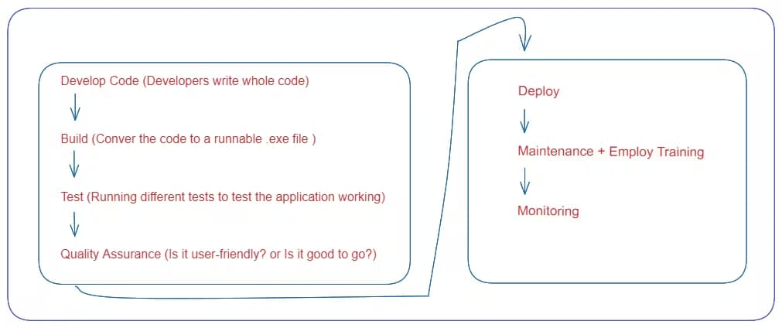
Before DevOps, we used to follow the waterfall or step-by-step model.

Slide 11
The Waterfall methodology has been largely replaced by Agile methodology. The main difference between Agile and Waterfall is that Waterfall is a linear system of working that requires the team to complete each project phase before moving on to the next one. Agile, on the other hand, encourages the team to work simultaneously on different phases of the project and allows them to iterate, make changes, and check in along the way.

Slide 12
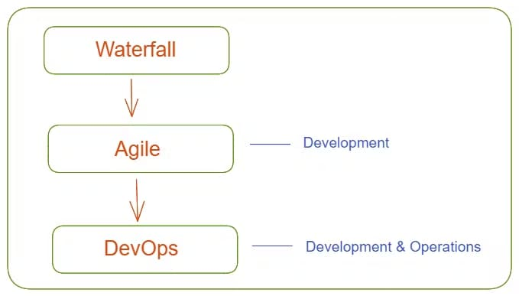

Slide 13
DevOps is an extension of Agile practices. DevOps builds on the principles of Agile, which emphasizes collaboration, flexibility, and iterative development.
Agile phases are comprised of scrums, sprint planning, sprint review, and so on. DevOps, on the other hand, includes planning, building, continuous delivery, testing, and feedback.

Slide 14
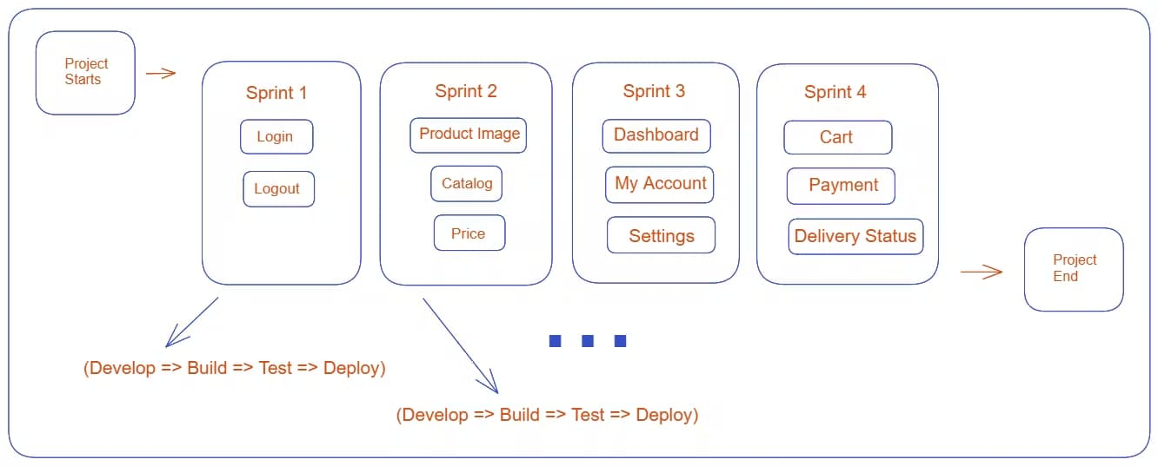
Example:
Suppose a customer wants to build an e-commerce app. Let's have a look at the workflow:

Slide 15
The sprints shown in the figure represent the steps in the project. Each sprint includes Develop, Build, Test, and Deploy phases.
After completing a sprint, the team contacts the client to check in. If the client wants any changes, the team can easily make them. Once a sprint finishes, the team move on to the next one.

Slide 16
This process may take several days or weeks, which is where DevOps comes in. By implementing DevOps practices like continuous integration and continuous delivery, you can automate the process of building, testing, and deploying the app.
If any issues arise, the team can quickly fix them without causing any downtime for the users.

Slide 17
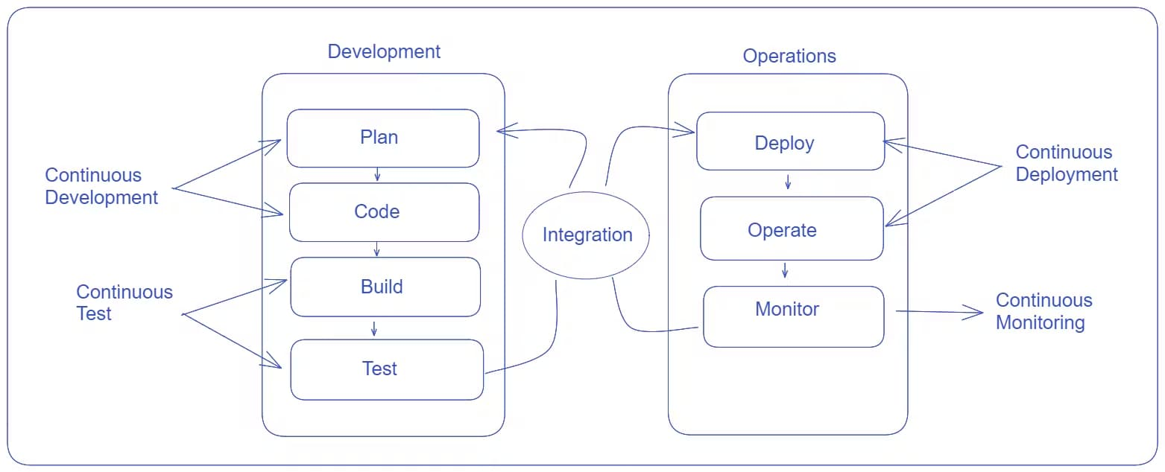
This is how the DevOps team works to build any software more efficiently.

Slide 18
V-Shaped Strengths
Emphasize planning for verification and validation of the product in early stages of product development
Each deliverable must be testable
Project management can track progress by milestones
Easy to use

Slide 19
V-Shaped Weaknesses
Does not easily handle concurrent events
Does not handle iterations or phases
Does not easily handle dynamic changes in requirements
Does not contain risk analysis activities

Slide 20
When to use the V-Shaped Model
Excellent choice for systems requiring high reliability – hospital patient control applications
All requirements are known up-front
When it can be modified to handle changing requirements beyond analysis phase
Solution and technology are known

Slide 21
Structured Evolutionary Prototyping Model
Developers build a prototype during the requirements phase
Prototype is evaluated by end users
Users give corrective feedback
Developers further refine the prototype
When the user is satisfied, the prototype code is brought up to the standards needed for a final product.

Slide 22
Structured Evolutionary Prototyping Steps
A preliminary project plan is developed
An partial high-level paper model is created
The model is source for a partial requirements specification
A prototype is built with basic and critical attributes
The designer builds
  the database
  user interface
  algorithmic functions
The designer demonstrates the prototype, the user evaluates for problems and suggests improvements.
This loop continues until the user is satisfied

Slide 23
Structured Evolutionary Prototyping Strengths
Customers can “see” the system requirements as they are being gathered
Developers learn from customers
A more accurate end product
Unexpected requirements accommodated
Allows for flexible design and development
Steady, visible signs of progress produced
Interaction with the prototype stimulates awareness of additional needed functionality

Slide 24
Structured Evolutionary Prototyping Weaknesses
Tendency to abandon structured program development for “code-and-fix” development
Bad reputation for “quick-and-dirty” methods
Overall maintainability may be overlooked
The customer may want the prototype delivered.
Process may continue forever (scope creep)

Slide 25
When to use
Structured Evolutionary Prototyping
Requirements are unstable or have to be clarified
As the requirements clarification stage of a waterfall model
Develop user interfaces
Short-lived demonstrations
New, original development
With the analysis and design portions of object-oriented development.

Slide 26
Rapid Application Model (RAD)
Requirements planning phase (a workshop utilizing structured discussion of business problems)
User description phase – automated tools capture information from users
Construction phase – productivity tools, such as code generators, screen generators, etc. inside a time-box. (“Do until done”)
Cutover phase -- installation of the system, user acceptance testing and user training

Slide 27
RAD Strengths
Reduced cycle time and improved productivity with fewer people means lower costs
Time-box approach mitigates cost and schedule risk
Customer involved throughout the complete cycle minimizes risk of not achieving customer satisfaction and business needs
Focus moves from documentation to code (WYSIWYG).
Uses modeling concepts to capture information about business, data, and processes.

Slide 28
RAD Weaknesses
Accelerated development process must give quick responses to the user
Risk of never achieving closure
Hard to use with legacy systems
Requires a system that can be modularized
Developers and customers must be committed to rapid-fire activities in an abbreviated time frame.

Slide 29
When to use RAD
Reasonably well-known requirements
User involved throughout the life cycle
Project can be time-boxed
Functionality delivered in increments
High performance not required
Low technical risks
System can be modularized

Slide 30
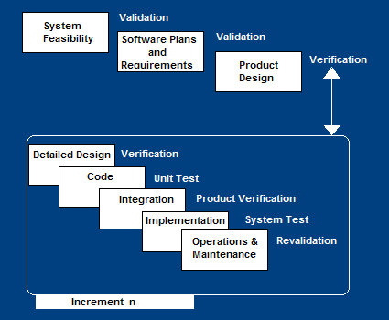
Incremental SDLC Model
Construct a partial implementation of a total system
Then slowly add increased functionality
The incremental model prioritizes requirements of the system and then implements them in groups.
Each subsequent release of the system adds function to the previous release, until all designed functionality has been implemented.

Slide 31
Incremental Model Strengths
Develop high-risk or major functions first
Each release delivers an operational product
Customer can respond to each build
Uses “divide and conquer” breakdown of tasks
Lowers initial delivery cost
Initial product delivery is faster
Customers get important functionality early
Risk of changing requirements is reduced

Slide 32
Incremental Model Weaknesses
Requires good planning and design
Requires early definition of a complete and fully functional system to allow for the definition of increments
Well-defined module interfaces are required (some will be developed long before others)
Total cost of the complete system is not lower

Slide 33
When to use the Incremental Model
Risk, funding, schedule, program complexity, or need for early realization of benefits.
Most of the requirements are known up-front but are expected to evolve over time
A need to get basic functionality to the market early
On projects which have lengthy development schedules
On a project with new technology

Slide 34
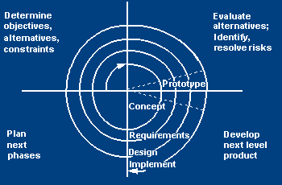
Spiral SDLC Model
Adds risk analysis, and 4gl RAD prototyping to the waterfall model
Each cycle involves the same sequence of steps as the waterfall process model

Slide 35
Spiral Quadrant
Determine objectives, alternatives and constraints
Objectives: functionality, performance, hardware/software interface, critical success factors, etc.
Alternatives: build, reuse, buy, sub-contract, etc.
Constraints: cost, schedule, interface, etc.

Slide 36
Spiral Quadrant
Evaluate alternatives, identify and resolve risks
Study alternatives relative to objectives and constraints
Identify risks (lack of experience, new technology, tight schedules, poor process, etc.
Resolve risks (evaluate if money could be lost by continuing system development

Slide 37
Spiral Quadrant
Develop next-level product
Typical activites:
  Create a design
  Review design
  Develop code
  Inspect code
  Test product

Slide 38
Spiral Quadrant
Plan next phase
Typical activities
  Develop project plan
  Develop configuration management plan
  Develop a test plan
  Develop an installation plan

Slide 39
Spiral Model Strengths
Provides early indication of insurmountable risks, without much cost
Users see the system early because of rapid prototyping tools
Critical high-risk functions are developed first
The design does not have to be perfect
Users can be closely tied to all lifecycle steps
Early and frequent feedback from users
Cumulative costs assessed frequently

Slide 40
Spiral Model Weaknesses
Time spent for evaluating risks too large for small or low-risk projects
Time spent planning, resetting objectives, doing risk analysis and prototyping may be excessive
The model is complex
Risk assessment expertise is required
Spiral may continue indefinitely
Developers must be reassigned during non-development phase activities
May be hard to define objective, verifiable milestones that indicate readiness to proceed through the next iteration

Slide 41
When to use Spiral Model
When creation of a prototype is appropriate
When costs and risk evaluation is important
For medium to high-risk projects
Long-term project commitment unwise because of potential changes to economic priorities
Users are unsure of their needs
Requirements are complex
New product line
Significant changes are expected (research and exploration)

Slide 42
Agile SDLC’s
Speed up or bypass one or more life cycle phases
Usually less formal and reduced scope
Used for time-critical applications
Used in organizations that employ disciplined methods

Slide 43
Some Agile Methods
Adaptive Software Development (ASD)
Feature Driven Development (FDD)
Crystal Clear
Dynamic Software Development Method (DSDM)
Rapid Application Development (RAD)
Scrum
Extreme Programming (XP)
Rational Unify Process (RUP)

Slide 44
Extreme Programming - XP
For small-to-medium-sized teams developing software with vague or rapidly changing requirements
Coding is the key activity throughout a software project
Communication among teammates is done with code
Life cycle and behavior of complex objects defined in test cases – again in code

Slide 45
XP Practices (1-6)
Planning game – determine scope of the next release by combining business priorities and technical estimates
Small releases – put a simple system into production, then release new versions in very short cycle
Metaphor – all development is guided by a simple shared story of how the whole system works
Simple design – system is designed as simply as possible (extra complexity removed as soon as found)
Testing – programmers continuously write unit tests; customers write tests for features
Refactoring – programmers continuously restructure the system without changing its behavior to remove duplication and simplify

Slide 46
XP Practices (7 – 12)
Pair-programming -- all production code is written with two programmers at one machine
Collective ownership – anyone can change any code anywhere in the system at any time.
Continuous integration – integrate and build the system many times a day – every time a task is completed.
40-hour week – work no more than 40 hours a week as a rule
On-site customer – a user is on the team and available full-time to answer questions
Coding standards – programmers write all code in accordance with rules emphasizing communication through the code

Slide 47
XP is “extreme” because
Commonsense practices taken to extreme levels
If code reviews are good, review code all the time (pair programming)
If testing is good, everybody will test all the time
If simplicity is good, keep the system in the simplest design that supports its current functionality. (simplest thing that works)
If design is good, everybody will design daily (refactoring)
If architecture is important, everybody will work at defining and refining the architecture (metaphor)
If integration testing is important, build and integrate test several times a day (continuous integration)
If short iterations are good, make iterations really, really short (hours rather than weeks)

Slide 48
XP References
Online references to XP at
http://www.extremeprogramming.org/
http://c2.com/cgi/wiki?ExtremeProgrammingRoadmap
http://www.xprogramming.com/

Slide 49
Feature Driven Design (FDD)
Five FDD process activities
Develop an overall model – Produce class and sequence diagrams from chief architect meeting with domain experts and developers.
Build a features list – Identify all the features that support requirements. The features are functionally decomposed into Business Activities steps within Subject Areas.
    Features are functions that can be developed in two weeks and expressed in client terms with the template: <action> <result> <object>
    i.e. Calculate the total of a sale
Plan by feature -- the development staff plans the development sequence of features
Design by feature -- the team produces sequence diagrams for the selected features
Build by feature – the team writes and tests the code
http://www.nebulon.com/articles/index.html

Slide 50
Dynamic Systems Development Method (DSDM)
Applies a framework for RAD and short time frames
Paradigm is the 80/20 rule
– majority of the requirements can be delivered in a relatively short amount of time.

Slide 51
DSDM Principles
Active user involvement imperative (Ambassador users)
DSDM teams empowered to make decisions
Focus on frequent product delivery
Product acceptance is fitness for business purpose
Iterative and incremental development - to converge on a solution
Requirements initially agreed at a high level
All changes made during development are reversible
Testing is integrated throughout the life cycle
Collaborative and co-operative approach among all stakeholders essential

Slide 52
DSDM Lifecycle
Feasibility study
Business study – prioritized requirements
Functional model iteration
  risk analysis
  Time-box plan
Design and build iteration
Implementation

Slide 53
Adaptive SDLC
Combines RAD with software engineering best practices
Project initiation
Adaptive cycle planning
Concurrent component engineering
Quality review
Final QA and release

Slide 54
Adaptive Steps
Project initialization – determine intent of project
Determine the project time-box (estimation duration of the project)
Determine the optimal number of cycles and the time-box for each
Write an objective statement for each cycle
Assign primary components to each cycle
Develop a project task list
Review the success of a cycle
Plan the next cycle

Slide 55
Tailored SDLC Models
Any one model does not fit all projects
If there is nothing that fits a particular project, pick a model that comes close and modify it for your needs.
Project should consider risk but complete spiral too much – start with spiral & pare it done
Project delivered in increments but there are serious reliability issues – combine incremental model with the V-shaped model
Each team must pick or customize a SDLC model to fit its project

Slide 56
Agile Web references
DePaul web site has links to many Agile references
http://se.cs.depaul.edu/ise/agile.htm

Slide 57
Quality – the degree to which the software satisfies stated and implied requirements
Absence of system crashes
Correspondence between the software and the users’ expectations
Performance to specified requirements
Quality must be controlled because it lowers production speed, increases maintenance costs and can adversely affect business

Slide 58
Quality Assurance Plan
The plan for quality assurance activities should be in writing
Decide if a separate group should perform the quality assurance activities
Some elements that should be considered by the plan are: defect tracking, unit testing, source-code tracking, technical reviews, integration testing and system testing.

Slide 59
Quality Assurance Plan
Defect tracing – keeps track of each defect found, its source, when it was detected, when it was resolved, how it was resolved, etc
Unit testing – each individual module is tested
Source code tracing – step through source code line by line
Technical reviews – completed work is reviewed by peers
Integration testing -- exercise new code in combination with code that already has been integrated
System testing – execution of the software for the purpose of finding defects.

