Slide 1
CelluPulp BD
Strategic Import Substitution for Bangladesh’s Hygiene Sector
April 2026 | BEZA Industrial Zone
Notes:
Welcome everyone. Today we present CelluPulp BD, a venture dedicated to securing Bangladesh's hygiene supply chain.

Slide 2
The Problem: Forex & Supply Chain Crisis
Dependency: Bangladesh imports 60k-80k MT of wood fluff pulp annually.
Cost: $80 Million USD per year leaving the local economy.
Volatility: LC margins and dollar liquidity disrupting production.
Notes:
The problem is clear: our hygiene sector is entirely dependent on expensive, dollar-denominated imports.

Slide 3
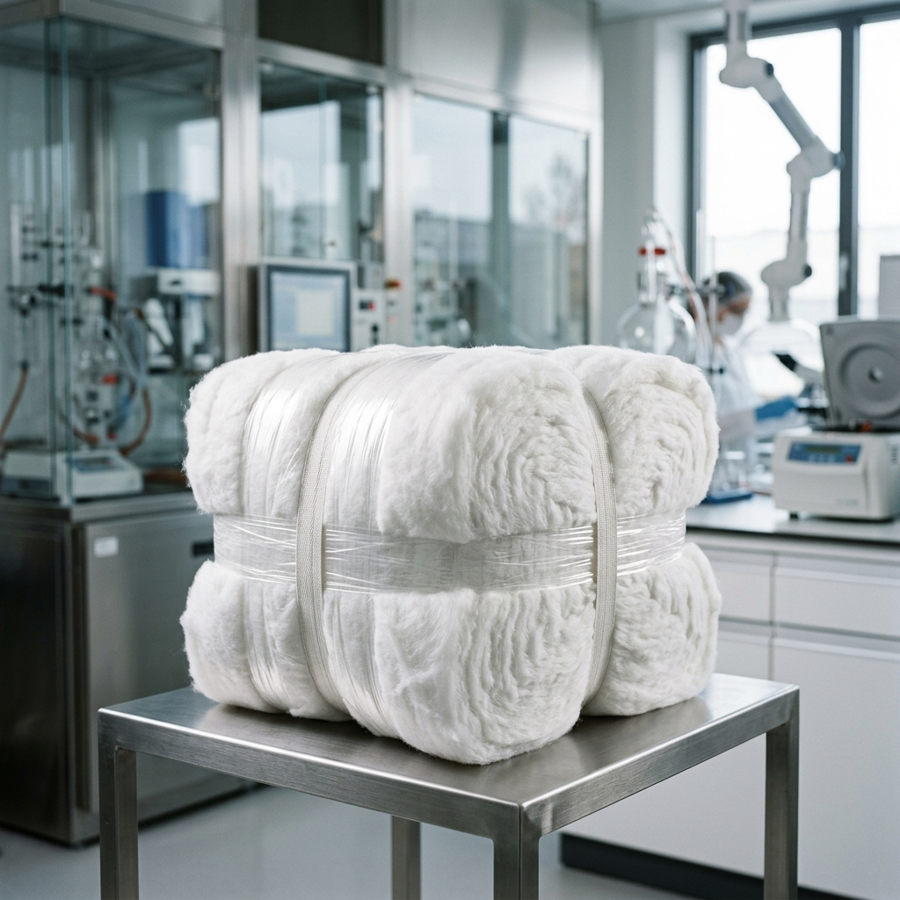
The Solution: Localized Fluff Pulp
Material: Jute and Bamboo fiber blending.
Cost Leadership: 15-25% cheaper than landed imports.
Efficiency: 48-hour lead time vs 60-day imports.
Notes:
We use local jute and bamboo to create a product that is cheaper, faster, and more reliable.

Slide 4
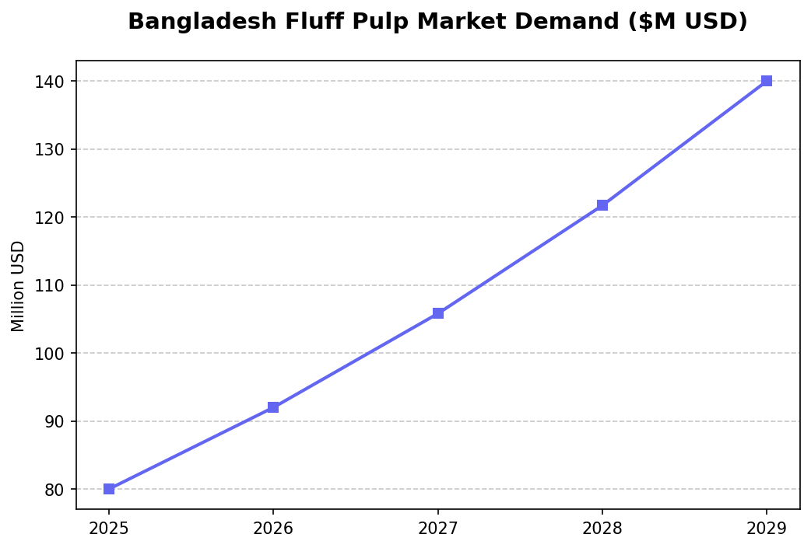
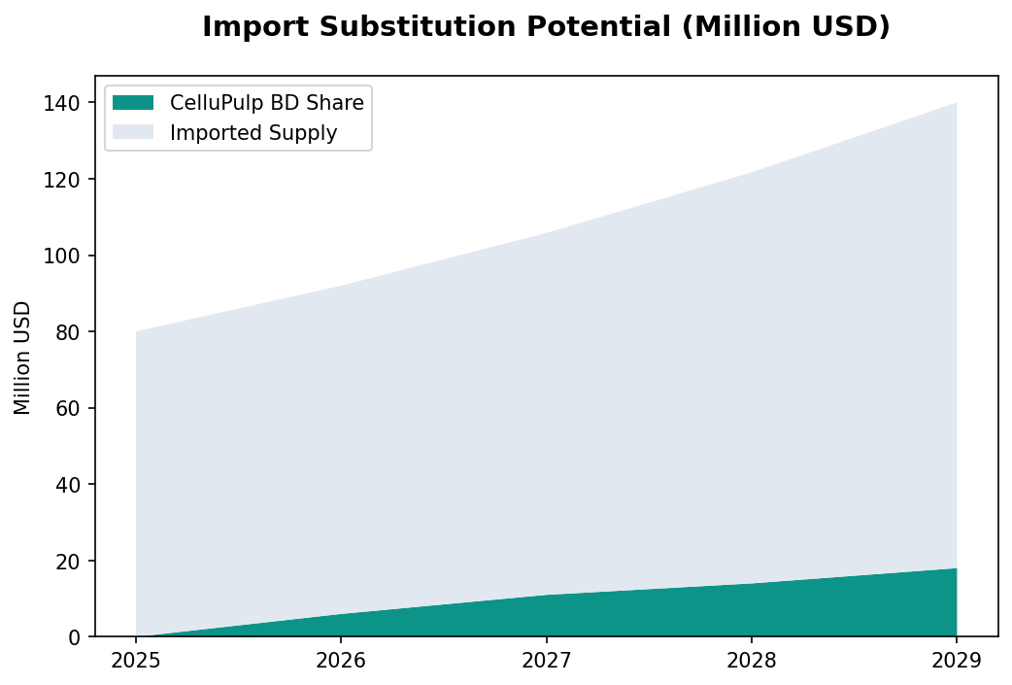
Market Opportunity & Demand
Notes:
The market is growing at 15% CAGR. We aim to capture a strategic 10% share in the pilot phase.

Slide 5
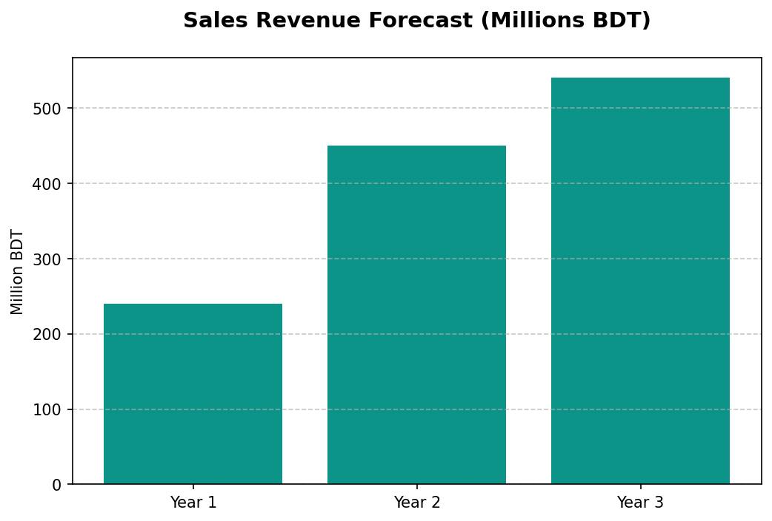
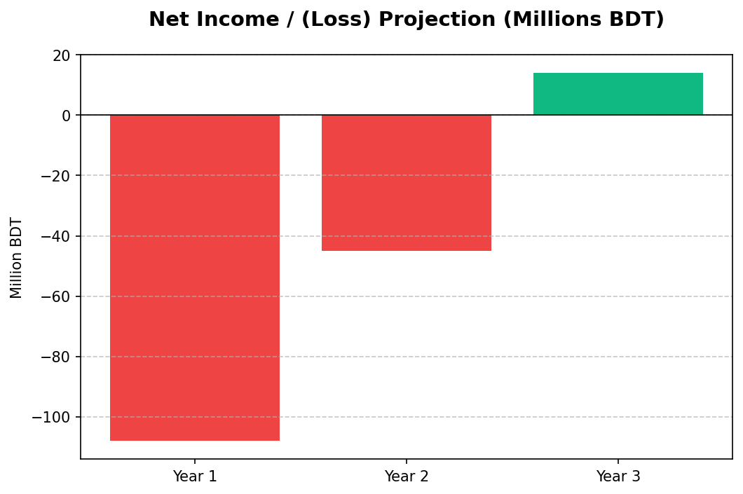
Financial Projections (Year 1-3)
Notes:
Our financials show the classic J-curve. We break even operationally in Year 2 and hit net profitability in Year 3.

Slide 6
Securing Bangladesh's Hygiene Future
Md Sayem Sarkar | md.sayem@cellupulpbd.com
Notes:
Thank you for your time. We are ready to build the future of industrial manufacturing in Bangladesh.

