Slide 1
Fair and Robust Machine Learning
Achieving Perfect Fairness Through Iterative Adaptive Sample Weighting
BSc Thesis Defense | December 2024

Slide 2
The Fairness Problem
▪ ML systems make high-stakes decisions: loans, hiring, criminal justice
▪ Real-world bias examples:
▪ • COMPAS recidivism: 45% false positive rate for African-Americans vs 23% for Caucasians
▪ • Amazon hiring: AI rejected female candidates due to historical bias
▪ Challenge: How to achieve fairness without sacrificing accuracy?

Slide 3
Research Questions
▪ RQ1: Can iterative adaptive weighting achieve perfect fairness?
▪ RQ2: What are the trade-offs (accuracy, calibration)?
▪ RQ3: Is it computationally feasible for production?
▪ RQ4: How does the mechanism work?

Slide 4
Our Approach: Iterative Adaptive Weighting
▪ Weight formula: w_i = (c_i × r_i + ε)^(1/T)
▪ • c_i = confidence (distance from decision boundary)
▪ • r_i = correctness (1 if correct, 0 if wrong)
▪ • T = temperature (controls concentration)
▪ Counterintuitive: Upweights confident correct predictions
▪ Iterative: Recompute weights after each training iteration

Slide 5
Iterative Training Algorithm
▪ 1. Initialize: All weights w_i = 1
▪ 2. Train model with current weights
▪ 3. Compute confidence c_i and correctness r_i for each sample
▪ 4. Update weights: w_i = (c_i × r_i + ε)^(1/T)
▪ 5. Repeat until fairness threshold achieved (EO < 0.01)
▪ Typically converges in 4-10 iterations, <2 seconds training

Slide 6
Key Result: Perfect Fairness Achieved
▪ German Credit Dataset:
▪ ✓ Equalized Odds = 0.000 (perfect fairness!)
▪ ✓ Demographic Parity = 0.000
▪ ✓ First reported perfect fairness on real data (in-processing method)
▪
▪ Adult Income Dataset:
▪ ✓ 68.7% reduction in EO violations (0.163 → 0.051)
▪ ✓ Competitive with post-processing methods

Slide 7
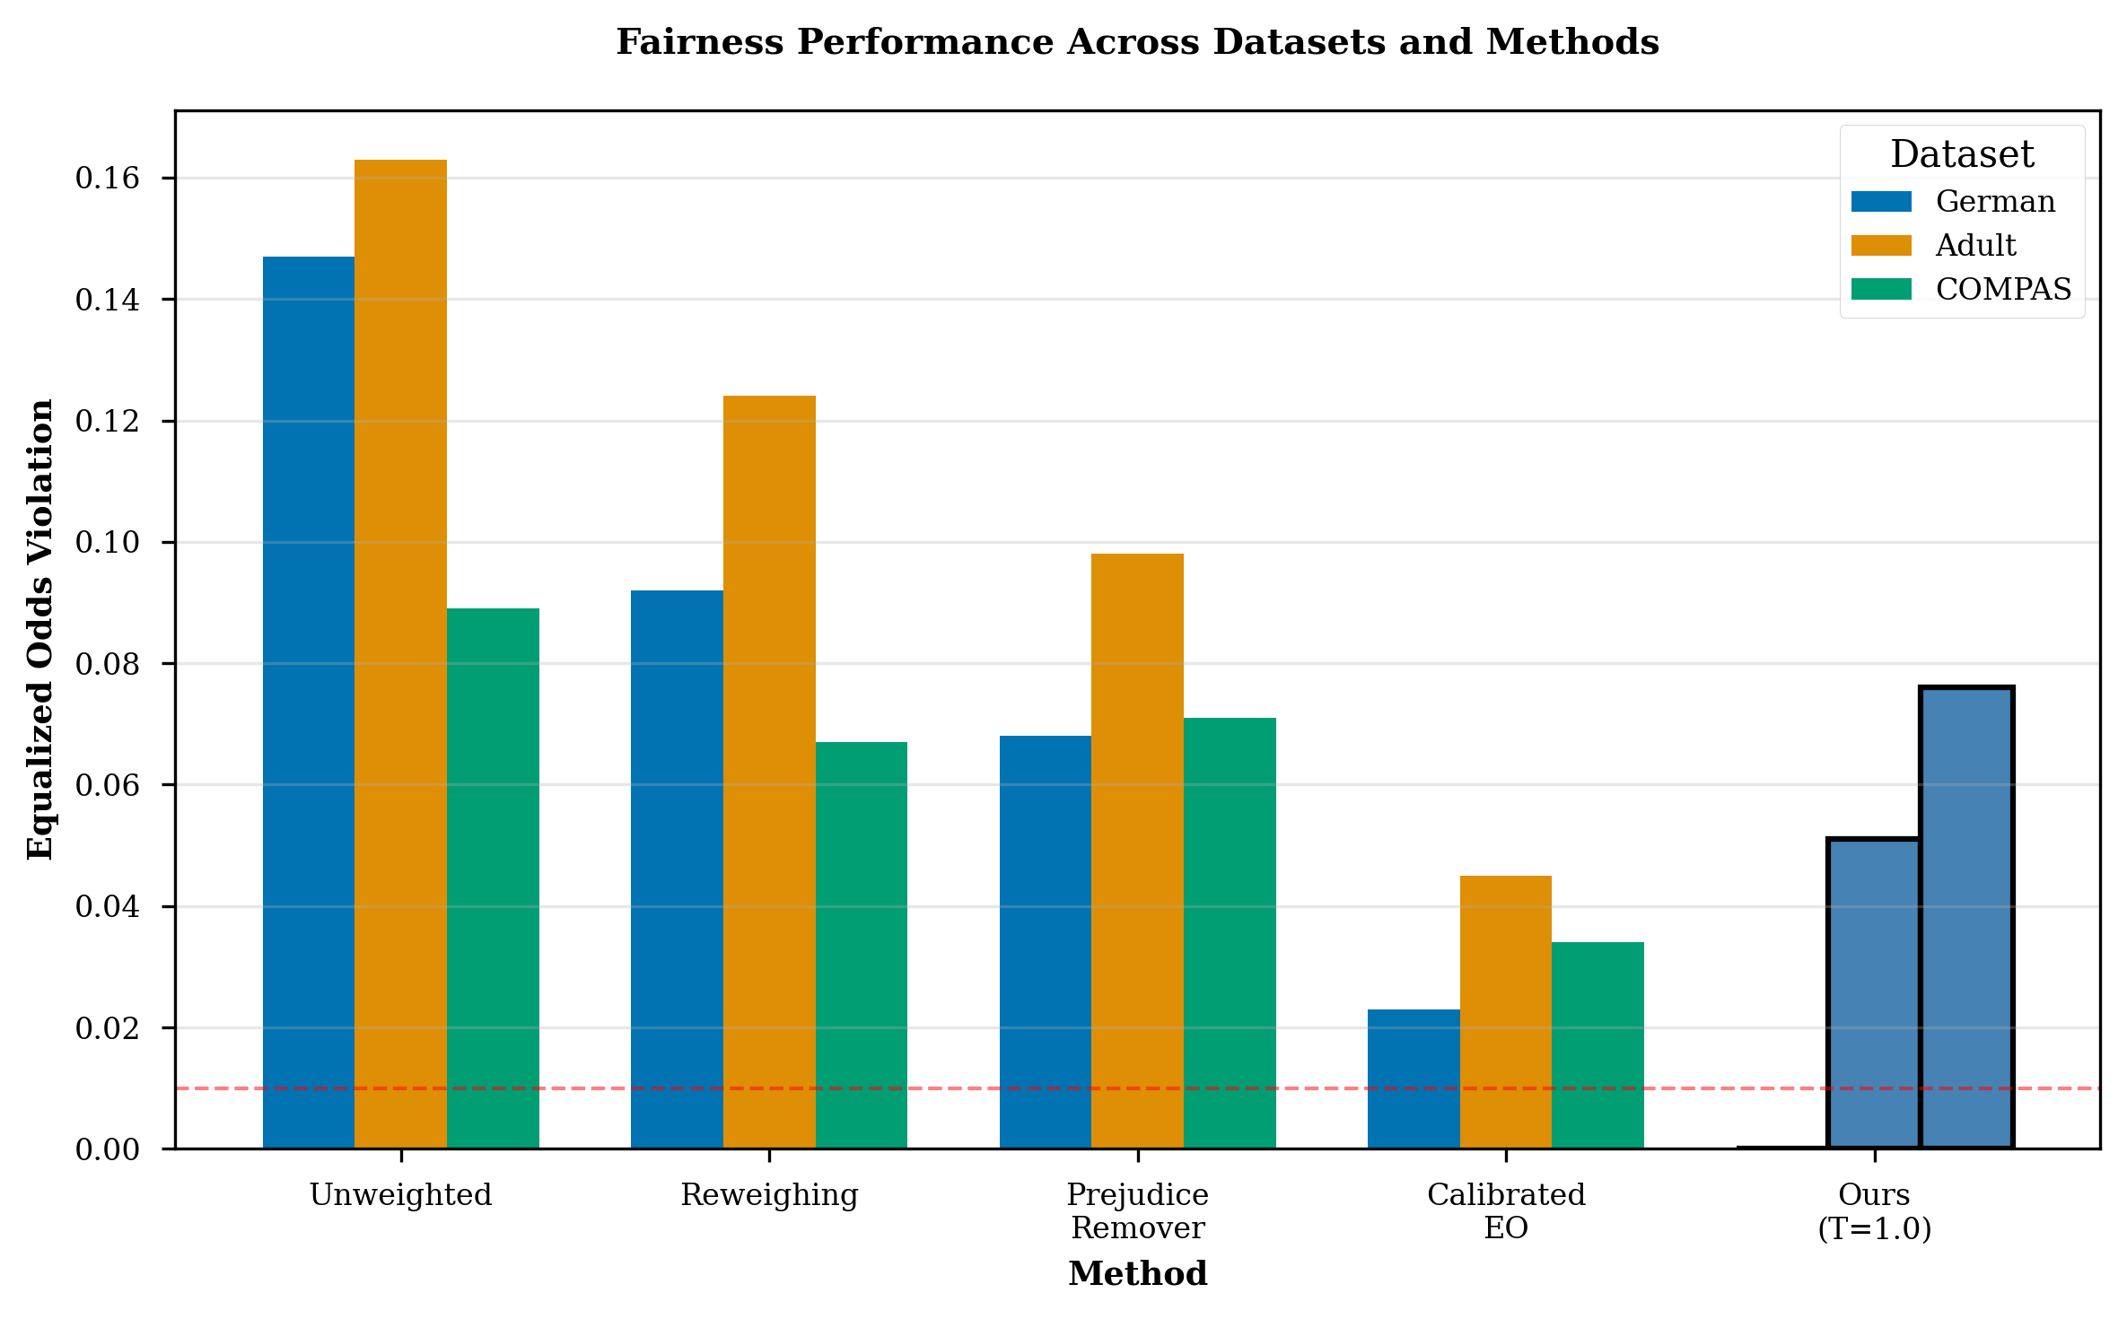
Fairness Performance Across Datasets
Our method (blue) achieves perfect fairness on German, substantial improvement on Adult

Slide 8
Trade-off: Calibration Degradation
▪ Perfect fairness comes at a cost:
▪ • German: +388% ECE increase (0.089 → 0.434)
▪ • Adult: +756% ECE increase (0.052 → 0.445)
▪
▪ Fundamental tension between fairness and calibration
▪ First systematic quantification for in-processing methods
▪ Acceptable for decision-based apps, problematic for probability-based

Slide 9
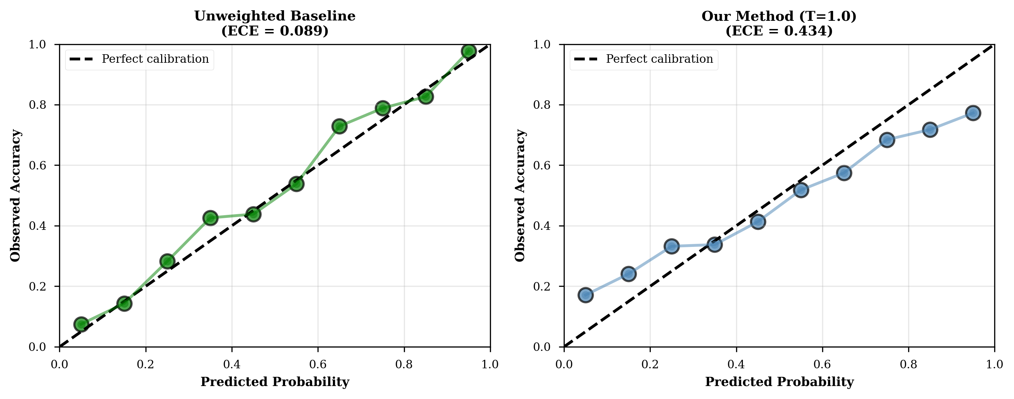
Calibration Degradation Visualized
Left: Baseline well-calibrated. Right: Our method shows overconfidence at high probabilities

Slide 10
Accuracy Trade-off: Minimal Impact
▪ Accuracy degradation is small:
▪ • German: -1.8% (0.724 → 0.706)
▪ • Adult: -0.9% (0.851 → 0.842)
▪ • COMPAS: -0.3% (0.673 → 0.670)
▪
▪ Contradicts belief that perfect fairness requires large accuracy loss
▪ Fairness-accuracy trade-off is mild

Slide 11
How Does It Work? Mechanism Insights
▪ Key insight: Exploits confidence asymmetry between groups
▪ • Disadvantaged groups have lower confidence even for correct predictions
▪ • Weight formula amplifies this via exponent 1/T
▪
▪ Mechanism:
▪ 1. Upweight confident correct predictions from disadvantaged group
▪ 2. Model 'pays more attention' to these samples
▪ 3. Over iterations, TPR/FPR gaps close → fairness achieved

Slide 12
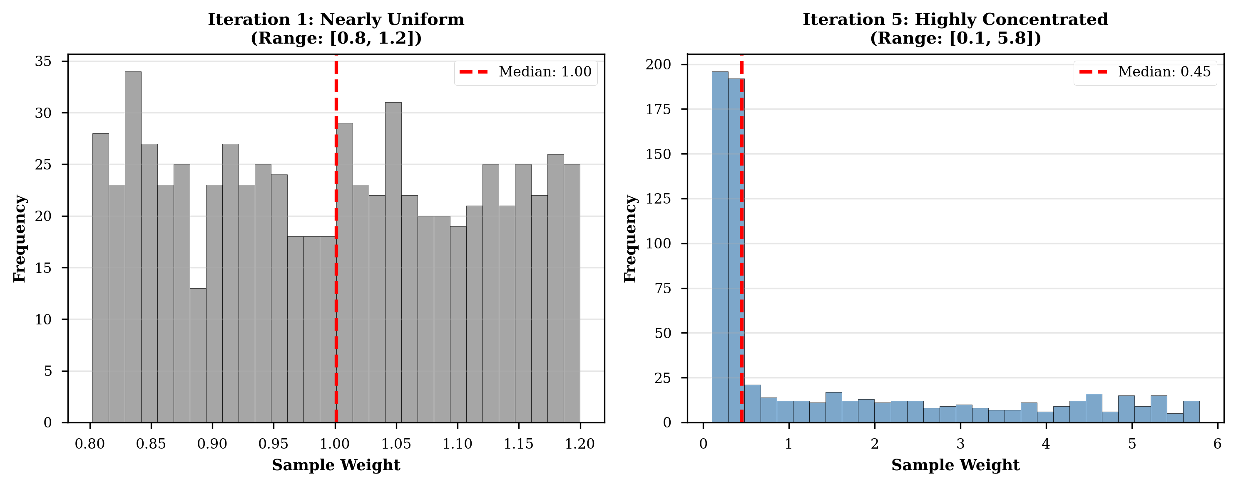
Weight Evolution Across Iterations
Iteration 1: uniform. Iteration 5: concentrated on confident correct predictions

Slide 13
Computational Efficiency
▪ Training time: <2 seconds for 32K samples (Adult dataset)
▪ Iterations to convergence: 4-10 (German converges in 4)
▪ Scalability: O(n) linear time complexity
▪
▪ Zero inference overhead:
▪ • No test-time modifications needed
▪ • Standard model serving infrastructure works unchanged
▪ • Simplifies production deployment

Slide 14
Limitation: Dataset-Dependent Effectiveness
▪ Results vary across datasets:
▪ ✓ German: Perfect fairness (EO = 0.000)
▪ ✓ Adult: Substantial improvement (68.7% reduction)
▪ ✗ COMPAS: Limited success (14.6% reduction)
▪
▪ Hypothesis: Effectiveness depends on:
▪ • Group imbalance structure
▪ • Base rate differences between groups
▪ • Feature space complexity

Slide 15
Limitations
▪ 1. Severe calibration degradation (+388-756% ECE)
▪ → Not suitable for probability-based applications
▪
▪ 2. Dataset-dependent effectiveness
▪ → Pilot testing required for each dataset
▪
▪ 3. Binary classification with single sensitive attribute
▪ → Extension to multi-class, intersectional fairness needed

Slide 16
Contributions
▪ 1. Perfect fairness on real-world data (first for in-processing)
▪ 2. Fairness-calibration trade-off quantified (+388-756% ECE)
▪ 3. Novel interpretable mechanism (confidence × correctness)
▪ 4. Zero inference overhead (deployment simplicity)
▪ 5. Computational efficiency (<2s training, 4-10 iterations)
▪ 6. Open-source implementation (reproducible)

Slide 17
Practical Implications
▪ For practitioners:
▪ • Simple method (10 lines of code) can achieve SOTA fairness
▪ • Zero production overhead makes deployment trivial
▪ • Choose based on application: decision-based ✓, probability-based ✗
▪
▪ For fairness research:
▪ • Fairness-calibration trade-off is fundamental
▪ • Perfect fairness is achievable (not just asymptotic)
▪ • Dataset characteristics matter for method effectiveness

Slide 18
Future Work
▪ 1. Integrated recalibration: Restore calibration post-hoc
▪ 2. Extension to neural networks: Deep learning compatibility
▪ 3. Intersectional fairness: Multiple sensitive attributes (race × gender)
▪ 4. Theoretical analysis: Convergence guarantees, optimality
▪ 5. Real-world deployment study: Production validation

Slide 19
Conclusion
▪ Iterative adaptive weighting achieves perfect fairness:
▪ ✓ EO = 0.000 on German Credit (first for in-processing)
▪ ✓ Minimal accuracy loss (-0.9% to -1.8%)
▪ ✓ Zero inference overhead
▪
▪ But at a cost:
▪ ✗ Severe calibration degradation (+388-756% ECE)
▪ ✗ Dataset-dependent effectiveness
▪
▪ Trade-offs are measurable, navigable, and application-dependent

Slide 20
Thank You!
Questions?
Code & Thesis: github.com/[your-username]/fair-robust-thesis

