Slide 1


Node.js Basics
Summarized by S. Saeed Hosseini

Slide 2
What is Node.js
Open source, cross platform runtime environment for developing server-side application
Built on the Google Chrome V8 JavaScript engine
Event-driven, non-blocking I/O model
Simple answer: “JavaScript on the Server”

Slide 3
What is npm
Node Package Manager is the world's largest Software Registry
The registry contains over 800,000 code packages
Open-source developers use npm to share software
npm is installed with node.js and free to use
All npm packages are defined in files called package.json
npm can manage and install dependencies

Slide 4
Simple Web Server
We’ll try to learn by doing
Our first project will be to create a simple static Web Server
We want to serve files with html, css, javascript, jpg and png extension
We want to generate proper response to every request
All requests need to be logged with details
We don’t want to use any framework/middleware

Slide 5
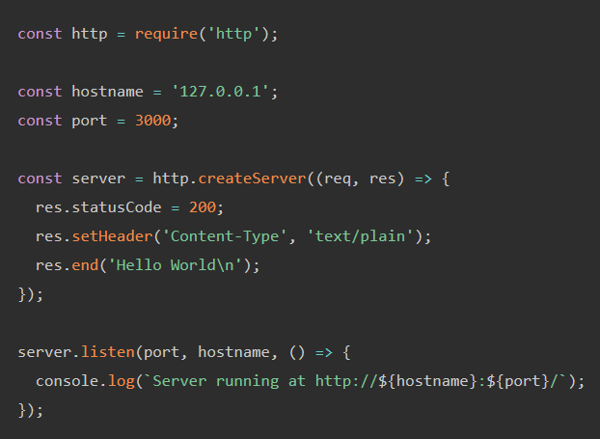
Simple Web Server
Make sure to have node.js & npm installed
Check out the about page on the node.js website
Let’s build the web server up on that!

Slide 6
Simple Web Server
First, create a HTTP server using the http module on port 80
Then, we need to parse the request URL using the parse method of url module
In order to check if the file exists, we need to create a string with the complete address of the file requested.
Use the cwd method of the process module to get the address of current dir
Use the join method of the path module to create the complete address of the file (Why not just concatenate?)

Slide 7
Simple Web Server
Now we need to check if the file really exists on the server
To do that, we’ll use the lstatSync method of the fs module
It will either give you an status of the address you called upon (is it a file, directory, …) or throw an exception indicating that the file does not exist
So we’ll need a try/catch block to generate a 404 Not Found response on the occasion of the second case
Call setHeader and end methods of the res object to create proper response

Slide 8
Simple Web Server
Now if we haven’t responded yet, it means that the address actually exists
Here there are 3 possible scenarios in which we’d like to generate a response:
1. Request for a file
2. Request for a directory
3. Neither of the above cases

Slide 9
Simple Web Server
In the occasion of the first case, we’ll need to stream the file
Since we need to tell what kind of file we’ll be streaming in the HTTP request (via a Content-type header), we need to extract the file extension and interpret that to the appropriate header value (a mimeType key value pair could help)
If the extension is not supported, we’ll generate a 415 Content Not Supported response
Else we’ll create a read stream using the createReadStream method of the fs module and pipe it through the response

Slide 10
Simple Web Server
In the event of a request on a directory, we’ll need to redirect it to the index.html file of that directory; This is what common Web Servers do
We’ll send a 301 Moved Permanently with a Location header key set to /index.html
This would result in a second request for the index.html file of the directory

Slide 11
Simple Web Server
For the occurrence of the neither of the previous scenario, we’ll send a 500 Internal Server Error because we cannot process the request!

Slide 12
Simple Web Server
For logging, use the log method of the console module which is included by default
In order to specify the exact occurrence time of the request, we can create a Date object and use toISOString method to get a proper format

Slide 13


Learn Node.js by building 12 projects
By Brad Traversy
Simple Web Server project explained and summarized by
SayidHosseini
SayidHosseini

