Slide 1
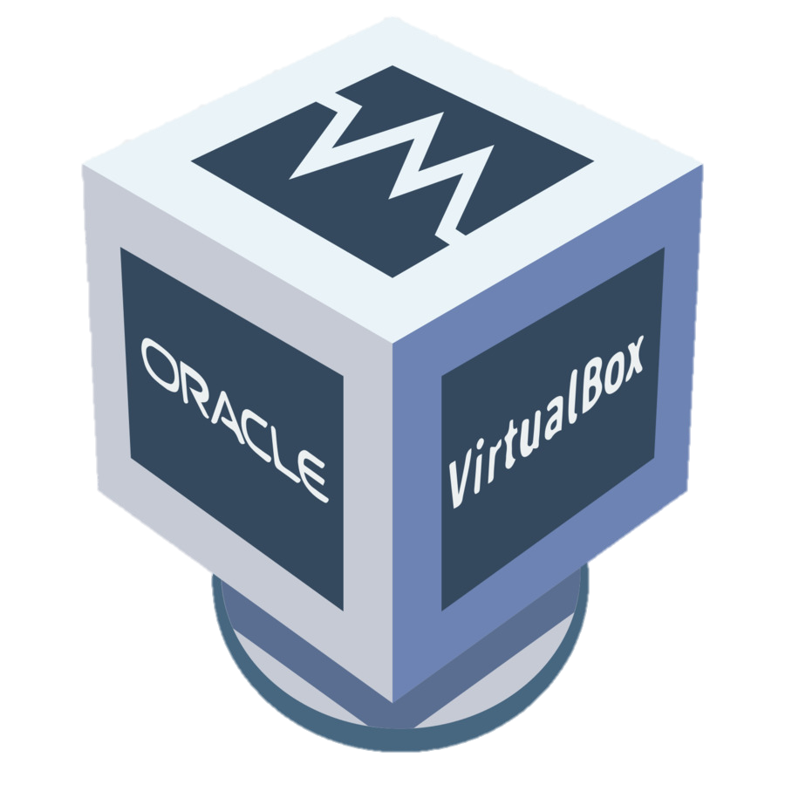
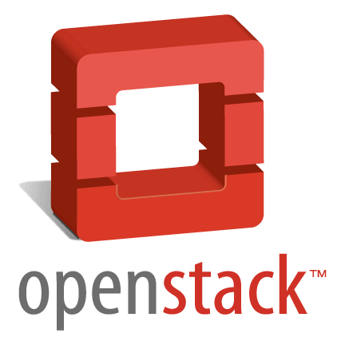


Introduction to Virtualization & OpenStack
Provided By: S. Saeed Hosseini
SayidHosseini
SayidHosseini

Slide 2
Index
Virtualization
Types of Virtualization
Operating System-level Virtualization
Operating System-level Virtualization softwares
VirtualBox and Ubuntu
Introduction to OpenStack
OpenStack Architecture
OpenStack Keystone
OpenStack Glance
OpenStack Neutron
OpenStack Nova
OpenStack Cinder
OpenStack Horizon

Slide 3
Index
Introduction to DevStack
DevStack Installation
Installation and Debugging Notes

Slide 4
Virtualization
In computing, virtualization refers to the act of creating a virtual (rather than actual) version of something, including virtual computer hardware platforms, storage devices, and computer network resources.
Virtualization began in the 1960s, as a method of logically dividing the system resources provided by mainframe computers between different applications. Since then, the meaning of the term has broadened.

Slide 5
Types of Virtualization
Execution Virtualization
Hardware Level
Operating System Level
Programming Language Level
Network Virtualization
Storage Virtualization
Desktop Virtualization
…

Slide 6
Hardware-assisted Virtualization
This term refers to a scenario in which the hardware provides architectural support for building a virtual machine manager able to run a guest operating system in complete isolation
This technique was originally introduced in the IBM System/370
At present, examples of hardware-assisted virtualization are the extensions to the x86-64 bit architecture introduced with Intel-VT and AMD-V

Slide 7
Operating System-level Virtualization
It offers the opportunity to create different and separated execution environments for applications that are managed concurrently
Differently from hardware virtualization, there is no virtual machine manager or hypervisor, and the virtualization is done within a single operating system, where the OS kernel allows for multiple isolated user space instances

Slide 8
Operating System-level Virtualization
The kernel is also responsible for sharing the system resources among instances and for limiting the impact of instances on each other
A user space instance in general contains a proper view of the file system, which is completely isolated, and separate IP addresses, software configurations, and access to devices

Slide 9
OS-level Virtualization Softwares
VMWare Workstation Pro/Player
Microsoft Hyper-V
Parallels Desktop
VirtualBox
KVM
QEMU
Xen
…

Slide 10
VirtualBox
VirtualBox is a powerful x86 and AMD64/Intel64 virtualization product for enterprise as well as home use. Not only is VirtualBox an extremely feature rich, high performance product for enterprise customers, it is also the only professional solution that is freely available as Open Source Software under the terms of the GNU General Public License (GPL) version 2. See "About VirtualBox" for an introduction.
Presently, VirtualBox runs on Windows, Linux, Macintosh

Slide 11
Ubuntu on VirtualBox
It’s the time to create a virtual machine on your OS
We are going to install Ubuntu 18.04.3 LTS on VirtualBox with the following minimum requirements:
4 Virtual CPU Cores
6 GB of RAM
50 GB of Storage
2 Networks (NAT + Host-Only)
Make sure to take a snapshot after a clean install.
Enable SSH for easier communication with your VM!

Slide 12
Introduction to OpenStack
OpenStack is a cloud operating system that controls large pools of compute, storage, and networking resources throughout a datacenter, all managed and provisioned through APIs with common authentication mechanisms.
A dashboard is also available, giving administrators control while empowering their users to provision resources through a web interface.

Slide 13
Introduction to OpenStack
Beyond standard infrastructure-as-a-service functionality, additional components provide orchestration, fault management and service management amongst other services to ensure high availability of user applications.

Slide 14
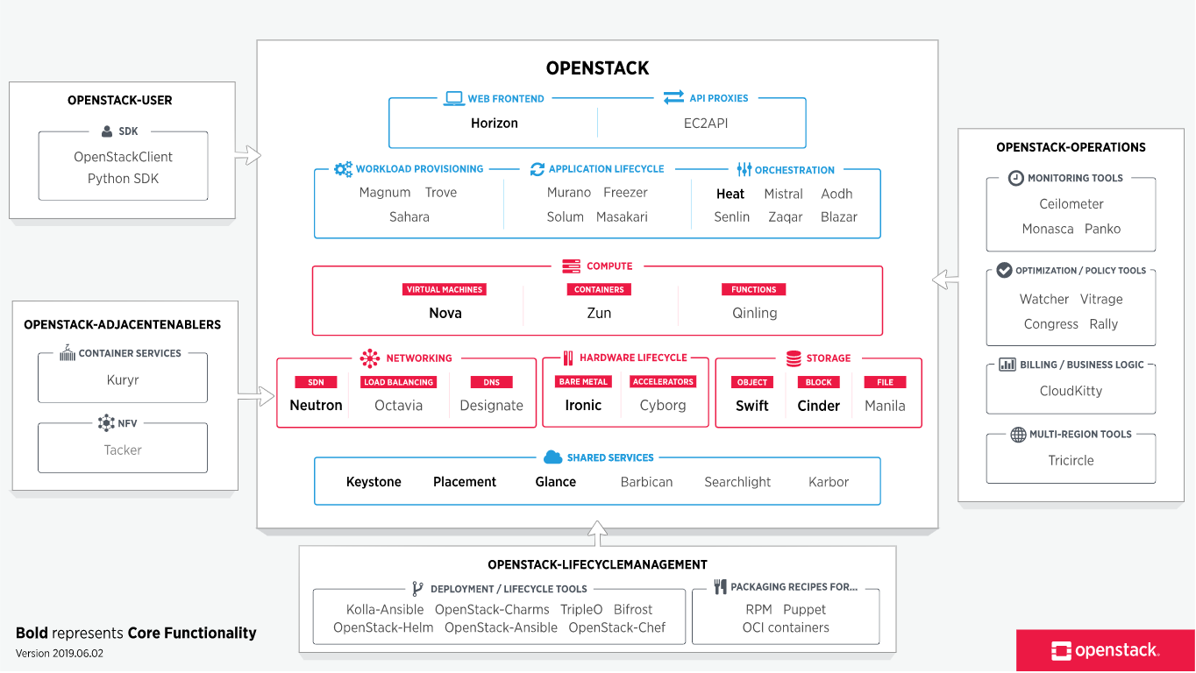

Slide 15
OpenStack Keystone
Keystone is an OpenStack service that provides API client authentication, service discovery, and distributed multi-tenant authorization by implementing OpenStack’s Identity API
Keystone is organized as a group of internal services exposed on one or many endpoints. Many of these services are used in a combined fashion by the frontend. For example, an authenticate call will validate user/project credentials with the Identity service and, upon success, create and return a token with the Token service

Slide 16
OpenStack Glance
The Image service (glance) project provides a service where users can upload and discover data assets that are meant to be used with other services. This currently includes images and metadata definitions
Glance image services include discovering, registering, and retrieving virtual machine (VM) images. Glance has a RESTful API that allows querying of VM image metadata as well as retrieval of the actual image

Slide 17
OpenStack Neutron
Neutron is an OpenStack project to provide “network connectivity as a service” between interface devices (e.g., vNICs) managed by other OpenStack services (e.g., nova). It implements the OpenStack Networking API.

Slide 18
OpenStack Nova
Nova is the OpenStack project that provides a way to provision compute instances (aka virtual servers). Nova supports creating virtual machines, baremetal servers (through the use of ironic), and has limited support for system containers. Nova runs as a set of daemons on top of existing Linux servers to provide that service.

Slide 19
OpenStack Cinder
Cinder is a Block Storage service for OpenStack. It's designed to present storage resources to end users that can be consumed by the OpenStack Compute Project (Nova). This is done through the use of either a reference implementation (LVM) or plugin drivers for other storage.
The short description of Cinder is that it virtualizes the management of block storage devices and provides end users with a self service API to request and consume those resources without requiring any knowledge of where their storage is actually deployed or on what type of device.

Slide 20
OpenStack Horizon
Horizon is the canonical implementation of OpenStack’s Dashboard, which provides a web based user interface to OpenStack services including Nova, Swift, Keystone, etc
Horizon ships with three central dashboards, a “User Dashboard”, a “System Dashboard”, and a “Settings” dashboard. Between these three they cover the core OpenStack applications and deliver on Core Support

Slide 21
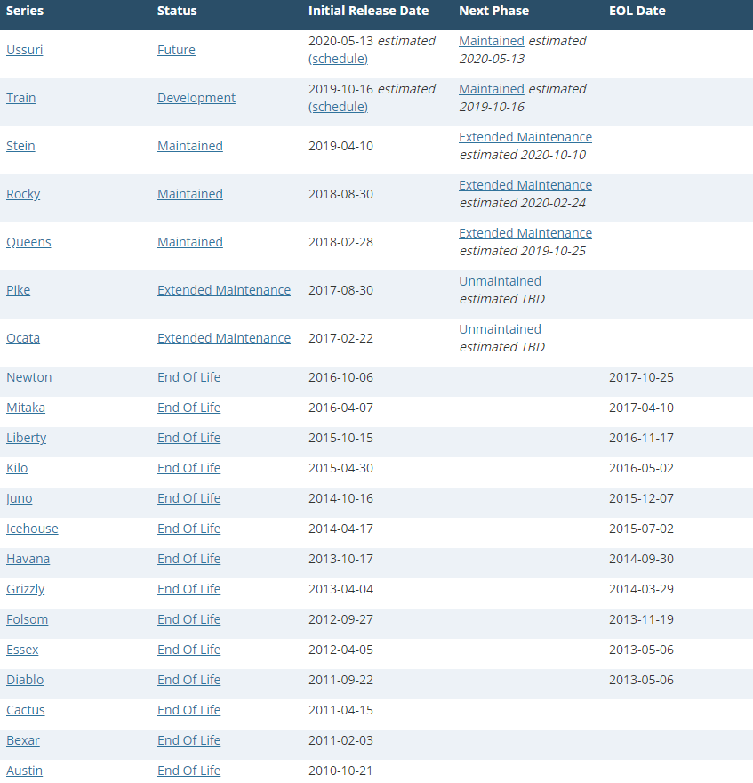
OpenStack Releases

Slide 22
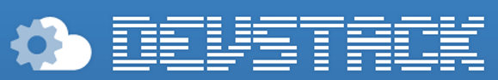
DevStack
DevStack is a series of extensible scripts used to quickly bring up a complete OpenStack environment based on the latest versions of everything from git master. It is used interactively as a development environment and as the basis for much of the OpenStack project’s functional testing
Check out the “stein” documentation from here:
https://docs.openstack.org/devstack/stein/

Slide 23
DevStack
Following the instruction from the DevStack documentation, first you’ll need to create a non-root user with sudo privileges and change to that user:
Now, since opendev.org sanctioned Iran, you may use the GitHub repository instead:
$ sudo useradd -s /bin/bash -d /opt/stack -m stack
$ echo "stack ALL=(ALL) NOPASSWD: ALL" | sudo tee /etc/sudoers.d/stack
$ sudo su - stack
$ git clone https://github.com/openstack/devstack.git -b stable/stein
$ cd devstack

Slide 24
DevStack
Create a local.conf file with the following contents:
[[local|localrc]]
HOST_IP=w.x.y.z
ADMIN_PASSWORD=secret1
DATABASE_PASSWORD=secret2
RABBIT_PASSWORD=secret3
SERVICE_PASSWORD=secret4
LOGFILE=./stack.sh.log
VERBOSE=True
ENABLE_DEBUG_LOG_LEVEL=True
ENABLE_VERBOSE_LOG_LEVEL=True
GIT_BASE=${GIT_BASE:-https://github.com}

Slide 25
DevStack
Check the configuration file documentation from here.
The “HOST_IP” parameter defines the IP that horizon will be available on. Assign the IP from the Host-Only network card.
The passwords can be the same or different.
The logs of the installation will be available in “stack.sh.log” file in the devstack installation directory. Check that out if something goes wrong!

Slide 26
DevStack
As stated before opendev.org sanctioned Iran, so the last line states that every repository should be downloaded from GitHub. However, some repository may want to download from opendev.org. So to get around that you may use openconnect on you ubuntu; or an alternative that you are familiar with.
After preparing the file, enter “./stack.sh” to start the process. Make sure you are connected to the internet.
If installation finished successfully, make sure to take a snapshot.

Slide 27
DevStack
If something went wrong, you always have the option to revert to your clean install snapshot.
If you want to stop all of the devstack services, enter “./unstack.sh”.
If you want to stop and uninstall devstack and all of its dependencies, enter “./clean.sh”.
Good Luck with the installation!

Slide 28
Resources
Cloud-Computing course slides of Ferdowsi University of Mashhad
https://www.virtualbox.org/
https://www.openstack.org/software/
https://docs.openstack.org/keystone/latest/
https://docs.openstack.org/keystone/stein/getting-started/architecture.html
https://docs.openstack.org/glance/stein/
https://docs.openstack.org/neutron/stein/
https://docs.openstack.org/nova/stein/
https://wiki.openstack.org/wiki/Cinder
https://wiki.openstack.org/wiki/Horizon
https://releases.openstack.org/
https://docs.openstack.org/devstack/stein/
https://docs.openstack.org/devstack/stein/configuration.html
https://stackoverflow.com/questions/20390267/installing-openstack-errors
https://ask.openstack.org/en/question/58887/how-to-complete-uninstall-devstack/

