Slide 1
TASK 5 : DATA STORY TELLING
Presented By : Sayini Sreenidhi
Tools Used : Python, Pandas, Matplotlib, Seaborn, Jupyter
Notebook

Slide 2
PROJECT OVERVIEW
This project focuses on analyzing the Sample Superstore dataset using Python. The objective is to understand sales performance, profit trends, and customer purchasing patterns through data visualization.
Objectives
Analyze sales and profit.
Identify top-performing categories.
Visualize business data.
Generate meaningful insights for decision-making.

Slide 3
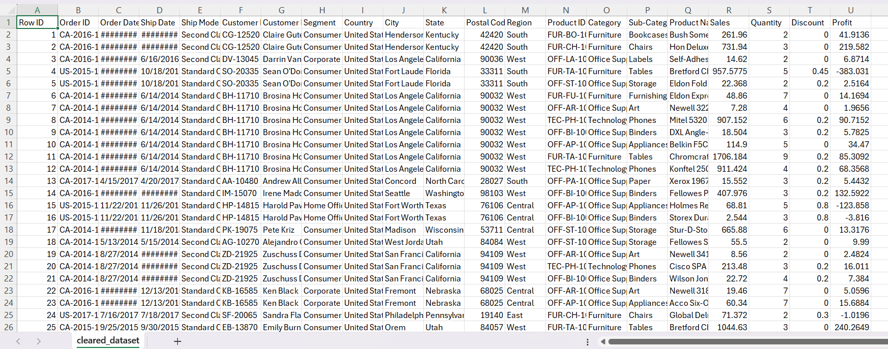
DATA DESCRIPTION
Dataset Information
Dataset Name: Sample Superstore
File Format: CSV
Total Records: Around 9,994
Features include:
Order ID
Category
Sub-Category
Sales
Profit
Quantity
Region
Customer Segment

Slide 4
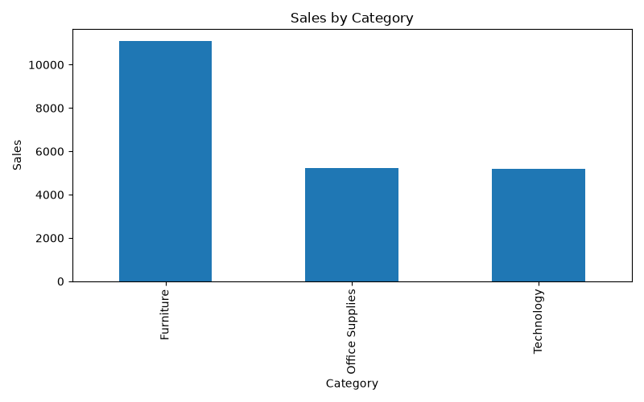
Data Preprocessing
Steps Performed
Imported required libraries.
Loaded the dataset using Pandas.
Checked for missing values.
Removed duplicate records.
Verified data types.
Prepared data for visualization.

Slide 5
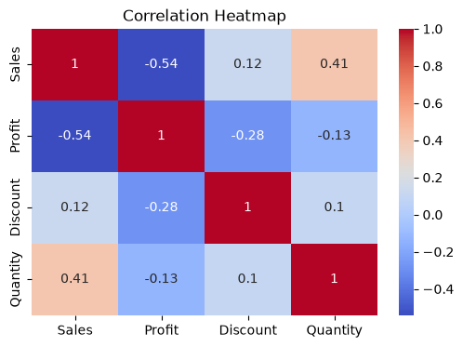
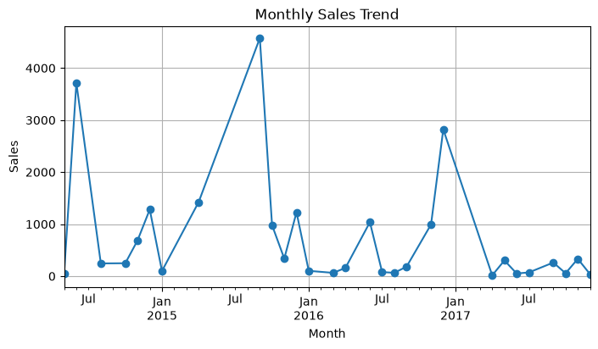
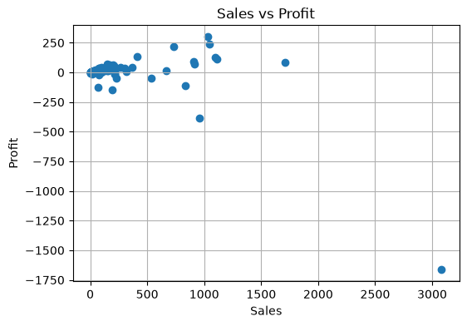
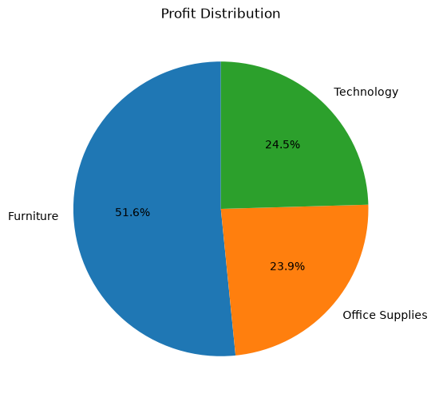
Data Visualization
Visualizations Created
Sales by Category (Bar Chart)
Category Distribution (Pie Chart)
Correlation Heatmap
Profit Analysis
Tools Used
Matplotlib
Seaborn

Slide 6
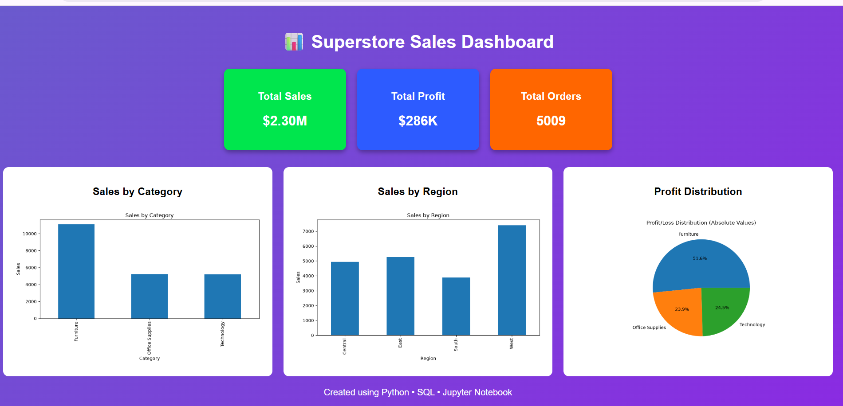
Analysis & Insights
Key Findings
Technology category generated the highest sales.
Office Supplies had the highest number of orders.
Some categories showed high sales but lower profits.
Strong relationships were observed between sales and profit.

Slide 7
Conclusion
The project demonstrates how data visualization helps convert raw data into useful business insights. It supports better understanding of sales performance and enables informed business decisions.

Slide 8
Future Enhancements
Future Scope
Build interactive dashboards using Power BI or Tableau.
Predict future sales using Machine Learning.
Perform real-time data analysis.
Analyze customer behavior for better marketing strategies.

Slide 9
THANK YOU

