Slide 1
FoodStore
Выполнил:
IT2CCO2112
Шигабутдинов Руслан

Slide 2

About project
Purpose of project foodstore is aggregator of prices different menus each companies added to site

Slide 3
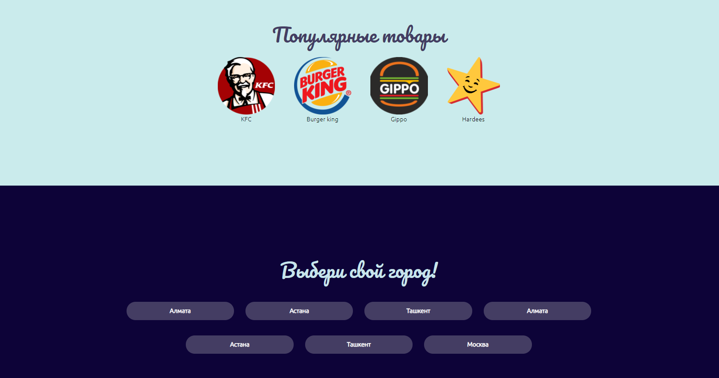
My site is made for online delivery food from restaurants to basic humans, who has internet and cash.
My project has 3 html pages: index, login and product, and have one css file for each page.
In index page I have favorite fast-food companies, and option to choose your city to deliver.

Slide 4
On all pages we have navbar, which have search bar, all companies and all categories of food pages.

Slide 5
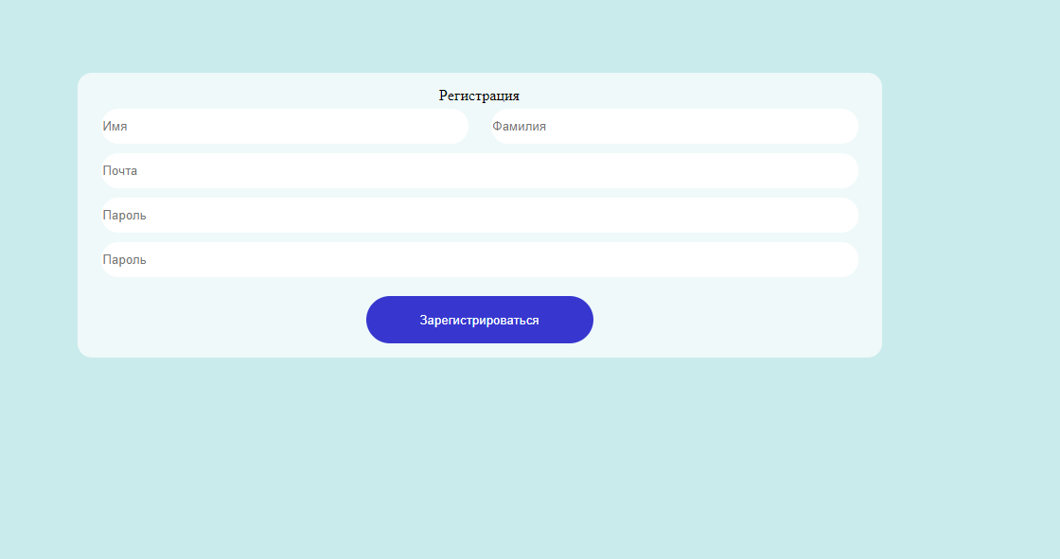
You also can register to site.

Slide 6
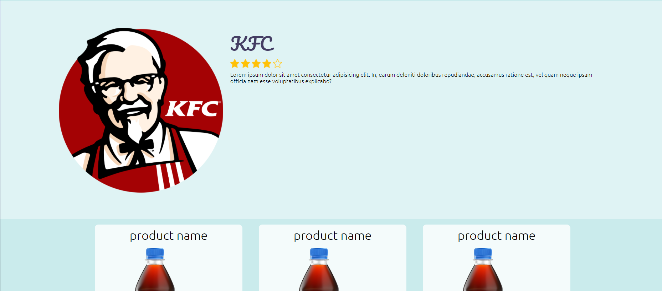
If you choose one of the popular company, you can see name. image, description and rating of the shop.

Slide 7
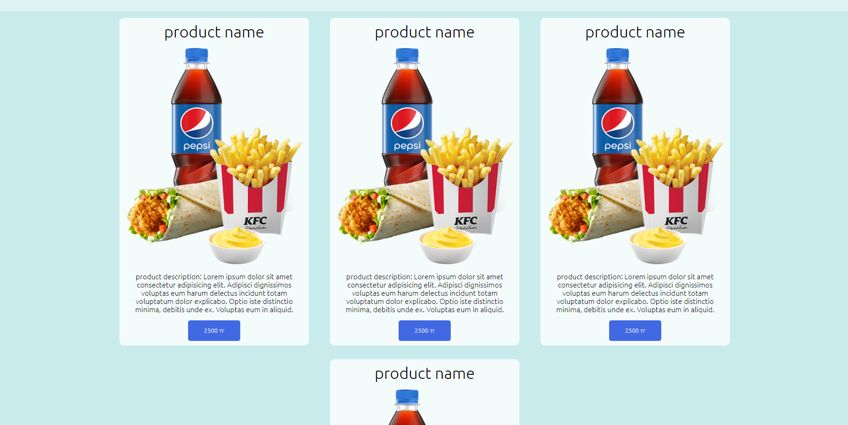
After common company information you can see products, that he sells.
I done my site in light blue colors, because I think it`s not so boring as white, and I try to save color pallet not so splashy.

Slide 8
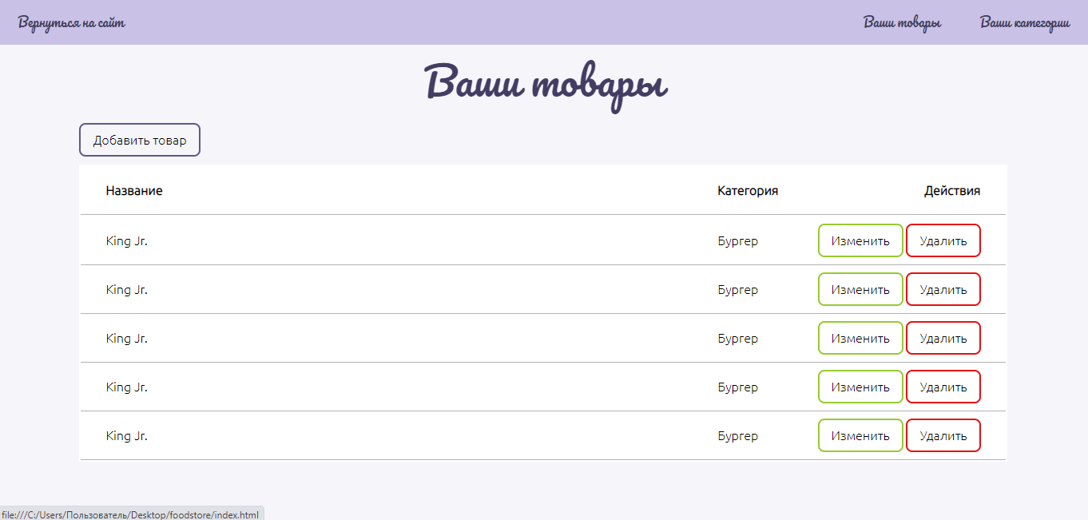
In admin panel I have table with all products

Slide 9
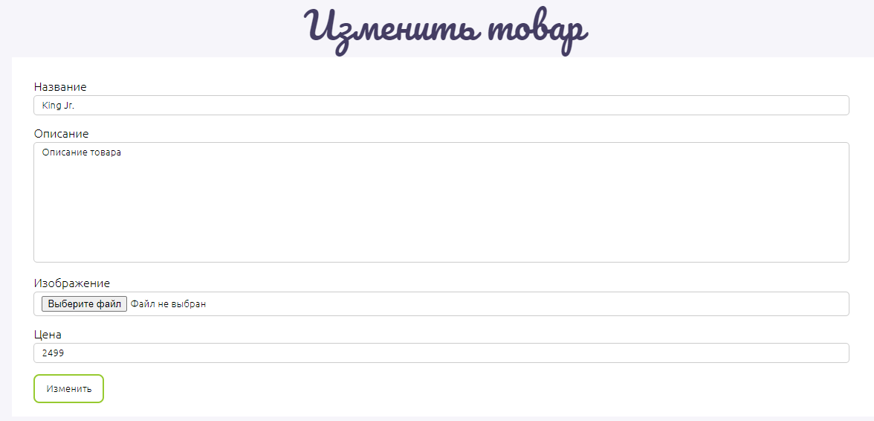
Product edit

Slide 10
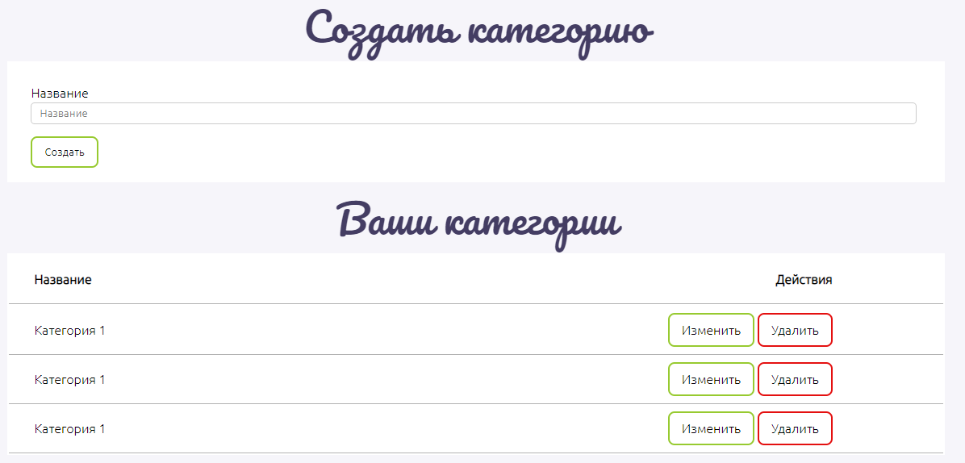
Create and edit all categories

