Slide 1
Big Data Architecture and Governance Individual Project – Walmart
Sayli Umesh Bhutkar
NUID 001427569

Slide 2
Company Name: Walmart
Industry: Multinational retail corporation
History/Background: Walmart Inc. is an American multinational retail corporation that operates a chain of hypermarkets, discount department stores, and grocery stores.
Headquarters are located in Bentonville, Arkansas. The company was founded by Sam Walton in 1962 and incorporated on October 31, 1969. As of October 31, 2018, Walmart has 11,277 stores and clubs in 27 countries, operating under 55 different names.
The company operates under the name Walmart in the United States and Canada, as Walmart de Mexico y Centro América in Mexico and Central America, as Asda in the United Kingdom, as the Seiyu Group in Japan, and as Best Price in India.
It has wholly owned operations in Argentina, Chile, Canada, and South Africa. Since August 2018, Walmart only holds a minority stake in Walmart Brazil, with 20% of the company's shares, and private equity firm Advent International holding 80% ownership of the company.
The company was listed on the New York Stock Exchange in 1972. By 1988, Walmart was the most profitable retailer in the U.S., and by October 1989, it had become the largest in terms of revenue.
Walmart's investments outside North America have seen mixed results. Its operations and subsidiaries in the United Kingdom, South America, and China are highly successful, whereas its ventures in Germany and South Korea failed

Slide 3
Organization Issues
Project Name: Supply chain management
Project Name: Efficient pharmacy management
Walmart is facing issue to make 100% of its product delivered on time.
Walmart is now concentrating on developing a more highly structured and advanced supply chain management strategy to exploit and enhance this competitive advantage and assume market leadership position.
This includes to manage the routes to shipping dock and track the number of times the product gets touched along the way to the customer with the help of Big Data.
They also need to analyze the transportation lanes and routes for the group of company’s trucks.
By using Big Data Walmart can analyze the number of steps from dock to the store.
This can reduce the transportation cost and also schedule driver times.
Walmart is looking to segment for growth, while Target sold its pharmacy business to CVS last year.
They are facing difficulties in managing the prescriptions as the number of users are increasing overtime.
By using simulation analysis which is a part of Big Data, Walmart can handle how many prescriptions are filled in a day and this can also help to analyze the busiest times during a day or a month.
Big Data will also help the pharmacy with staff scheduling and also will reduce the amount of time required to fill a prescription.
They also want to control the long queues of the customer waiting to get the medicines according to the prescriptions.
With the help big data, customers can using mobile application to order the medicines. This will save their time as they will get notified once the order is ready.

Slide 4
Why I chose Supply Chain Management over Efficient pharmacy Management
It has a larger scope than the other.
Improvement in the supply chain will automatically flourish their pharmacy business.
This project will help Walmart to gain a good strength among its competitors.
Will provide better customer satisfaction.
Significant revenue growth.
Improving the supply chain management will help Walmart to overcome its threats and weaknesses.
Proper management will help Walmart reduce its transportation cost which will increase the overall company profit.
Improve the company’s business

Slide 5
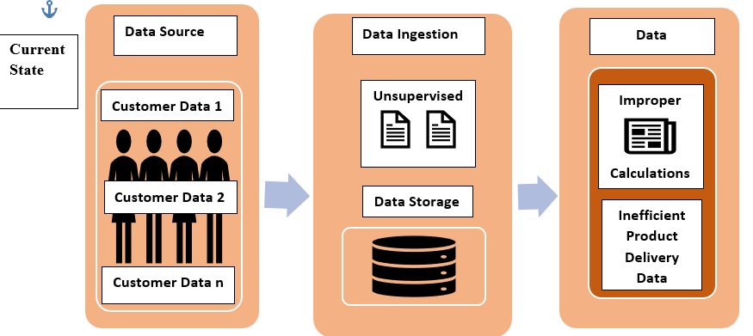
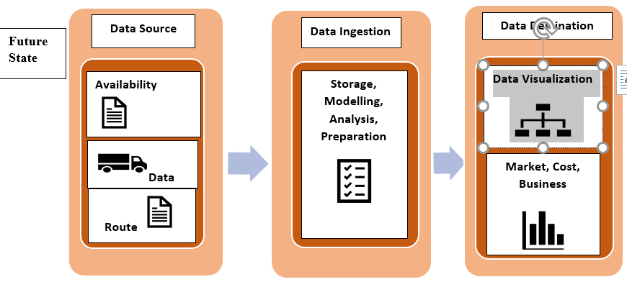
VISION DIAGRAM: SUPPLY CHAIN MANAGEMENT

Slide 6
Functional Requirements
Customer Relationship Management- All the customer data must be stored properly to manage the customer orders. This will lead to proper customer management. It should use data analysis for customers history with a company to improve business relationships with customers, specifically focus on customer retention and ultimately driving sales growth.
Customer Service Management- Customer service is the provision of service to customers before, during and after a purchase. For good customer service management all the previous and current customer data should be properly maintained. This includes the purchase order history, customer reviews and many other factors.
Demand Management- The product availability should be managed according to the demand by the customers. The stock should be tracked accordingly this will lead in successful demand management.
Order Fulfillment- The orders of the customers should be monitored on a continuous basis. The products which are ordered more frequently must be available on a short notice and should always be in stock which would lead to on time product delivery.
Manufacturing Flow Management- It is the supply chain management process that includes all activities necessary to move products through the plants and to obtain, implement, and manage manufacturing flexibility in the supply chain. This can be achieved by maintaining the product manufacturing data which will help in managing the flow of the product efficiently.
Supplier Relationship Management- It is the discipline of strategically planning for, and managing, all interactions with third party organizations that supply goods and/or services to an organization in order to maximize the value of those interactions. This can be achieved by managing the supplier data for each product and updating it according to the product demand

Slide 7
Non Functional Requirements
Security and Privacy- It refers to the efforts required to protect the privacy and security of the customers. Customer and product data should be protected from threats such as piracy, theft and violation.
Performance- The company performance depends on how satisfied its customers are. This can be maintained by proper customer data governance and on time product delivery.
System- The entire system is responsible for efficient supply chain management. This includes organizations, people, activities, information, and resources involved in moving a product or service from supplier to customer.
Operational Environment- The environment includes logistics, data governance, procurement, information technology and data analysis. All these should be managed efficient for a good operational environment.
Process- The supply chain management process includes design, planning, execution, control, and monitoring of supply chain activities.
System Performance Constraints- This includes monitoring the entire system for customer satisfaction. The product delivery, quality of product, product availability are some of the characteristics on which the systems performance is highly dependent.

Slide 8
Project Architecture
The project architecture is broken down into 4 major layers which are as follows:
Framework & Orchestration
Database
Languages & Tools
Visualization and Management Tools
The above architecture is used to achieve efficient Supply Chain Management at Walmart.

Slide 9
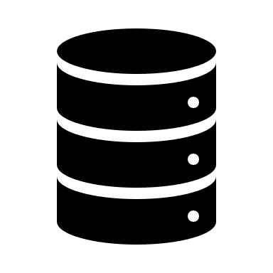
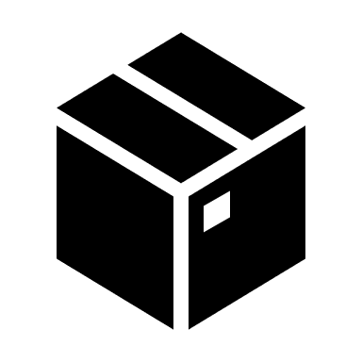


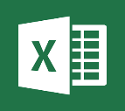




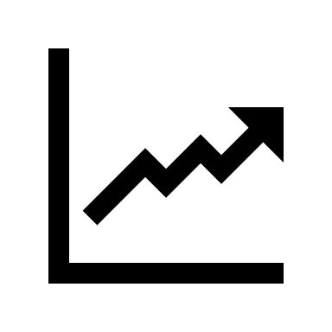
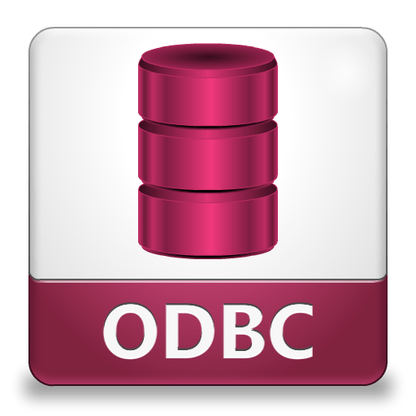

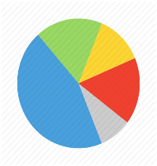

PROJECT ARCHITECTURE
Vision Diagram with Tools used in Each Layer
Data Source
Data Ingestion
Data Destination
Customer
Product
Truck
Route
Delivery
Manual Data Cleaning
Data Analysis
Program-based Data Cleaning
Hadoop Framework
Data Orchestration
Market Report Analysis and Visualization
Database

Slide 10
Architecture
The first layer is Data Source.
Hadoop framework is used in this layer as it that supports the processing and storage of extremely large data sets in a distributed computing environment.
Customer, Product, Delivery, Reviews, Truck, Supplier and Route data is collected and then processed using simple programming models with the help of Hadoop Framework.
It is preferred over other frameworks because of following reasons:
Linear and Horizontal scalability
Good Security
Better Manageability
Good Integration
Cost Effective
Resilient to Failures

Slide 11
Architecture
The second layer is Data Ingestion.
It includes Data Cleaning, Data Extraction, Data Normalization.
The data from various gathered to make a Massive Parallel Processing (MPP) environment by using Big Data technologies.
The new technology is more focused on the single purpose data delivery i.e. Data Lakes, rather than multipurpose tradition data delivery provided by relational database management systems (RDBMS).
We have used MongoDB as a No Relational Database to handle large amounts of data.
We chose MongoDB over other databases because it enabled us to build the application faster. As we had large volume of data with multiple read and writes which require high query capabilities for data extraction we decided to select MongoDB over other databases.
Development is simplified as MongoDB documents map naturally to modern, object-oriented programming languages. Using MongoDB removes the complex object-relational mapping (ORM) layer that translates objects in code to relational tables. MongoDB’s flexible data model also means that your database schema can evolve with business requirements.
MongoDB can also be scaled within and across multiple distributed data centers, providing new levels of availability and scalability previously unachievable with relational databases like MySQL. As your deployments grow in terms of data volume and throughput, MongoDB scales easily with no downtime, and without changing your application.

Slide 12
Architecture
The third layer is Data Destination which includes Data Visualization, Data Analysis and Market Reporting
Data from the database is visualized using Visualization and Business Intelligence Tool.
Changes are made according to the reports for the betterment of the organization and improved Supply Chain Management.
The BI tool used is Power BI
Following are reasons for using Power BI
Powerful dashboard visualizations that are top-notch and are being continuously updated which leads to Product and Customer Data manipulation.
In-memory analytics feature and columnar database supporting tabular data for effective Data Analysis.
The best of both worlds when it comes to simplicity and performance in a single BI tool because of which it can be used by low skilled employees.
Interactive geo-mapping powered by Bing Maps.
Data Analysis Expressions (DAX) scripting for creating measures and columns.

Slide 13
Project Planning Diagram
Define the project mandate
Identify the objective
Analyze the resources
Generate a schedule
Identify the sponsoring authorities
1. Conceptualize
2. Input Analysis
3. Model Planning
4. Implement
5. Testing and Review Analysis
Observe the outcomes using test cases
Ensure that the end product meets the desired outcome of the project
Document the result
Provide the feedback
Analyze the customer demand for delivery
Management of the routes to shipping dock
Analyzing the transportation lanes
Scheduling driver times
SUPPLY CHAIN MANAGEMENT
Build the project model using Big Data techniques
Implement the project
Record the perceptions
Generate a plan to process the objectives
Analyze the number of orders
Plan the working project model

Slide 14
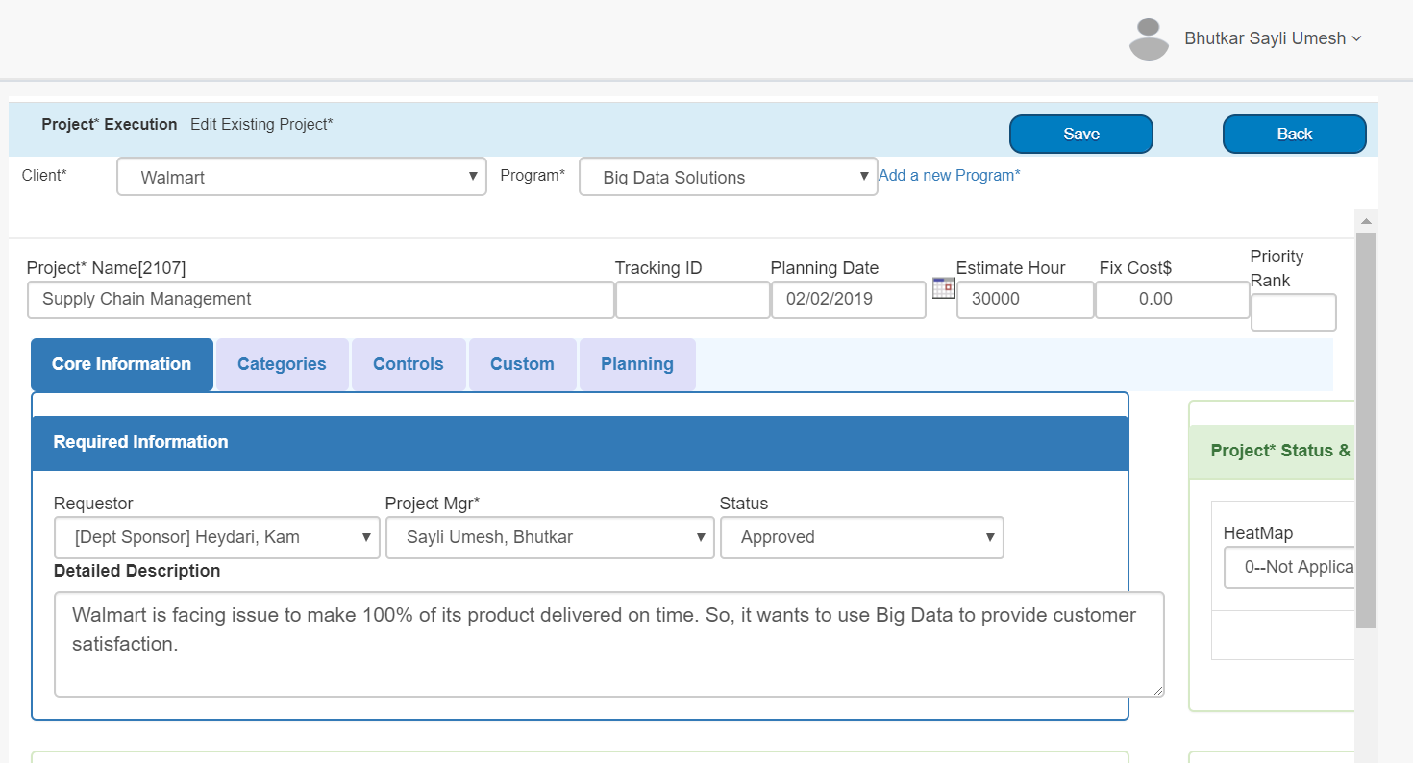
Project Plan: Step 1
Select of project on the basis of SWOT Analysis, Budget Allocation, Risk and Issues, Time Required for completion, Investment and few other factors.

Slide 15
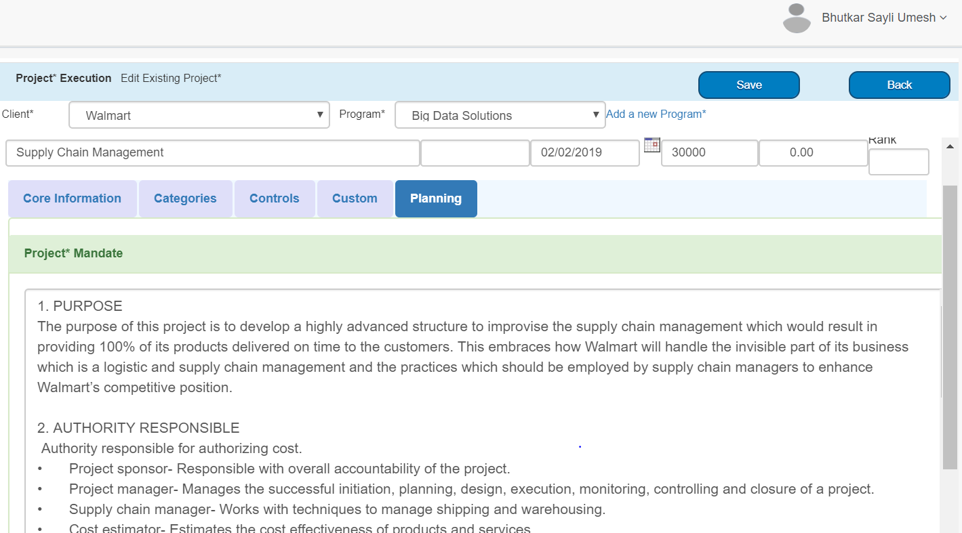
Project Plan: Step 2
Project Mandate creation which includes purpose, scope, background, requirement, interfaces and other project related functionalities.

Slide 16
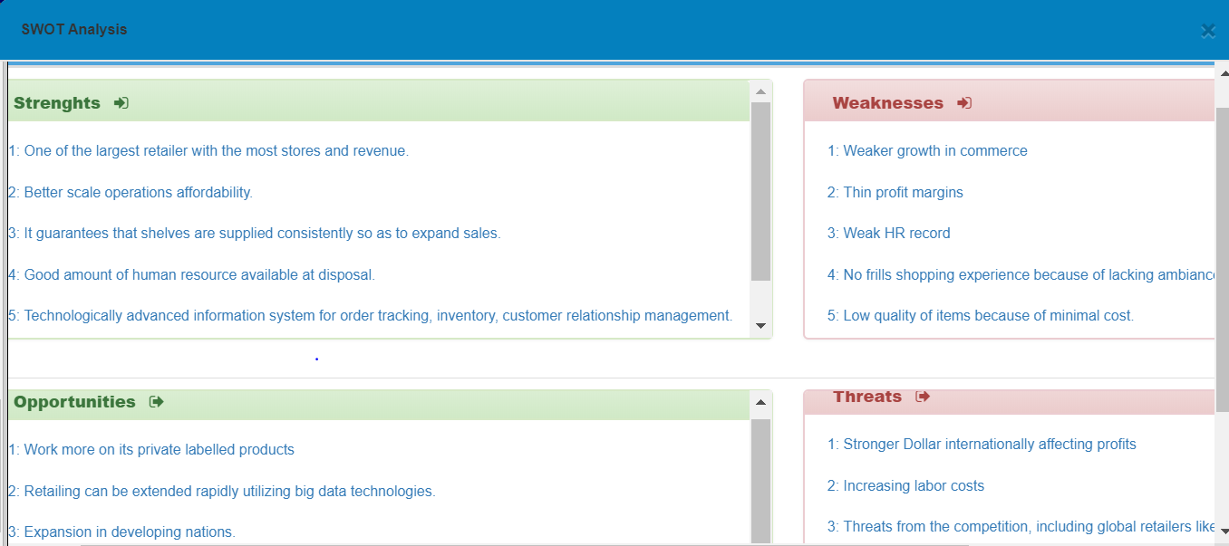
Project Plan: Step 3
SWOT Analysis which includes analyzing the strength, weakness, opportunities, threats of the project.

Slide 17
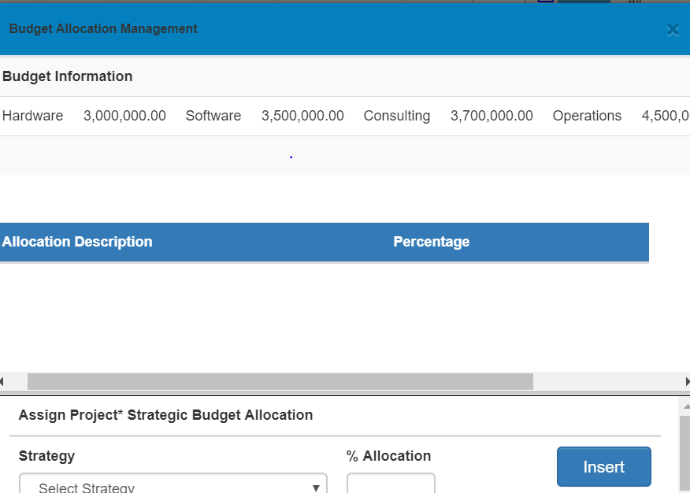
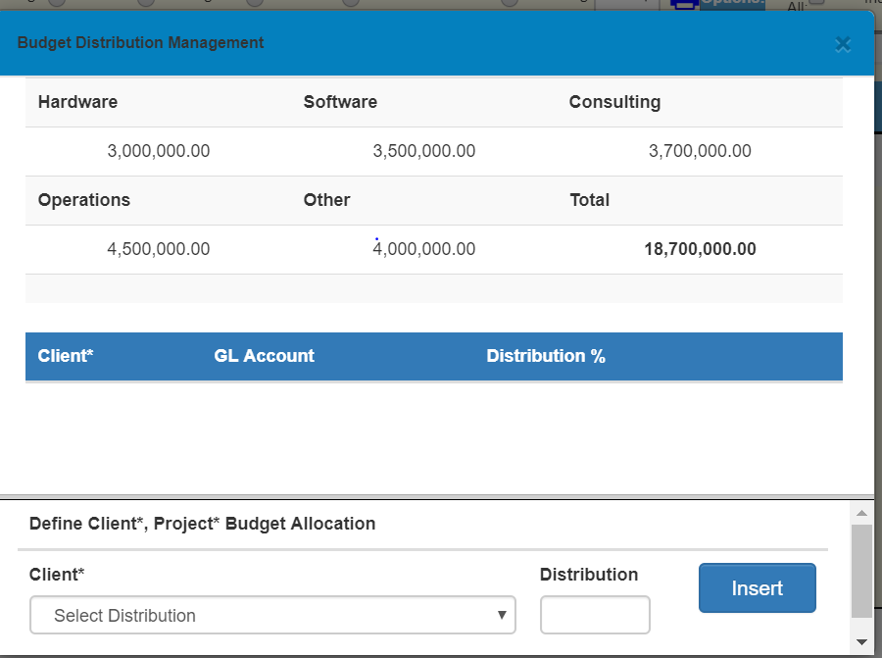
Project Plan: Step 4
Budget Allocation and Budget Distribution

Slide 18
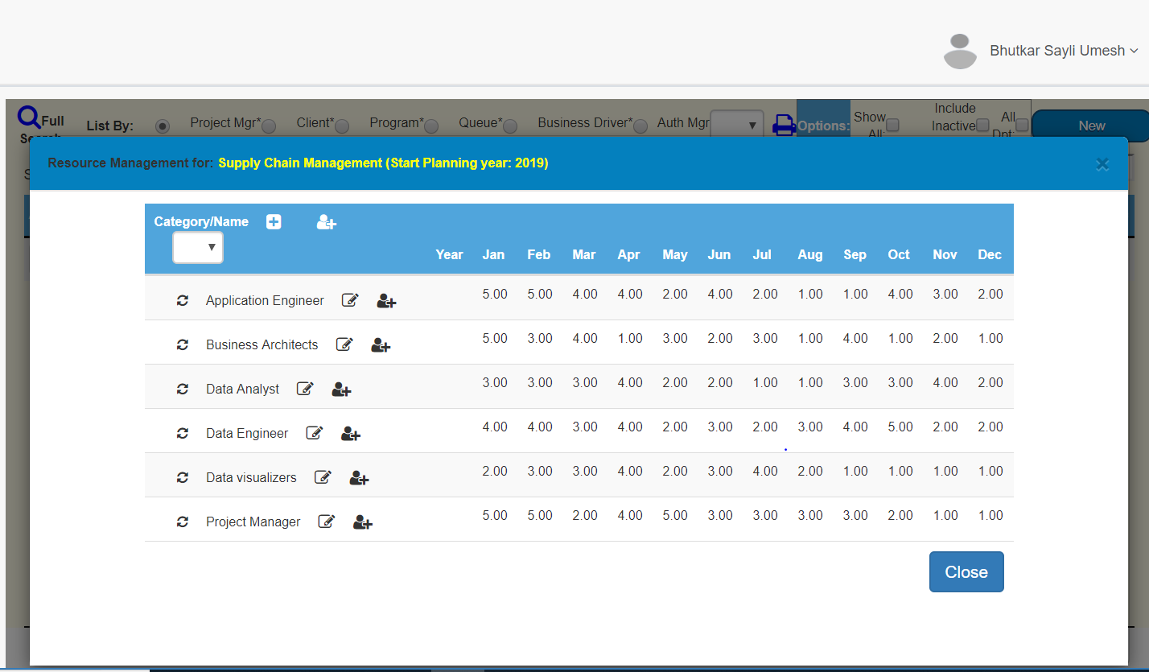
Project Plan: Step 5
Resource Allocation and Management

Slide 19
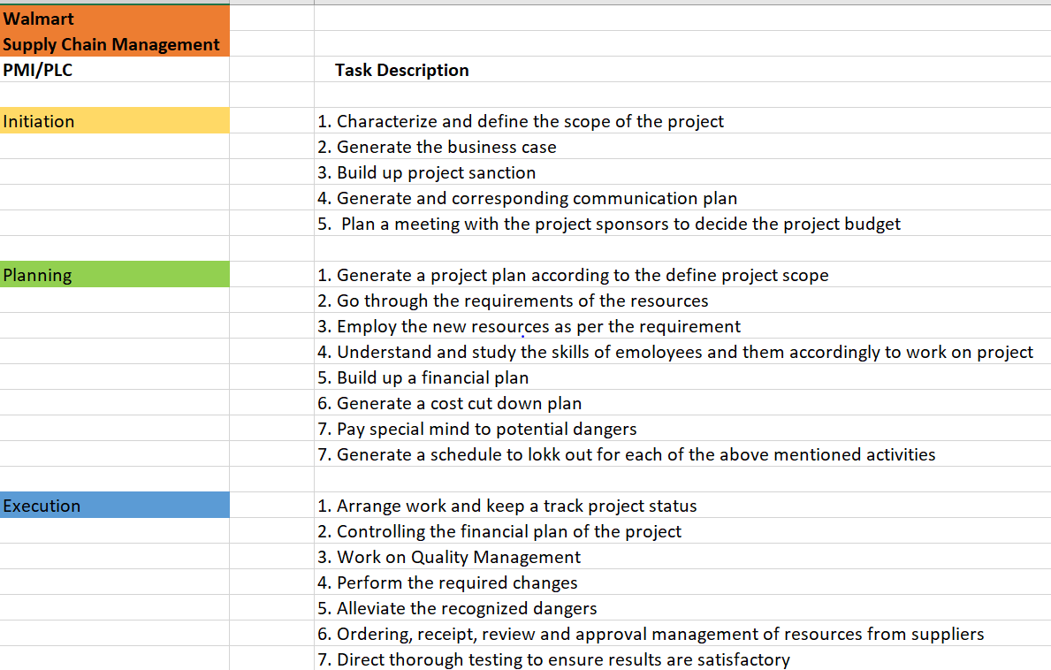
Project Plan: Step 6
Project Management Life Cycle (PMI) creation.

Slide 20
Issues and Risks
Lack of interaction with customers can lead to improper data storage.
Lack of product availability can lead to delay in the delivery.
Improper truck, route, and driver information.
Improper monitoring of customer reviews can lead to customer dissatisfaction.
Lack of data governance can hamper the company reputation which would lead to growing competition with other competitors like Star, Amazon, Target, CVS and many more.
Lack of data transparency in the architectural layers.

Slide 21
Data Collection
Various data which is collected by Walmart includes: Customer, Truck, Route, Product, Supplier Data
The Big Fast Data team acquire data, develop and operate data feeds, analysis tools and implement the infrastructure.
The database used for storing such data is Mongo DB.
MongoDB is an open source database that uses a document-oriented data model.
MongoDB is built on an architecture of collections and documents which makes data storage easy.
The framework used is Hadoop.
It is a distributed file system (HDFS) that supports the processing and storage of extremely large data sets in a distributed computing environment
It can scale up from single servers to thousands of machines. It provides a framework that allows distributed processing of large sets of data across clusters of computers using simple programming models.

Slide 22
Security
Protecting Data At-Rest
HDFS Level Encryption- HDFS transparent encryption cannot encrypt any data outside HDFS.
Data redaction- Data redaction is the suppression of sensitive data, such as any personally identifiable information (PII)
Password Redaction: Component that use Hadoop such has HDFS, Hive use Hadoop’s Credential Provider interface to encrypt and store passwords inside a secure key-store file.
Protecting Data-in-Transit.
Data in Transit encryption is built in using session- level one-time keys, by means of a session handshake with immediate and subsequent transmission.
TLS/SSL encryption.
Setting Information Security policies.

Slide 23
Scalability
Dynamic: Meeting current and future performance requirements
Extendable: Partitioning for fast and easy scalability
Hadoop integration: Using it as part of an integration architecture to land data and determine its value while balancing optimization
Shared-nothing architecture: Data sets are partitioned across computing nodes and a single application is executed with the same application logic implemented against each data partition.
Software data flow: A shared-nothing architecture can be fully exploited by a software data flow that easily implements and executes data pipelining and data partitioning within a node and across nodes. Software data flow also hides the complexities of building, tuning, and executing parallel applications from end users.
Data partitioning for linear data scalability: Large data sets can be partitioned across separate nodes, and a single job can execute the same application logic against all partitioned data.
Design isolation: This approach allows a job to be built once and run without modification anywhere. It offers one unified mechanism for parallelizing data flow

Slide 24
Management
Data Acquisition
Extract data from any source, the way you need it.
Unstructured data extraction & parsing from external sources.
Pattern detection during data extraction.
Real time, on-demand and scheduled data extraction capabilities.
Disruption free simplified integration with internal data assets of organization.
Simplified integration with internal data sources.
Data Aggregation
Organize data into structured web datasets.
Group data under one customizable category.
Establish a centralized ecosystem for managing distributed complex datasets.
Store aggregated data under a single structure in a Hadoop cluster.
Define data structure on-the-fly, depending on the defined category and sub category.
No manual or predefined data structure creation is required.
Data Transformation
Transform any available data in real time.
Customized data sets for personal, restricted and public utilization.
Interoperability with all data sources.
Move from ETL to personalized ELT.
Multiple transformations on single source of truth.
Utilization of same raw organizational data assets/information from multi-business units perspective.

Slide 25
Thank You….

