Slide 1



























https://gitforwindows.org/

Slide 2
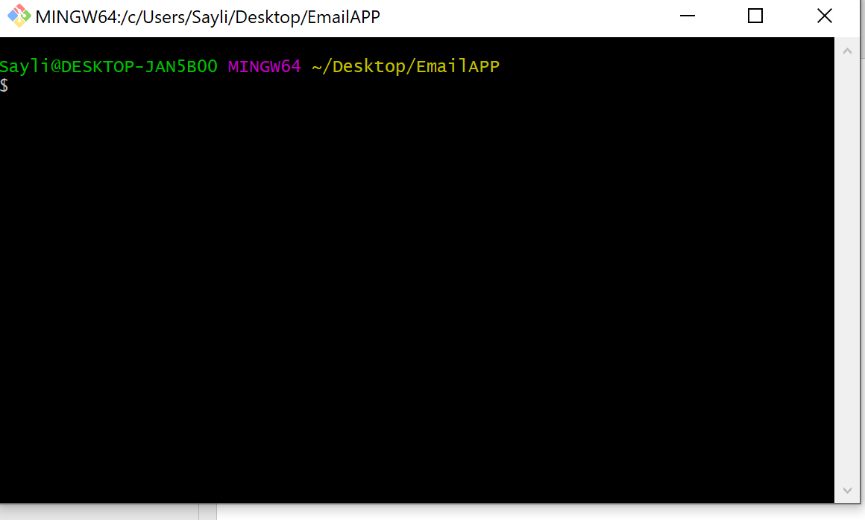












Slide 3






















Slide 4
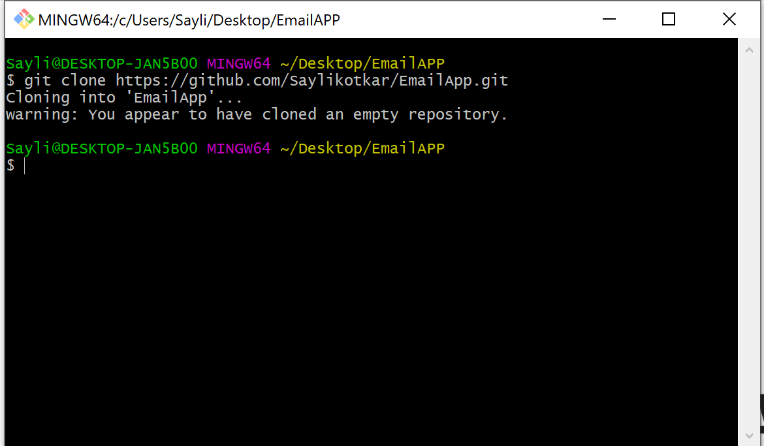






Slide 5
