Slide 1
NSU Welfare
Group Members
Sayma Mahmud 1912773042
Arjuman Ara Boishakhi 1922116642

Slide 2
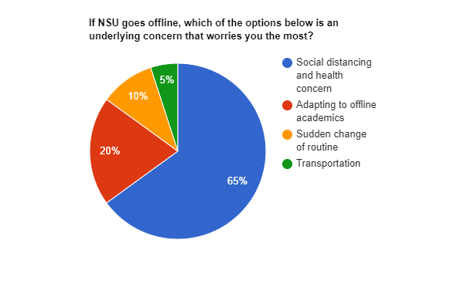
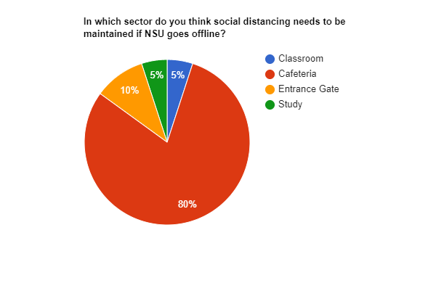
The concerns with offline classes

Slide 3
Presenting
NSU Welfare

Slide 4
What is NSU Welfare?
Our product intends to:
Facilitating the students to systematically buy meals.
Assist Faculties to order food through delivery.
Avoid lunchtime rush and maintain social distancing.
Plan meals as per Nutritional Values.
Recommend meals
Predict future disease based on food habits
Saves time and increase revenue of the Cafeterias.
NSU Welfare is a digital platform for NSUers, allowing them to order/buy meals digitally from the cafeterias within the university premises. Moreover, it allows an Nsuer to keep track about health, recommending meals and predicting diseases.
Target Audience: Students, Faculties and others of NSU

Slide 5
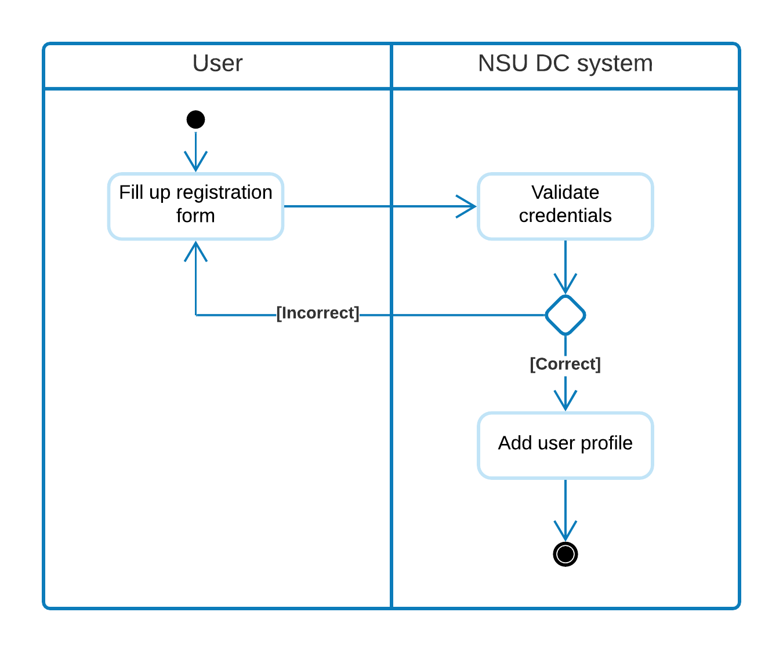
How will it work?
-

Slide 6
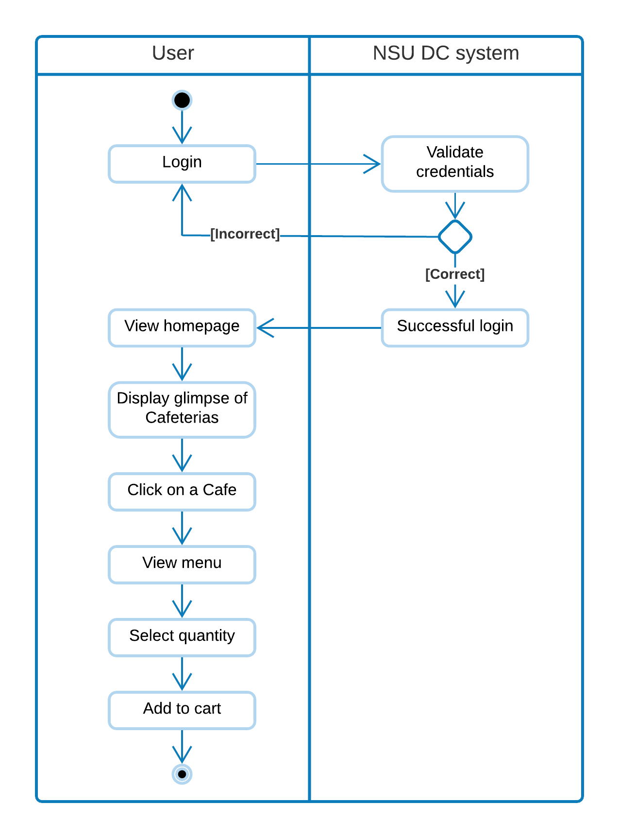
Adding Items to cart

Slide 7
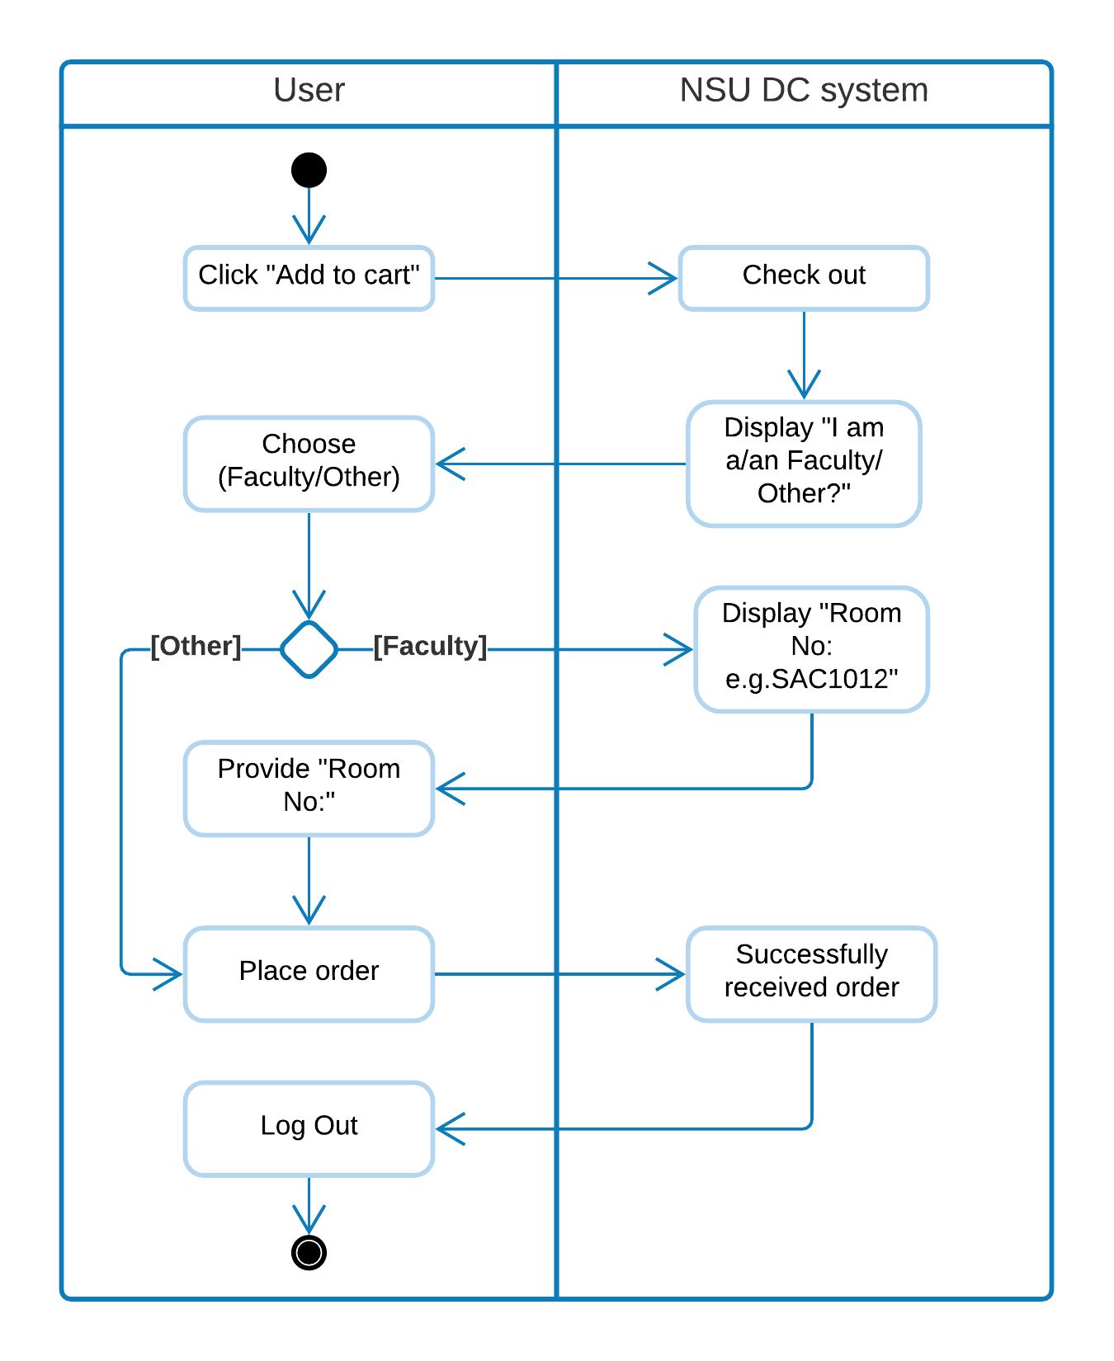
Issuing the purchase

Slide 8
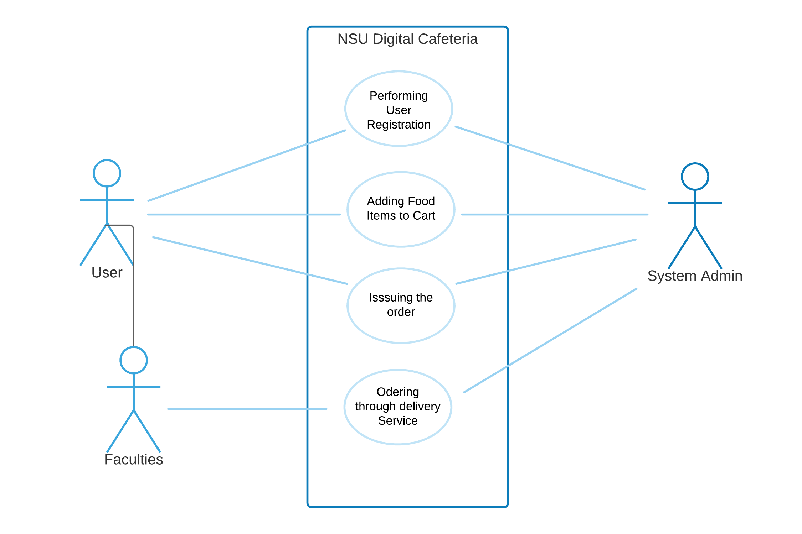
Use Case Diagram
-

Slide 9
Tools to be used for developing
Frontend
Tools
HTML
CSS3
Bootstrap
XAMPP Server
Tools
MySQL
XAMPP
PHP
Python3
VS Code
Backend

Slide 10
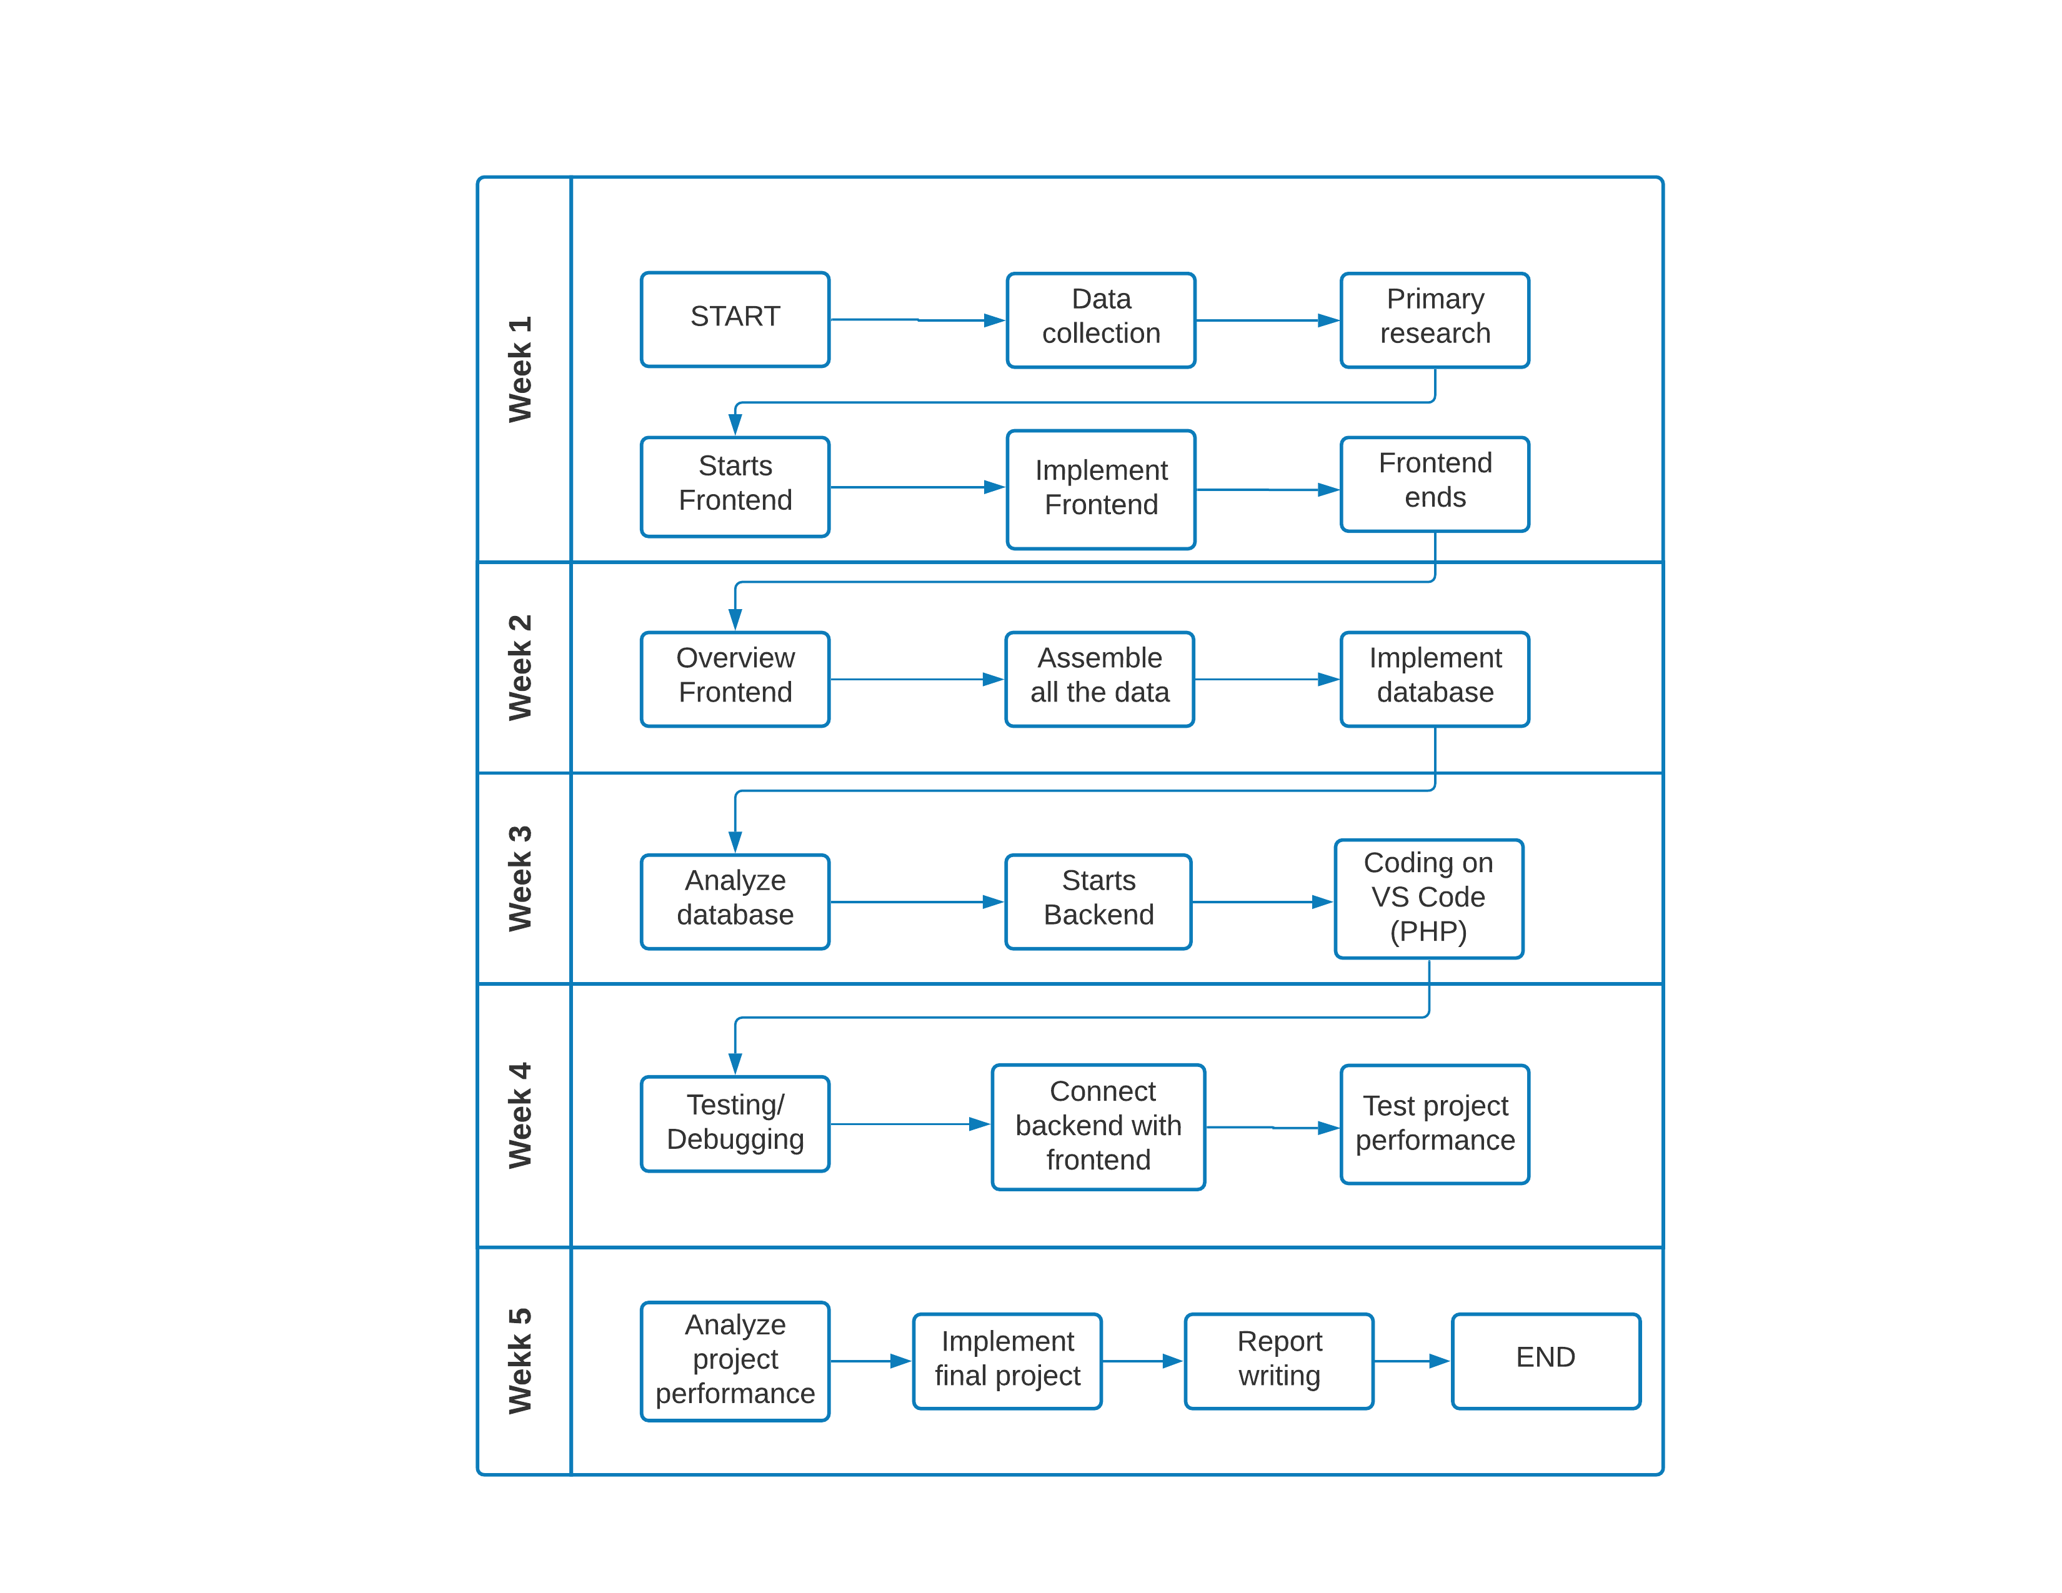
Projected Plan & Timeline for the Product

Slide 11
The objectives in the long run
Recommending of meals based of gender and BMR.
Predicting health disease based of lifestyle.
Permanent shift to purchasing meals Digitally and Systematically.
Enhancing meal experience.
Track real time data analysis for business purposes.
Digital Payment System to be implemented in the future.

Slide 12
Conclusion
Users in NSU will be benefited .
Will address the COVID 19 concern.
Keeping health in check.

Slide 13
Thank You!

