Slide 1
HOUSE PRICE PREDICTION SYSTEM
A Machine Learning Approach to Residential Property Valuation
AIML Summer Internship 2026 | IIHMF, MNNIT Allahabad, Prayagraj
Capstone Project Presentation

Slide 2
THE CHALLENGE
Problem Statement
Manual property valuation is subjective, inconsistent, and slow — buyers and sellers need an objective, data-driven way to estimate fair market price.
Key Inputs
Area (Sq Ft)
Location / City Tier
Predict residential house prices from property attributes — area, location, BHK, age, and amenities — using a complete Machine Learning lifecycle from raw data to a deployed prediction app.
BHK & Bathrooms
Property Age
Furnishing & Amenities
2

Slide 3
GOALS
Project Objectives
1
Collect & Preprocess
2
Explore & Engineer
3
Train & Compare
Build a clean, structured housing dataset (3,000+ records)
Run EDA and create meaningful new features
Build 3 regression models and benchmark performance
4
Evaluate
5
Deploy
Use MAE, RMSE, R² to choose the best model
Ship a live Streamlit app for real-time predictions
3

Slide 4
DATA
Dataset Description
3,000+ residential property records across 8 Indian cities, capturing realistic city-tier and locality-tier pricing patterns.
3,035
17
8
20
Raw Records
Original Features
Cities Covered
Engineered Features
Feature groups: Location (City, Locality Tier) · Structural (Area, BHK, Bathrooms, Floors) · Condition (Age, Furnishing) · Amenities (Parking, Lift, Metro Distance, School/Hospital proximity)
Note: Built from a statistically realistic generator modelling real Indian housing price relationships, since live Kaggle access was unavailable in the build environment; the pipeline accepts any Kaggle housing CSV as a drop-in replacement.
4

Slide 5
ML LIFECYCLE
Methodology
Problem
Understanding
→
Data
Collection
→
Data
Preprocessing
→
EDA
→
Feature
Engineering
→
Model
Building
→
Model
Evaluation
→
Model
Deployment
Eight-phase pipeline followed end-to-end, from raw data to a deployed prediction tool.
5

Slide 6
CLEANING THE DATA
Data Preprocessing
Duplicate Removal
35 duplicate rows identified and dropped
Missing Value Imputation
Median for numeric, mode for categorical (~4.5% missing)
Outlier Treatment
IQR-based capping on Area & Price
Categorical Encoding
One-Hot Encoding + ordinal Tier_Rank
Feature Scaling
StandardScaler for numeric features (Linear Regression)
6

Slide 7
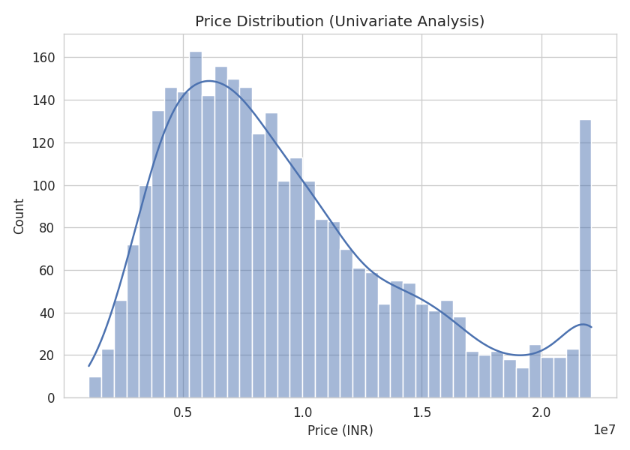
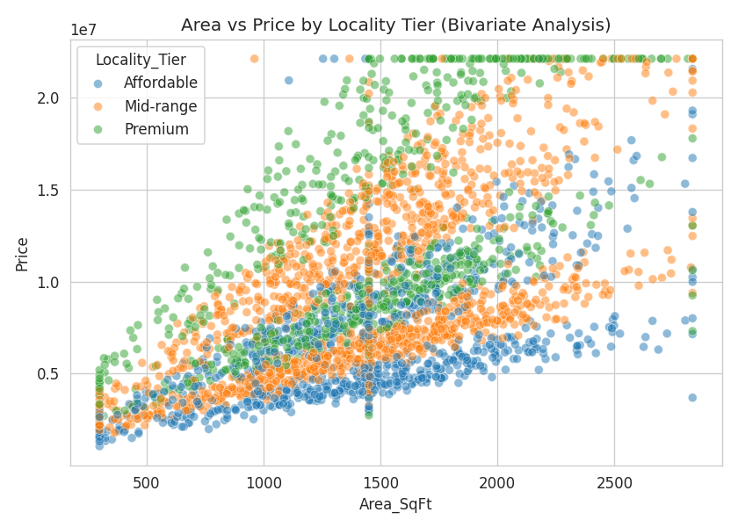
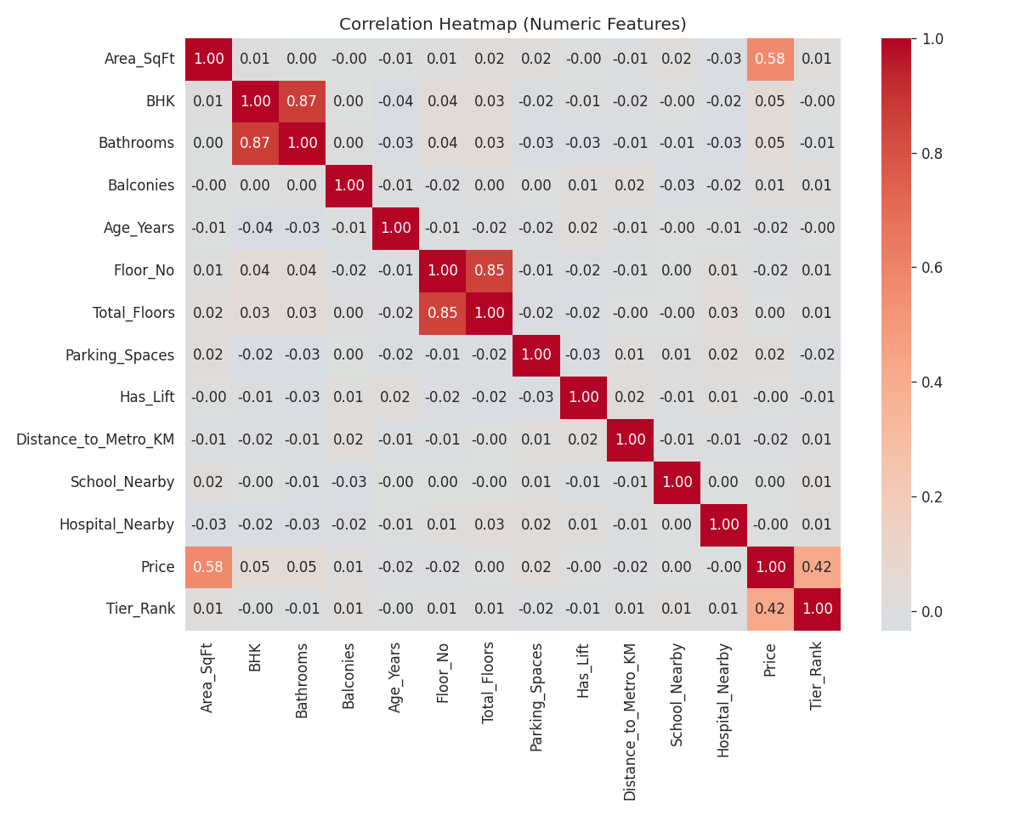
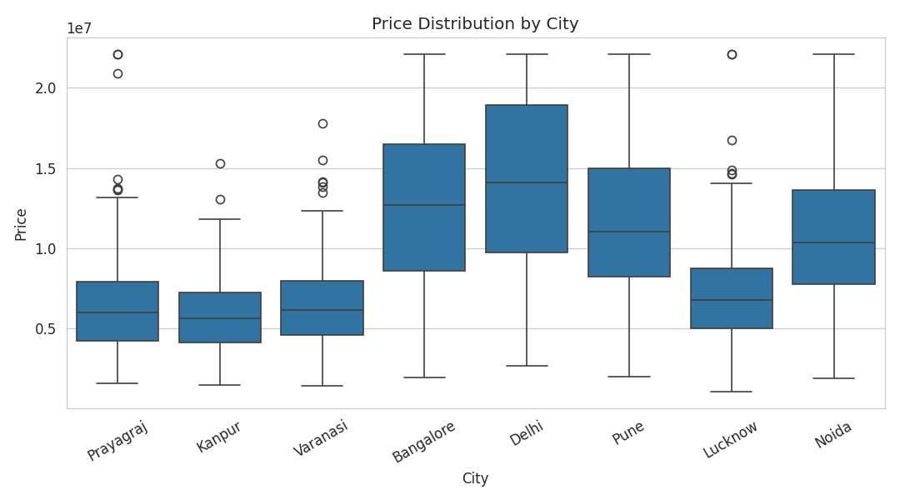
UNDERSTANDING THE DATA
Exploratory Data Analysis
Price is right-skewed; Area and Locality Tier show the strongest correlation with Price.
7

Slide 8
BUILDING & COMPARING
Models Used
Linear Regression
Random Forest
XGBoost
Interpretable baseline; assumes linear feature-price relationship
300 trees, ensemble of decision trees, captures non-linear interactions
400 estimators, gradient boosting, sequentially corrects errors
8

Slide 9
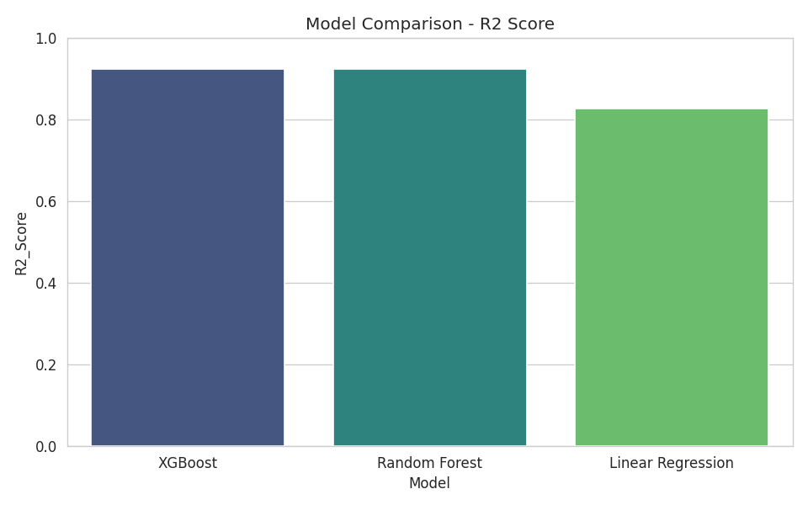
PERFORMANCE
Results & Model Comparison
Model | MAE | RMSE | R² Score
Linear Regression | ₹13.9 Lakh | ₹19.9 Lakh | 0.826
Random Forest | ₹7.1 Lakh | ₹13.1 Lakh | 0.924
XGBoost (Selected) | ₹7.2 Lakh | ₹13.1 Lakh | 0.924
XGBoost and Random Forest both substantially outperform the Linear Regression baseline, improving R² from 0.83 to 0.92.
9

Slide 10
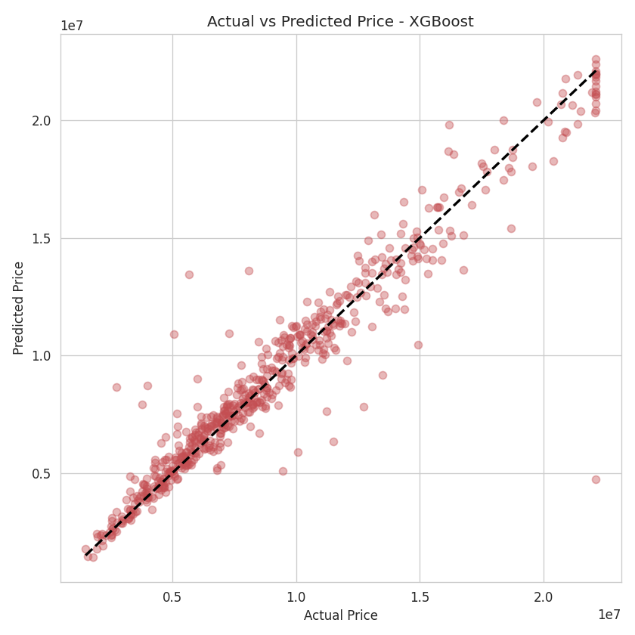
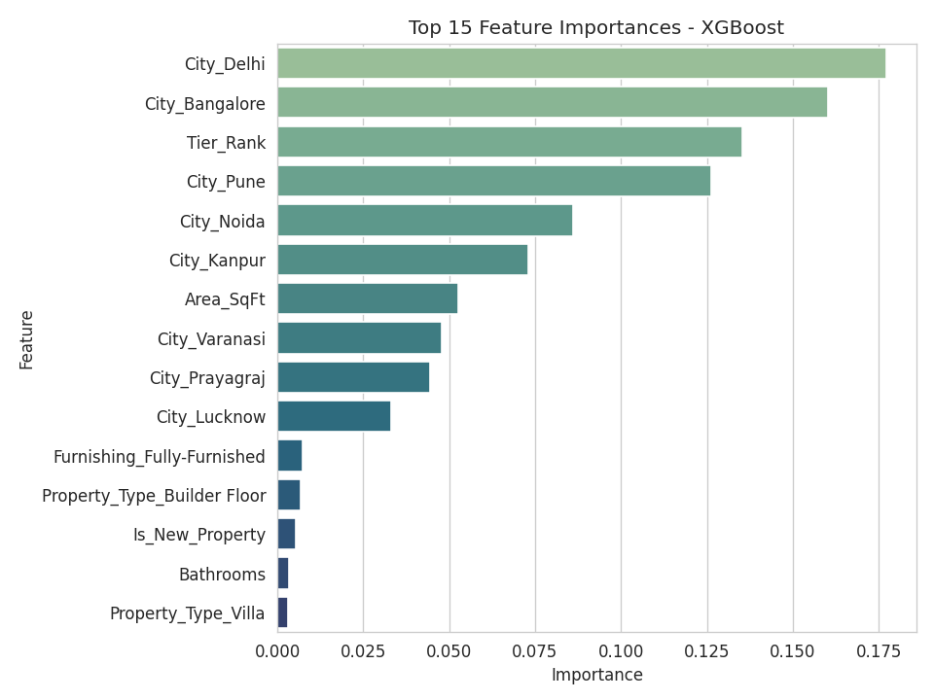
PREDICTION QUALITY
Demo Screenshots
10

Slide 11
FROM MODEL TO PRODUCT
Deployment — Streamlit App
🏠 House Price Prediction System
User enters City, Property Type, Area, BHK, Age, Furnishing, and Amenities
Trained XGBoost pipeline runs inference in real time
App returns predicted price and implied price-per-sq-ft
Built with Streamlit — runs locally or deploys to Streamlit Cloud
11

Slide 12
WHAT WE ACHIEVED
Conclusion
Built a complete ML pipeline: preprocessing → EDA → feature engineering → modelling → deployment
Compared 3 regression models; XGBoost achieved the best performance (R² = 0.924)
Reduced prediction error (RMSE) by ~34% over the linear baseline
Delivered a working, interactive Streamlit application for real-time price prediction
12

Slide 13
Future Scope
1
Integrate live Kaggle / real estate portal data feeds
2
Add geospatial features (lat/long, walkability, safety index)
3
Use property images via CNN-based feature extraction
4
Hyperparameter tuning & model stacking for higher accuracy
5
Cloud deployment with public URL & usage analytics
6
Add SHAP-based explainability to the deployed app
Thank You | Questions & Discussion
13

