Slide 1
Bus Route Tracking
Mentor: Ms. Pradnya shende
Presented by: 9185 – saynam Sharma
9195 – nirata Sinha
9196 – shivani Shukla
9198 – saksham inde

Slide 2
Problem Statement to understand the reason behind bus delay and find out the most efficient bus route.

Slide 3
Given Data
1. School Year 2. Run Type 3. Bus No 4. Route Number 5. Reason 6. Occurred On 7. Number Of Students On The Bus

Slide 4
Technology Used: Spark sql
Why spark sql ?
Spark Integration
Performance
Connectivity
Uniform Data Access
Support for existing Data Formats

Slide 5
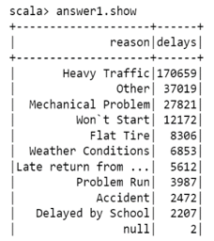
Solutions to the given problem statement:
Use case – 1: Most common reasons for either a delay or breaking down of the bus
scala> val query = """Select * from (Select reason,count(run_type) as delays from caseData group by reason) sub order by delays desc """
scala> val answer1 = spark.sql(query)
scala> answer1.show

Slide 6
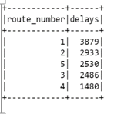
Use case - 2: Top five route numbers where the bus was either delayed or broke down
scala> val query = """select * from (select route_number,count(run_type) as delays from casedata group by route_number) sub order by delays desc limit 5"""
scala> val answer2 = spark.sql(query)
scala> answer2.show

Slide 7
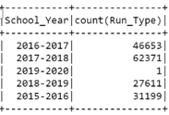
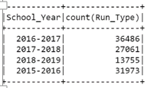
Use Case 3 - The total number of incidents, year-wise, when the students
3.1 when students were not in the bus
scala> val query = """select school_year,count(run_type) from casedata where number_of_students_on_the_bus=0 group by school_year"""
scala> val answer3 = spark.sql(query)
scala> answer3.show
3.2 when students were in the bus
scala> val query = """select school_year,count(run_type) from casedata where number_of_students_on_the_bus!=0 group by school_year"""

Slide 8
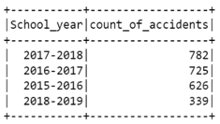
Use Case 4 - The year in which accidents were less
scala > val query = """ select * from (select school_year,count(run_type) as count_of_accidents from casedata where reason="accident" group by school_year) sub order by count_of_accidents desc"""
scala > val answer4 = spark.sql(query)
scala > answer4.show

Slide 9
Thank YOU

