Slide 1


Edubridge Learning Pvt Ltd
Capstone Project:
Flight Price Prediction
Presented by:
Sayon Dey
Avadhut Jagtap
Guided by:
Vikas Dubey

Slide 2

Abstract:
Flight ticket fare is the most fluctuating data which varies every day. Depending on the various factors that affect it directly or indirectly. we cannot say that the price of flight ticket fare remains the same or not. It is quite a tough task to predict the flight ticket fare. It may change throughout the week, month or some days, but it can be predicted nearly accurate to the actual flight ticket fare.
The prime objective of our project "Improved Flight Prediction System" is to make a prediction of the flight ticket fare for the future flights. The proposed approach is using machine learning algorithm and we are using supervised learning.
The regression model used in this code is called a Random Forest Regressor. A Random Forest Regressor is a machine learning algorithm that belongs to the ensemble learning family. It is used for regression tasks, where the goal is to predict a continuous numerical value (in this case, flight prices).

Slide 3
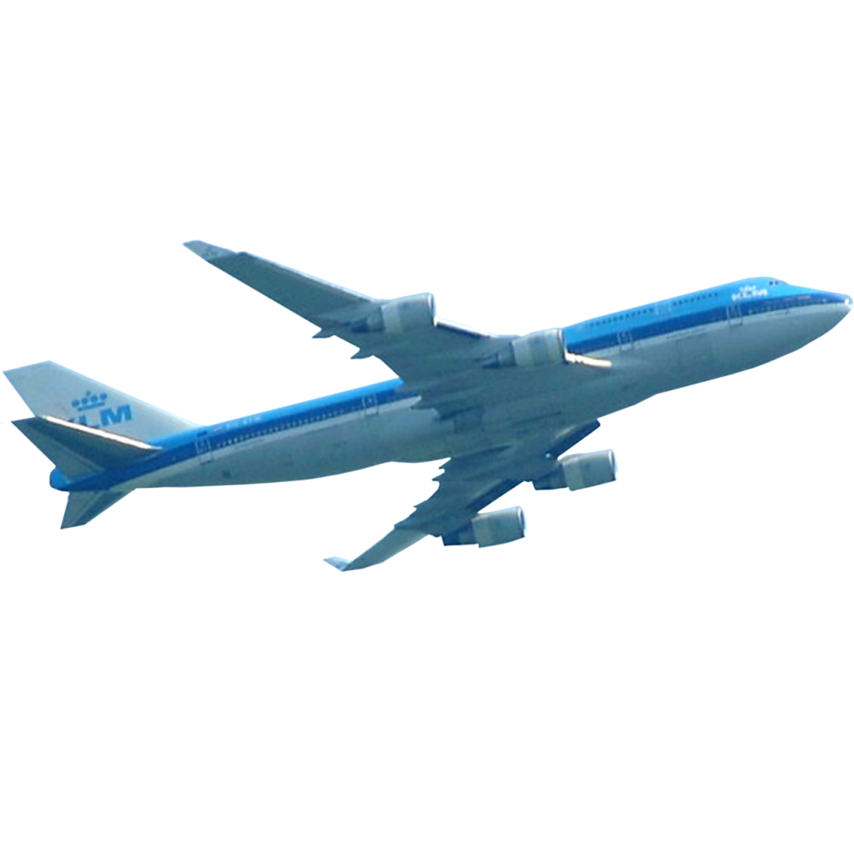
Introduction:
Nowadays, the airline corporations are using complex strategies for the flight ticket fare calculations. This highly complicated methods makes the flight ticket fare difficult to guess for the customers, since the fare changes dynamically.
Our project Flight Price Prediction which resolve this problem and provide a facility where people will be able to predict the flight-ticket price before purchasing the ticket.

Slide 4

The tools and technologies that are used are as follow:
Data Selection
Exploratory data analysis(EDA)
Data Pre-processing
Feature Selection
Applying ML Algorithm
Model Evaluation
Model Deployment

Slide 5

Objective:
The prime objective of this project is to use machine learning techniques to model the behaviour of flight ticket prices over the time and predict the price of the flight-ticket.
The goal of this project is to study how airline ticket prices change over time, extract the factors that influence these fluctuations, and describe how they're correlated ( essentially guess the model that air carriers use to price their tickets).

Slide 6
Resource Methodology:
For this project, we have implemented the machine learning life cycle. After selecting the features which are more correlated to cost the following step involves applying machine algorithm and creating a model. As our dataset incorporates labelled data, we've got to use supervised machine learning algorithms also in supervised we are going to be using regression algorithms as our dataset contains continuous values within the features. Regression models are wont to describe relationship between dependent and independent variables. The machine learning algorithms that we are going to be using in our project are:
Linear Regression- In simple linear regression there’s only one independent and one dependent feature but as our dataset consists of many independent features on which the worth may rely on, we are going to be using multiple linear regression which estimates the relationship between two or more independent variables and one dependent variable.
Decision Tree- There are basically two types of decision tree; classification and regression where the former is employed for categorical values and the later is for continuous values. Decision tree chooses independent variable from dataset as decision nodes for decision making. It divides the entire dataset as several subsection and when test data is passed to the model the output is determined by checking the data points.

Slide 7


Resource Methodology:
Random Forest- Random Forest is an ensemble learning technique where training model uses multiple learning algorithms then combine the individual result to urge a final predicted result.
Mean Absolute Error(MAE)- Mean Absolute Error is basically the sum of the average of the difference between the excepted and actual values.

Slide 8
Conclusion:
This project can result in saving money of inexperienced people by providing them the information related to flight price and also give them a predicted value of the price which they used to decide whether to book tickets now or later. On working with different algorithms, it was found that the random forest algorithm gives the highest accuracy in predicting the output.

