Slide 1

Vision AI in 5 Days:
From Beginner to Image Recognition Expert
A Project Submission by ~ SAYON GHOSH

Slide 2

Project Objective
The core goal of this project was to build and evaluate two distinct Convolutional Neural Network (CNN) models for the task of handwritten digit recognition using the classic MNIST dataset. The aim was to compare a custom-built model against a powerful pre-trained model.

Slide 3

Methodology & Tools Used
Custom CNN Model
Transfer Learning Model
A sequential CNN was built from scratch using TensorFlow/Keras. It featured two convolutional layers and utilized data augmentation techniques like rotation and zoom to improve robustness.
The pre-trained MobileNetV2 model was adapted for this task. The convolutional base was frozen, and a new classification head was added and fine-tuned on the MNIST data.
Key Tools: Python, Google Colab, TensorFlow, Scikit-learn.

Slide 4
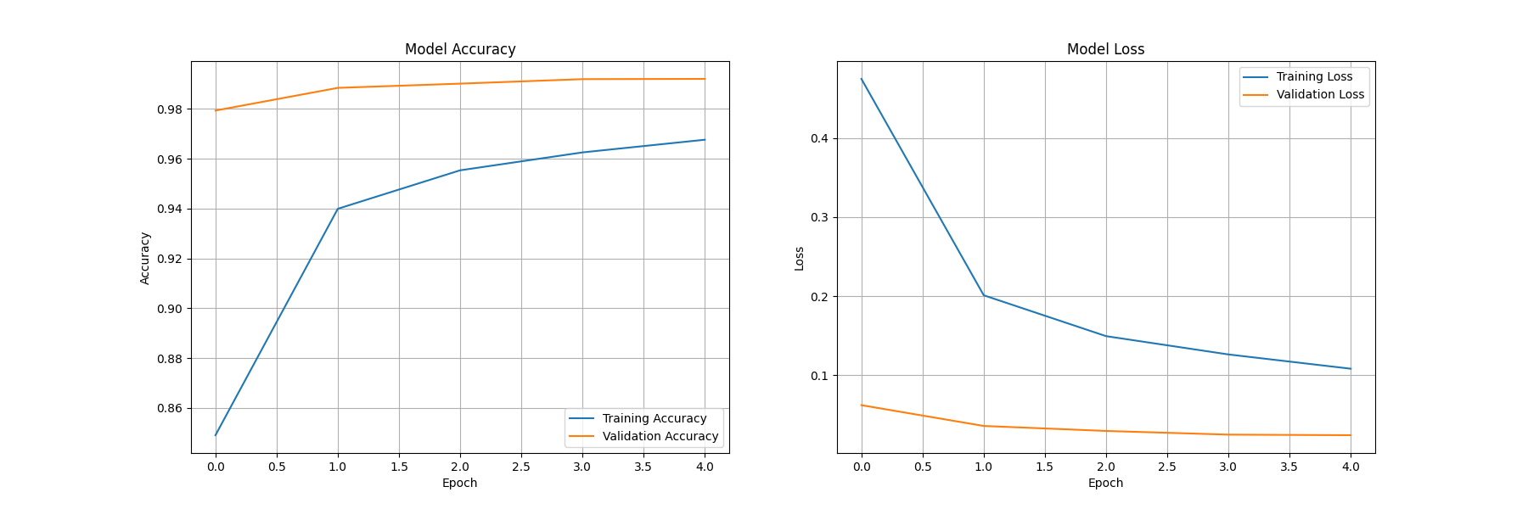
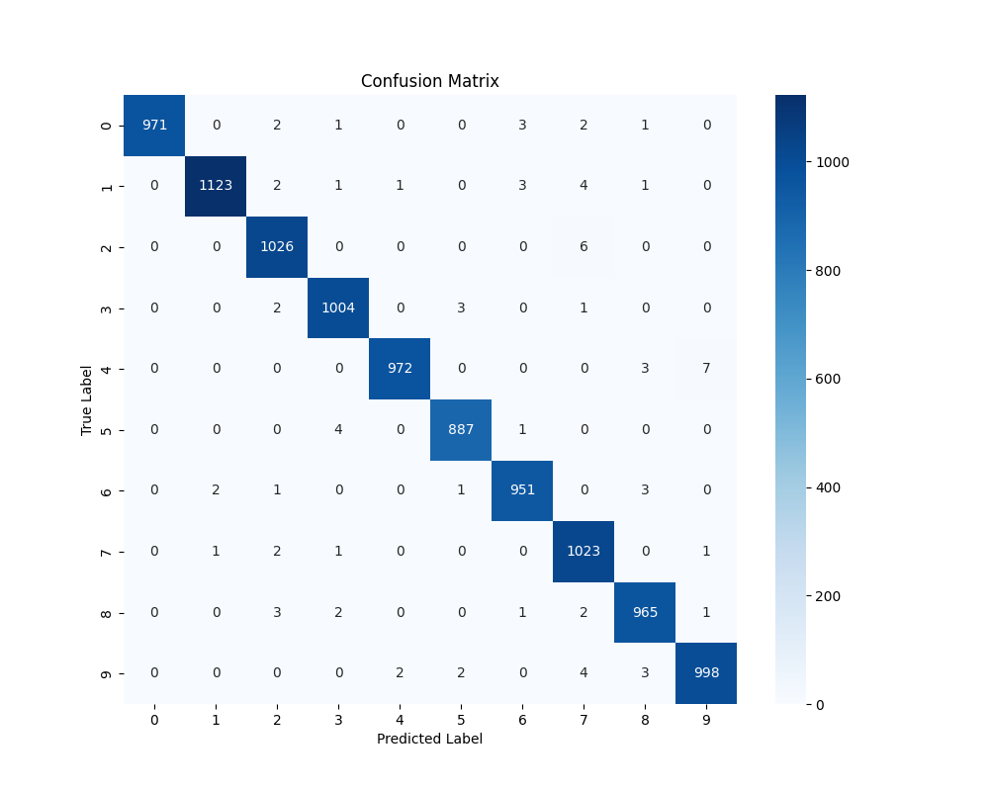
Performance Results
Display the final test accuracies of both models side-by-side for comparison.
99.26%
96.99%
Custom CNN Accuracy
Transfer Learning (MobileNetV2) Accuracy
Confusion Matrix
Training & Loss Curves
Confusion Matrix

Slide 5

Conclusion & Future Work
The custom CNN achieved exceptionally high accuracy, proving effective for the simple MNIST dataset. The transfer learning model also performed well and demonstrates a powerful approach for more complex, real-world image classification problems.
Future Work:
Suggestions include further fine-tuning of hyperparameters or applying these models to more challenging datasets like CIFAR-10.

