Slide 1

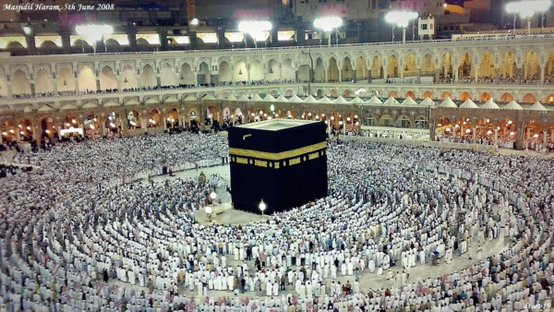
O my Lord! Expand for me my chest [with assurance] and ease for me my task and untie the knot from my tongue that they may understand my speech. (Quran 20 : 25-28)

Slide 2
Course Introduction

Slide 3
Contact Details
Dr. Muhammad Umair Ramzan
Office Hours: Tuesday
12:00 pm – 01:00 pm
muramzan@kau.edu.sa

Slide 4
Course Learning Outcomes (CLOs)

Slide 5
Course Learning Outcomes (CLO)
Discuss the formal definition of algorithm.
Discus how the efficiency of algorithms is characterized and measured.
Solve simple recurrence relations using select (covered) techniques.
Determine the time efficiency of simple iterative or recursive algorithm given its pseudocode using select (covered) techniques and theorems.
Use given algorithm to solve small instances of select (covered) problems by hand.
SO-1
SO-1
SO-1
SO-2
SO-2

Slide 6
Course Learning Outcomes (CLO)
Write proper pseudocode based on knowledge of algorithm operation. (Intent: not a design outcome).
Analyze select (covered) decrease-conquer algorithms given a pesudocode.
Compare select (covered) algorithms and related data structures in terms of design, operation, performance, and applications.
Analyze select (covered) divide-conquer algorithms given a pesudocode.
Compare select (covered) algorithms and related data structures in terms of operation, performance, and applications.
SO-1
SO-2
SO-2
SO-2
SO-2

Slide 7
Course Learning Outcomes (CLO)
Analyze select (covered) transform-conquer algorithms given a pesudocode.
Compare select (covered) data structures with respect to dictionary operations.
Apply empirical techniques to assess the performance of (a set) of algorithm(s).
Implement algorithm given its pseudocode in programming language and environment of choice.
Design an algorithm to solve a problem based on solution descriptions or outline of steps.
SO-2
SO-2
SO-2
SO-1
SO-2

Slide 8
Goals Analysis and Design of Algorithm

Slide 9
Goals
Improve knowledge of writing the algorithms and pseudocode
Improve knowledge of measuring and characterizing the efficiency of any given algorithm
Learning the techniques to analyze simple iterative and recursive algorithms
Learning of selected techniques used in designing the algorithms and their comparisons
Learn about empirical techniques to assess the performance of a set of algorithms

Slide 10
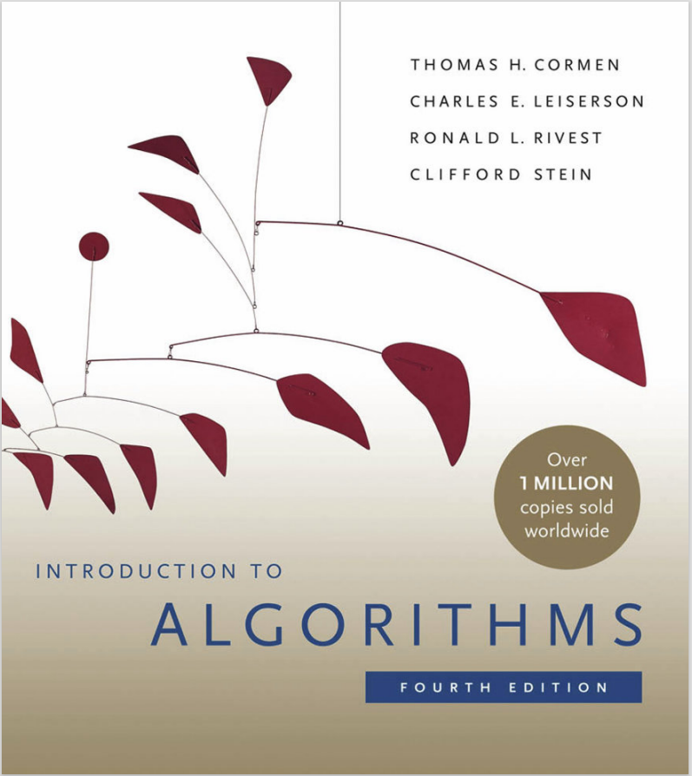
Text Book
“Introduction to Algorithms,
Thomas H. Cormen et al., MIT press; 4th edition (2022). ISBN: 978-0262046305 .

Slide 11
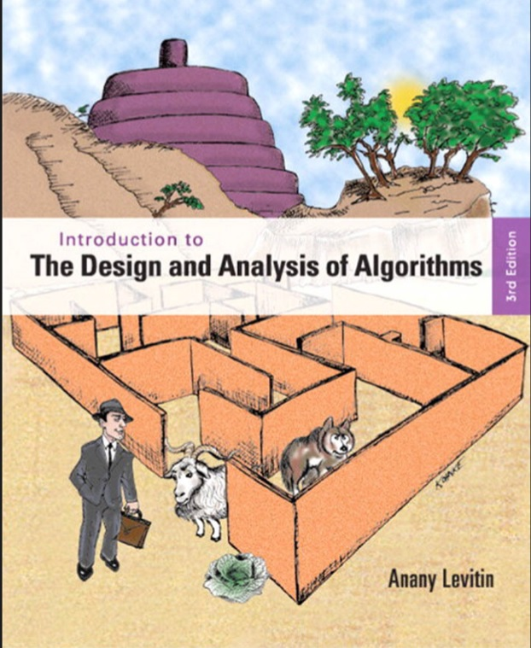
Text Book
“Introduction to The Design and Analysis of Algorithms,
Anany Levitin, Addison-Wesley Longman; 3rd edition (2012). ISBN-10: 0-13-231681-1 , ISBN-13: 978-0-13-231681-1 .

Slide 12
General Policies
Attendance must be 75% or more
Only final exam will be cumulative
No make up for any quiz whatsoever is the reason
Plagiarism / cheating will result in 0% marks
Pay regular visit to Blackboard
Need help for Assignments; contact lab instructor
No scale up / bonus for final grade

Slide 13
Assessments
Assessment | Grading Percentage
Mid Term Exam | 30%
Quizzes | 10%
Project (Group) | 15%
H/W Assignments (03 * 5 pts each) | 15%
Comprehensive Final Exam | 30%

Slide 14
Assessments Schedule
Assessment | Dates
Home Work Assignment 01 | Thursday, February 05, 2026
 | Sunday, February 15, 2026
Quiz 01 | Thursday, February 19, 2026
Home Work Assignment 02 | Thursday March 05, 2026
 | Sunday, April 05, 2026
Quiz 02 | Thursday, April 09, 2026
Course Project | Thursday April 09, 2026
 | Thursday April 30, 2026
Home Work Assignment 03 | Thursday April 30, 2026
 | Sunday May 10, 2026

Slide 15
Assessments Topics:
Assessments | Week | Topics
Assignment 01 | 3 | Mathematical/Theoretical Analysis (Iterative),Correctness of Algorithms, Asymptotic Notations, Mathematical/Theoretical Analysis (Recursive), Backward Substitution Method
Quiz 1 | 5 | Material covered from Week 1 to Week 5
Assignment 02 | 7 | The Substitution Method, The Recursion – Tree Method, The Master Method, Brute Force Techniques, Exhaustive Search Techniques
Midterm | 8 | All topics up to week 8
Quiz 02 | 9 | Material covered from Week 6 to Week 9
Group Project | 9 | Empirical Analysis
Assignment 03 | 12 | Master Method, Decrease & Conquer and Divide & Conquer
Final Exam | 16 | All topics

Slide 16
Review Questions
Course Introduction

Slide 17
01
How many CLOs are defined for CPCS-223
11
15
17
19
None of above

Slide 18
02
Among the defined CLOs, how many of them are more significant
1
3
5
7
None of above

Slide 19
03
Which of the followings is not the CLOs of CPCS-223
Compare select (covered) data structures with respect to dictionary operations
Analyze select (covered) decrease-conquer algorithms given a pesudocode
Analyze select (covered) divide-conquer algorithms given a pesudocode
Compare select (covered) data structures with respect to dictionary operations
None of above

Slide 20
04
Which of the followings is significant clo of CPCS-223
Apply empirical techniques to assess the performance of (a set) of algorithm(s).
Design an algorithm to solve a problem based on solution descriptions or outline of steps
Analyze select (covered) transform-conquer algorithms given a pesudocode
Use given algorithm to solve small instances of select (covered) problems by hand
All of above

Slide 21
05
Which of the followings is a goal of Analysis of Design of Algorithms (CPCS-223)
Improve knowledge of measuring and characterizing the efficiency of any given algorithm
Learning of selected techniques used in designing the algorithms and their comparisons
Improve knowledge of measuring and characterizing the efficiency of any given algorithm
Learn about empirical techniques to assess the performance of a set of algorithms
All of above

Slide 22
06
What is the name title of the “Text Book” for CPCS-223
Introduction to The Design and Analysis of Algorithms
Introduction to The Analysis and Design of Algorithms
Introduction to Algorithms
Design and Analysis of Algorithms
All of above

Slide 23
07
Who is the author of the “Text Book” for CPCS-223
Nell Dale
Anany Levitin
Thomas H. Cormen
Peter Baer
None of above

Slide 24
08
Which edition of the text book for CPCS-223 is recommended?
2nd
3rd
4th
5th
None

Slide 25
09
What is the name title of the “Text Book” for CPCS-223
Introduction to The Design and Analysis of Algorithms
Introduction to The Analysis and Design of Algorithms
Introduction to Algorithms
Design and Analysis of Algorithms
All of above

Slide 26
10
Who is the author of the “Text Book” for CPCS-223
Nell Dale
Anany Levitin
Thomas H. Cormen
Peter Baer
None of above

Slide 27
11
Which edition of the Text book for CPCS-223 is recommended?
2nd
3rd
4th
5th
None

Slide 28
12
What percentage of classes may be missed at the most to avoid DN?
75%
50%
25%
20%
None

Slide 29
13
All written exams (Exam 1, Exam 2 and Final Exam) will be cumulative.
True
False

Slide 30
14
Which of the following assessments will be conducted on “Blackboard”?
Exam 1
Exam 2
Final Exam
Quizzes
None

Slide 31
15
If someone is caught cheating in any assessment, he will be given ------------
- 4 % marks
DN grade
0% marks
None of above

Slide 32
16
If someone is caught for plagiarism in assignment, he will be given ------------
- 4 % marks
DN grade
0% marks
None of above

Slide 33
17
If you have any issue related to assignments, to whom you must contact first?
Vice Dean FCIT
Chairman (CS)
Course Coordinator
Theory Instructor
Lab Instructor

Slide 34
18
How much “bonus marks” you may get on final grade?
5
8
10
15
0

Slide 35
19
What is the grading percentage of “Quizzes” for CPCS-223?
5
10
15
20
None of above

Slide 36
20
What is grading percentage of “H/W Assignments” for CPCS-223?
5
10
15
20
30

Slide 37
21
What is grading percentage of “Exam 1” for CPCS-223?
10
15
20
25
30

Slide 38
22
What is grading percentage of “Exam 2” for CPCS-223?
5
10
15
20
None

Slide 39
23
What is grading percentage of “Final Exam” for CPCS-223?
5
10
15
20
30

Slide 40
24
How many “Quizzes” will be conducted for CPCS-223?
0
1
2
3
4

Slide 41
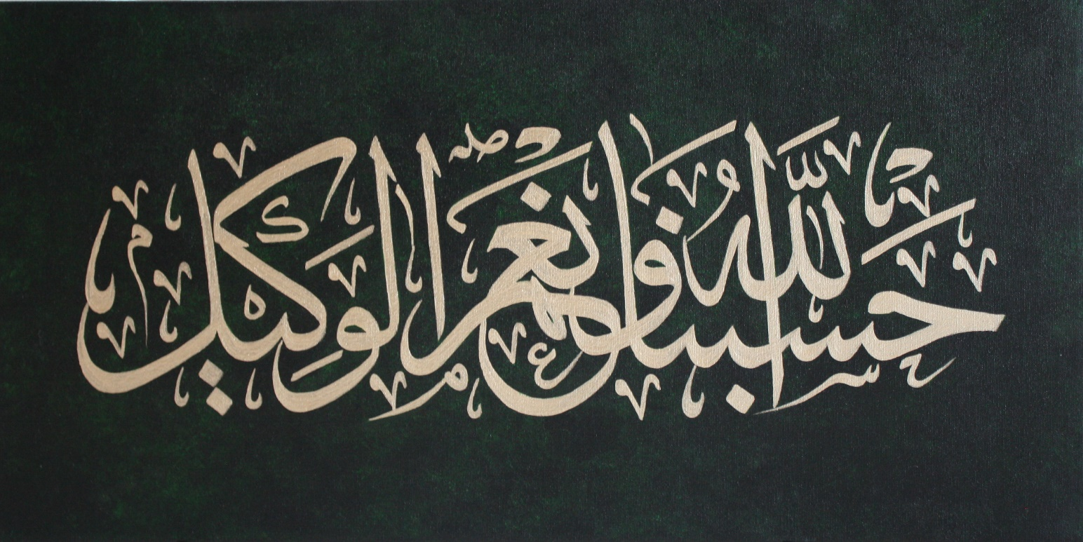
Allah (Alone) is Sufficient for us, and He is the Best Disposer of affairs (for us).(Quran 3 : 173)

