Slide 1

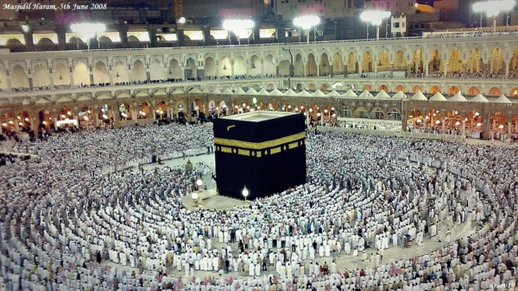
O my Lord! Expand for me my chest [with assurance] and ease for me my task and untie the knot from my tongue that they may understand my speech. (Quran 20 : 25-28)

Slide 2
Algorithm Correctness
Loop Invariant

Slide 3
Loop Invariant
It is used to check the “Correctness”
“It is the condition(s) which must hold before, during and after the execution of any loop”
It can be written as
Descriptive Statement(s)
Mathematical Expression(s)

Slide 4
Loop Invariant
It has three stages
Initialization
Verify conditions before start of loop
Maintenance
Verify conditions after few iterations of loop
Termination
Verify conditions once the loop is terminated

Slide 5
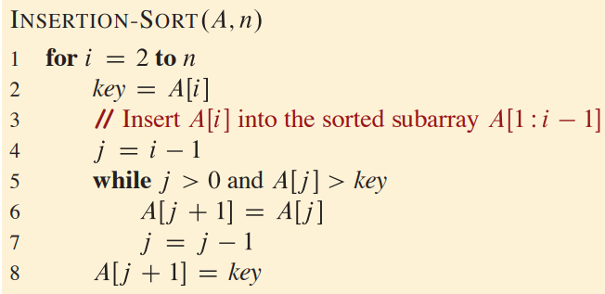
Example 01: Insertion Sort

Slide 6

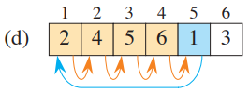
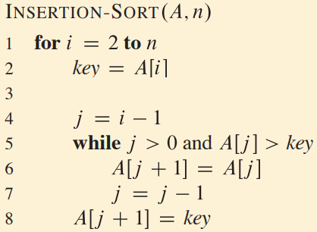


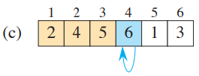

Insertion Sort: Tracing

Slide 7
Insertion Sort: Loop Invariant
“At the start of each iteration of the for loop of lines 1-8, the subarray A[1 : i-1] consists of the elements originally in A[1 : i-1], but in sorted order. ”

Slide 8

Loop Invariant: Verification

Slide 9
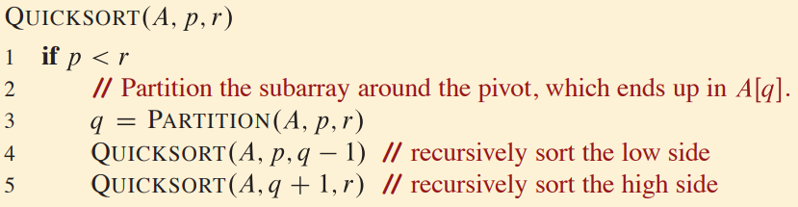
Example 02: Quick Sort

Slide 10
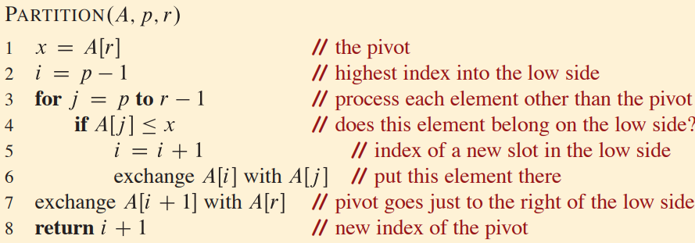
Example 02: Quick Sort

Slide 11



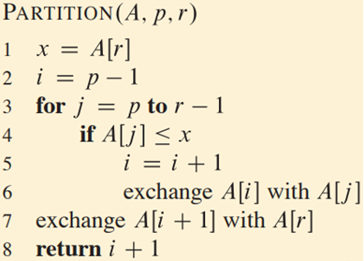







Partitioning: Tracing

Slide 12
Partitioning: Loop Invariant
If p <= k <= i, then A [k] <= x
If i + 1 <= k <= j-1, then A [k] > x
If k = r, then A [k] = x

Slide 13

Loop Invariant: Verification

Slide 14
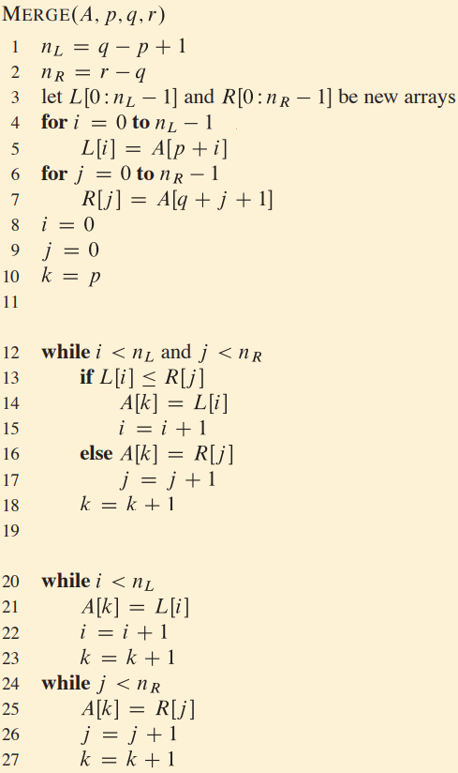
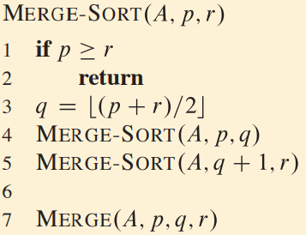
Example 03: Merge Sort

Slide 15
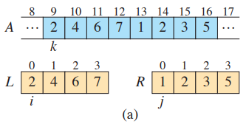
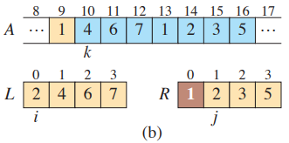
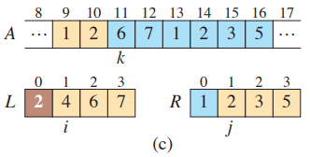
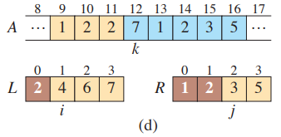
Merge function: Tracing

Slide 16
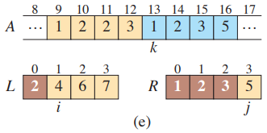
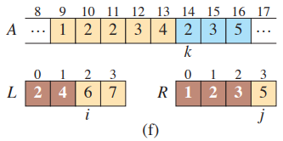
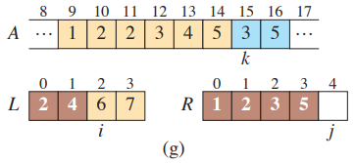
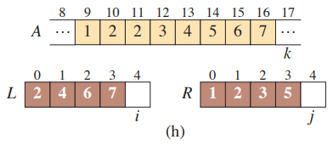
Merge function: Tracing

Slide 17
Merge function: Loop Invariant
“At the start of each iteration of the for loop of lines 12-18, the subarray A[p .. r] contains the (i+j) smallest elements of L [0..n_{L}-1] and R[0..n_{R}-1], in sorted order. Moreover, L[i] and R[j] are the smallest elements of their arrays that have not been copied back into A”

Slide 18
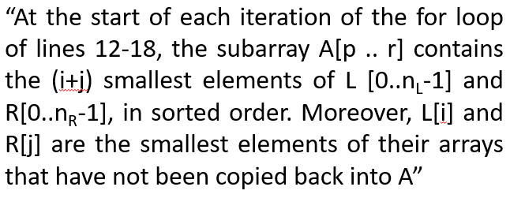
Loop Invariant: Verification

Slide 19
Loop Invariant: Verification

Slide 20
Loop Invariant
Students’ Exercises

Slide 21
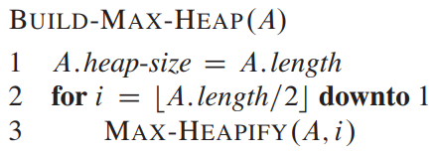
Exercise 01: Build Heap

Slide 22
Build Heap: Tracing

Slide 23
Build Heap: Loop Invariant

Slide 24
Loop Invariant: Verification

Slide 25
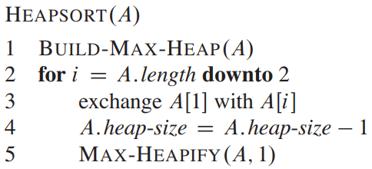
Exercise 02: Heap Sort

Slide 26
Heap Sort: Tracing

Slide 27
Heap Sort: Loop Invariant

Slide 28
Loop Invariant: Verification

Slide 29
Growth Order
Asymptotic Analysis

Slide 30
Order of Growth
What is the Big-O of the following functions:
f(n) = 4n² +3n +10

Slide 31
Order of Growth
What is the Big-O of the following functions:
f(n) = 4n² +3n +10
Answer: O(n²)

Slide 32
Order of Growth
What is the Big-O of the following functions:
f(n) = 4n² +3n +10
Answer: O(n²)
f(n) = 76,756,234n² + 427,913n + 7

Slide 33
Order of Growth
What is the Big-O of the following functions:
f(n) = 4n² +3n +10
Answer: O(n²)
f(n) = 76,756,234n² + 427,913n + 7
Answer: O(n²)

Slide 34
Order of Growth
What is the Big-O of the following functions:
f(n) = 4n² +3n +10
Answer: O(n²)
f(n) = 76,756,234n² + 427,913n + 7
Answer: O(n²)
f(n) = 74n⁸ - 62n⁵ - 71562n³ + 3n² – 5

Slide 35
Order of Growth
What is the Big-O of the following functions:
f(n) = 4n² +3n +10
Answer: O(n²)
f(n) = 76,756,234n² + 427,913n + 7
Answer: O(n²)
f(n) = 74n⁸ - 62n⁵ - 71562n³ + 3n² – 5
Answer: O(n⁸)

Slide 36
Order of Growth
What is the Big-O of the following functions:
f(n) = 4n² +3n +10
Answer: O(n²)
f(n) = 76,756,234n² + 427,913n + 7
Answer: O(n²)
f(n) = 74n⁸ - 62n⁵ - 71562n³ + 3n² – 5
Answer: O(n⁸)
f(n) = 42n⁴*(12n⁶ - 73n² + 11)

Slide 37
Order of Growth
What is the Big-O of the following functions:
f(n) = 4n² +3n +10
Answer: O(n²)
f(n) = 76,756,234n² + 427,913n + 7
Answer: O(n²)
f(n) = 74n⁸ - 62n⁵ - 71562n³ + 3n² – 5
Answer: O(n⁸)
f(n) = 42n⁴*(12n⁶ - 73n² + 11)
Answer: O(n¹⁰)

Slide 38
Order of Growth
What is the Big-O of the following functions:
f(n) = 4n² +3n +10
Answer: O(n²)
f(n) = 76,756,234n² + 427,913n + 7
Answer: O(n²)
f(n) = 74n⁸ - 62n⁵ - 71562n³ + 3n² – 5
Answer: O(n⁸)
f(n) = 42n⁴*(12n⁶ - 73n² + 11)
Answer: O(n¹⁰)
f(n) = 75n*logn – 415

Slide 39
Order of Growth
What is the Big-O of the following functions:
f(n) = 4n² +3n +10
Answer: O(n²)
f(n) = 76,756,234n² + 427,913n + 7
Answer: O(n²)
f(n) = 74n⁸ - 62n⁵ - 71562n³ + 3n² – 5
Answer: O(n⁸)
f(n) = 42n⁴*(12n⁶ - 73n² + 11)
Answer: O(n¹⁰)
f(n) = 75n*logn – 415
Answer: O(n*logn)

Slide 40
Order of Growth
C P C S
Most important: Order of growth within a constant multiple as n→∞
Empirical Analysis:
How much faster will algorithm run on computer that is twice as fast?
Theoretical Analysis
How much longer does it take to solve problem of double input size?
2
2
3

Slide 41
Asymptotic Notation
Represents “asymptotic” efficiency
Running Time Variations
Asymptotic Notation
Used to describe the asymptotic running time of an algorithm in terms of function whose domains are set of natural numbers

Slide 42
Asymptotic Notation

Slide 43
Asymptotic Notation
Θ - Notation (Theta)

Slide 44
Asymptotic Notation
Θ - Notation (Theta)
O – Notation (Big- Oh)

Slide 45
Asymptotic Notation
Θ - Notation (Theta)
O – Notation (Big- Oh)
Ω - Notation (Omega)

Slide 46
Asymptotic Notation
Θ - Notation (Theta)
O – Notation (Big- Oh)
Ω - Notation (Omega)
o – Notation (little Oh)

Slide 47
Asymptotic Notation
Θ - Notation (Theta)
O – Notation (Big- Oh)
Ω - Notation (Omega)
o – Notation (little Oh)
ω - Notation (little Omega)

Slide 48
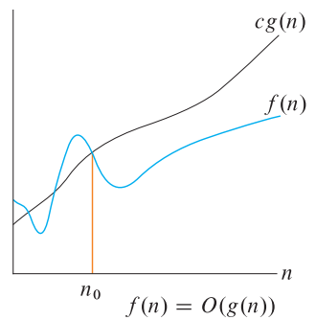
O-Big Oh

Slide 49
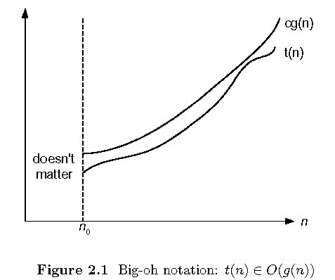
O-Big Oh
O (g(n)) = { f(n) : such that 0 <= f(n) <= c g(n) }
Where c and n are positive constant and n₀ <= n

Slide 50
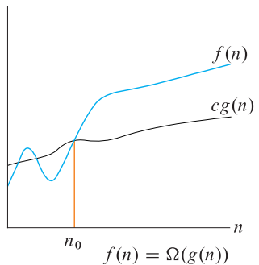
Ω -Omega

Slide 51
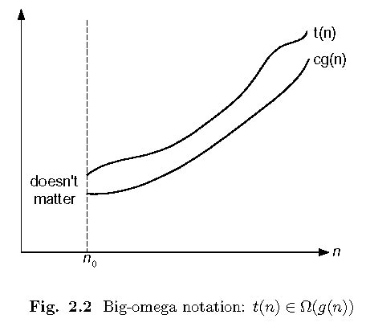
Ω -Omega
Ω (g(n)) = { f(n) : such that 0 <= c g(n) <= f(n) }
Where c and n are positive constant and n₀ <= n

Slide 52
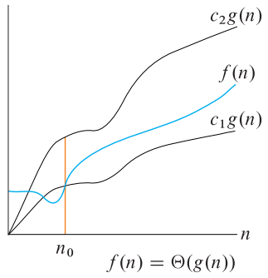
Θ-Theta

Slide 53
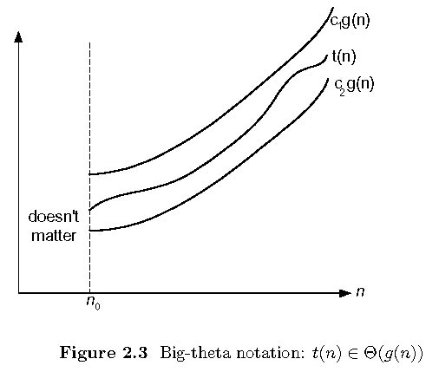
Θ-Theta
Θ (g(n)) = { f(n) : such that
0 <= c1 g(n) <= f(n) <= c2 g(n) }
Where c1, c2 and n are positive constant and n₀ <= n

Slide 54
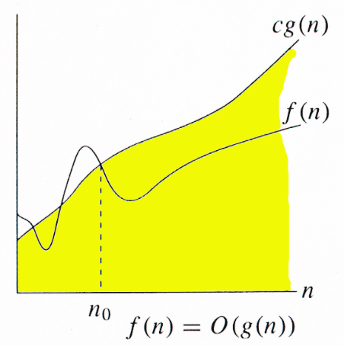
o-little Oh

Slide 55
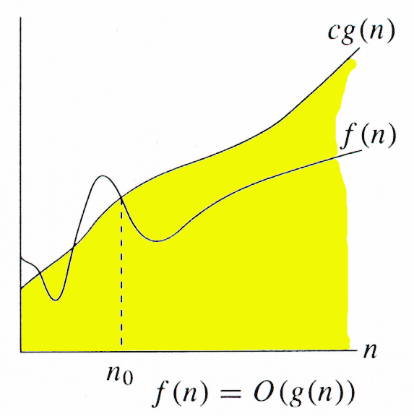
o-little Oh
O (g(n)) = { f(n) : such that 0 <= f(n) < c g(n) }
Where c and n are positive constant and n₀ <= n

Slide 56
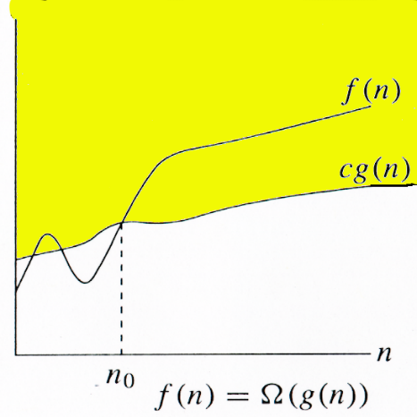
ω -little Omega

Slide 57

ω -little Omega
Ω (g(n)) = { f(n) : such that 0 <= c g(n) < f(n) }
Where c and n are positive constant and n₀ <= n

Slide 58
Order of Growth
Θ - Theta

Slide 59
Θ-Theta
f(n) =½ n² – 3n

Slide 60

f(n) =½ n² – 3n; f(n) = ϴ g(n)

Slide 61

f(n) =½ n² – 3n; f(n) = ϴ g(n)

Slide 62
f(n) =½ n² – 3n; f(n) = ϴ g(n)

Slide 63

f(n) =½ n² – 3n; f(n) = ϴ g(n)

Slide 64

f(n) =½ n² – 3n; f(n) = ϴ g(n)

Slide 65
f(n) =½ n² – 3n; f(n) = ϴ g(n)

Slide 66
f(n) =½ n² – 3n; f(n) = ϴ g(n)

Slide 67
f(n) =½ n² – 3n; f(n) = ϴ g(n)

Slide 68

f(n) =½ n² – 3n; f(n) = ϴ g(n)

Slide 69

f(n) =½ n² – 3n; f(n) = ϴ g(n)

Slide 70

f(n) =½ n² – 3n; f(n) = ϴ g(n)

Slide 71
f(n) =½ n² – 3n; f(n) = ϴ g(n)

Slide 72
f(n) =½ n² – 3n; f(n) = ϴ g(n)

Slide 73

f(n) =½ n² – 3n; f(n) = ϴ g(n)

Slide 74
f(n) =½ n² – 3n; f(n) = ϴ g(n)

Slide 75

f(n) =½ n² – 3n; f(n) = ϴ g(n)

Slide 76

f(n) =½ n² – 3n; f(n) = ϴ g(n)

Slide 77
f(n) =½ n² – 3n; f(n) = ϴ g(n)

Slide 78
f(n) =½ n² – 3n; f(n) = ϴ g(n)

Slide 79
f(n) =½ n² – 3n; f(n) = ϴ g(n)

Slide 80
f(n) =½ n² – 3n; f(n) = ϴ g(n)

Slide 81
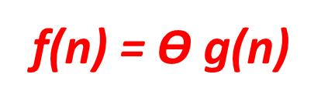
f(n) =½ n² – 3n; f(n) = ϴ g(n)

Slide 82
Θ-Theta
f(n)=an²+bn+c

Slide 83

f(n)=an²+bn+c; f(n) = Ω g(n)

Slide 84

f(n)=an²+bn+c; f(n) = Ω g(n)

Slide 85

f(n)=an²+bn+c; f(n) = Ω g(n)

Slide 86

f(n)=an²+bn+c; f(n) = Ω g(n)

Slide 87
f(n)=an²+bn+c; f(n) = Ω g(n)

Slide 88
f(n)=an²+bn+c; f(n) = Ω g(n)

Slide 89

f(n)=an²+bn+c; f(n) = Ω g(n)

Slide 90

f(n)=an²+bn+c; f(n) = Ω g(n)

Slide 91

f(n)=an²+bn+c; f(n) = Ω g(n)

Slide 92
f(n)=an²+bn+c; f(n) = Ω g(n)

Slide 93

f(n)=an²+bn+c; f(n) = Ω g(n)

Slide 94

f(n)=an²+bn+c; f(n) = Ω g(n)

Slide 95
f(n)=an²+bn+c; f(n) = O g(n)

Slide 96
Θ-Theta (Exercise)
(3/2) n² - 4n = ϴ (n²)
6n³ = ϴ(n²)

Slide 97
Order of Growth
O – Big Oh

Slide 98
Establishing order of growth using the definition
Definition: f(n) is in O(g(n)) if order of growth of f(n) ≤ order of growth of g(n) (within constant multiple), i.e., there exist positive constant c and non-negative integer n₀ such that
f(n) ≤ c g(n) for every n ≥ n₀
Examples:
10n² is O(n²)
5n+20 is O(n)
Notes:
Examples:
10n is O(n²)
since 10n ≤ 10n² for n ≥ 1 or 10n ≤ n² for n ≥ 10
c n₀
5n+20 is O(10n)
since 5n+20 ≤ 10 n for n ≥ 4
c n₀

Slide 99
Example 01 - O – Big Oh
7n³ +100n² – 20n +6
f(n) = 7n³ +100n² – 20n +6
g(n) = n³
We need to prove f(n) <= c g(n)
7n³ +100n² – 20n +6 <= c n³
7 + 100/n – 20/n² +6/n³ <= c

Slide 100
Example 01 - O – Big Oh
7 + 100/n – 20/n² +6/n³ <= c
Max: for n = 1
f(n) = 7+100-20+6 = 93
Min: for n = ∞
f(n) = 7
So for c >= 93 and n₀ = 1
f(n) <= c g(n)
f(n) = O (n³)

Slide 101
O- Big Oh
n² = O (n²)
2 n² = O (n³)

Slide 102
O- Big Oh(Exercise)
2^{n+1} = O(2^{n})
2^{2n} = O(2^{n})
d nlgn – dn(lg 3 – 2/3) + cn <= d(nlgn)
(3/16) d n² + cn² <= d(n²)

Slide 103
Order of Growth
Ω - Omega

Slide 104
Example 01 - Ω – Omega
7n³ +100n² – 20n +6
f(n) = 7n³ +100n² – 20n +6
g(n) = n³
We need to prove f(n) >= c g(n)
7n³ +100n² – 20n +6 >= c n³
7 + 100/n – 20/n² +6/n³ <= c

Slide 105
Example 01 - Ω – Omega
7 + 100/n – 20/n² +6/n³ >= c
Max: for n = 1
f(n) = 7+100-20+6 = 93
Min: for n = ∞
f(n) = 7
So for c <= 7 and n₀ = 1
f(n) >= c g(n)
f(n) = Ω (n³)

Slide 106
Ω -Omega (Exercise)
5n² = Ω (n)
5 n + 10 = Ω (n)

Slide 107
Review Questions
Growth Order

Slide 108
01
For Big-O approximation of
f(n) = 4n⁸-6n⁵-7n³ which terms will
be ignored
4n⁸
6n⁵
7n³
Both b & c
All of above

Slide 109
02
Which of the terms are not ignored which writing the big-O approximation?
Highest Order Term
Lower Order Terms
Coefficient Constants
All of above
None of above

Slide 110
03
Order of growth describes “How much faster will algorithm run on computer that is twice as fast?
True
False

Slide 111
04
Which of the followings describes the “upper” bound for given function?
Θ - Notation (Theta)
O – Notation (Big- Oh)
Ω - Notation (Omega)
o – Notation (little Oh)
ω - Notation (little Omega)

Slide 112
05
Which of the followings describes the “lower” bound for given function?
Θ - Notation (Theta)
O – Notation (Big- Oh)
Ω - Notation (Omega)
o – Notation (little Oh)
ω - Notation (little Omega)

Slide 113
06
Which of the followings describes both “lower & upper” bound for given function?
Θ - Notation (Theta)
O – Notation (Big- Oh)
Ω - Notation (Omega)
o – Notation (little Oh)
ω - Notation (little Omega)

Slide 114
07
Which of the followings is a tight bound?
Θ - Notation (Theta)
O – Notation (Big- Oh)
Ω - Notation (Omega)
o – Notation (little Oh)
ω - Notation (little Omega)

Slide 115
08
Which of the followings is not a tight bound?
Θ - Notation (Theta)
O – Notation (Big- Oh)
Ω - Notation (Omega)
o – Notation (little Oh)
ω - Notation (little Omega)

Slide 116
09
For (Θ-Theta), which of the following is true?
f(n) < c₁ g(n)
f(n) < c₂ g(n)
f(n) <= c₂ g(n)
f(n) > c₁ g(n)
f(n) > c₂ g(n)

Slide 117
10
For (Θ-Theta), which of the following is true?
f(n) < c₁ g(n)
f(n) < c₂ g(n)
f(n) >= c₁ g(n)
f(n) > c₁ g(n)
f(n) > c₂ g(n)

Slide 118
11
For (Θ-Theta), which of the following is true?
f(n) < g(n)
f(n) = g(n)
f(n) > g(n)
All of above
None of above

Slide 119
12
For (Θ-Theta), which of the following is true?
c₁ and c₂ are constants
c₁ and c₂ are integer constants
c₁ and c₂ are real constants
c₁ and c₂ are positive constants
c₁ and c₂ are negative constant

Slide 120
10
Which term of a polynomial function is not ignored while representing the running using Big – oh (O)?
All constants
All coefficients
Lower order terms
The highest order term
None of above

Slide 121
Asymptotic Notations
Some Examples

Slide 122
Some Solutions
Θ - Notation (Theta)

Slide 123
Class exercises Θ - Notation (Theta)
Prove that ½.n² – ½.n = Θ(n²)
Prove that a.n² + b.n + c = Θ(n²)
Prove that 2.n² + 3.n + 6 = Θ(n³)
Prove that (3/2) n² - 4n = ϴ (n²)
Prove that 6n³ = ϴ(n²)

Slide 124
Θ - Notation (Theta)
Example 1: Prove that ½.n² – ½.n = Θ(n²)
Proof
Assume that f(n) = ½.n² – ½.n, and g(n) = n²
f(n) ∈ Θ(g(n))?
We have to find the existence of c₁, c₂ and n₀ s.t.
c₁.g(n) ≤ f(n) ≤ c₂.g(n)  n ≥ n₀
Since, ½ n² - ½ n ≤ ½ n² ∀n ≥ 0 if c₂= ½ and
½ n² - ½ n ≥ ½ n² - ½ n . ½ n ( ∀n ≥ 2 ) = ¼ n^{2,} c₁= ¼
Hence ½ n² - ½ n ≤ ½ n² ≤ ½ n² - ½ n
c₁.g(n) ≤ f(n) ≤ c₂.g(n) ∀n ≥ 2, c₁= ¼, c₂ = ½
Hence f(n) ∈ Θ(g(n)) ⇒ ½.n² – ½.n = Θ(n²)

Slide 125
Θ - Notation (Theta)
Example 3: Prove that 2.n² + 3.n + 6 = Θ(n³)
Proof: Let f(n) = 2.n² + 3.n + 6, and g(n) = n³
we have to show that f(n) = Θ(g(n))
On contrary assume that f(n) ∈ Θ(g(n)) i.e.
there exist some positive constants c₁, c₂ and n₀ such that: c₁.g(n) ≤ f(n) ≤ c₂.g(n)
c₁.g(n) ≤ f(n) ≤ c₂.g(n)  c₁.n³ ≤ 2.n² + 3.n + 6 ≤ c₂. n³ 
c₁.n ≤ 2 + 3/n + 6/n² ≤ c₂. n ⇒
c₁.n ≤ 2 ≤ c₂. n, for large n ⇒
n ≤ 2/c₁ ≤ c₂/c₁.n which is not possible
Hence f(n) = Θ(g(n)) ⇒ 2.n² + 3.n + 6 = Θ(n³)

Slide 126
Some Solutions
O – Notation (Big- Oh)

Slide 127
Class exercises O – Notation (Big- Oh)
Prove that 2n² = O(n³)
Prove that n² = O(n²)
Prove that 1000.n² + 1000.n = O(n²)
Prove that 2^{n+1} = O(2^{n})
Prove that 2^{2n} = O(2^{n})
Prove that d nlgn – dn(lg 3 – 2/3) + cn <= d(nlgn)
Prove that (3/16) d n² + cn² <= d(n²)

Slide 128
O – Notation (Big- Oh)
Example 1: Prove that 2n² = O(n³)
Proof:
Assume that f(n) = 2n² , and g(n) = n³
f(n) = O(g(n)) ?
Now we have to find the existence of c and n₀
f(n) ≤ c.g(n)  2n² ≤ c.n³  2 ≤ c.n
if we take, c = 1 and n₀= 2 OR
c = 2 and n₀= 1 then
2n² ≤ c.n³
Hence f(n) = O(g(n)), c = 1 and n₀= 2

Slide 129
O – Notation (Big- Oh)
Example 2: Prove that n² = O(n²)
Proof:
Assume that f(n) = n² , and g(n) = n²
Now we have to show that f(n) = O(g(n))
Since
f(n) ≤ c.g(n)  n² ≤ c.n²  1 ≤ c, take, c = 1, n₀= 1
Then
n² ≤ c.n² for c = 1 and n ≥ 1
Hence, 2n² = O(n²), where c = 1 and n₀= 1

Slide 130
O – Notation (Big- Oh)
Example 3: Prove that 1000.n² + 1000.n = O(n²)
Proof:
Assume that f(n) = 1000.n² + 1000.n, and g(n) = n²
We have to find existence of c and n₀ such that
0 ≤ f(n) ≤ c.g(n)  n ≥ n₀
1000.n² + 1000.n ≤ c.n² = 1001.n², for c = 1001
1000.n² + 1000.n ≤ 1001.n²
1000.n ≤ n²  n² ≥ 1000.n  n² - 1000.n ≥ 0
n (n-1000) ≥ 0, this true for n ≥ 1000
f(n) ≤ c.g(n)  n ≥ n₀ and c = 1001
Hence f(n) = O(g(n)) for c = 1001 and n₀ = 1000

Slide 131
Some Solutions
Ω - Notation (Omega)

Slide 132
Class exercises Ω - Notation (Omega)
Prove that 5.n² = Ω(n)
Prove that 5.n + 10 = Ω(n)
Prove that 100.n + 5 ≠ Ω(n²)

Slide 133
Ω - Notation (Omega)
Example 1: Prove that 5.n² = Ω(n)
Proof:
Assume that f(n) = 5.n² , and g(n) = n
f(n) ∈ Ω(g(n)) ?
We have to find the existence of c and n₀ s.t.
c.g(n) ≤ f(n)  n ≥ n₀
c.n ≤ 5.n²  c ≤ 5.n
if we take, c = 5 and n₀= 1 then
c.n ≤ 5.n²  n ≥ n₀
And hence f(n) = Ω(g(n)), for c = 5 and n₀= 1

Slide 134
Ω - Notation (Omega)
Example 2: Prove that 5.n + 10 = Ω(n)
Proof:
Assume that f(n) = 5.n + 10, and g(n) = n
f(n) ∈ Ω(g(n)) ?
We have to find the existence of c and n₀ s.t.
c.g(n) ≤ f(n)  n ≥ n₀
c.n ≤ 5.n + 10  c.n ≤ 5.n + 10.n  c ≤ 15.n
if we take, c = 15 and n₀= 1 then
c.n ≤ 5.n + 10  n ≥ n₀
And hence f(n) = Ω(g(n)), for c = 15 and n₀= 1

Slide 135
Ω - Notation (Omega)
Example 3: Prove that 100.n + 5 ≠ Ω(n²)
Proof:
Let f(n) = 100.n + 5, and g(n) = n²
Assume that f(n) = Ω(g(n)) ?
Now if f(n) = Ω(g(n)) then there exist c and n₀ s.t.
c.g(n) ≤ f(n)  n ≥ n₀ 
c.n² ≤ 100.n + 5 
c.n ≤ 100 + 5/n 
n ≤ 100/c, for a very large n, which is not possible
And hence f(n) ≠ Ω(g(n))

Slide 136
Some more Solutions
o - Notations (little Oh)

Slide 137
o – Notation (little Oh)
Example 1: Prove that 2n² = o(n³)
Proof:
Assume that f(n) = 2n² , and g(n) = n³
f(n) = o(g(n)) ?
Now we have to find the existence n₀ for any c
f(n) < c.g(n) this is true
 2n² < c.n³  2 < c.n
This is true for any c, because for any arbitrary c we can choose n₀ such that the above inequality holds.
Hence f(n) = o(g(n))

Slide 138
o – Notation (little Oh)
Example 2: Prove that n² ≠ o(n²)
Proof:
Assume that f(n) = n² , and g(n) = n²
Now we have to show that f(n) ≠ o(g(n))
Since
f(n) < c.g(n)  n² < c.n²  1 ≤ c,
In our definition of small o, it was required to prove for any c but here there is a constraint over c . Hence, n² ≠ o(n²), where c = 1 and n₀= 1

Slide 139
o – Notation (little Oh)
Examples
Example 3: Prove that 1000.n² + 1000.n ≠ o(n²)
Proof:
Assume that f(n) = 1000.n² + 1000.n, and g(n) = n²
we have to show that f(n) ≠ o(g(n)) i.e.
We assume that for any c there exist n₀ such that
0 ≤ f(n) < c.g(n)  n ≥ n₀
1000.n² + 1000.n < c.n²
If we take c = 2001, then,1000.n² + 1000.n < 2001.n²
 1000.n < 1001.n² which is not true
Hence f(n) ≠ o(g(n)) for c = 2001

Slide 140
Some more Solutions
ω - Notation (little Omega)

Slide 141
ω - Notation (little Omega)
Example 1: Prove that 5.n² = ω(n)
Proof:
Assume that f(n) = 5.n² , and g(n) = n
f(n) = Ω(g(n)) ?
We have to prove that for any c there exists n₀ s.t., c.g(n) < f(n)  n ≥ n₀
c.n < 5.n²  c < 5.n
This is true for any c, because for any arbitrary c e.g. c = 1000000, we can choose n₀ = 1000000/5 = 200000 and the above inequality does hold.
And hence f(n) = ω(g(n)),

Slide 142
ω - Notation (little Omega)
Examples
Example 2: Prove that 5.n + 10 ≠ ω(n)
Proof:
Assume that f(n) = 5.n + 10, and g(n) = n
f(n) ≠ Ω(g(n)) ?
We have to find the existence n₀ for any c, s.t.
c.g(n) < f(n)  n ≥ n₀
c.n < 5.n + 10, if we take c = 16 then
16.n < 5.n + 10 ⇔ 11.n < 10 is not true for any positive integer.
Hence f(n) ≠ ω(g(n))

Slide 143
ω - Notation (little Omega)
Example 3: Prove that 100.n ≠ ω(n²)
Proof:
Let f(n) = 100.n, and g(n) = n²
Assume that f(n) ≠ ω(g(n))
Now if f(n) = ω(g(n)) then there n₀ for any c s.t.
c.g(n) < f(n)  n ≥ n₀ this is true
 c.n² < 100.n  c.n < 100
If we take c = 100, n < 1, not possible
Hence f(n) = ω(g(n)) i.e. 100.n ≠ ω(n²)

Slide 144

Allah (Alone) is Sufficient for us, and He is the Best Disposer of affairs (for us).(Quran 3 : 173)

