Slide 1


O my Lord! Expand for me my chest [with assurance] and ease for me my task and untie the knot from my tongue that they may understand my speech. (Quran 20 : 25-28)

Slide 2
Algorithm Analysis
Introduction
Recursive

Slide 3
Introduction
Iterative Algorithms
Informal Analysis
Formal Analysis
RAM Model Analysis
Recursive Algorithm
Informal Analysis
Formal Analysis
Forward Substitution Method
Backwards Substitution Method
Substitution Method
Recursion Tree Method
Master Theorem Method

Slide 4
Plan for Analysis of Recursive Algorithms
Decide on a parameter indicating an input’s size.
Identify the algorithm’s basic operation.
Check whether the number of times the basic op. is executed may vary on different inputs of the same size. (If it may, the worst, average, and best cases must be investigated separately.)

Slide 5
Plan for Analysis of Recursive Algorithms - continued
Set up a recurrence relation with an appropriate initial condition expressing the number of times the basic op. is executed.
Solve the recurrence (or, at the very least, establish its solution’s order of growth) by backward substitutions or another method.

Slide 6
Recurrence
Introduction

Slide 7
Recurrence - Introduction
“It is an equation or inequality that describe a function in terms of its value on smaller input”
T (n) = a T (n/b) + f (n)
n = size of input
a = no. of sub-problems
b = value to yield n / b problem size
a >= 1 and b > 1

Slide 8
Recurrence - Examples
Merge Sort
T(n) = 2T(n/2) + Θ (n)
Quick Sort
T(n) = T(0)+T(n-1)+Θ(n)
T(n) <= 2T(n /2)+Θ(n)
T (n)<= T(9n/10) + T (n/10) +Θ(n)
Factorial
T(n) = T(n-1) + 1
Other Algorithms
T(n) = 3 T (floor(n/4)) + Θn²
T(n) = T(n/3) + T (2n/3) + O(n)

Slide 9
Introduction
Iterative Algorithms
Informal Analysis
Formal Analysis
RAM Model Analysis
Recursive Algorithm
Informal Analysis
Formal Analysis
Forward Substitution Method
Backwards Substitution Method
Substitution Method
Recursion Tree Method
Master Theorem Method

Slide 10
Algorithm Analysis
Recurrence
(Informal Analysis)

Slide 11
Binary Search

Slide 12
Binary Search
Binary Search code:
At the end of each array iteration, all we do is update either low or high
This modifies our search region
Essentially halving it

Slide 13
Binary Search
Efficiency of Binary Search
Analysis:
Let’s analyze how many comparisons (guesses) are necessary when running this algorithm on an array of n items
First, let’s try n = 100
After 1 guess, we have 50 items left,
After 2 guesses, we have 25 items left,
After 3 guesses, we have 12 items left,
After 4 guesses, we have 6 items left,
After 5 guesses, we have 3 items left,
After 6 guesses, we have 1 item left
After 7 guesses, we have 0 items left.

Slide 14
Binary Search
Efficiency of Binary Search
Analysis:
General case:
After 1 guess, we have n/2 items left
After 2 guesses, we have n/4 items left
After 3 guesses, we have n/8 items left
After 4 guesses, we have n/16 items left
…
After k guesses, we have n/2^{k} items left

Slide 15
Binary Search
Efficiency of Binary Search
Analysis:
General case:
So, after k guesses, we have n/2^{k} items left
The question is:
How many k guesses do we need to make in order to find our answer?
Or until we have one and only one guess left to make?
So we want to get only 1 item left
If we can find the value that makes the above fraction equal to 1, then we know that in one more guess, we’ll narrow down the item

Slide 16
Binary Search
Efficiency of Binary Search
Analysis:
General case:
So, after k guesses, we have n/2^{k} items left
Again, we want only 1 item left
So set this equal to 1 and solve for k
This means that a binary search roughly takes θ (log₂n ) comparisons when searching in a sorted array of n items

Slide 17
Introduction
Iterative Algorithms
Informal Analysis
Formal Analysis
RAM Model Analysis
Recursive Algorithm
Informal Analysis
Formal Analysis
Forward Substitution Method
Backwards Substitution Method
Substitution Method
Recursion Tree Method
Master Theorem Method

Slide 18
Algorithm Analysis
Recurrence
(Forwards Substitution)

Slide 19
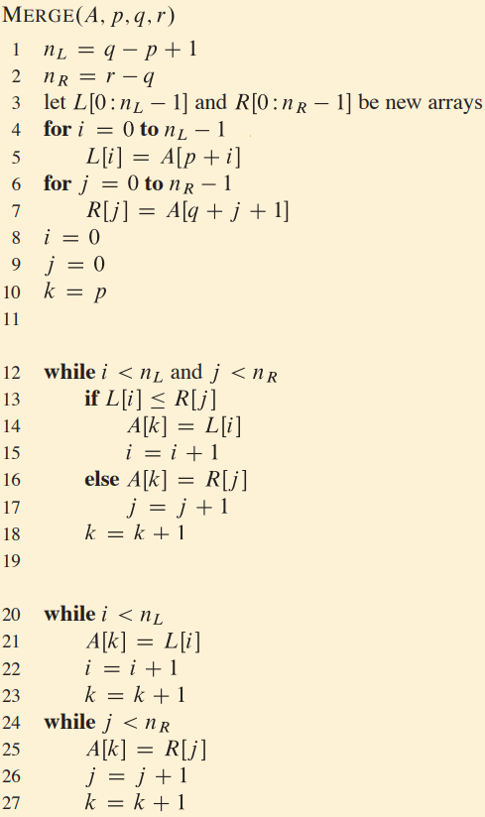
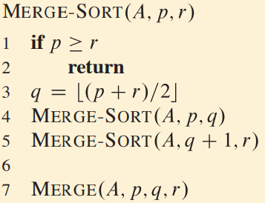
Merge Sort - Algorithm

Slide 20
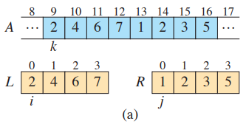
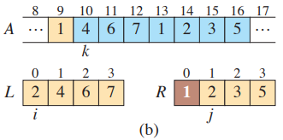
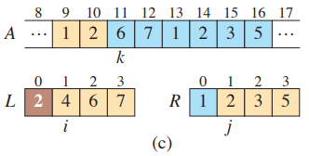
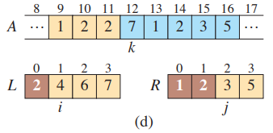
Merge Sort - Tracing

Slide 21
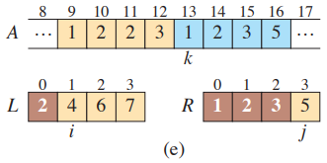
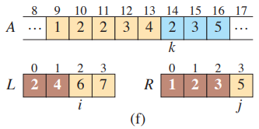
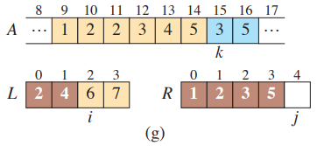
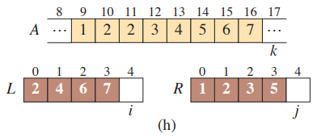
Merge Sort - Tracing

Slide 22

Merge Sort - Recurrence

Slide 23
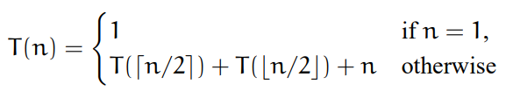
Forward Substitution
The total running time of entire MERGE-SORT method can be expressed as the following recurrence relation:

Slide 24




Forward Substitution

Slide 25
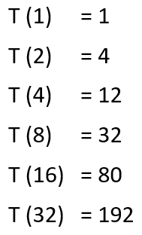
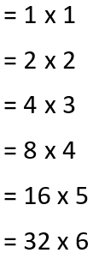
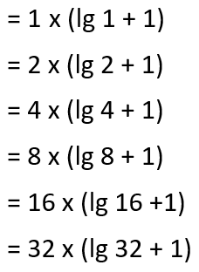



Forward Substitution

Slide 26



Forward Substitution
So the running time of Merge Sort is:
T (n) = θ (n lg n)

Slide 27
Introduction
Iterative Algorithms
Informal Analysis
Formal Analysis
RAM Model Analysis
Recursive Algorithm
Informal Analysis
Formal Analysis
Forward Substitution Method
Backwards Substitution Method
Substitution Method
Recursion Tree Method
Master Theorem Method

Slide 28
Algorithm Analysis
Recurrence
(Backwards Substitution)

Slide 29
Backwards Substitution
Find the recurrence
Find the unknown value with the help of given recurrence
Substitute the unknown value
Repeat it until reached to trivial case
Use the solution for trivial case and solve the recurrence

Slide 30
Merge Sort - Recurrence

Slide 31
Backward Substitution
Merge Sort Analysis
T(n) = 2T(n/2) + n
Do you know what T(n/2) equals
Does it equal 2,125 operations? We don’t know!
So we need to develop an equation for T(n/2)
How?
Take the original equation shown above
Wherever you see an ‘n’, substitute with ‘n/2’
T(n/2) = 2T(n/4) + n/2
So now we have an equation for T(n/2)
and T(1) = 1

Slide 32
Backward Substitution
Merge Sort Analysis
T(n) = 2T(n/2) + n
T(n/2) = 2T(n/4) + n/2
So now we have an equation for T(n/2)
We can take this equation and substitute it back into the original equation
T(n) = 2T(n/2) + n = 2[2T(n/4) + n/2] + n
now simplify
T(n) = 4T(n/4) + 2n
Same thing here: do you know what T(n/4) equals?
No we don’t! So we need to develop an eqn for T(n/4)
and T(1) = 1

Slide 33
Backward Substitution
Merge Sort Analysis
T(n) = 2T(n/2) + n
T(n/2) = 2T(n/4) + n/2
T(n) = 4T(n/4) + 2n
Same thing here: do you know what T(n/4) equals?
No we don’t! So we need to develop an eqn for T(n/4)
Take the eqn above and again substitute ‘n/2’ for ‘n’
T(n/4) = 2T(n/8) + n/4
So now we have an equation for T(n/4)
We can take this equation and substitute it back the equation that we currently have in terms of T(n/4)
and T(1) = 1

Slide 34
Backward Substitution
Merge Sort Analysis
T(n) = 2T(n/2) + n
T(n/2) = 2T(n/4) + n/2
T(n) = 4T(n/4) + 2n
T(n/4) = 2T(n/8) + n/4
So now we have an equation for T(n/4)
We can take this equation and substitute it back the equation that we currently have in terms of T(n/4)
T(n) = 4T(n/4) + 2n = 4[2T(n/8) + n/4] + 2n
Simplify a bit
T(n) = 8T(n/8) + 3n
and T(1) = 1

Slide 35
Backward Substitution
Merge Sort Analysis
So now we have three equations for T(n):
T(n) = 2T(n/2) + n
T(n) = 4T(n/4) + 2n
T(n) = 8T(n/8) + 3n
So on the kth step/stage of the recursion, we get a generalized recurrence relation:
T(n) = 2^{k}T(n/2^{k}) +kn
Whew! So now we’re done right?
← 1st step of recursion
← 2nd step of recursion
← 3rd step of recursion
← k^{th} step of recursion
Wrong!

Slide 36
Backward Substitution
Merge Sort Analysis
So on the kth step/stage of the recursion, we get a generalized recurrence relation:
T(n) = 2^{k}T(n/2^{k}) +kn
We need to get rid of the T(…)’s on the right side
Remember, we know T(1) = 1
So we make a substitution:
Let n = 2^{k}
and also solve for k
k = log₂n
Plug these back in…

Slide 37
Backward Substitution
Merge Sort Analysis
So on the kth step/stage of the recursion, we get a generalized recurrence relation:
T(n) = 2^{k}T(n/2^{k}) +kn
Let n = 2^{k}
and also solve for k
k = log₂n
Plug these back in…
T(n) = n*T(1) + n lgn = n + n*lgn
So Merge Sort runs in θ(n*lg n) time

Slide 38
Tower of Hanoi
Example 01
Algorithm and Tracing

Slide 39
Towers of Hanoi
There are three vertical poles
There are 64 disks on tower 1 (left most tower)
The disks are arranged with the largest diameter disks at the bottom
Some monk has the daunting task of moving disks from one tower to another tower
Often defined as moving from Tower #1 to Tower #3
Tower #2 is just an intermediate pole
He can only move ONE disk at a time
And he MUST follow the rule of NEVER putting a bigger disk on top of a smaller disk

Slide 40
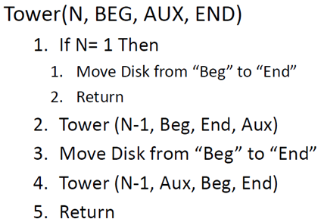
Tower of Hanoi - Algorithm

Slide 41
Towers of Hanoi – Tracing
start
temp
finish
start
temp
finish
start
temp
finish
start
temp
finish
start
temp
finish
start
temp
finish

Slide 42
Towers of Hanoi – Tracing
start
temp
finish
start
temp
finish
# of steps needed:
We had 3 disks requiring 7 steps
4 disks would require 15 steps
n disks would require 2^{n} -1 steps
HUGE number
start
temp
finish

Slide 43
Tower of Hanoi
Example 01
Analysis

Slide 44
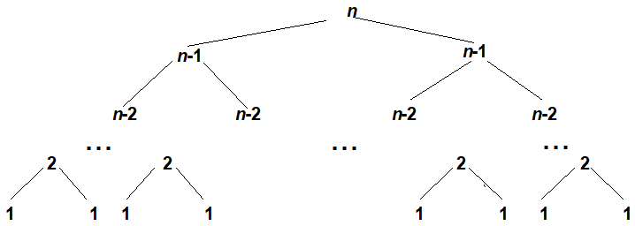
Towers of Hanoi – Analysis

Slide 45
Towers of Hanoi – Analysis
Basic Operation
Number of moves
For “n” disks
M(n)
Recurrence
M(n) = M(n-1) + M(n-1) + 1
M(n) = 2 M(n-1) + 1

Slide 46

Towers of Hanoi – Analysis
M(n) = 2M(n-1) + 1, M(1) = 1

Slide 47


Towers of Hanoi – Analysis
M(n) = 2M(n-1) + 1, M(1) = 1
M (n) = θ ( 2^{n})

Slide 48
Counting Bits for a number
Example 02
Algorithm and Tracing

Slide 49
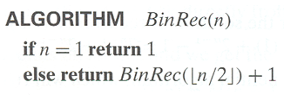
Counting Bits- Algorithm

Slide 50
Counting Bits for a number
Example 02
Analysis

Slide 51

Counting Bits – Analysis
Basic Operation
Number of addition
For “n” bits
A(n)
Recurrence

Slide 52







Counting Bits – Analysis
A (n) = log₂ n = θ (lg n)

Slide 53
Students’ Exercises
Recursive Analysis

Slide 54
Fibonacci Sequence
Example 03
Algorithm and Tracing

Slide 55
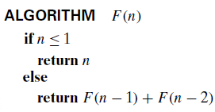
Fibonacci Sequence - Algorithm
0, 1, 1, 2, 3, 5, 8, 13, 21, …

Slide 56
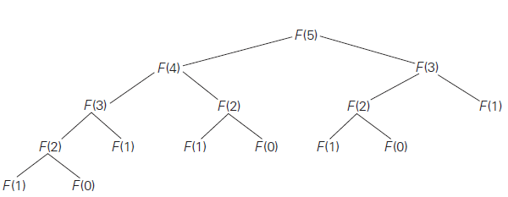
Fibonacci Sequence - Tracing

Slide 57
Fibonacci Sequence
Example 03
Analysis

Slide 58

Fibonacci Sequence – Analysis
Basic Operation
Number of addition
For “n”
A(n)
Recurrence

Slide 59
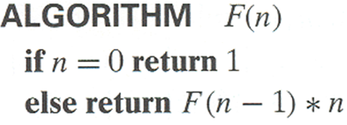
Factorial i.e. n!
Definition:
n ! = 1 ⋅ 2 ⋅ … ⋅ (n-1) ⋅ n for n ≥ 1 and
0! = 1

Slide 60
Factorial - Analysis
Recursive Definition:
F(n) = F(n-1) ⋅ n for n ≥ 1 and
F(0) = 1
T(n) = T(n-1) + 1, T(0) = 0
Informal analysis is left for students as an exercise

Slide 61

Allah (Alone) is Sufficient for us, and He is the Best Disposer of affairs (for us).(Quran 3 : 173)

